Slide 1
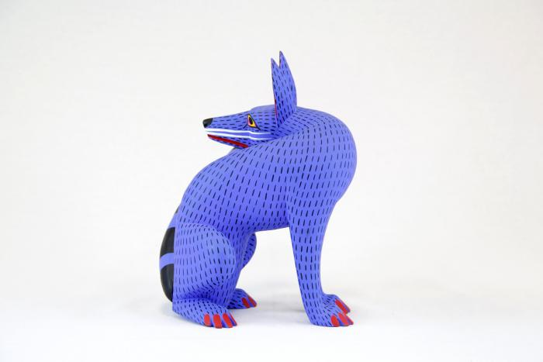
Coyote (CA3)

