Slide 1
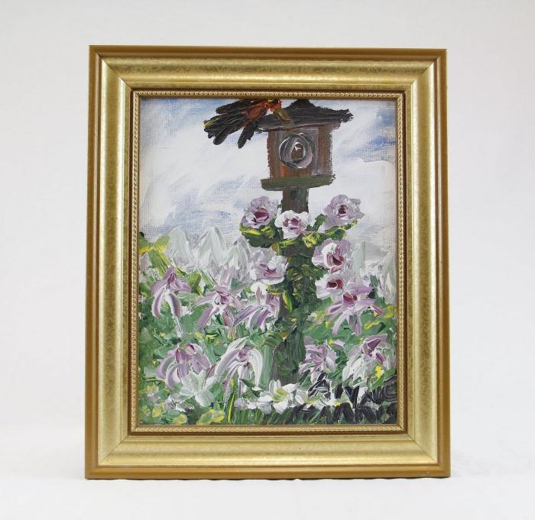
Bird House and Flowers (HA1)

Slide 2
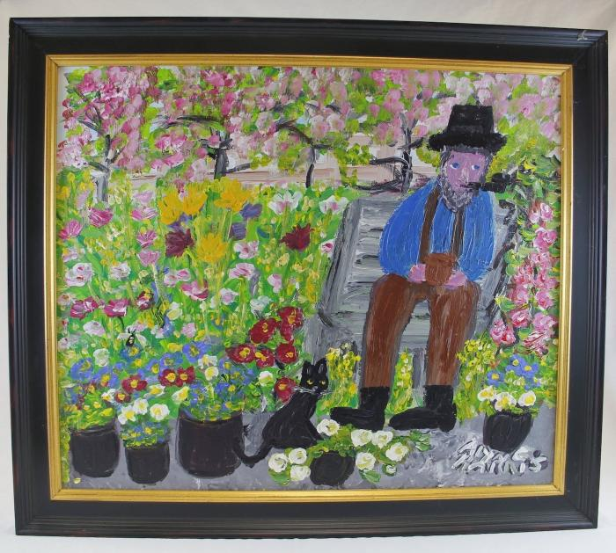
Man smoking pipe with cat and flowers (HA2)

Slide 3
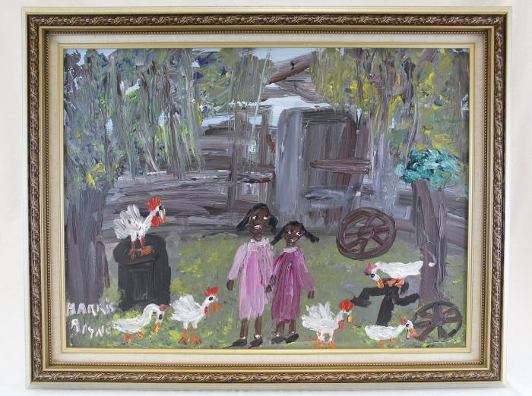
Two girls and chickens (HA3)

Slide 4
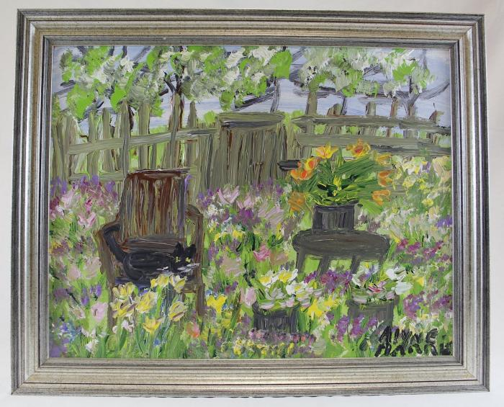
Cat sits on chair surrounded by flowers (HA4)

