Slide 1
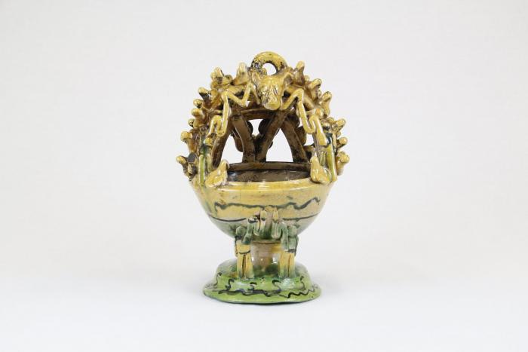
Mayolica Incense Burner (CA5)

Slide 2
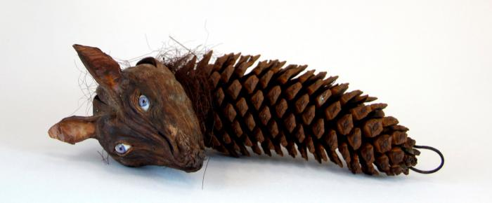
wolf head on pine cone (CA12)

Slide 3
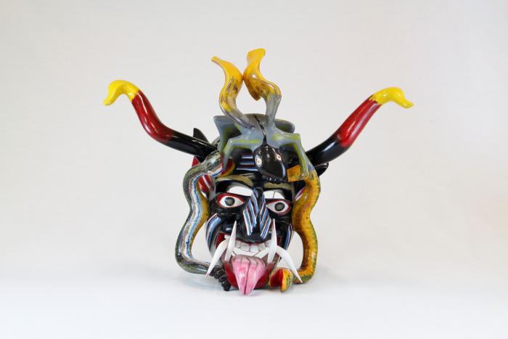
Devil mask with 2 snakes, horns (CA14)

Slide 4
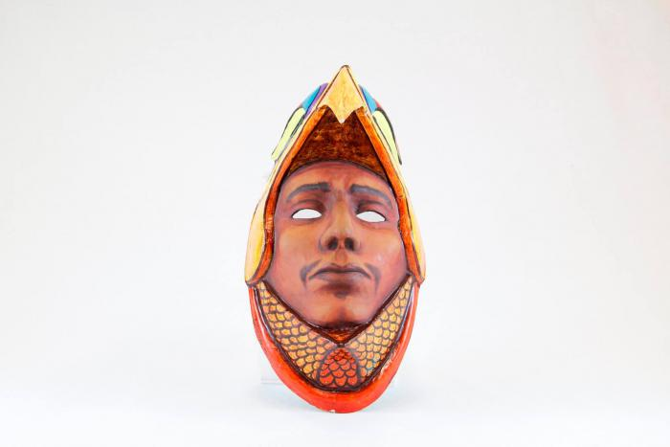
Eagle Warrior mask (CA16)

Slide 5
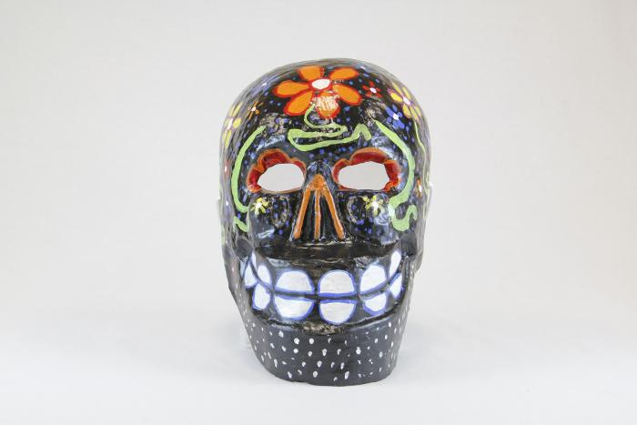
Large black skull mask with flowers (CA21)

Slide 6
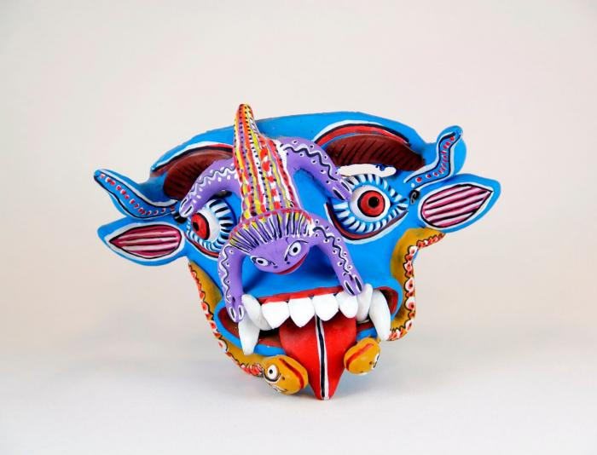
Blue Devil mask with purple toad and 2 snakes (CA22)

Slide 7
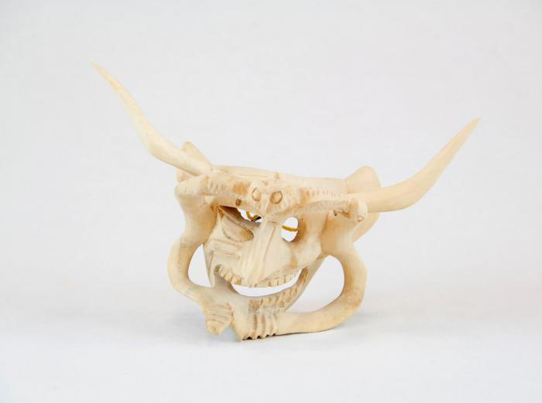
Devil Mask w/ two serpents and owl (CA24)

Slide 8
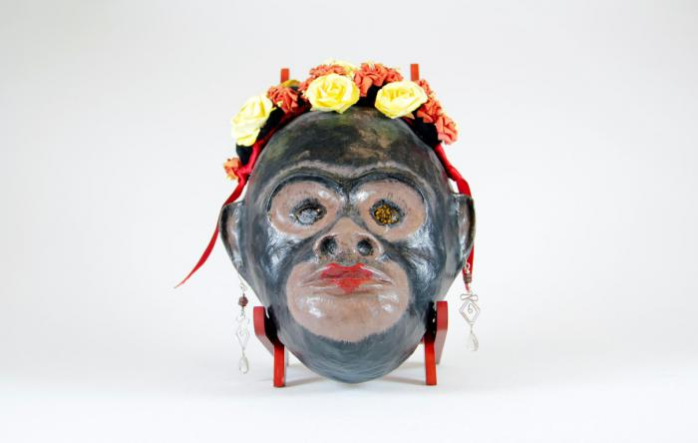
Monkey mask with flowers and earrings (CA25)

Slide 9
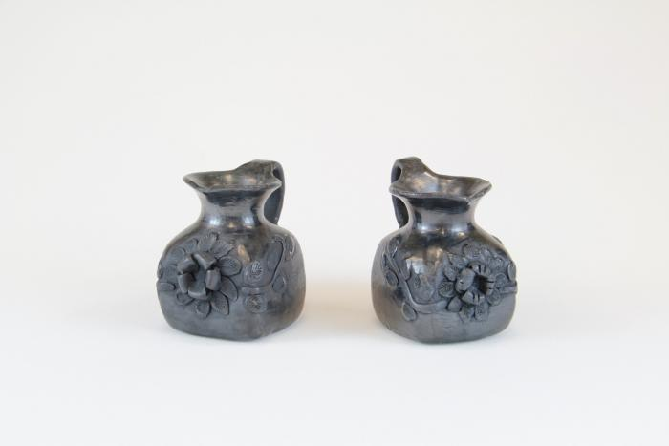
Black Clay Pitchers (M1026)

Slide 10
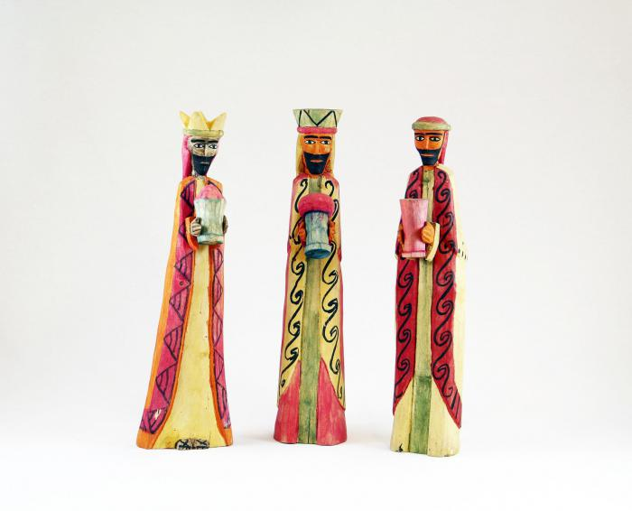
Wisemen Standing (3 pieces) (M1038)

Slide 11
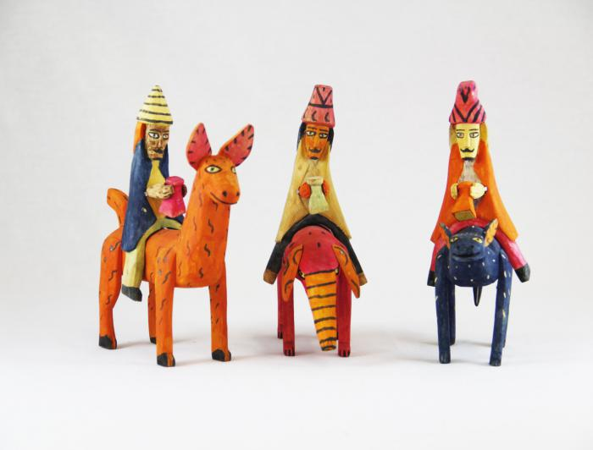
Three Wood Carved Wiseman riding on Animals (M1039)

Slide 12
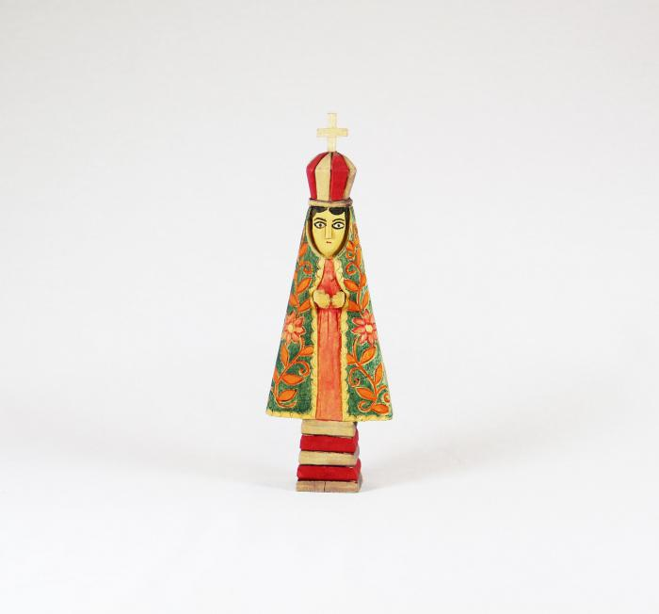
Virgin (M1040)

Slide 13
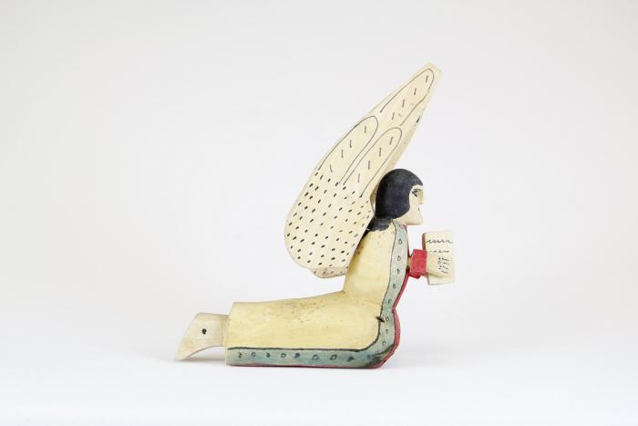
Praying Angel, 1981 (M1041)

Slide 14
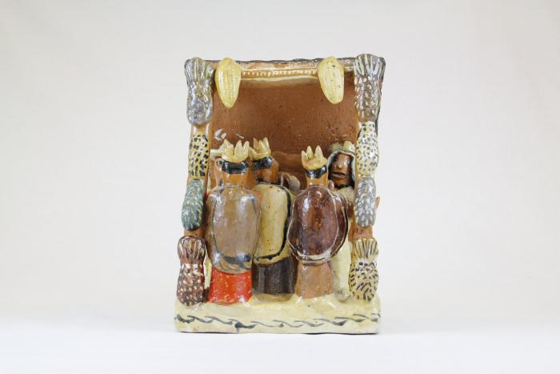
Nativity with Corn in Shelter (1 piece) (M1042)

Slide 15
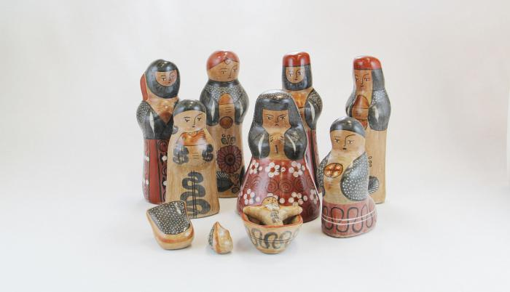
Tonalá Burnished Nativity (11 Pieces) (M1043)

Slide 16
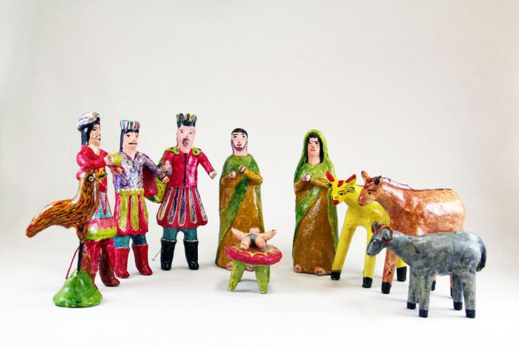
Mexican Nativity (Nacimiento) (10 pieces) (M1055)

Slide 17
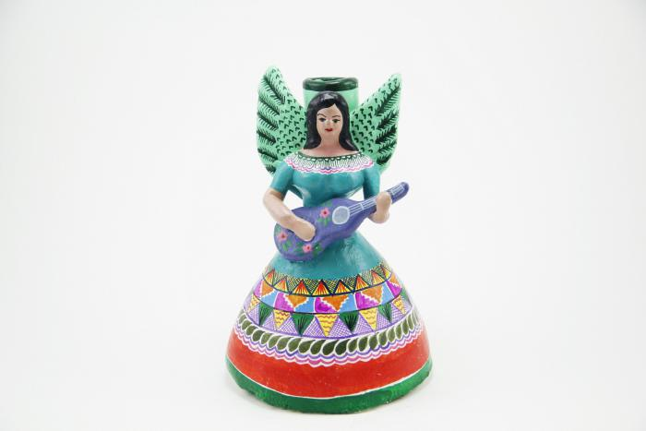
Angel with Guitar Candle Holder (M1057)

Slide 18
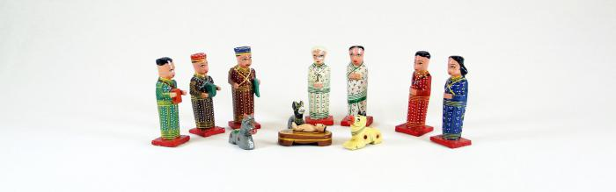
Wood Nativity (12 pieces) (M1063)

Slide 19
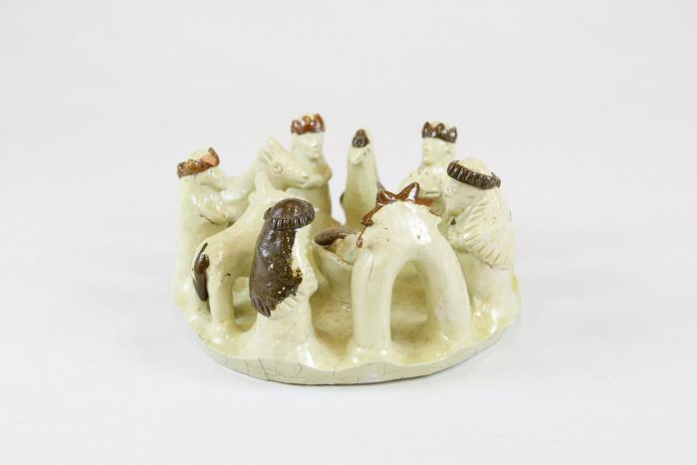
Circular Clay Nativity (1 piece) (M1065)

Slide 20
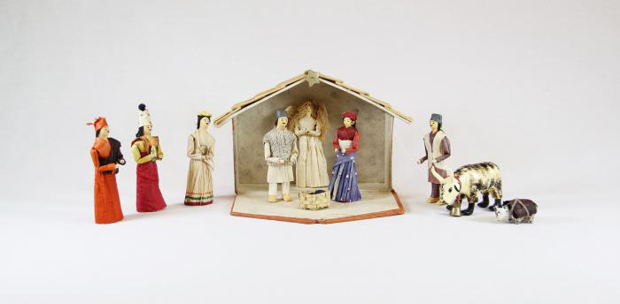
Nepal Nativity (11 pieces) (M1066)

Slide 21
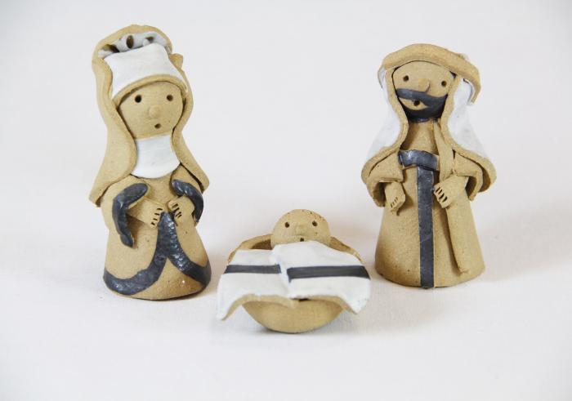
Wales Nativity (3 pieces) (M1070)

Slide 22
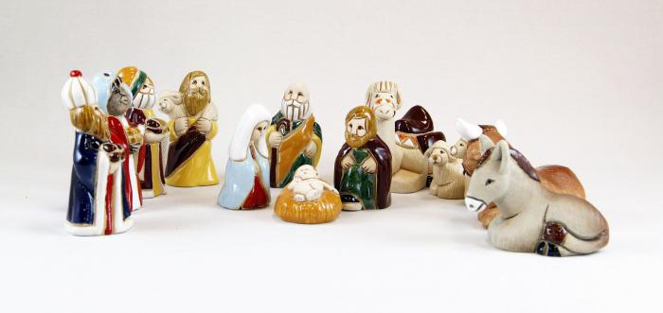
Uruguayan Nativity (13 pieces) (M1071)

Slide 23
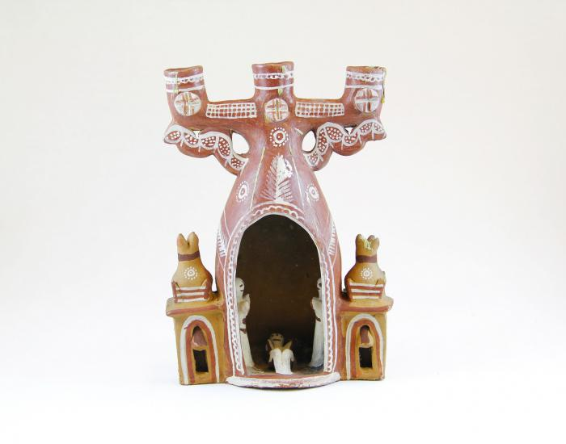
3 Candle Candelabra Nativity (M1072)

Slide 24
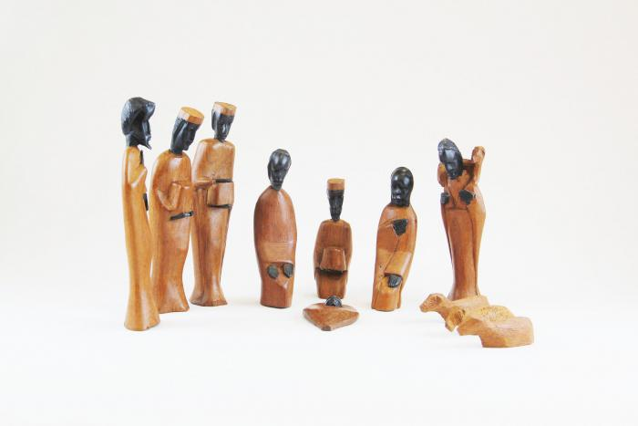
African Nativity (11 pieces) (M1073)

Slide 25
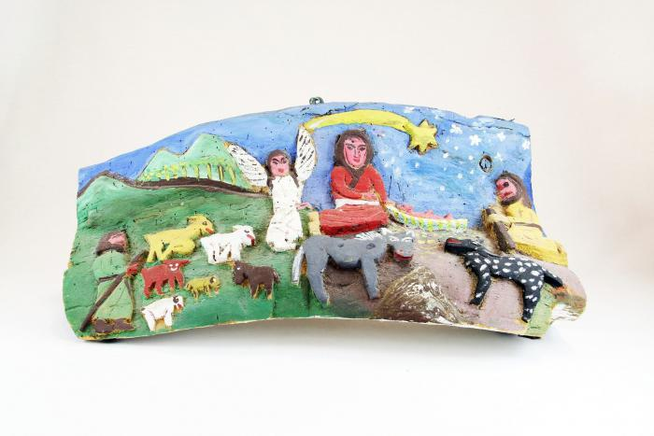
Nativity Bas-Relief Carved from Tree (M1077)

Slide 26
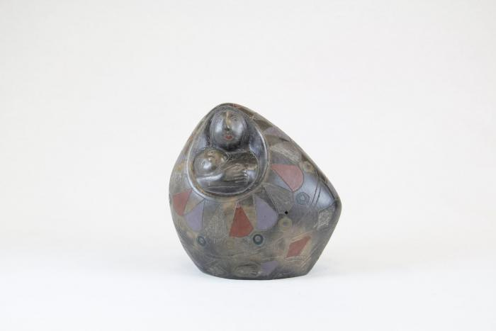
Clay Madonna and Child in Oval Pot (M1084)

Slide 27
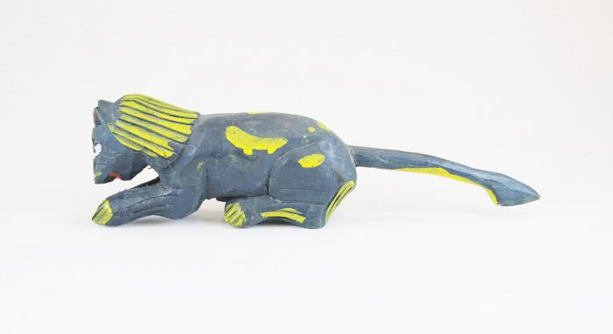
Spotted Feline (M1086)

Slide 28
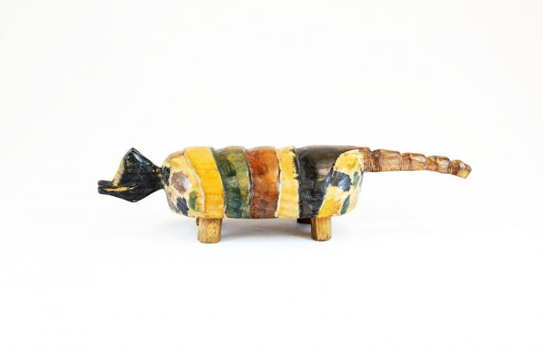
Painted Armadillo (M1088)

Slide 29
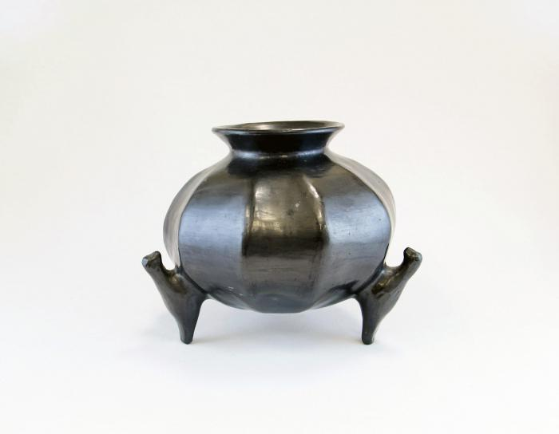
Pumpkin-Shaped Pot with 3 Bird Feet (M1092)

Slide 30
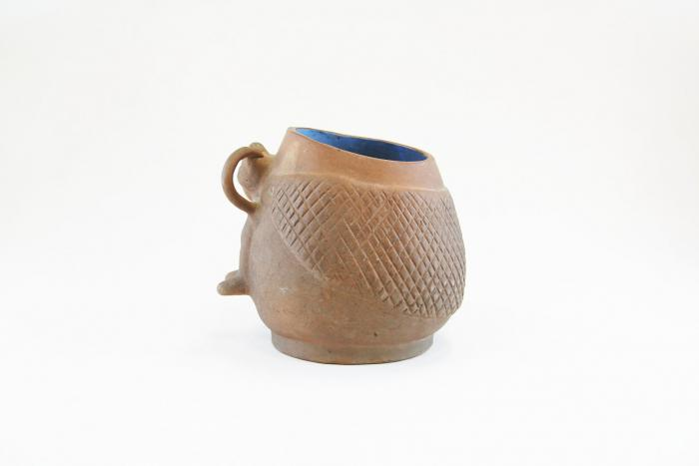
Unglazed Clay Pot with Blue Glaze Inside (M1093)

Slide 31
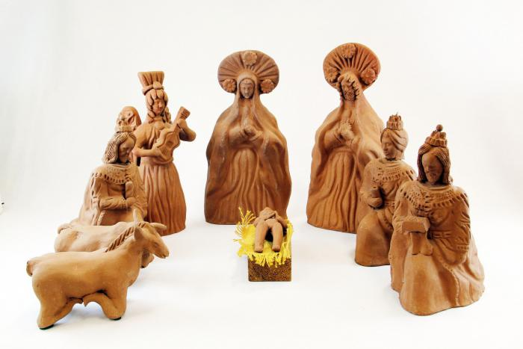
Mexico Box Nativity set (Nicho) (9 pieces) (M1103)

Slide 32
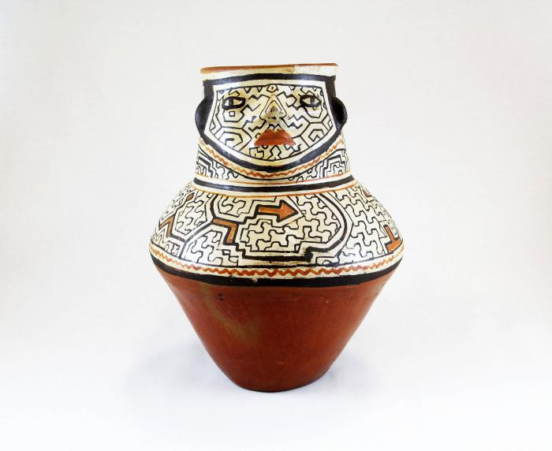
Vessel with Face (M1105)

Slide 33
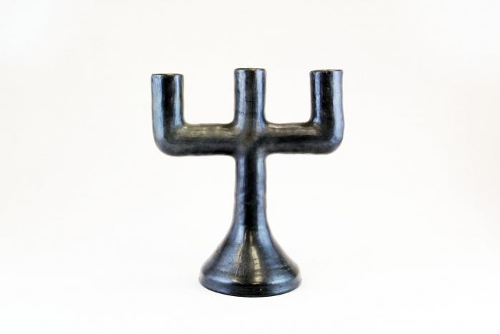
Barro Negro 3 Candle Candelabra (M1109)

Slide 34
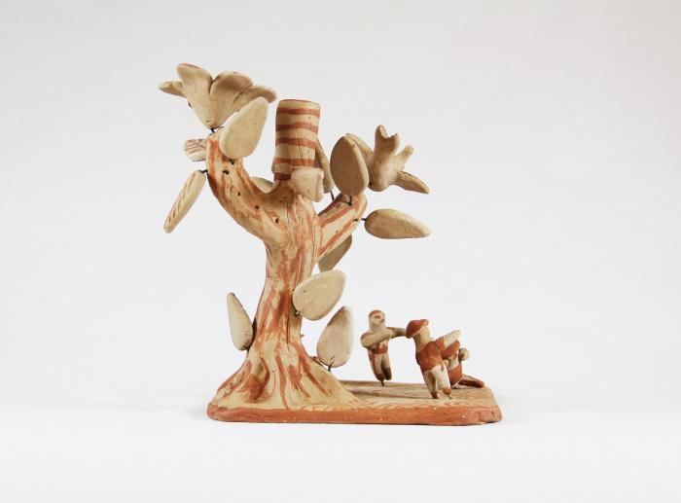
Tree Single Candle Holder on clay base with a few people (M1110)

Slide 35
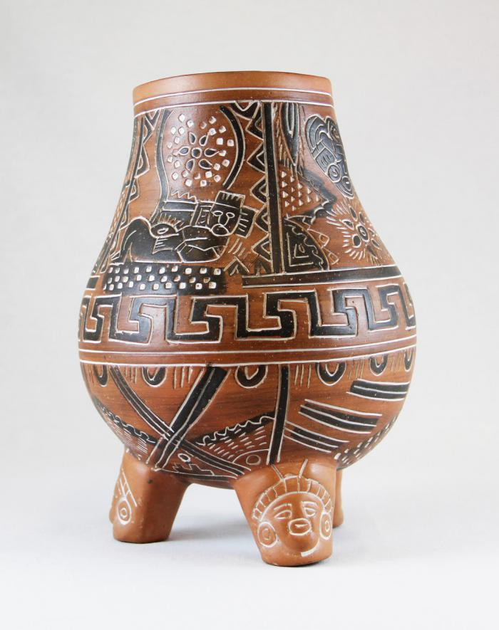
Vessel with Chac Mool (M1111)

Slide 36
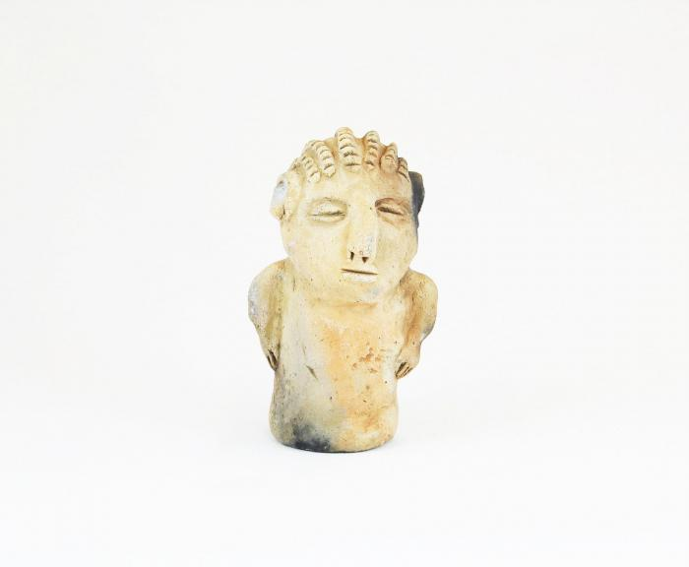
Clay figure with braided hair (M1502)

Slide 37
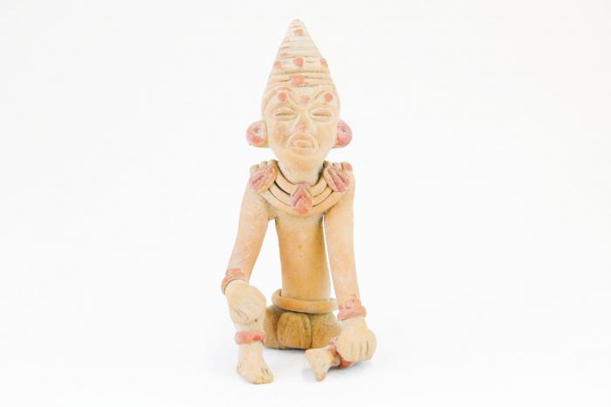
Pre-Columbian Figure Reprodiction (M1503)

Slide 38
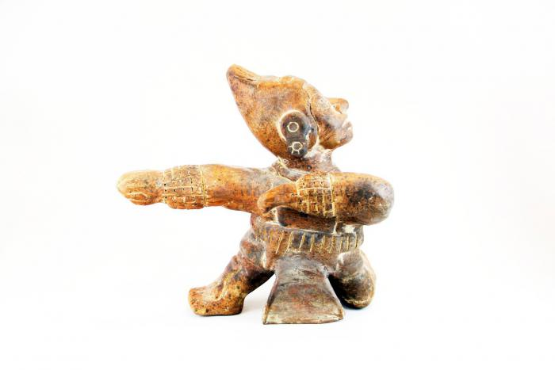
Reproduction Pre-Columbian Kneeling Warrior (M1511)

Slide 39
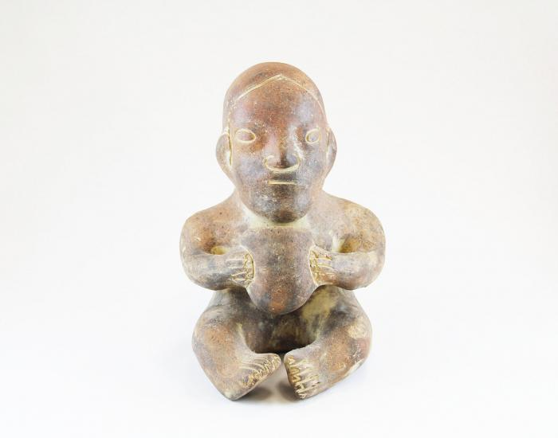
Clay Figure holding a Cup (M1515)

Slide 40
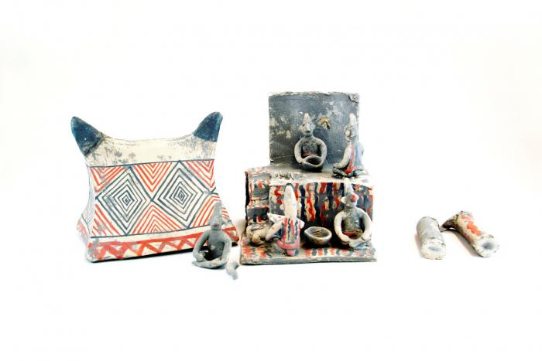
Gray Mayan Hut with Figures and Dogs (broken into 9 pieces) (M1519)

Slide 41
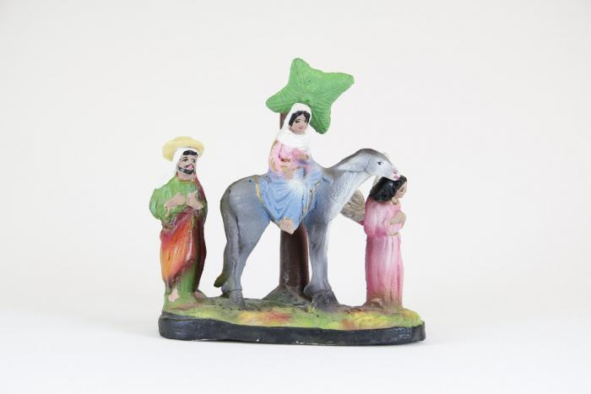
Flight into Egypt - Mary on Donkey (M1524)

Slide 42
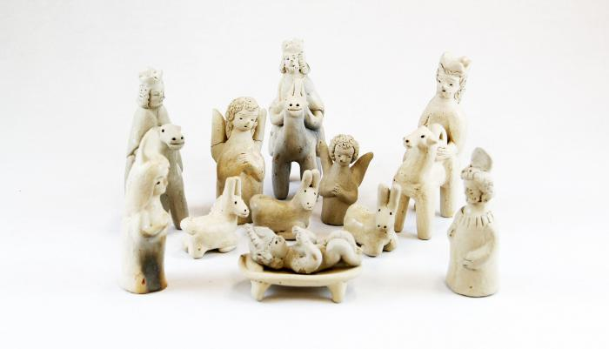
Clay Nativity (12 pieces) (M1528)

Slide 43
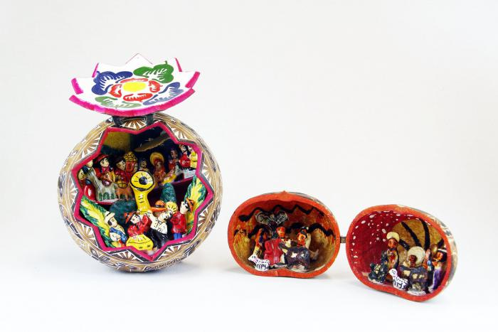
Two Brown Gourds that Open to Nativity (M1547)

Slide 44
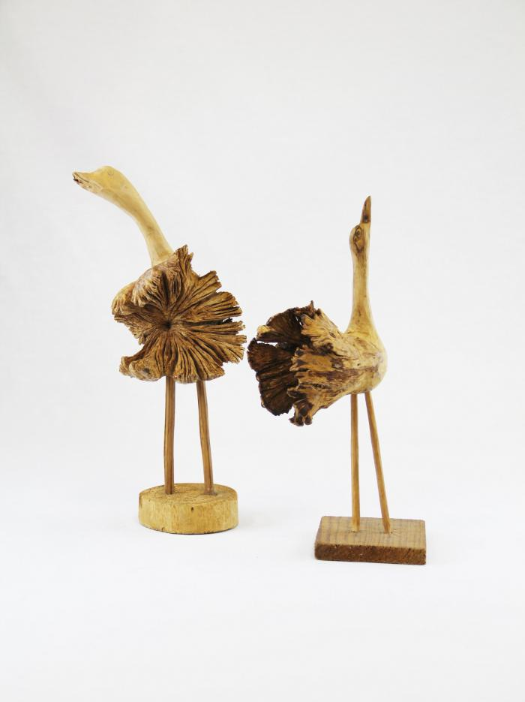
Two birds carved from Wood Burls (M1552)

Slide 45
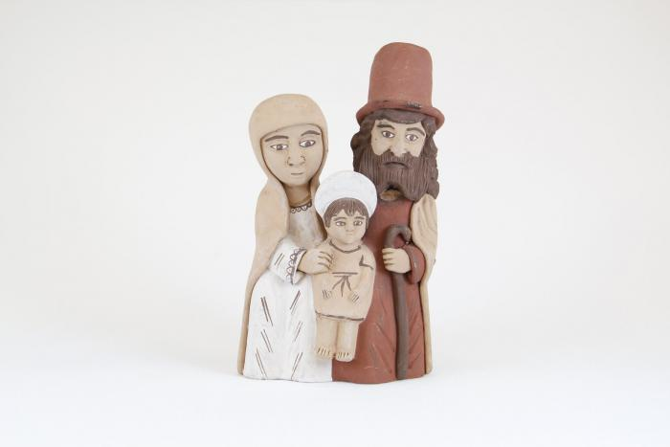
Mary, Joseph and Jesus Standing Together (M1554)

Slide 46
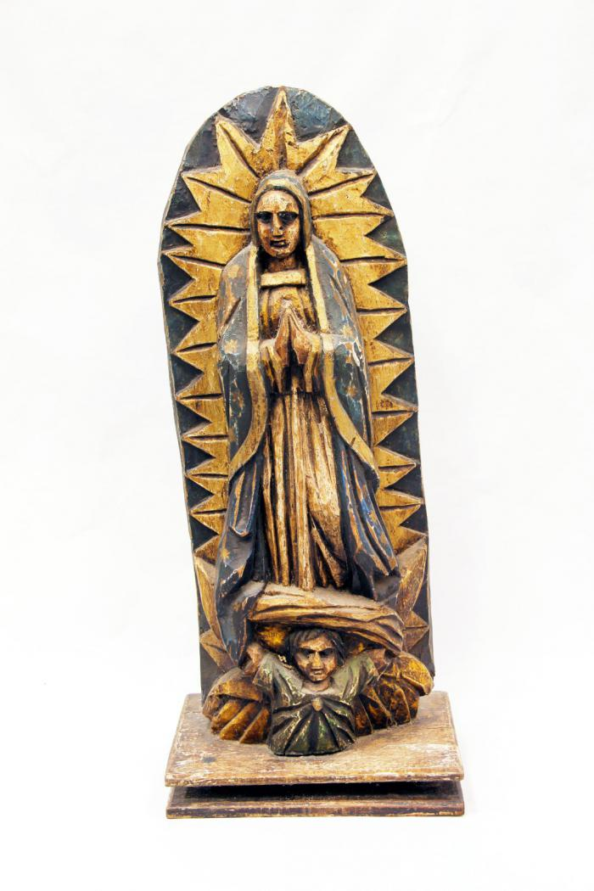
Santo Virgin of Guadalupe (M1555)

Slide 47
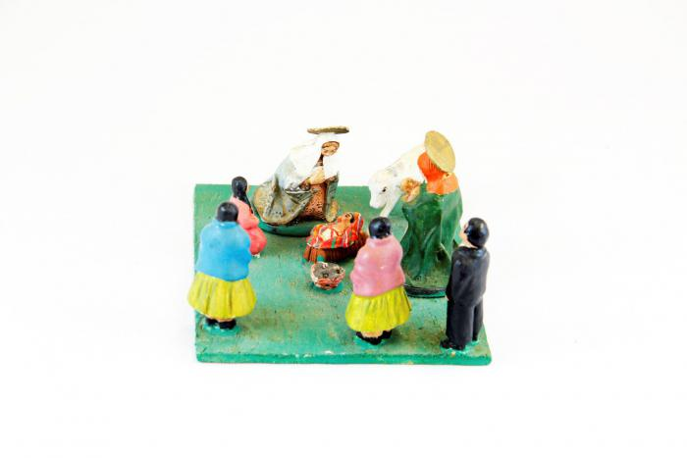
Small Nativity on Wood base (M1559)

Slide 48
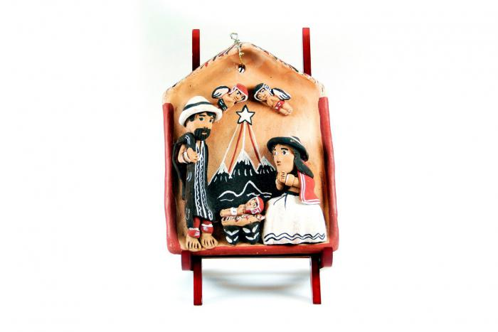
Peruvian Nativity Plaque (M1570)

Slide 49
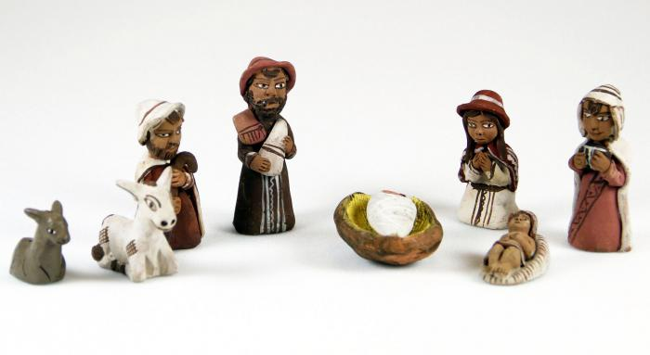
Peruvian Nativity (8 pieces) (M1578)

Slide 50
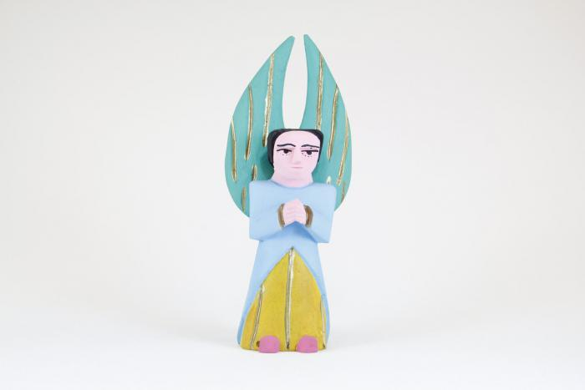
Painted Angel (M1595)

Slide 51

Three Kings (M1603)

Slide 52

Vase San Bartolo (M1605)

Slide 53

Black Clay Candelabra (M1606)

Slide 54

San Bartolo Coyotepec Incised Vase (M1607)

Slide 55

Black Clay Pot (M1608)

Slide 56

Two Navajo Dance Wands (MU3471)

Slide 57

Red, White & Blue Woven Wool Rug (MU3473)

Slide 58

Burnished Clay Bird Pitcher (MU3477)

Slide 59

Zuni Burnished Pot (Cracked & Repaired) (MU3479)

Slide 60

Zuni Terra Cotta Pot with Brown & Red Accents (MU3480)

Slide 61

Casas Grandes Vase (MU3481)

Slide 62

Terra Cotta Bowl with Bird in Center (MU3483)

Slide 63

Painted Particle Board (MU3484)

Slide 64

Black & White Seed Pot with lizards (MU3485)

Slide 65

Black & White Zuni Pot with Tadpole Motif (MU3486)

Slide 66

Clay Black & White Acoma Pot (MU3487)

Slide 67

Small Clay White, Black & Tan Painted Pot (MU3488)

Slide 68

Small Painted Acoma Pot with Lizard Design (MU3489)

Slide 69

Small painted Acoma Pot with Lid & Kokopelli design (MU3490)

Slide 70

Cochiti Pueblo Ceramic Frog (MU3492)

Slide 71

Small Clay Brown and Tan Painted Pot (MU3493)

Slide 72

7 Porcupine Quills (MU3499)

Slide 73

Tohona-O’Odham Small Woven Cream & Brown Coil Pot (MU3500)

Slide 74

Tohono-O’Odham Woven Yucca Round Basket (MU3502)

Slide 75

Tohono-O’Odham Woven Yucca Basket (MU3503)

Slide 76

Ojibwe Porcupine Quill and Birch Bark Box (MU3505)

Slide 77

Gourd Doll on Grass Ring Pedestal (MU3506)

Slide 78

Kachina Doll (Shaloko) (MU3508)

Slide 79

Kachina Doll (MU3510)

Slide 80

Kachina Doll (MU3516)

Slide 81

Kachina Doll (Shalako) (MU3517)

Slide 82
Kachina Doll (Ogre Woman) (MU3518)

Slide 83

Initiation Doll (MU1)

Slide 84

Sangoma Doll (MU2)

Slide 85

Ceremonial Doll (MU3)

Slide 86

Isicwoyo Front Apron (MU4)

Slide 87

Small Doll (MU5)

Slide 88

Maiden Doll (MU6)

Slide 89

Inkehli / Headdress (MU7)

Slide 90

Quechua Rag Doll (MU8)

Slide 91

Dancing Women Blanket (MU9)

Slide 92

Dancing Figures Blanket (MU10)

Slide 93

4 Beaded Coasters (MU11)

Slide 94

Brown, Black and White Coaster (MU12)

Slide 95

Jar with belt pattern and base (MU17)

Slide 96

Hopi Hemis Kachina (MU18)

Slide 97

Two Wooden Spoons (MU19)

Slide 98

Kachina Doll (Handprint Racer) (MU3521)

Slide 99

Skeleton Couple (EH2)

Slide 100

Catrina (EH3)

Slide 101

Ceramic Chiva Bus (EH5)

Slide 102

Skeleton Riding Bicycle (EH6)

Slide 103

Zimbabwean Quilt (EH7)

Slide 104

Peruvian Chancay Birthing Scene (EH8)

Slide 105

Two Skeleton Drummers (EH12)

Slide 106

Guatemalan Horseshoe Wall Art (EH14)

Slide 107

Wolf Head on Metal Band (EH17)

Slide 108

Sterling Silver Sculpture of Man playing Violin, made in Israel (EH18)

Slide 109

Large Skeleton with Rotating Arms and Legs (EH27)

Slide 110

Wood Skeleton Armoire (EH28)

Slide 111

Don Pedrito Jaramillo with chipped nose on blue base (RE1)

Slide 112
Don Pedrito Jaramillo with criss cross base and chair (RE2)

Slide 113
Don Pedrito Jaramillo white and dark grey hair seated in orange chair (RE3)

Slide 114

Peruvian Church with Market Scene
(SE51)

Slide 115

Peruvian Church Candle Holder and Luminary
(SE52)

Slide 116

Peruvian Church with Multiple Small Figures (SE53)

Slide 117

Iatmul Wood Figure
(SE54)

Slide 118

Tigre Mask (PR1)

Slide 119

Bat Mask (PR2)

Slide 120

Devil Mask with Two Snakes (PR3)

Slide 121

Mermaid Mask (PR4)

Slide 122

Hermit Mask (PR5)

Slide 123

Goat Mask (PR6)

Slide 124

Mermaid and Bird Mask (PR7)

Slide 125

Old Man Mask (Viejo) (PR8)

Slide 126

Viejito Mask (PR9)

Slide 127

Bat and Mermaid Mask (PR10)

Slide 128

Tin Mask (PR11)

Slide 129

El Barbón Mask (PR12)

Slide 130

Nagual Mask (PR13)

Slide 131
Wood Carved Leopard Mask (PR14)

Slide 132

Diablo-Calavera (Devil-Skull) Mask (PR15)

Slide 133

Leather Mask (PR16)

Slide 134

Carnival Jester Mask (PR17)

Slide 135

Moro Pasion Mask (PR18)

Slide 136

Round Ceramic Mask (PR19)

Slide 137

Unglazed Ocumicho Mask (PR20)

Slide 138

Blue Devil Mask (PR21)

Slide 139

Straw or Palm Mask (PR22)

Slide 140

Donkey Mask (PR23)

Slide 141

Devil Mask (PR24)

Slide 142

Chané Jaguar Mask (PR25)

Slide 143

Moon and Star Ceramic Mask / Wall Hanging (PR26)

Slide 144

Stars Ceramic Mask / Wall Hanging (PR27)

Slide 145

Venezuelan Tribal Mask (PR28)

Slide 146

Piaroa Kohue Mask (PR29)

Slide 147

Ecuadorian Monkey Mask (PR30)

Slide 148

Puerto Rican Vejigantes Mask (PR31)

Slide 149

Puerto Rican Vejigantes Mask (PR32)

Slide 150

Ranga Mask (PR33)

Slide 151

Indonesian Barong Mask (PR34)

Slide 152

Indonesian Barong Mask (PR35)

Slide 153

Balinese Long Mask with Lizards (PR36)

Slide 154

Ganesha mask (PR37)

Slide 155

Hill Tribe Thai Mask #1 (PR38)

Slide 156

Hill Tribe Thai Mask #2 (PR39)

Slide 157

Sepik River Mask (PR40)

Slide 158

Porcelain Foo Dog Wall Hanging (PR41)

Slide 159

Jero Luh Mask (PR42)

Slide 160

Namahage Mask (PR43)

Slide 161

Meng Liang, white opera mask (PR44)

Slide 162

Okina Mask (PR45)

Slide 163

Gigaku or Tengu mask (PR46)

Slide 164

Okame (Otafuku) Mask (PR47)

Slide 165

Nojang (monk) mask (PR48)

Slide 166

Fang Mask from Ghana (PR49)

Slide 167

Carved Wood Mask, Possibly African (PR50)

Slide 168

Coconut Man's Head Mask (PR51)

Slide 169

Dan Tribe Mask (PR52)

Slide 170

Brazilian Gemstone Mask (PR53)

Slide 171

Rectangular Wood Mask (PR54)

Slide 172

Maasai mask (PR55)

Slide 173

Ashanti mask, from the Akan people group in Ghana (PR56)

Slide 174

Fanged Mask (PR57)

Slide 175

Brazilian Carranca Figurehead (PR58)

Slide 176

Kifwebe Ceremonial Mask (PR59)

Slide 177

Sombreria Market Scene (MC1)

Slide 178

Grocery Store Scene "Tienda Amelia" (MC2)

Slide 179

"Artesanias Ecuador" Market Scene (MC3)

Slide 180

Grocery Store Scene "Tienda Penelope" (MC4)

Slide 181

Christ on Cross with Angels Wood Wall Hanging (MC5)

Slide 182

Topsy Turvy Doll (MC6)

Slide 183

Chancay Doll, Mother and Child (MC7)

Slide 184

Venezuelan Piranha Mask (MC8)

Slide 185

Wooden Mask, Stained Pink (MC9)

Slide 186

Indonesian Wayang Shadow Puppet (MC10)

Slide 187

Yagua Mask (MC11)

Slide 188

Monkey Mask (MC12)

Slide 189

Guro Mask (MC13)

Slide 190

Ebony Carved Figures from Makonde Tribe (MC14)

Slide 191

Long Forehead Face Mask (MC15)

Slide 192

Ebony Carved Woman with Fabric Dress, Metal Neck Wrap, Beaded Earrings (MC16)

Slide 193

Mapula (Mother of Rain) Flower and Lion Cloth (MC17)

Slide 194

Small Wood Carved Figure with Wire Earrings and Staff (MC18)

Slide 195

Ashanti Small Mask (MC19)

Slide 196

Beaded Metal Dragon (MC20)

Slide 197

Papua New Guinea Tribal Shield (SE55)

Slide 198

Kilim Rug (SE56)

Slide 199

Angel holding Book (SH7)

Slide 200

Aztec / Mayan holding Woman (SH21)

Slide 201

Bowl (SH35)

Slide 202

Tarahumara Indian Baskets (SH36)

Slide 203

Celebration Belt (SH42)

Slide 204

Crucification (SH47)

Slide 205

Danza de la Pluma (SH48)

Slide 206

Danza de la Pluma (SH49)

Slide 207

Dancing Man with Bird (SH50)

Slide 208

Torito Dancer with Fireworks (SH51)

Slide 209

Dancing Man with Cow Fireworks (SH52)

Slide 210

Drum (SH59)

Slide 211

Farmers on Parade (SH61)

Slide 212

Makonde Shetani Sculpture (SH62)

Slide 213

Firework Castle (SH63)

Slide 214

Firework Dancing man (SH64)

Slide 215

Garuda (SH66)

Slide 216

Green Masked Dancer (SH69)

Slide 217

Hookah (SH70)

Slide 218

La Serina playing Horn (SH74)

Slide 219

Tigrada Parade Cornhusk Doll (SH79)

Slide 220

Tigrada Parade Cornhusk Doll (SH80)

Slide 221

Lion (SH81)

Slide 222

Lizard (SH84)

Slide 223

Man with Maracas (SH88)

Slide 224

Man with Whip (SH89)

Slide 225

Ethiopian Canoe Gambella Basket (SH97)

Slide 226

Skeleton Band (SH109)

Slide 227

Tea Pot (SH112)

Slide 228

Virgin Mary (SH125)

Slide 229

Two-Headed Statue (AC5)

Slide 230

Miniature Mountain Spirit Mask (AC9)

Slide 231

Kayak Necklace (AC11)

Slide 232

Lucky Halibut (AC13)

Slide 233

Round Earrings (AC14)

Slide 234

Rhombus Earrings (AC15)

Slide 235

Beluga Whale (AC16)

Slide 236

Baby Polar Bear (AC18)

Slide 237

Bird Pendant (AC19)

Slide 238

Button Face Native Doll (AC20)

Slide 239

Yupik Bone Doll (AC21)

Slide 240

Yupik Bone Doll (AC22)

Slide 241

Impressioned Silver Mask (SHA1)

Slide 242

Pucara Ceramic Bull (SHA6)

Slide 243

Carved Wooden Bowl (SHA7)

Slide 244

Pisco Figural Bottle (SHA8)

Slide 245

Pisco Figural Bottle (SHA9)

Slide 246

Big Jaguar Wrap Skirt (AFFA1)

Slide 247

Blue Hearts Huipil (AFFA2)

Slide 248

Chiapas Magdalena Huipil (AFFA3)

Slide 249

Chiapas Tenejapa Huipil (AFFA4)

Slide 250

Chiapas Tenejapa Shawl (AFFA5)

Slide 251

Chiapas Zinacantan Huipil (AFFA6)

Slide 252

Chiapas Zinacantan Serape (AFFA7)

Slide 253

Chichicastenango Flowers Huipil (AFFA8)

Slide 254

Chichicastenango Huipil (AFFA9)

Slide 255

Colotenango Huipil (AFFA10)

Slide 256

Jalapa de Diaz Oaxaca Multicolored Bird and Flower Huipil (AFFA11)

Slide 257

Joyabaj Huipil (AFFA12)

Slide 258

Market Apron (AFFA13)

Slide 259

Bolivian Men's Poncho (AFFA14)

Slide 260
Oaxacan Amuzgo Huipil (AFFA15)

Slide 261

Oaxacan Huautla Huipil and Falda (AFFA16)

Slide 262

Chichicastenango Huipil with gold threading (AFFA17)

Slide 263

Patzún Huipil 1 (AFFA18)

Slide 264

Patzún Huipil 2 (AFFA19)

Slide 265

Pink Belt (AFFA20)

Slide 266

San Antonio Aguas Calientes Huipil (AFFA21)

Slide 267

San Juan Sacatepequez Faja (AFFA22)

Slide 268

San Lucas Toliman Huipil (AFFA23)

Slide 269

Santa Maria Nebaj Huipil (AFFA24)

Slide 270

Santiago Atitlán Bird Huipil (AFFA25)

Slide 271

Santiago Atitlán Bird Huipil #2 (AFFA26)

Slide 272

Santiago Atitlán Turkey Huipil (AFFA27)

Slide 273

Trique Huipil (AFFA28)

Slide 274

Two Peacocks Black and White Dress (AFFA29)

Slide 275

White Campesina Blouse (AFFA30)

Slide 276

White Skirt with Woman and Horse Scene on Edge (AFFA31)

Slide 277

Ecuadorian Women's Outfit (AFFA32)

Slide 278

Catrina (ME1)

Slide 279

"Elephant" Carved Dried Gourd with Lid (YO1)

Slide 280

"Zulu" Carved Dried Gourd (YO2)

Slide 281

Beaded Bracelets (YO3)

Slide 282

Beaded Wood Ndebele Brush (YO4)

Slide 283
Beaded Wood Ndebele Knife (YO5)

Slide 284

Carved Wood Ladle (YO6)

Slide 285

Pasiking (Rattan Backpack) (YO7)

Slide 286

Beaded Fly Whisk (YO8)

Slide 287

Tzintzuntzan Boat Women (YO9)

Slide 288

Turkish Talisman with Evil Eye (HU1)

Slide 289

Turkmen Child Tunic (HU2)

Slide 290

Turkish Karagöz Shadow Puppets (HU5)

Slide 291

Papua New Guinea Shell Necklace (SE57)

Slide 292

Andean Aguayo Blanket (WI1)

Slide 293

Guatemalan San Lucas Tolimán Huipil (WI2)

Slide 294

Guatemalan Tablecloth with Quetzales (WI3)

Slide 295

Wall Hanging from Chiapas (WI4)

Slide 296

Rebozo from Totonicapan, Guatemala (WI5)

Slide 297

Peruvian Manta (WI6)

Slide 298

Vintage table runner from San Martin Jlitepeque, Guatemala (WI7)

Slide 299

Guatemalan Huipil with Bird and Rooster Pattern (WI8)

Slide 300

Guatemalan Rebozo (WI9)

Slide 301

Guatemalan Patchwork Skirt (WI10)

Slide 302

Blue and Yellow Guatemalan Belt (WI11)

Slide 303

Guatemalan Purple Belt with Diagonal Threaded Rectangles (WI12)

Slide 304

Guatemalan Striped Faja (WI13)

Slide 305

Thin Green Patterned Guatemalan Cinta (WI14)

Slide 306

Guatemalan Short Red Striped Belt (WI15)

Slide 307

Turquoise and Yellow Faja (WI16)

Slide 308

Guatemalan Belt with Silver Circle Conchos (WI17)

Slide 309

San Antonio Aguas Calientes Faja (WI18)

Slide 310

Guatemalan Multicolored Faja with Yellow Line (WI19)

Slide 311

Purple and White Guatemalan Faja (WI20)

Slide 312

Stripe Belt (WI21)

Slide 313

Zunil Cinta (WI22)

Slide 314

Bolivian Manta (WI24)

Slide 315

Tibetan Yak Mat (WI25)

Slide 316

Toucan and Parrot Whistles (WI26)

Slide 317

Voodoo Doll (WI27)

Slide 318

Ivory and Metal Sculptures (WI28)

Slide 319

Tibetan Thangka (WI29)

Slide 320

Krishna and Three Wives Fabric Painting (Pichhwai) (WI30)

Slide 321

Chinese Carved Lacquer Vases (WI31)

Slide 322

Yangban Mask (WI32)

Slide 323

Turkmen Child Tunic (HU3)

Slide 324

Santa Maria Nebaj Rebozo (HU4)

Slide 325

Repeating Flower Cinta (WI23)

Slide 326

Egyptian Rug (AC25)

Slide 327

Ethiopian Meqenet (AC26)

Slide 328

Ethiopian Gabi (AC27)

Slide 329

Senegalese Wedding Fabric Strip (AC28)

Slide 330

Mud Cloth from Benin (AC29)

Slide 331

Akua'ba (DE1)

Slide 332

Ekeko Good Luck Charm (FR1)

Slide 333

Bolivian Cholita Doll (FR2)

Slide 334

Bolivian Aymara Blanket (FR3)

Slide 335

Woven Bamboo Conical Hat (FR4)

Slide 336

Bhutanese Kira (FR5)

Slide 337

Bhutan Belt (Kera) (FR6)

Slide 338

Bhutanese Embroidered Kira (FR7)

Slide 339

Cameroon Double Bell (FR8)

Slide 340

Inuit Stone Carved Bear (FR9)

Slide 341

Chinese Lotus Shoes (FR10)

Slide 342

Chinese Embroidered Headband (FR11)

Slide 343

Chinese Children's Tiger Hat (FR12)

Slide 344

Chinese Tiger Hat (FR13)

Slide 345

Jade Horse Incense Burner (FR14)

Slide 346

Lion Incense Holder (FR15)

Slide 347

Chinese Pose Doll (FR16)

Slide 348

Chinese Horse Bells (FR17)

Slide 349

Chinese Traditional Straw Sandals (FR18)

Slide 350

Chinese Wood Carved Panel (FR19)

Slide 351

Tibetan Miniature Village (FR20)

Slide 352

Tibetan Monk's Hat (FR21)

Slide 353

Tibetan Apron (FR22)

Slide 354

Tibetan Embroidered Silk Hat (FR23)

Slide 355

Tibetan Buddhist Amulet (FR24)

Slide 356

Tibetan Oil Lamp (FR25)

Slide 357

Tibetan Metal Fastener (FR26)

Slide 358

Tibetan Copper Pitcher (FR27)

Slide 359

Tibetan Prayer Wheels (FR28)

Slide 360

Tibetan Gau (FR29)

Slide 361

Tibetan Turquoise Pendant (FR30)

Slide 362

Tibetan Bowl (FR31)

Slide 363

Tibetan Camels Print (FR32)

Slide 364

Tibetan Wood Printing Block (FR33)

Slide 365

Tibetan Six Panel Printing Block (FR34)

Slide 366

Lega Hat (FR35)

Slide 367

Kuba Cloth (FR36)

Slide 368

Congo Kuba Table Cloth (FR37)

Slide 369

Kuba Raffia Cloth (FR38)

Slide 370

Kuba Cloth Checker Pattern (FR39)

Slide 371

Ecuadorian Straw Dolls (FR40)

Slide 372

Ghana Kente Cloth (FR41)

Slide 373

Guatemalan Chicken Van (FR42)

Slide 374

Guatemalan Wooden Bull Mask (FR43)

Slide 375

Red and Black Faja (FR44)

Slide 376

Chichicastenango Faja (FR45)

Slide 377

Faja (FR46)

Slide 378

Guatemalan Sashes (Fajas) (FR47)

Slide 379

Guatemalan Chicken Candle Holder (FR50)

Slide 380

Guatemalan Rooster (FR51)

Slide 381

Calabash Gourd Shakers (FR52)

Slide 382

Indian Hindu Painting (FR53)

Slide 383

Lacquer Box from Kashmir (FR54)

Slide 384

Mortar and Pestle (FR55)

Slide 385

Indian Stamp with Elephant (FR56)

Slide 386

Indian Parcel-Gilt Silver Comb (FR57)

Slide 387

Indian Horseshoes (FR58)

Slide 388

Brass Jewelry Mold (FR59)

Slide 389

Rabari Carrying Ring (Indhoni) (FR60)

Slide 390

Rabari Cap (FR61)

Slide 391

Rabari Shisha Embroidered Cloth (FR62)

Slide 392

Rabari Hat with Mirrors (FR63)

Slide 393

Stone Carved Horse Sculpture (FR64)

Slide 394

Banjara Textile (FR65)

Slide 395

Gujarat Textile (FR66)

Slide 396

Banjara Wall Hanging (Toran) (FR67)

Slide 397

Banjara Marriage Bag (FR68)

Slide 398

Balaram Suvadra Idols (FR69)

Slide 399

Wood Carved Box (FR70)

Slide 400

Indian Woman Figure (FR71)

Slide 401

Hindu Wood Painting (FR72)

Slide 402

Rajasthan Kavad Box (FR73)

Slide 403

Sandalwood Carved Cigarette Box (FR74)

Slide 404

Wayang Kulit Shadow Puppet (FR75)

Slide 405

Two Maasai Dolls (FR76)

Slide 406

Turkana Doll (FR77)

Slide 407

Maasai Milk Jug (FR78)

Slide 408

Beaded Kenyan Jugs (FR79)

Slide 409

Nyatiti Instrument (FR80)

Slide 410

Small Nativity Tree of Life (FR82)

Slide 411

Adam and Eve Tree of Life (FR83)

Slide 412

Ceramic Church (FR84)

Slide 413

Ceramic Church (FR85)

Slide 414

Ceramic Donkey (FR86)

Slide 415

Three Tarahumara Wood Carved Figures (FR88)

Slide 416

Five Tarahumara Wood Carved Figures (FR89)

Slide 417

Tarahumara Corn Grinding Woman (FR90)

Slide 418

Tarahumara Drum and Mallet (FR91)

Slide 419

Popotillo Boxes (FR92)

Slide 420

Mexican Cartoneria Doll (FR93)

Slide 421

Mexican Marionette (FR94)

Slide 422

Mexican Paper Puppets (FR95)

Slide 423

Mexican "Mary" Cartoneria Doll (FR96)

Slide 424

Straw Church (FR97)

Slide 425

Lelé Doll (FR98)

Slide 426

Mexican Dance of the Feathers Yarn Dolls (FR99)

Slide 427

Otomi Doll (FR100)

Slide 428

Wood Carved Boat and Fisherman (FR101)

Slide 429

Mexican Wooden Fish Child's Toy (FR102)

Slide 430

Deer Mask (FR105)

Slide 431

Mexican Clacker Toy (FR106)

Slide 432

Moroccan Peasant Doll Riding a Donkey (FR107)

Slide 433

Brass Incense Burner (FR108)

Slide 434

Sherpa Family Dolls in Box (FR109)

Slide 435

Tumbuan Long Nose Mask (FR110)

Slide 436

Bilum Bags (FR111)

Slide 437

Papua New Guinea Koteka (FR112)

Slide 438

Papua New Guinea Raffia Skirt (FR113)

Slide 439

Papua New Guinea Crocodile Boat (FR114)

Slide 440

Yerba Mate Cup and Mixer from Paraguay (FR115)

Slide 441

Pucara Bulls (FR116)

Slide 442

Chulucanas Peru Vessel (FR117)

Slide 443

Peruvian Wood and Stone Ear Gauges (FR118)

Slide 444

Peruvian Wood and Stone Box and Cup (FR119)

Slide 445

Yagua Doll (FR120)

Slide 446

Yagua Doll with Bowl (FR121)

Slide 447

Yagua Doll with Child (FR122)

Slide 448

Yagua Doll with Straw Dress and Beads (FR123)

Slide 449

Bamboo Mini Retablo (FR124)

Slide 450

Peruvian Carved Gourds (FR125)

Slide 451

Peruvian Fabric Doll with Baby (FR126)

Slide 452

Quechua Women's Hat (Montera) (FR127)

Slide 453

Quechua Women's Hat (Montera) #2 (FR128)

Slide 454

Peruvian Chullo Wool Hat (FR129)

Slide 455

Black and White Horse Pattern Bag (FR130)

Slide 456

Quechua Chumpi (FR131)

Slide 457

Shipibo Textile (FR132)

Slide 458

Small Andean Wool Blanket (FR133)

Slide 459

Andean Blanket with Animals (FR134)

Slide 460

Peruvian Wool Blanket (FR135)

Slide 461

Yarn Llama and Family (FR136)

Slide 462

Peruvian Painted Box (FR137)

Slide 463

Dymkovo Toy Figures (FR138)

Slide 464

Brass Russian Icon of St. Nicholas (FR139)

Slide 465

Russian Fabric Dolls (FR140)

Slide 466

Russian Cloth Doll (FR141)

Slide 467

Yaroslavna Russian Fabric Doll (FR142)

Slide 468

Straw Wreath (Swedish?) (FR143)

Slide 469

Tanzanian Tin Safari Jeep (FR144)

Slide 470

Zaramo "Mwana Hiti" Doll Figure (FR145)

Slide 471

Thai Spirit House (FR146)

Slide 472

Kilim Box with Fabric Lid and Wood Base (FR147)

Slide 473

Painted Gourd Doll (FR148)

Slide 474

Anatolian Talisman Wall Hanging (FR149)

Slide 475

Turkish Doll (FR150)

Slide 476
Don Pedrito Jaramillo with pattern base (RE4)

Slide 477
unknown (RE5)

Slide 478
Don Pedrito Jaramillo with blue and black base and red tie (RE6)

Slide 479
Don Pedrito Jaramillo on a light blue and dark red base (RE7)

Slide 480
Large Don Pedrito Jaramillo wearing hat and white scarf (RE8)

Slide 481
Large Don Pedrito Jaramillo wearing hat with checkered base (RE9)

Slide 482
Don Pedrito Jaramillo wearing hat with black suit and tie (RE10)

Slide 483
Don Pedrito Jaramillo wearing hat with red tie (RE11)

Slide 484
Grey monochromatic Don Pedrito Jaramillo wearing hat (RE12)

Slide 485
Two small identical Don Pedrito Jaramillo figures (RE13)

Slide 486
Small Don Pedrito Jaramillo wearing hat (RE14)

Slide 487

Don Pedrito Jaramillo in glass enclosure with flowers (RE15)

Slide 488

"Dios Bendiga Nustro Hogar" small altar to Don Pedrito Jaramillo (RE16)

Slide 489
A small gold altar to Don Pedrito Jaramillo with two angels (RE17)

Slide 490
"Bless Our Home" small altar to Don Pedrito Jaramillo (RE18)

Slide 491

A small altar to Don Pedrito Jaramillo in gold shell (RE19)

Slide 492

Turkish Runner Rug (FR151)

Slide 493

Pima Coil Basket (FR152)

Slide 494

Amish Dolls (FR154)

Slide 495

Inuit Inukshuk Figurine (FR155)

Slide 496

Comb with Kohl Applicator (FR156)

Slide 497

Flower Hmong Dolls (FR157)

Slide 498

Dao Child's Hat (FR158)

Slide 499

Ludayi (Carved Calabash Gourd Ladles) (FR159)

Slide 500

Coca Cola Can Motorcycle (FR160)

Slide 501

Antique Bisque Doll (FR161)

Slide 502

Bone Carved Figure with Parrot (FR162)

Slide 503

Large Doll with Wood Body and Face (FR163)

Slide 504

Nut Rattle (FR164)

Slide 505

Botswana Woven Coil Basket with Lid (FR165)

Slide 506

Black and White Wool Bag (FR166)

Slide 507

Bhutan Lucky Symbols Banner (FR167)

Slide 508

Christ and Mahomet Embroidery (FR168)

Slide 509

Silk Embroidered Blouse with Birds, Horses and People (FR169)

Slide 510

Animal Skin Tunic with Cross Pattern (FR170)

Slide 511

Kilim Rug Blue Red and White (FR171)

Slide 512

Wooden Toy Truck (FR172)

Slide 513

Wood Stirrup (FR173)

Slide 514

Basket (FR174)

Slide 515

Lobi Stool (FR175)

Slide 516

Chinese Tea pot (FR176)

Slide 517

Angel Doll (PE3)

