Slide 1
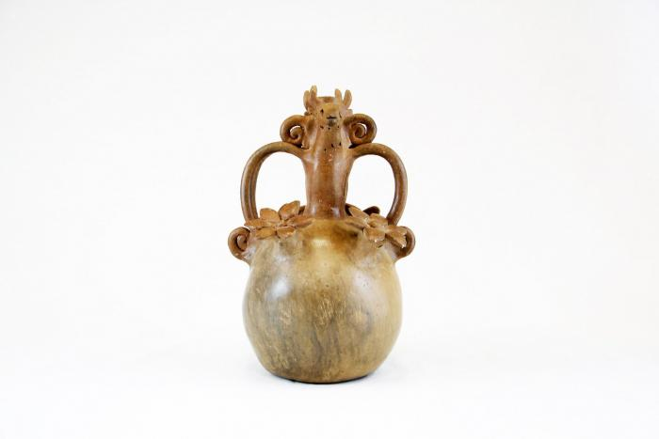
Candelabra with Animals and Flowers (M1001)

Slide 2
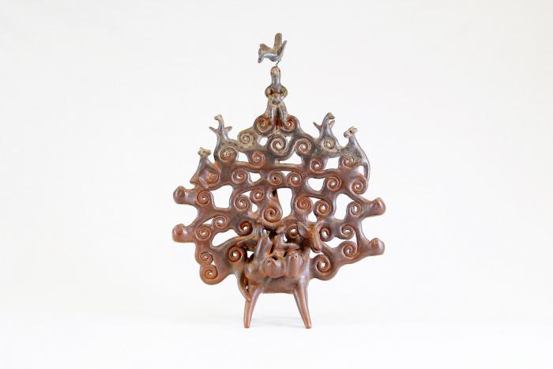
Tree of Life on Donkey (M1002)

Slide 3
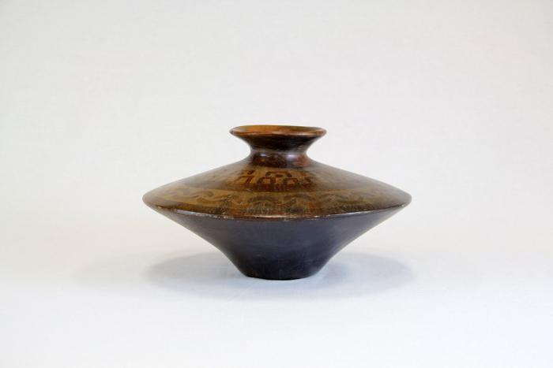
Angular Vessel (M1003)

Slide 4
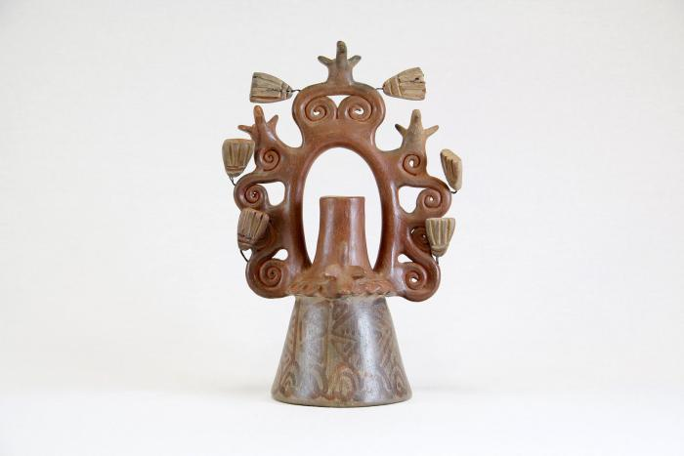
Tree of Life Candle Holder (M1004)

Slide 5
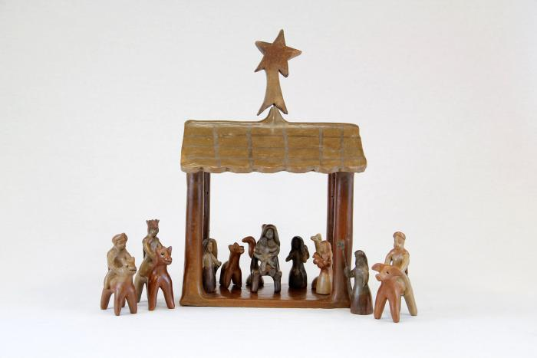
12 Piece Nativity Scene (M1005 / 1006)

Slide 6
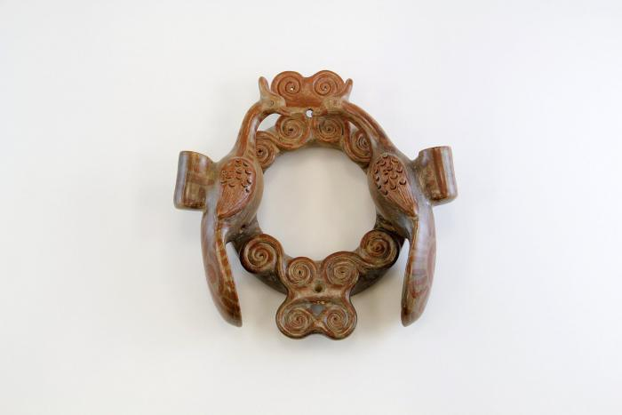
Circular Wall Sconces with 2 Birds ( 2 Pieces) (M1007)

Slide 7
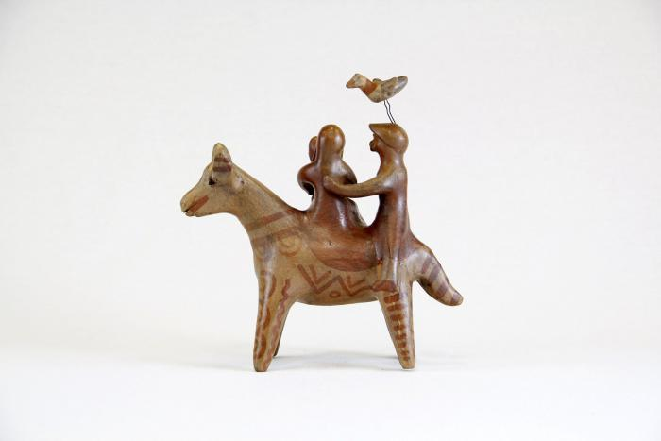
Flight Into Egypt (M1008)

Slide 8
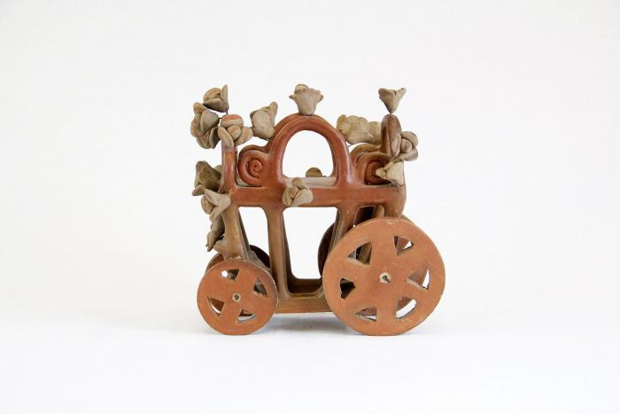
Cart with Team of Horses (M1009)

Slide 9
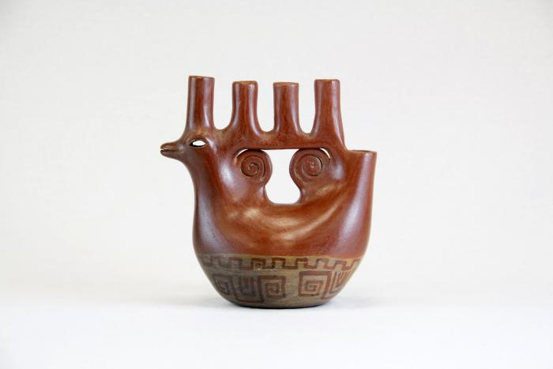
Bird Shaped Candelabra (M1010)

Slide 10
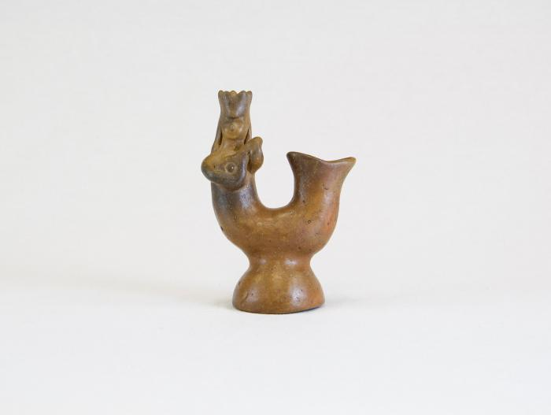
Mermaid (M1011)

Slide 11
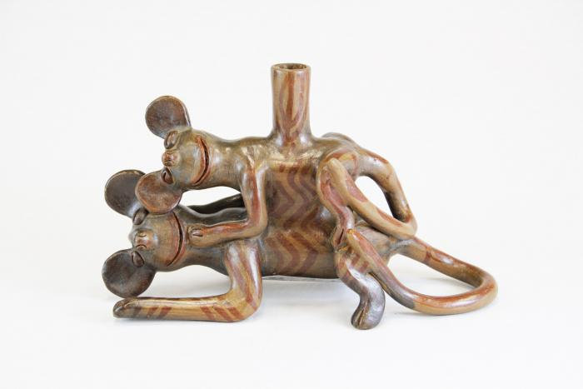
Two Mice Candle Holder (M1012)

Slide 12
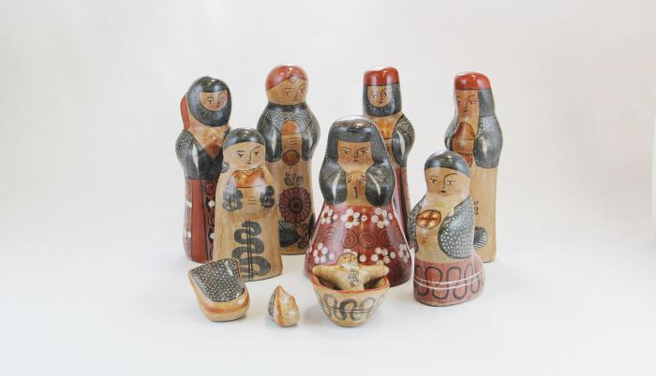
Tonalá Burnished Nativity (11 Pieces) (M1043)

