Slide 1
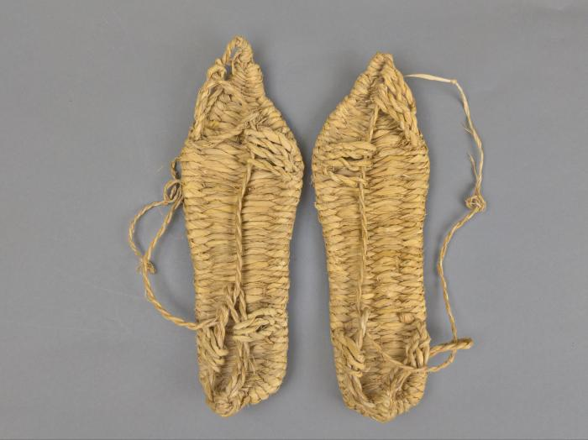
Chinese Traditional Straw Sandals (FR18)

Slide 2
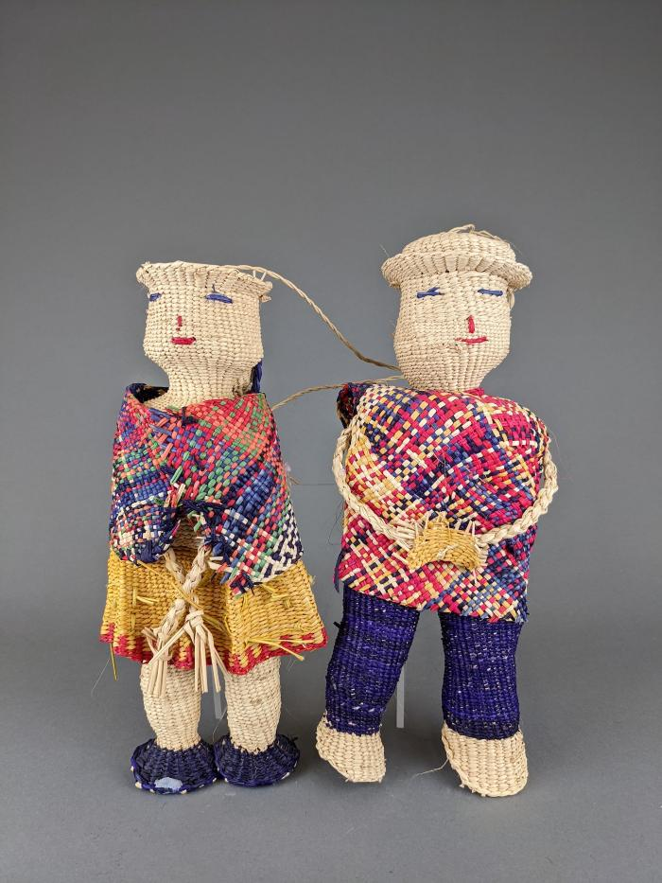
Ecuadorian Straw Dolls (FR40)

Slide 3
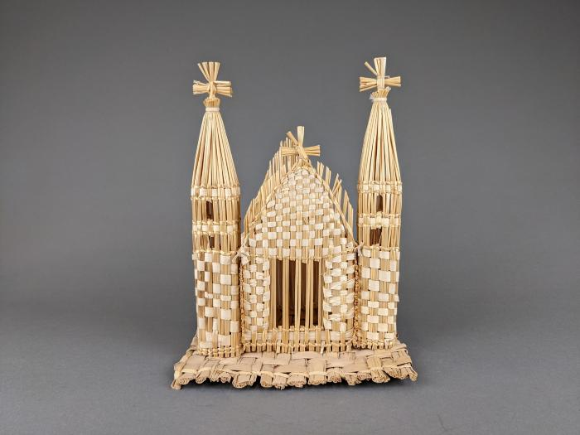
Straw Church (FR97)

Slide 4
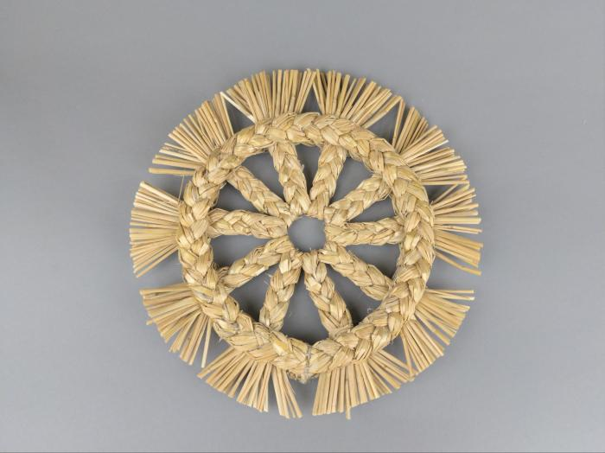
Straw Wreath (Swedish?) (FR143)

