Slide 1
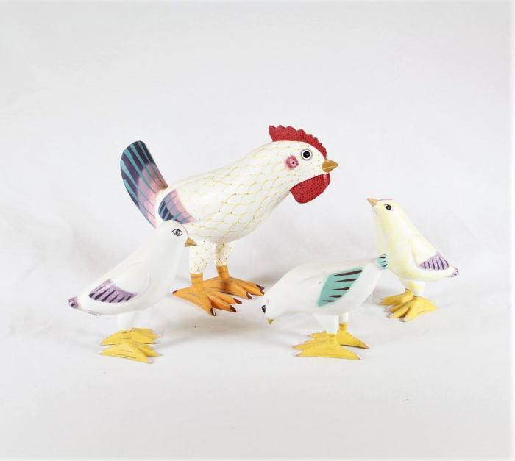
Chicken with Chicks (SH44)

