Slide 1
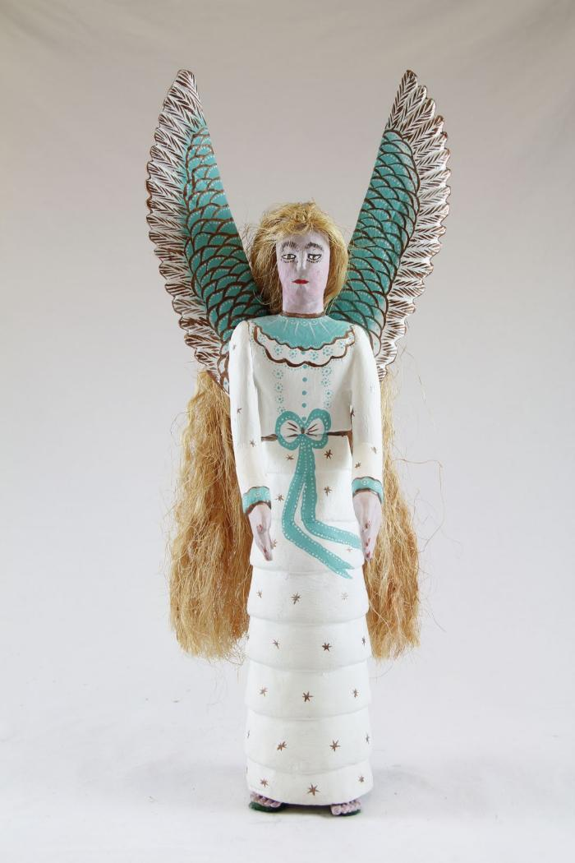
Angel (SH6)

Slide 2
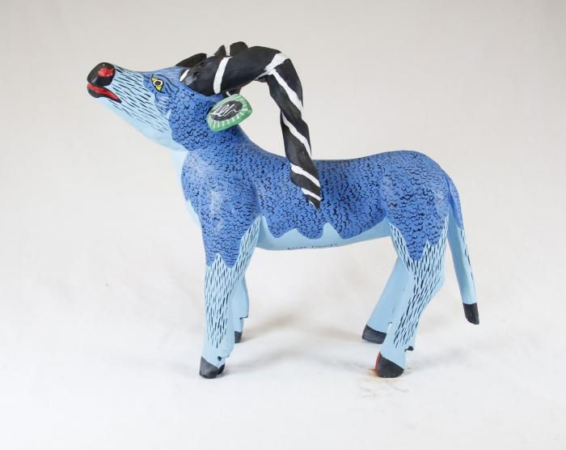
Blue Goat (SH33)

