Slide 1
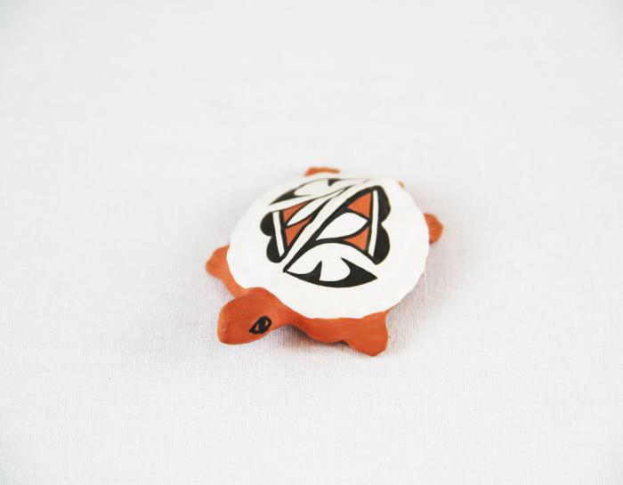
Small Painted Clay Turtle (MU3491)

