Slide 1
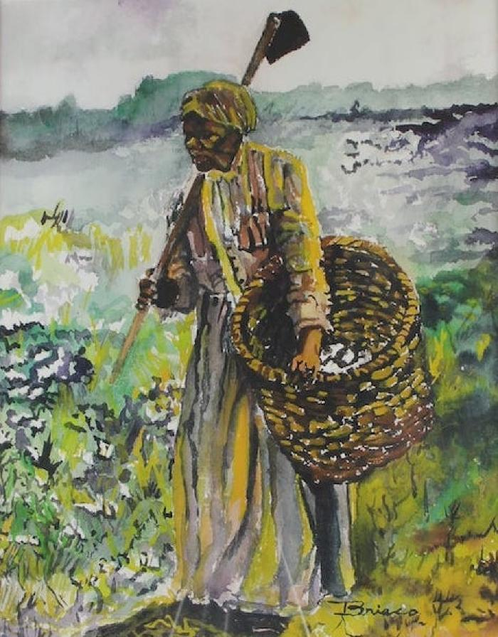
"Land Carer" (PE1)

Slide 2
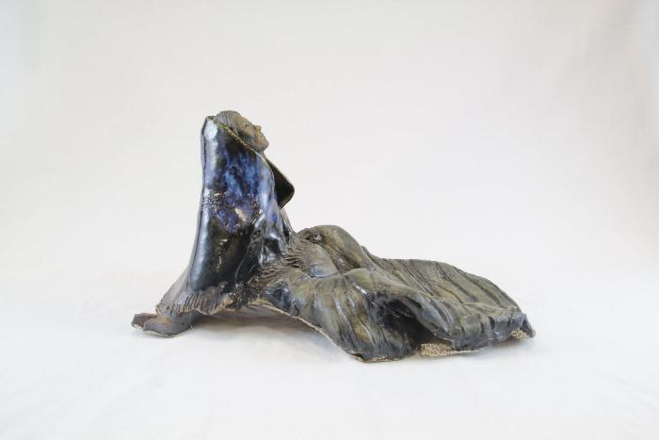
"Mother Earth" (PE2)

