Slide 1
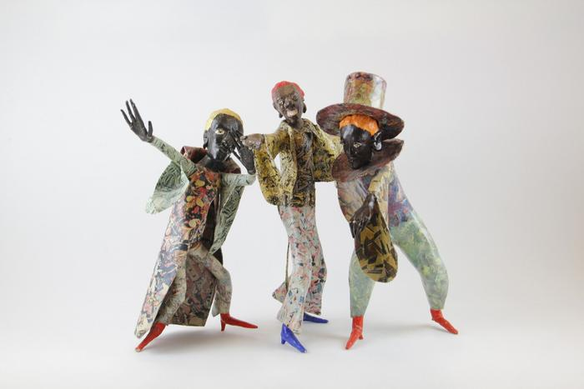
Three Minstrels (EH10)

Slide 2
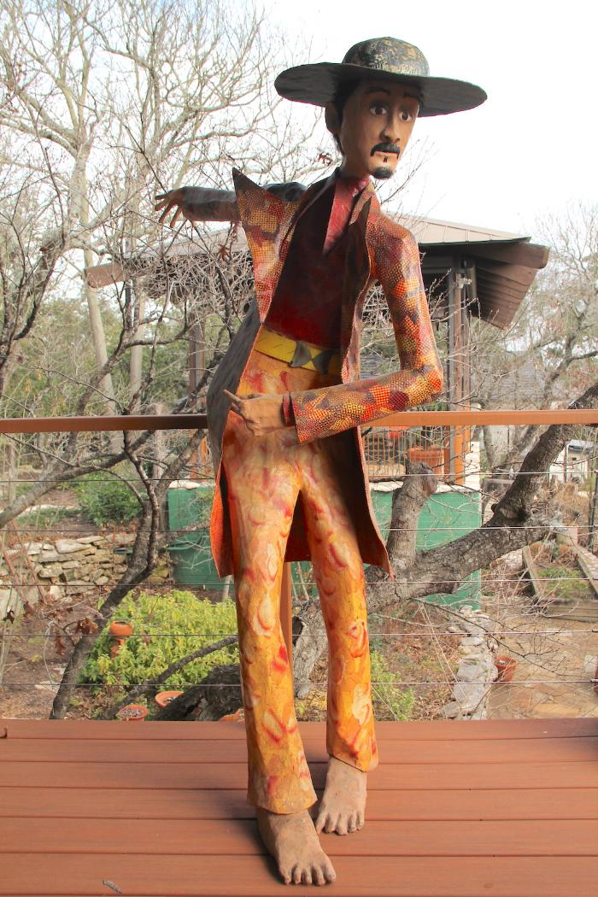
Three Figures (DA1)

