Slide 1
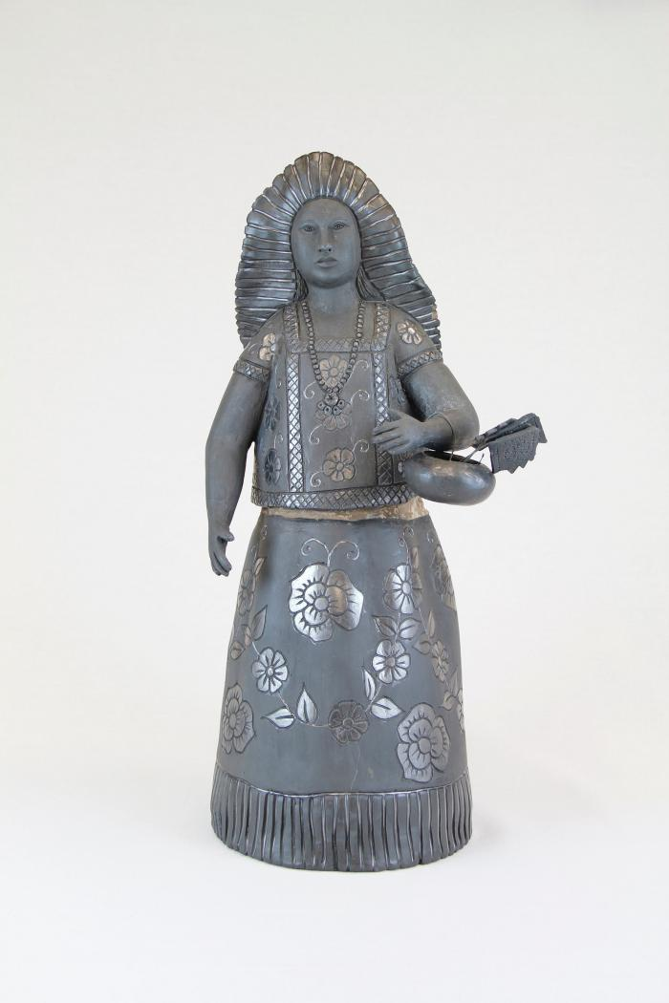
Black Maiden with Basket (M1023)

Slide 2
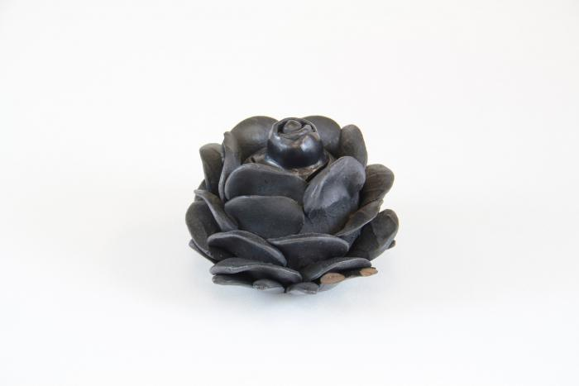
Black Clay Flower (M1027)

