Slide 1
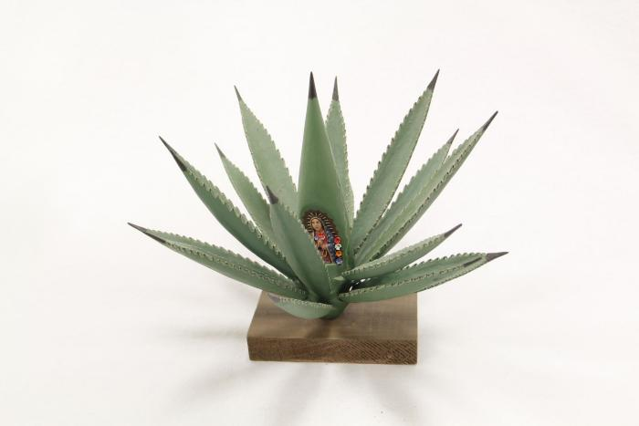
Agave Plant with Virgin of Guadalupe (SH1)

Slide 2
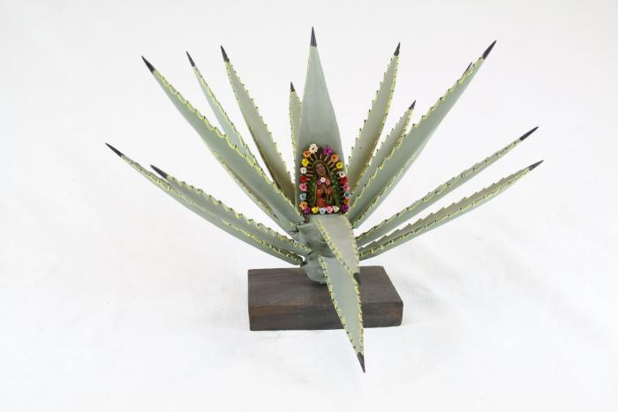
Agave Plant with Virgin of Guadalupe (SH2)

Slide 3
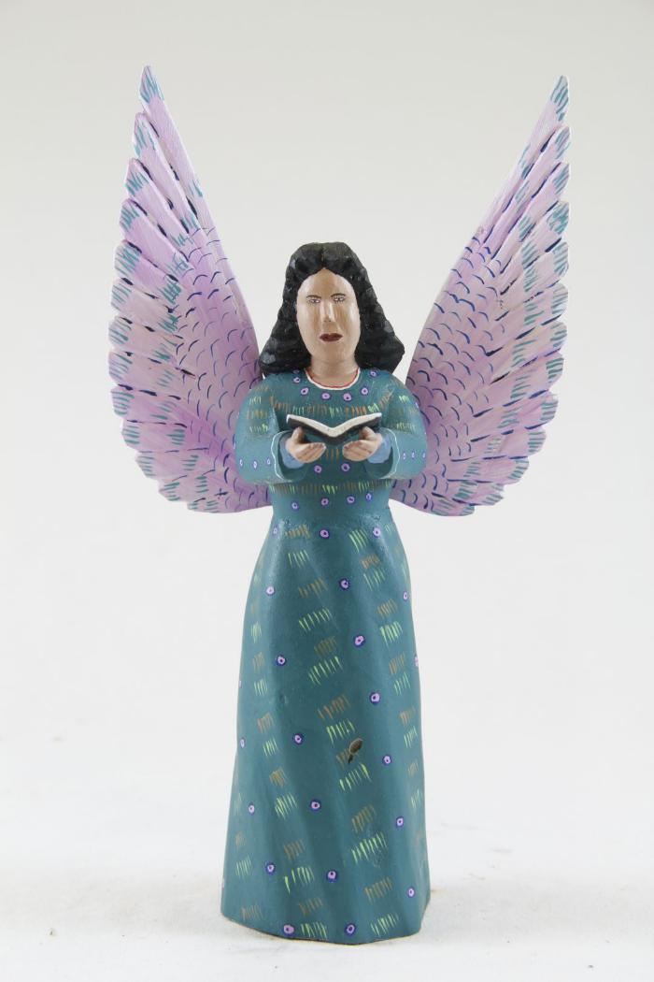
Angel (SH4)

Slide 4
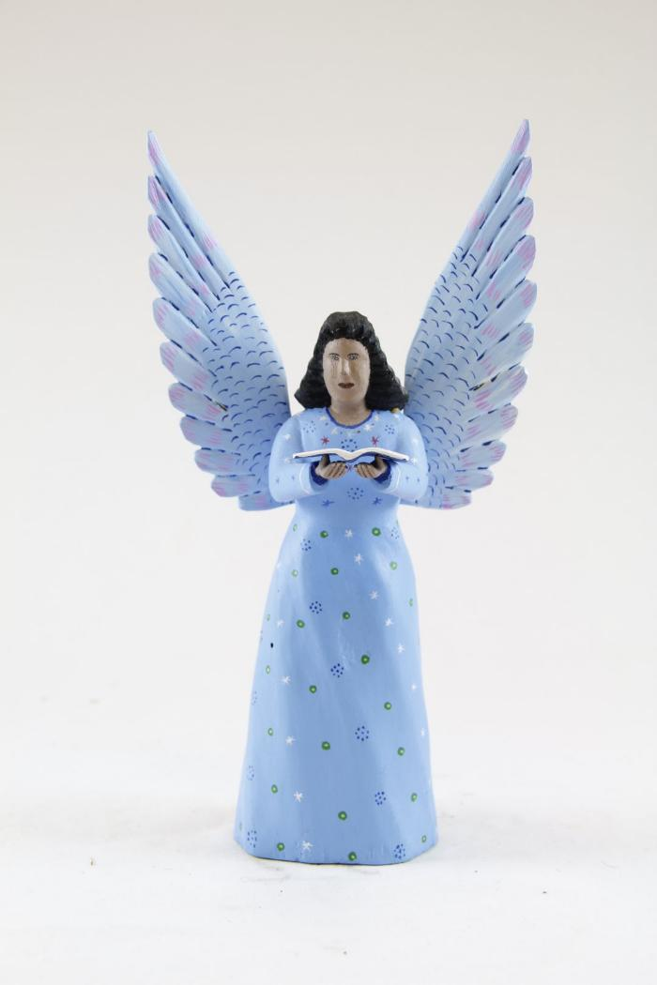
Angel (SH5)

Slide 5
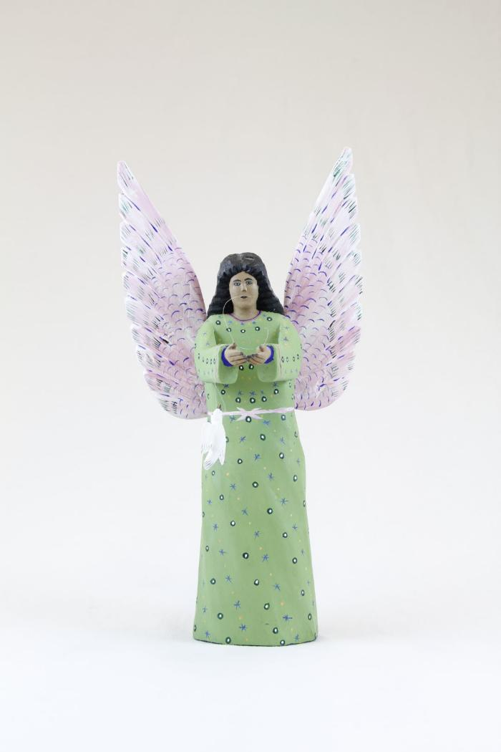
Angel holding Dove (SH8)

Slide 6
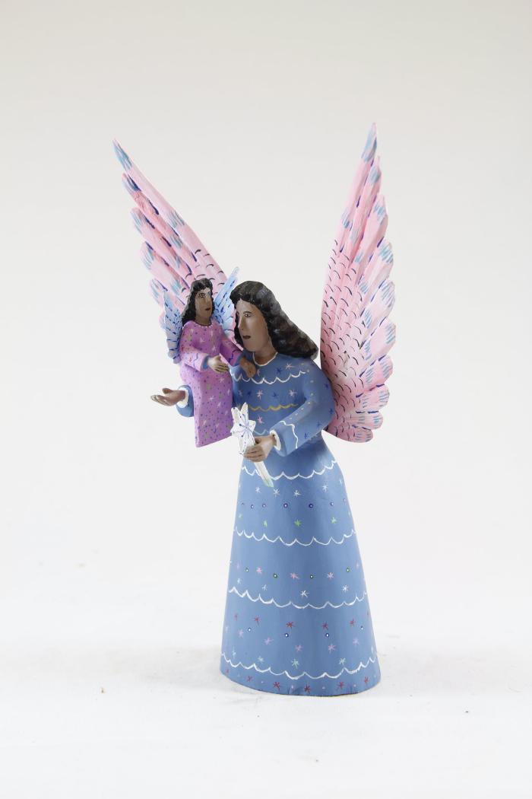
Angel with Small Angel (SH15)

Slide 7
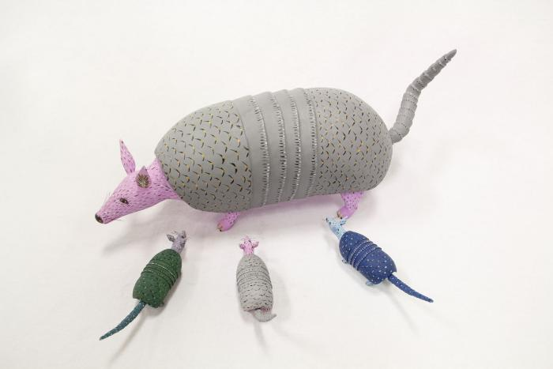
Armadillo (SH19)

Slide 8
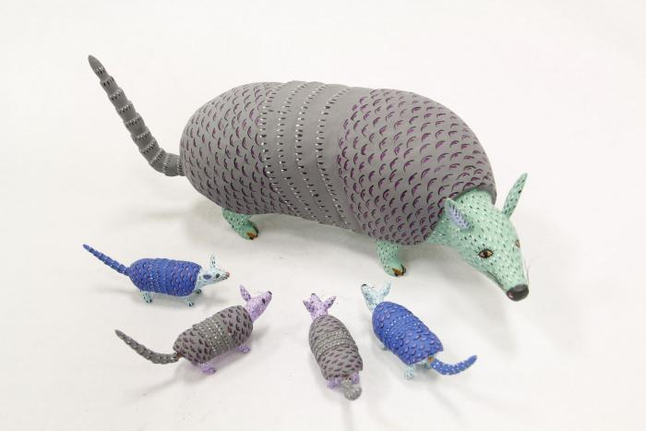
Armadillo (SH20)

Slide 9
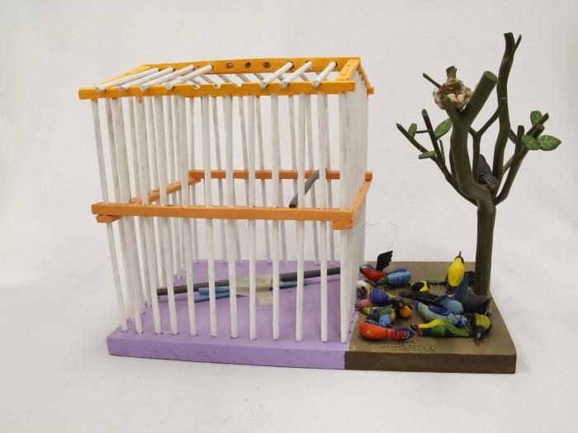
Bird Cage with Tree (SH22)

Slide 10
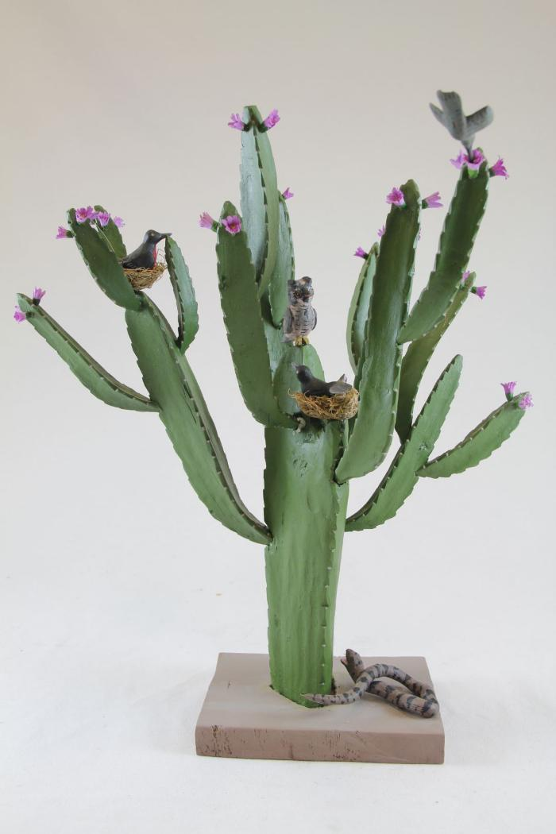
Cactus blooming Pink Flower (SH39)

Slide 11
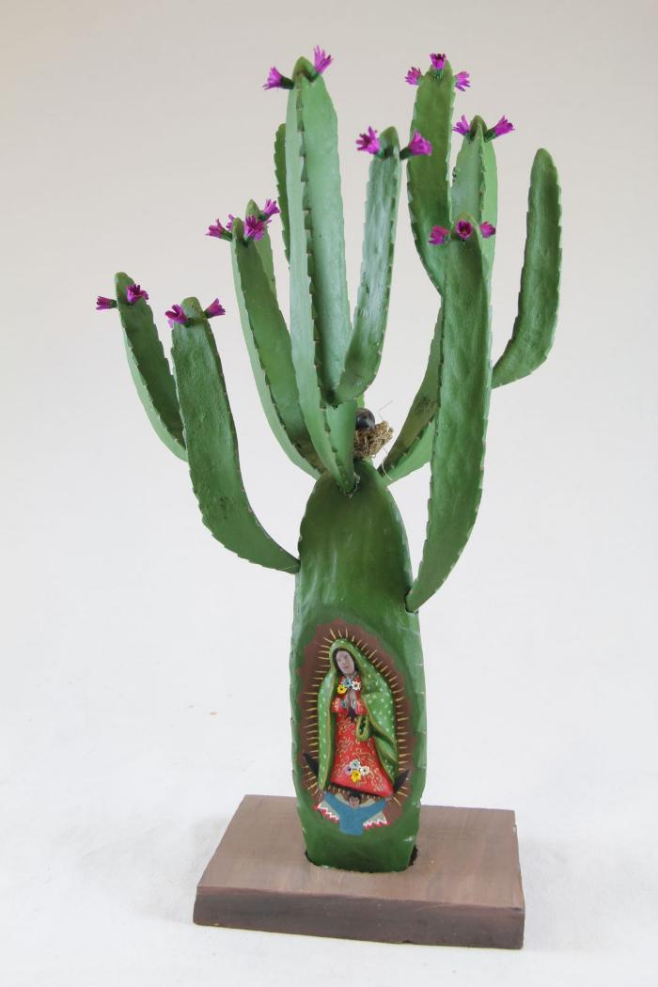
Cactus with Three Virgins (SH40)

Slide 12
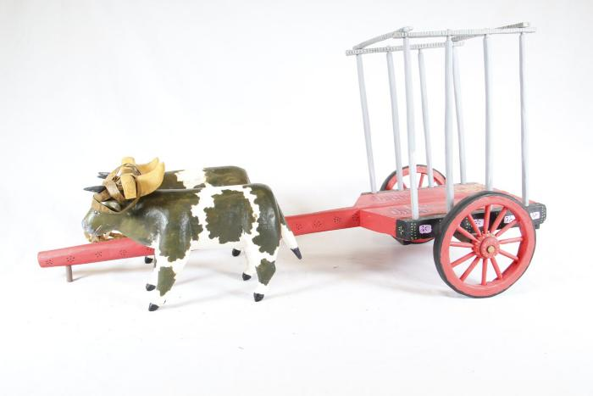
Cart with Cows (SH41)

Slide 13
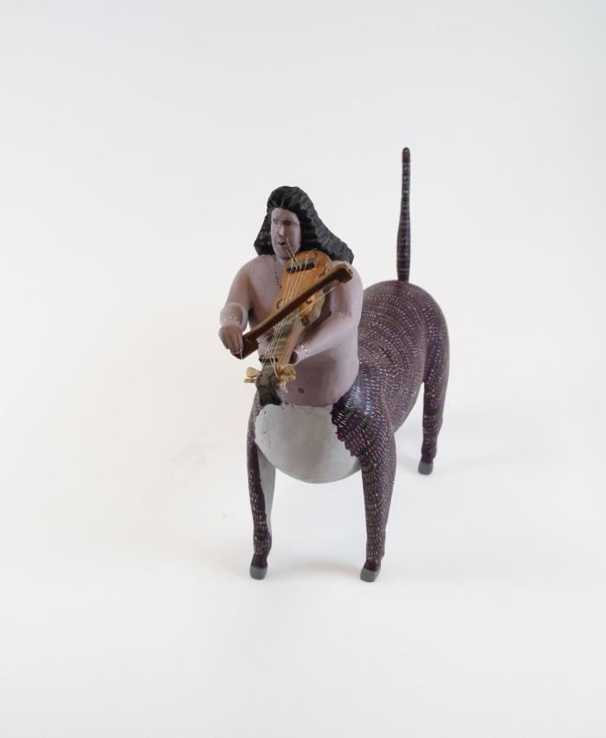
Centaur playing Violin (SH43)

Slide 14
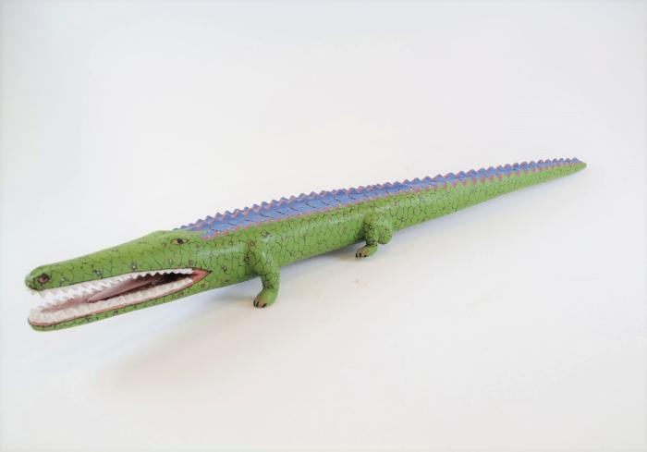
Crocodile (SH46)

Slide 15
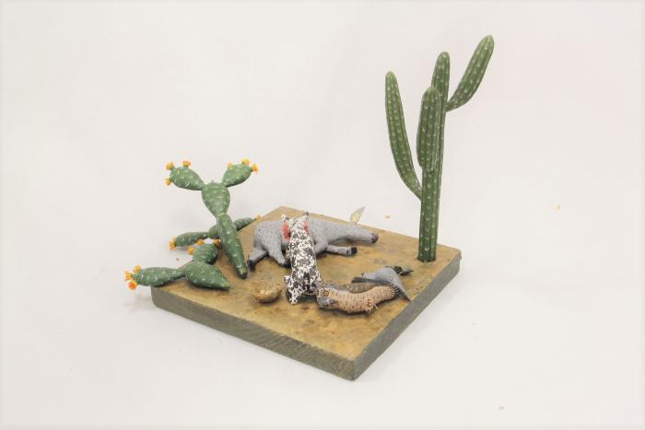
Desert Scene (SH54)

Slide 16
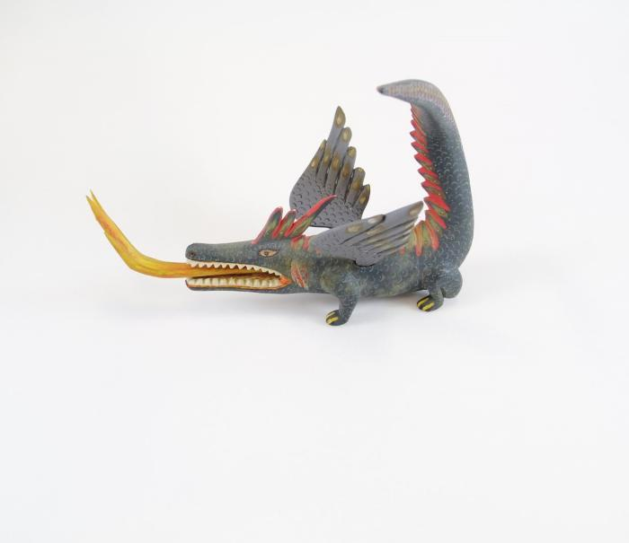
Dragon (SH56)

Slide 17
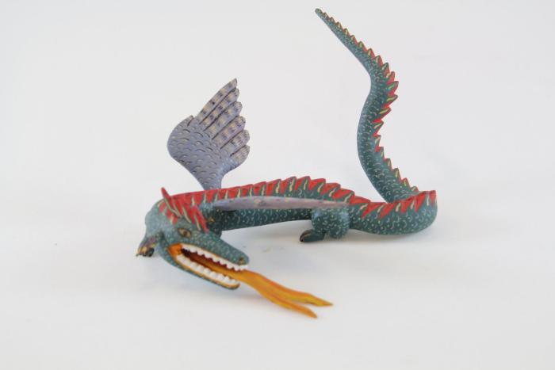
Dragon (SH57)

Slide 18
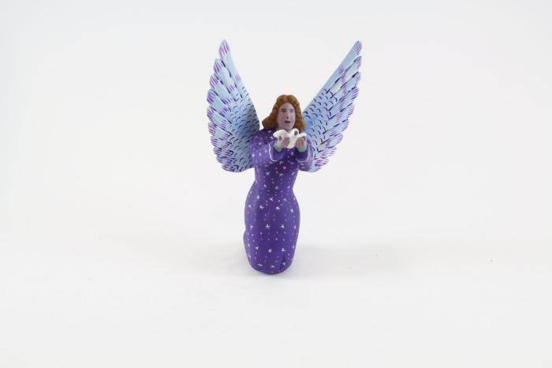
Kneeling Angel (SH73)

Slide 19
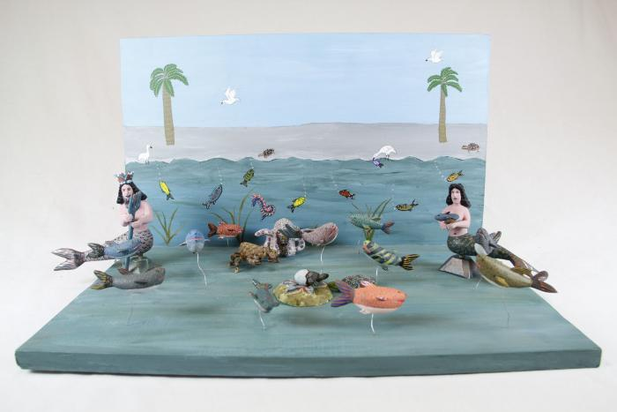
Mermaids on Beach (SH92)

Slide 20
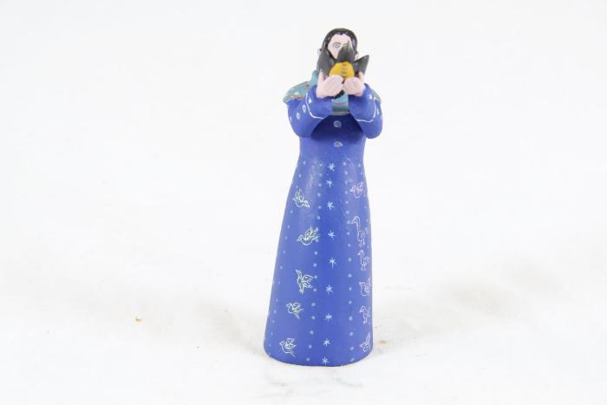
Monk with Bird (SH93)

Slide 21
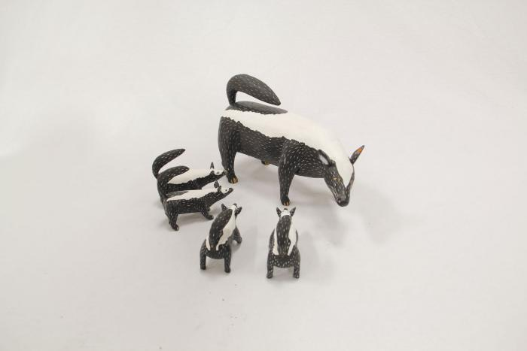
Mother Skunk (SH94)

Slide 22
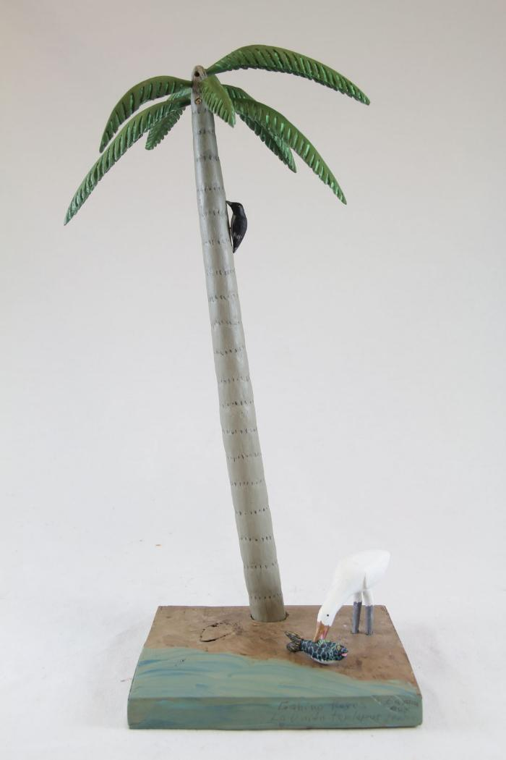
Palm Tree with Feeding Bird (SH98)

Slide 23
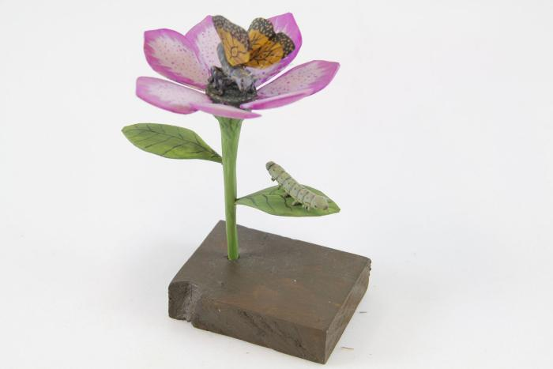
Pink Flower (SH99)

Slide 24
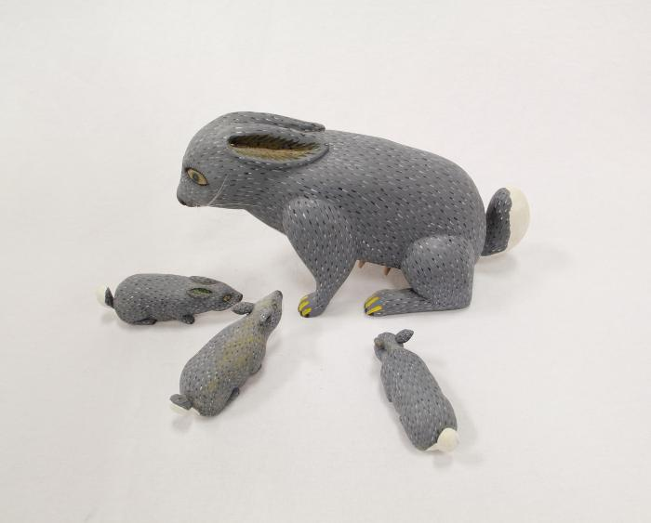
Rabbit (SH101)

Slide 25
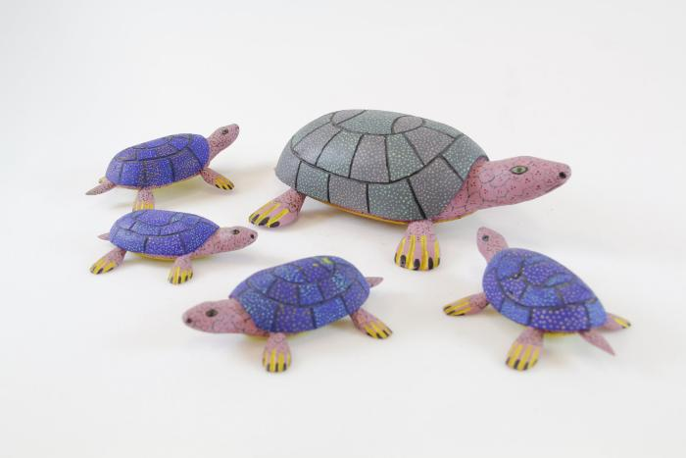
Wood Carved Turtles (SH114)

Slide 26
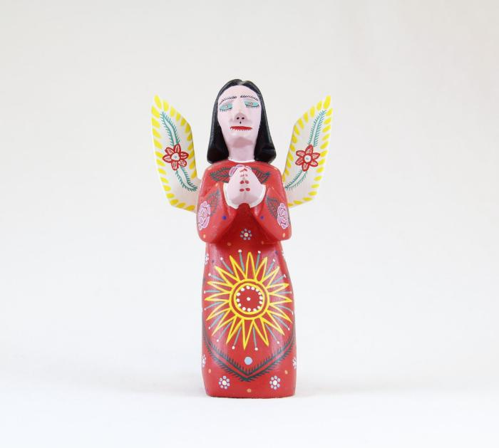
Virgin de Guadalupe (SH118)

Slide 27
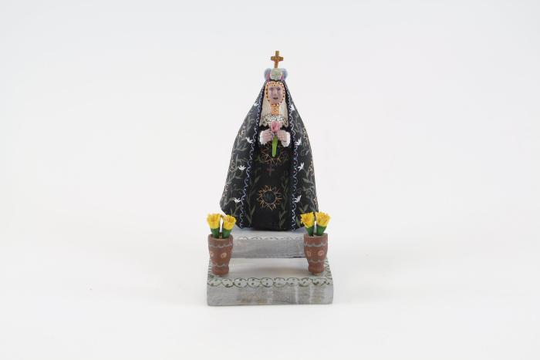
Virgin de la Soledad (SH122)

Slide 28
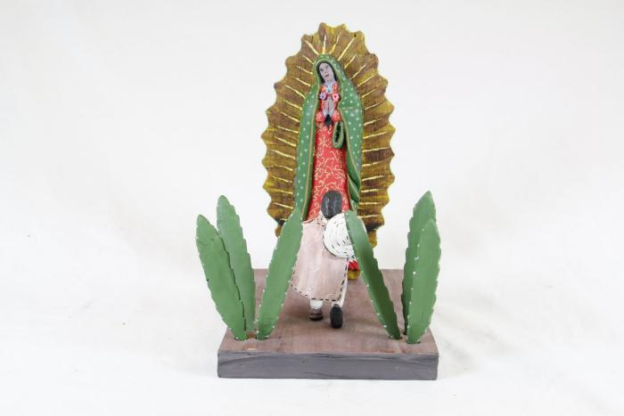
Virgin Mary with Man kneeling (SH126)

Slide 29
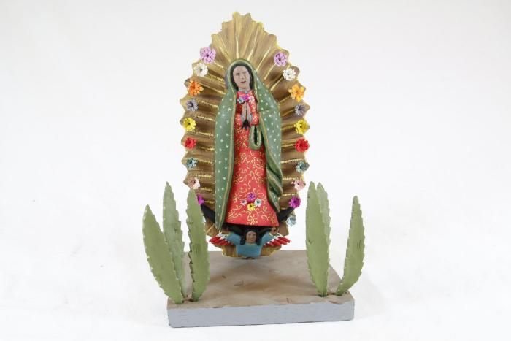
Virgin of Guadalupe (SH127)

Slide 30
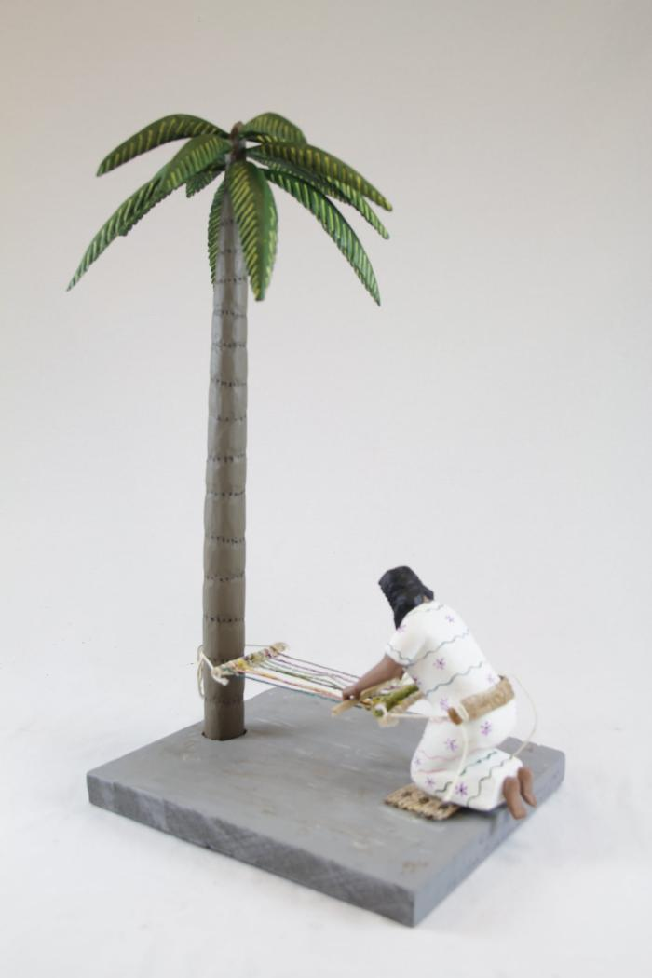
Woman making a Rug (SH130)

