Slide 1
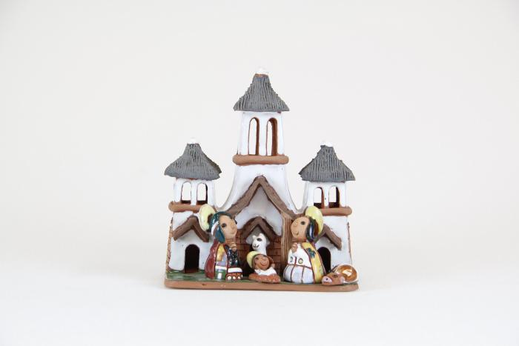
Bolivia Church Scene Nativity (1 of 2) (M1067a)

Slide 2
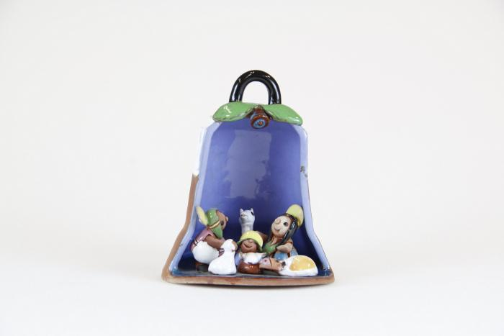
Bolivia (Bell Scene) Nativity (2 of 2 ) (M1067b)

