Slide 1
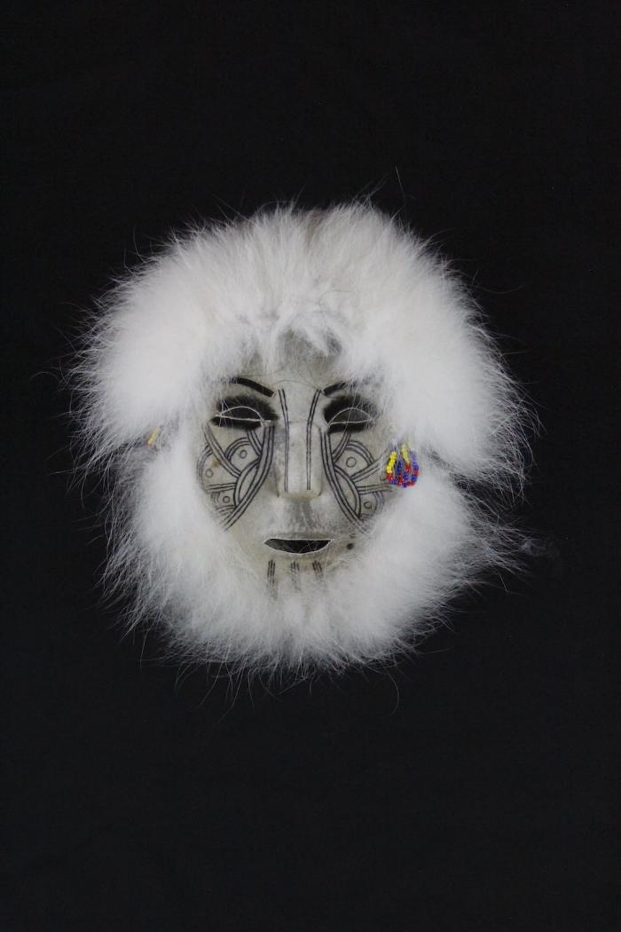
Caribou Skin Mask with Black Ink Tattoos (AC6)

