Slide 1
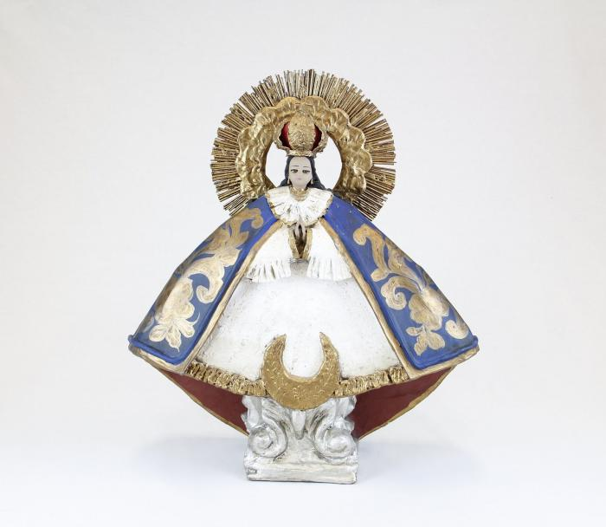
Nuestra Senora de la Salud (CA1)

Slide 2
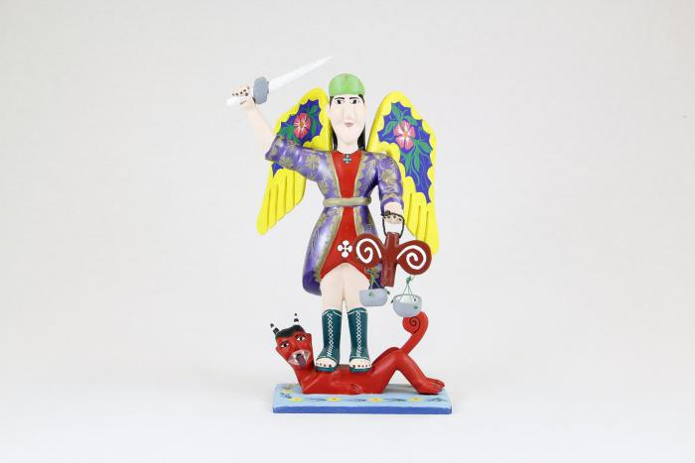
St. Michael with wings, sword and scales (CA2)

Slide 3
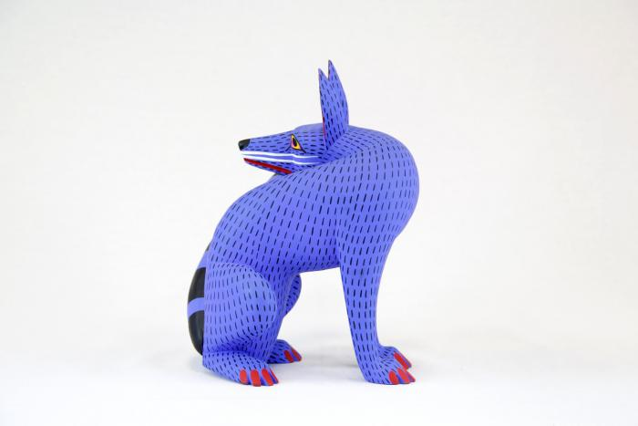
Coyote (CA3)

Slide 4
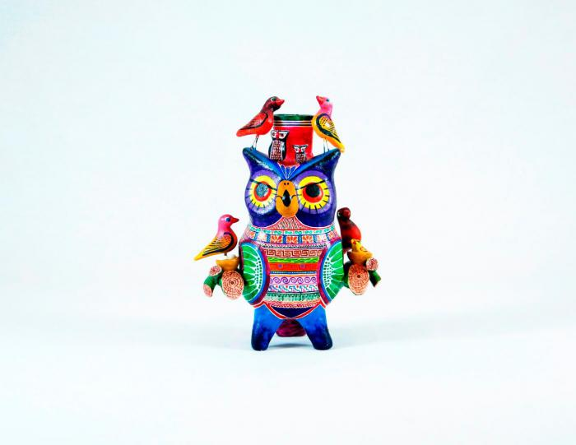
Owl Candleholder (CA4)

Slide 5
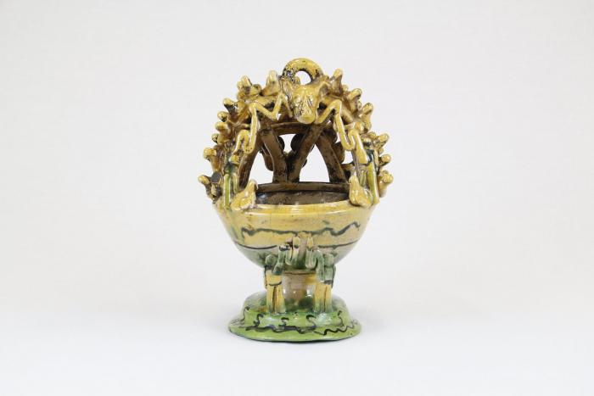
Mayolica Incense Burner (CA5)

Slide 6
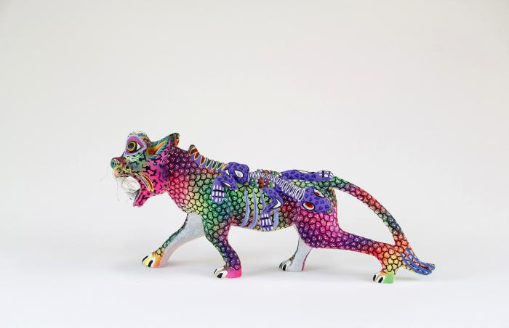
Whiskered jaguar with lizard (CA6)

Slide 7
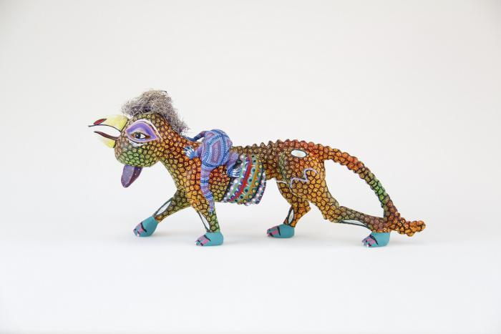
Rooster headed jaguar with lizard (CA7)

Slide 8
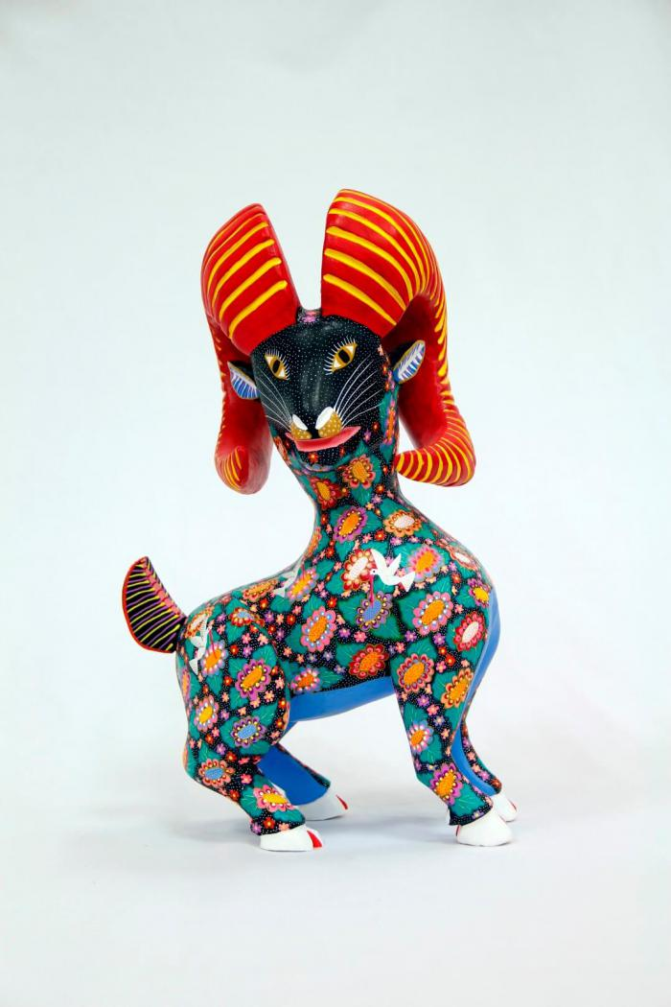
Horned goat (CA8)

Slide 9
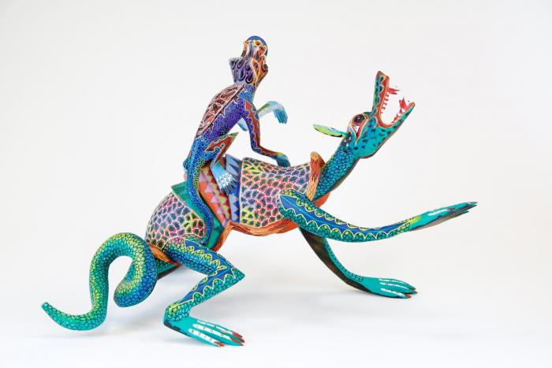
Two lizards (CA9)

Slide 10
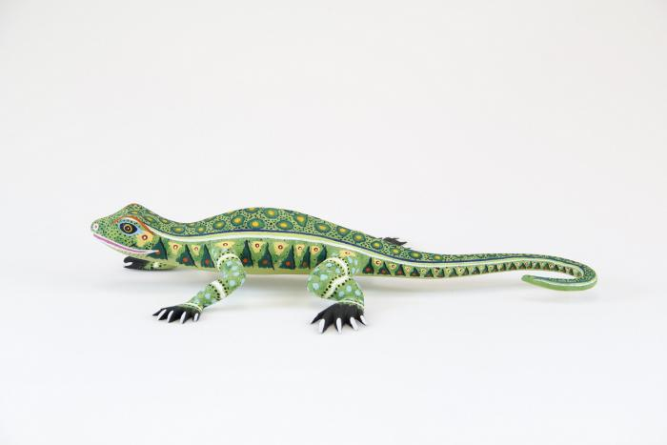
Lizard (CA10)

Slide 11
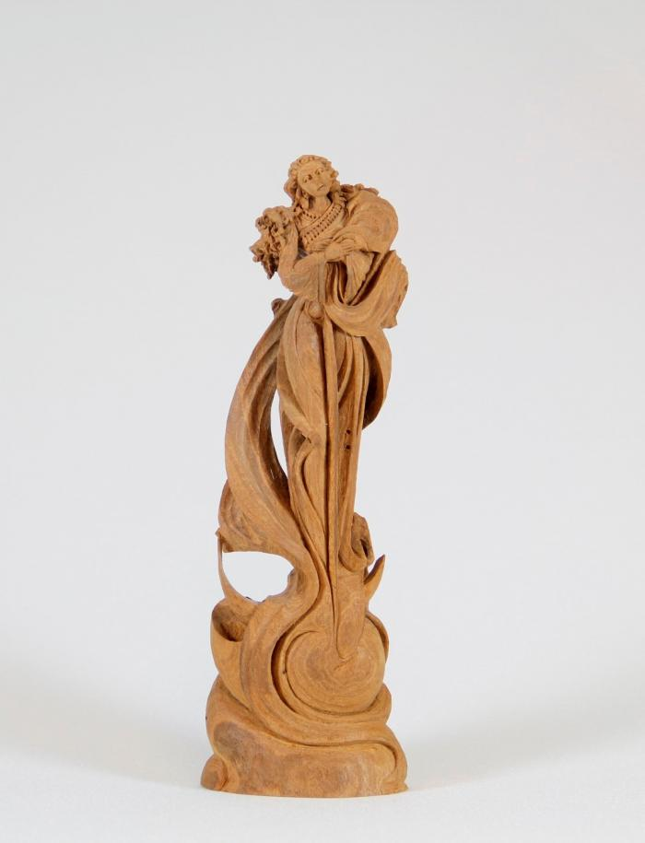
Angel (CA11)

Slide 12
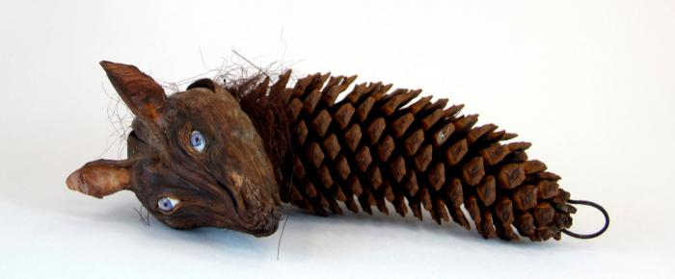
wolf head on pine cone (CA12)

Slide 13
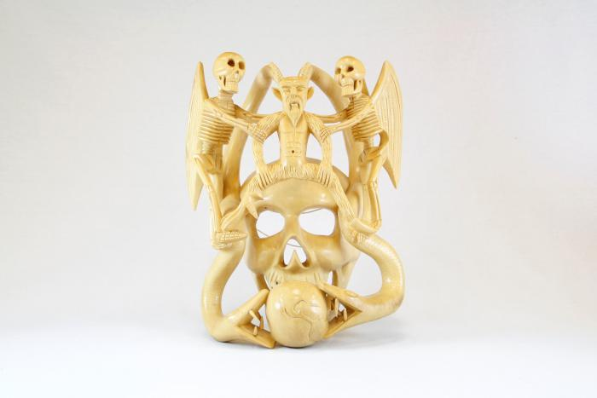
Skull mask (CA13)

Slide 14
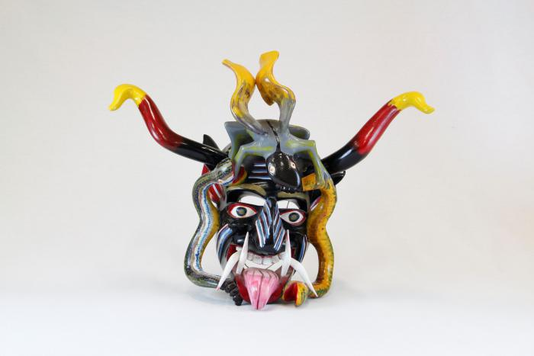
Devil mask with 2 snakes, horns (CA14)

Slide 15
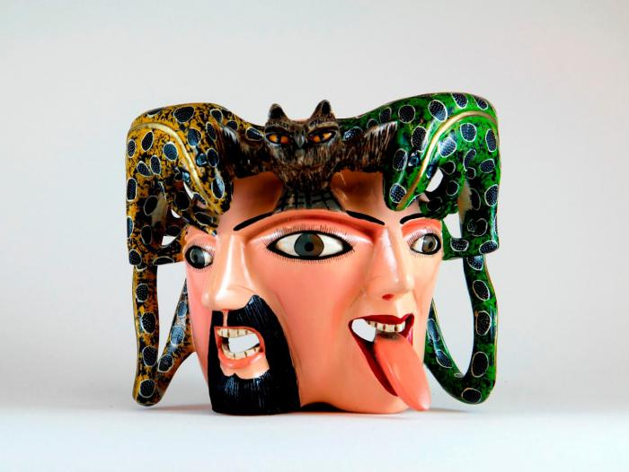
Male / female mask owl and lizards on top (CA15)

Slide 16
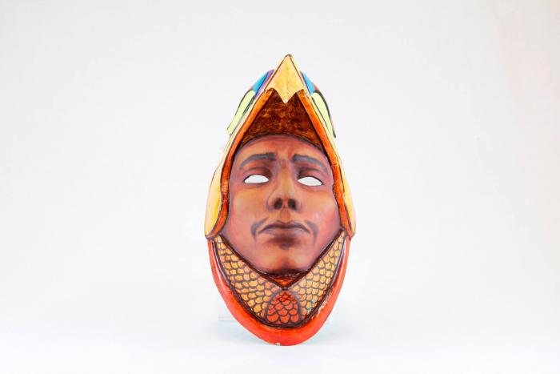
Eagle Warrior mask (CA16)

Slide 17
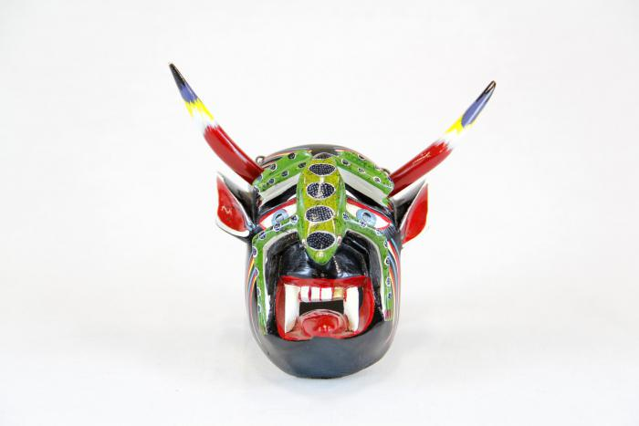
Small devil mask with green lizard (CA17)

Slide 18
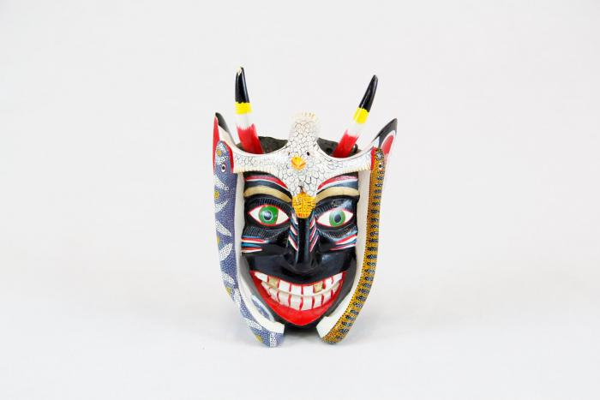
Small black devil mask with bird (CA18)

Slide 19
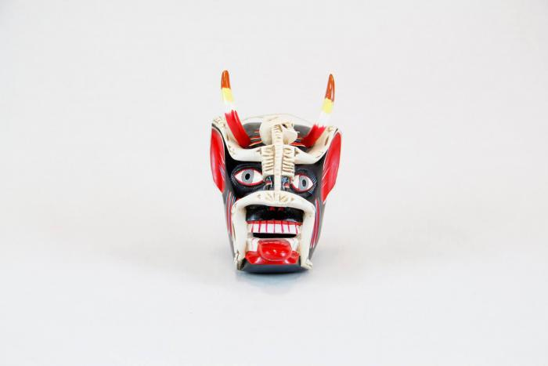
Small devil mask with skeleton (CA19)

Slide 20
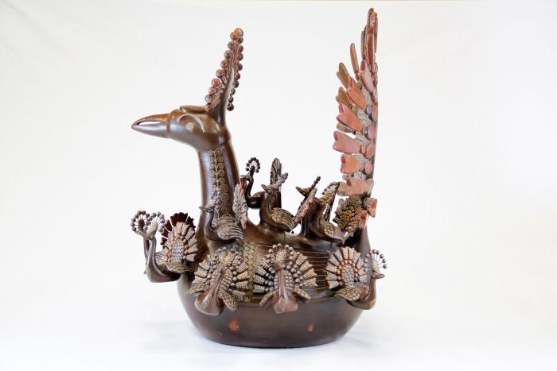
Peacock and Babies (CA20)

Slide 21
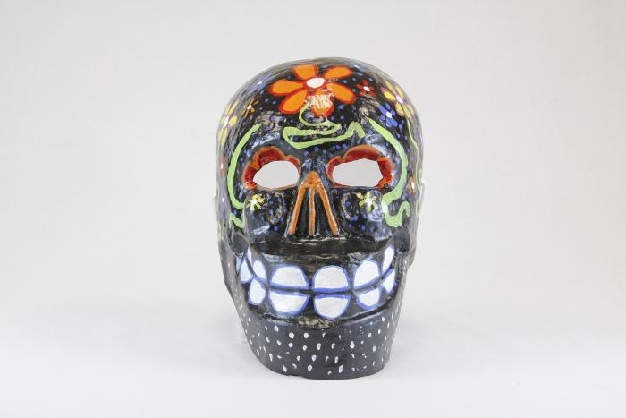
Large black skull mask with flowers (CA21)

Slide 22
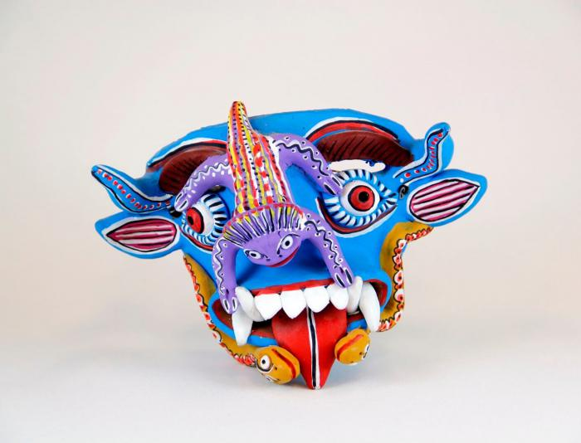
Blue Devil mask (CA22)

Slide 23
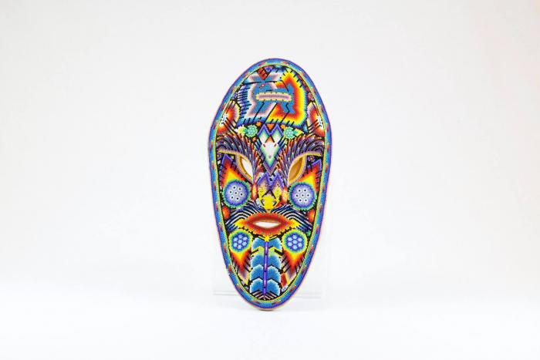
Huichol mask (CA23)

Slide 24
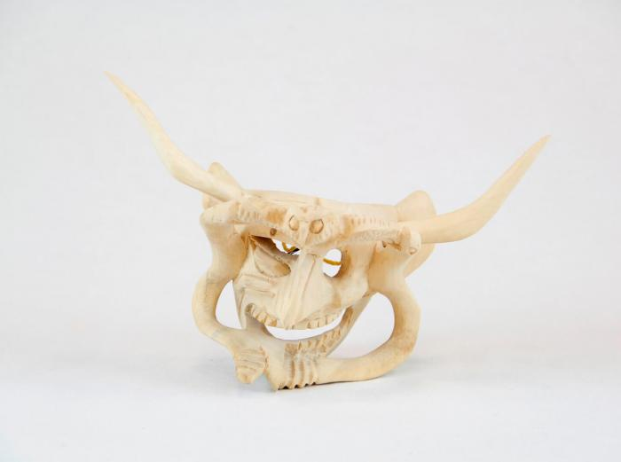
Devil Mask w/ two serpents and owl (CA24)

Slide 25
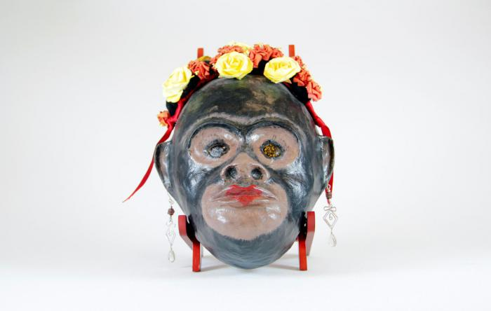
Monkey mask with flowers and earrings (CA25)

Slide 26
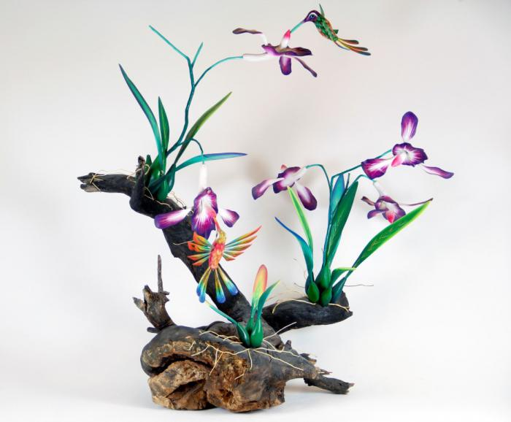
Orchid and Hummingbirds on driftwood base (CA26)

Slide 27
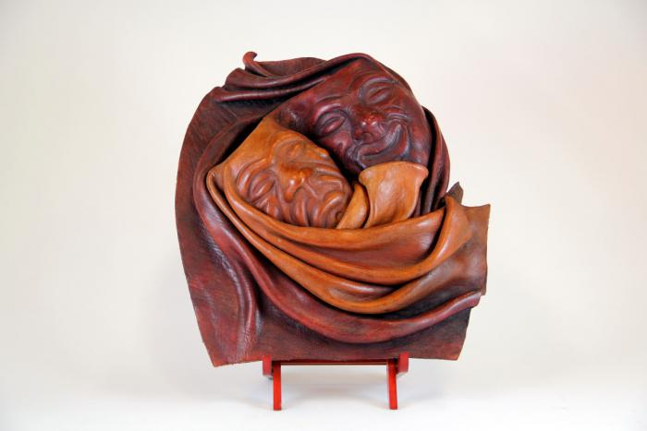
"Good Times / Bad Times" Mask (CA27)

Slide 28
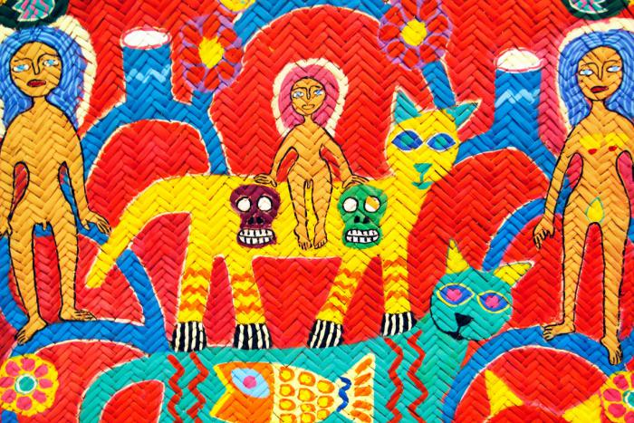
Woven Tree of Life Mat (CA28)

