Slide 1
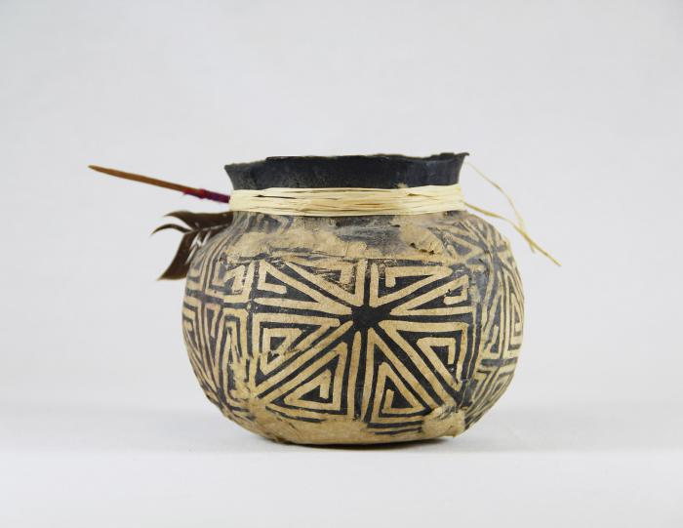
Cream & White Pot (MU3482)

