Slide 1
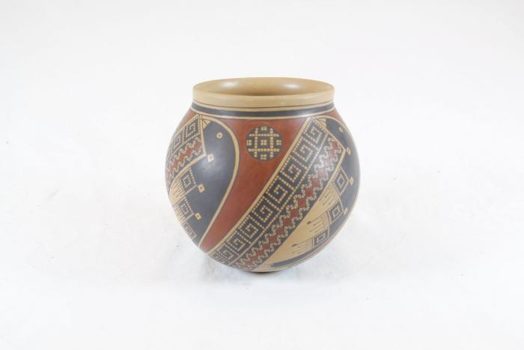
Black and Red Vase (SH23)

