Slide 1
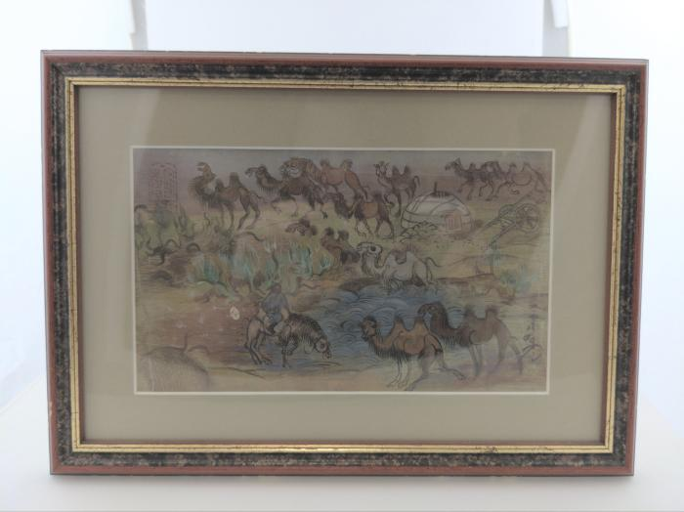
Tibetan Camels Print (FR32)

