Slide 1
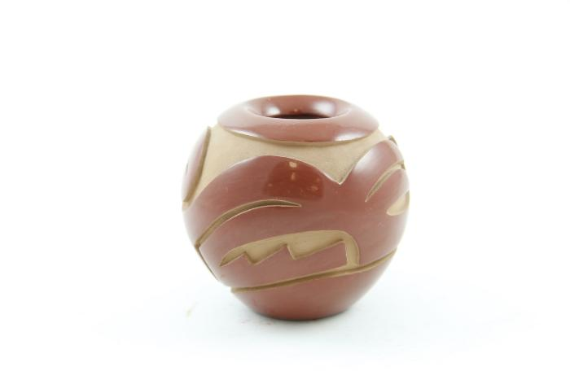
Small Red Vase (SH110)

Slide 2
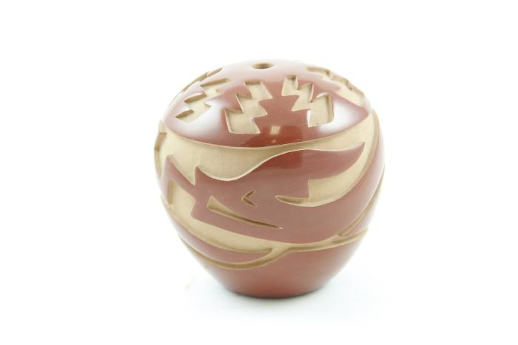
Small Red Vase (SH111)

