Slide 1
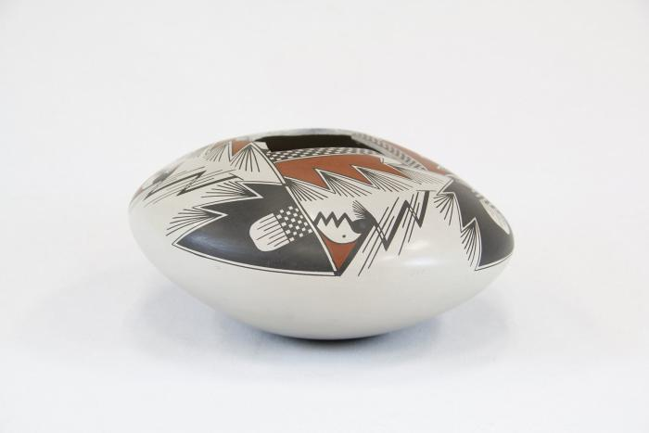
Burnished Pot from Mata Ortiz, Chihuahua (MU3478)

