Slide 1
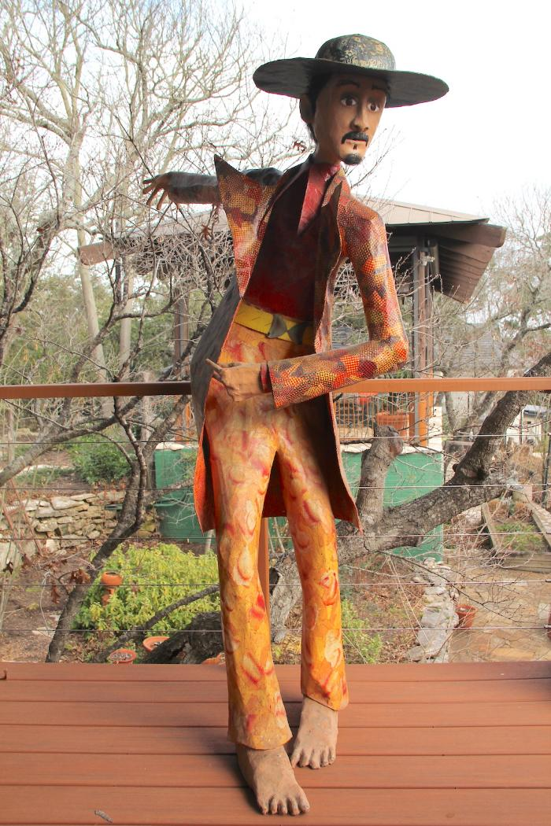
Three Figures (DA1)

