Slide 1
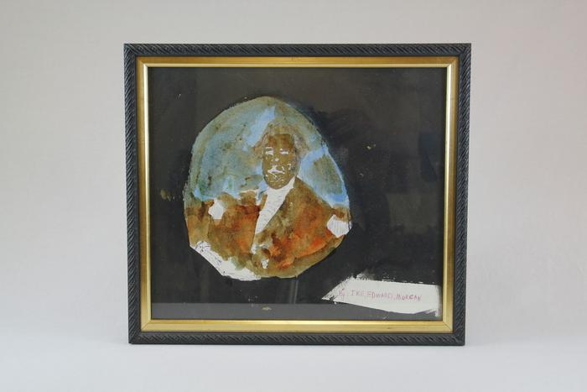
George Washington (EH21)

Slide 2
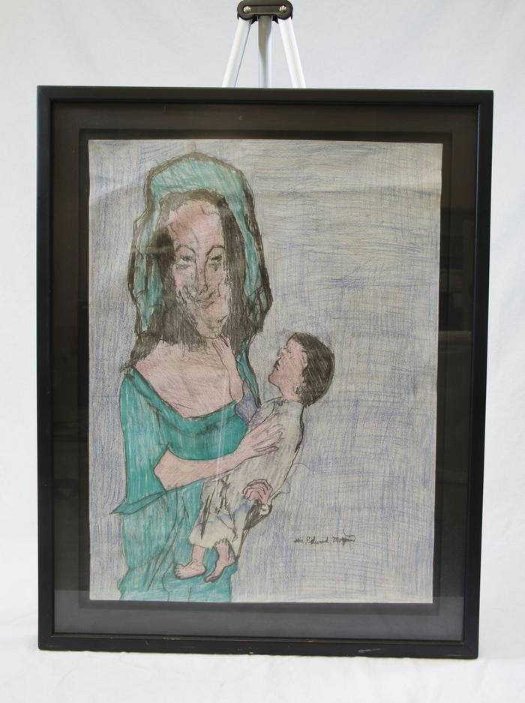
Woman and Child (EH32)

