Slide 1
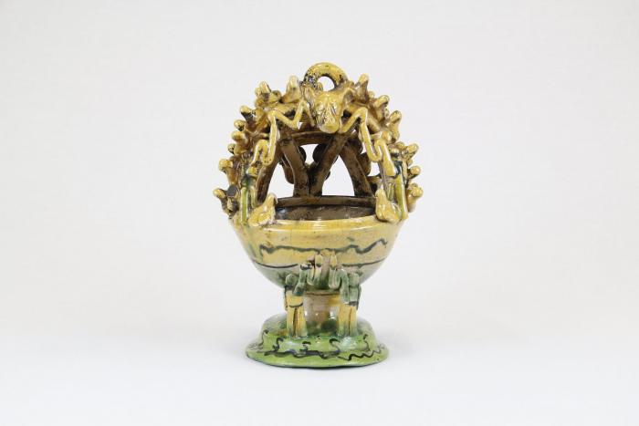
Mayolica Incense Burner (CA5)

Slide 2
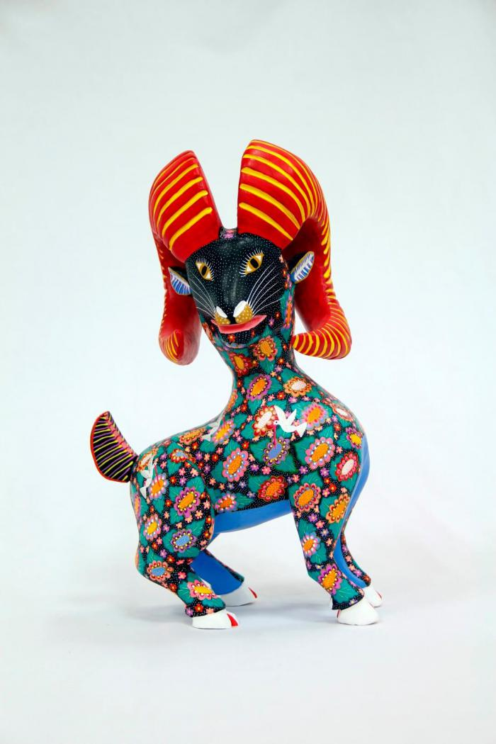
Horned goat (CA8)

Slide 3
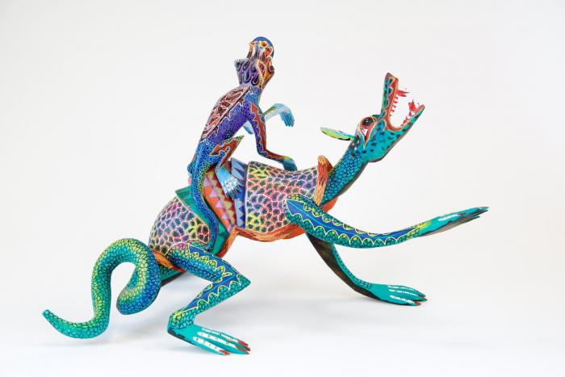
Two lizards (CA9)

Slide 4
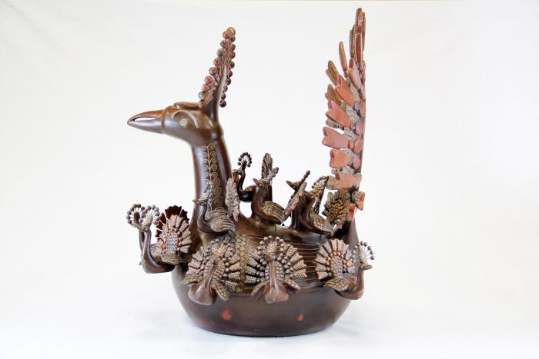
Peacock and Babies (CA20)

Slide 5
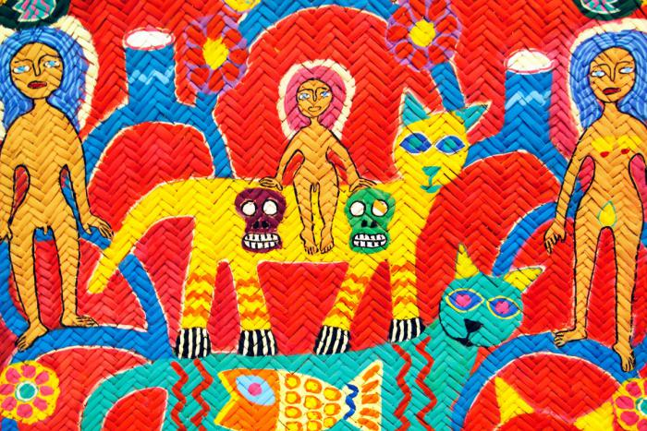
Woven Tree of Life Mat (CA28)

Slide 6
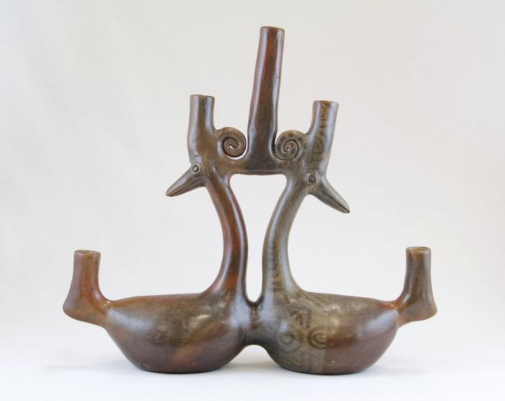
Parallel Ducks Candelabra (JO6)

Slide 7
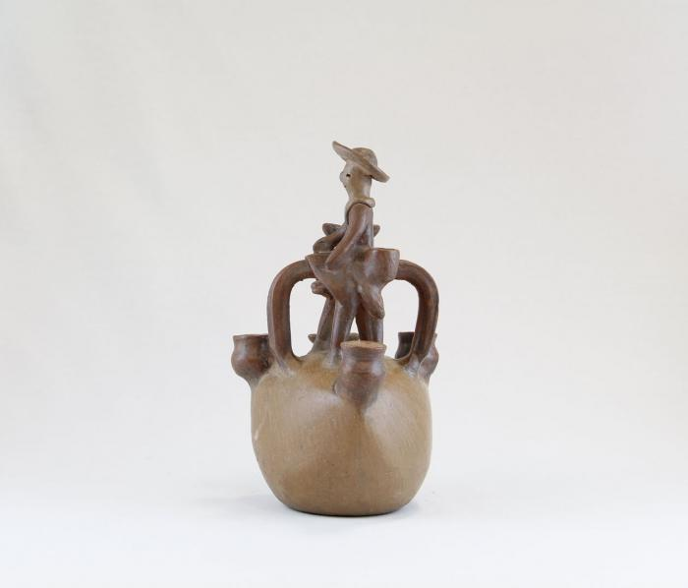
Man on Horse Candelabra (JO10)

Slide 8
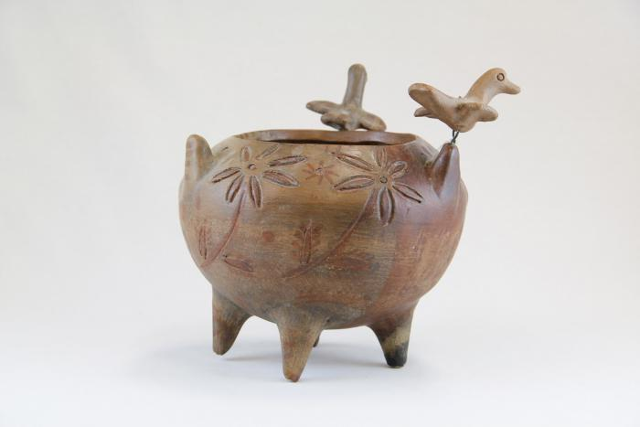
Incised Pot with Three Birds (JO11)

Slide 9
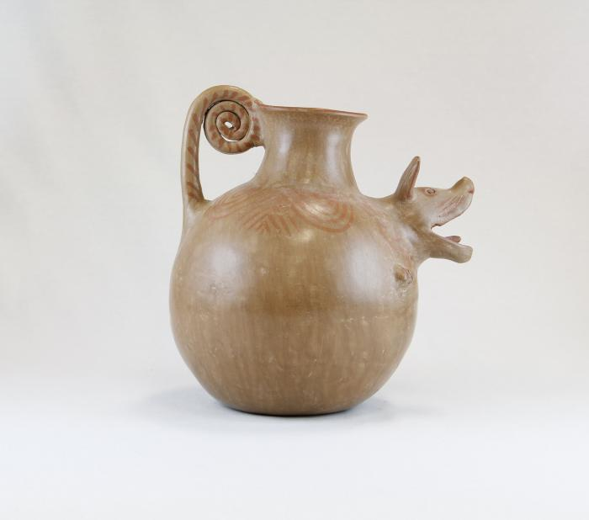
Barking Dog Pot (JO12)

Slide 10
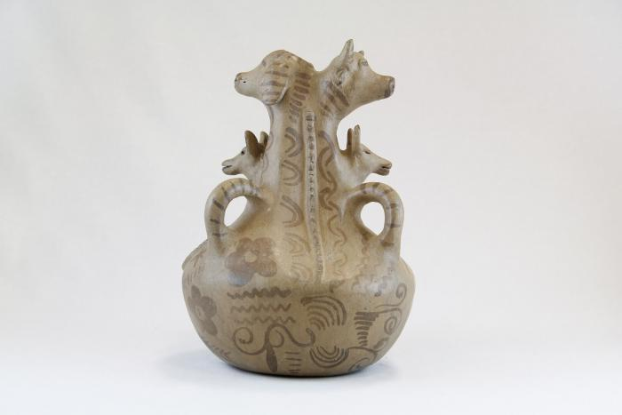
Three Dogs and a Cow Pot (JO13)

Slide 11
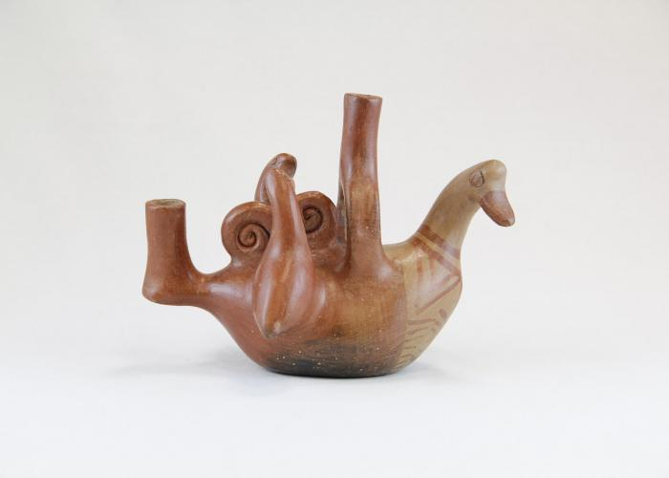
Bird and Two Baby Birds Candelabra (JO25)

Slide 12
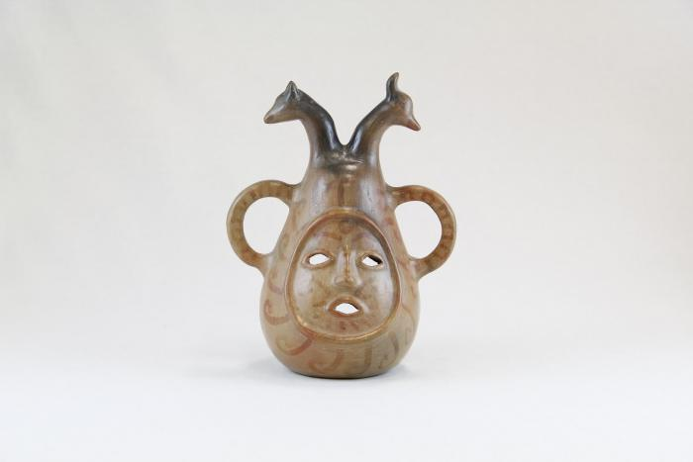
Face and Two Animal Head Candelabra (JO31)

Slide 13
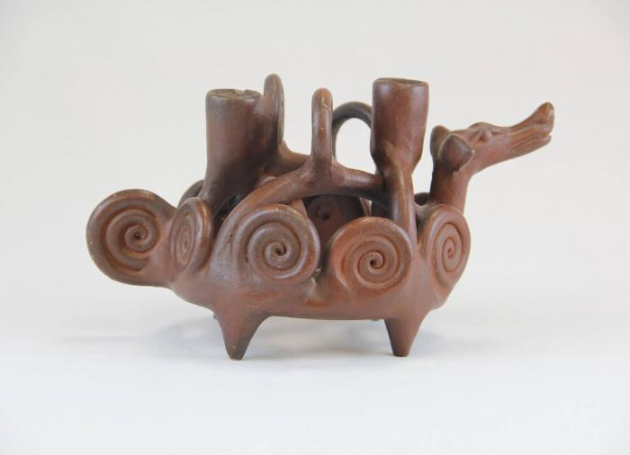
Dog Candelabra with Curled Designs (JO32)

Slide 14
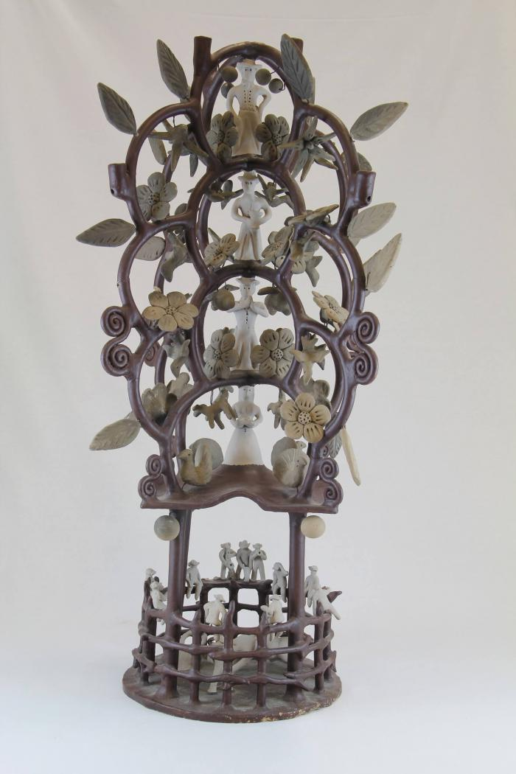
Circular Tree Candelabra (JO59)

Slide 15
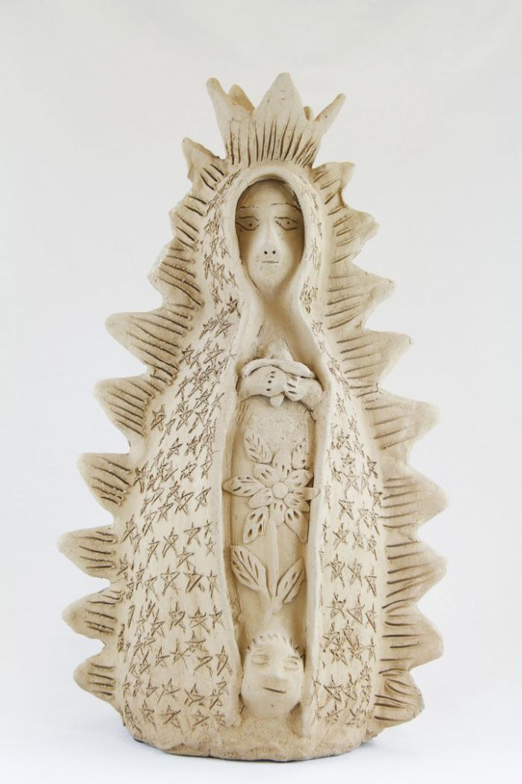
Virgen de Guadalupe (M1031)

Slide 16
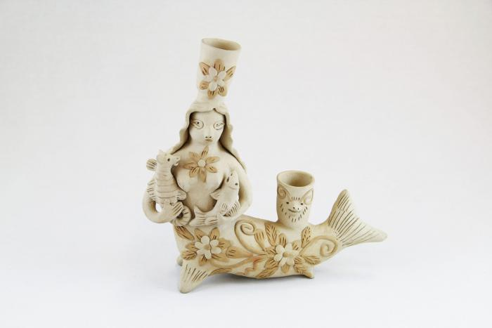
Mermaid Candelabra (M1033)

Slide 17
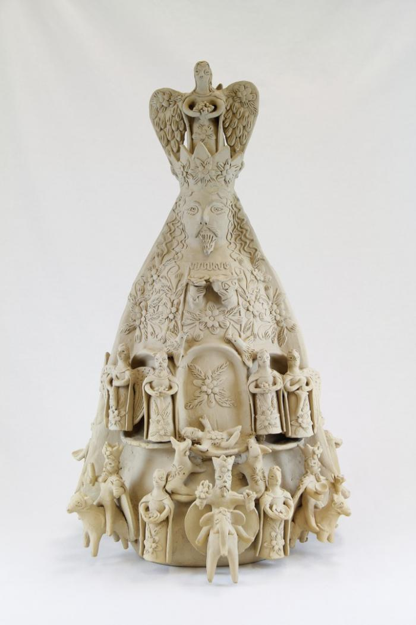
Two Sided Sculpture with Nativity Scenes (M1036)

Slide 18
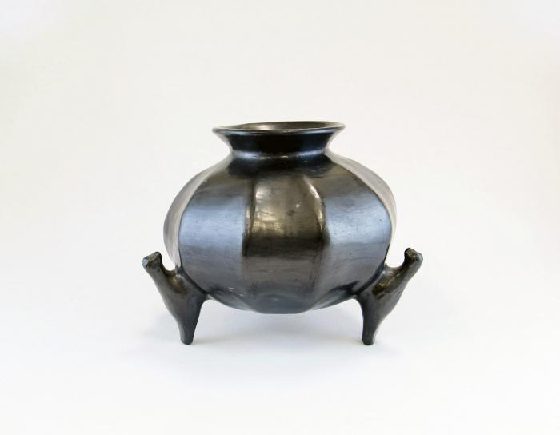
Barro Negro Round Pot (M1092)

Slide 19
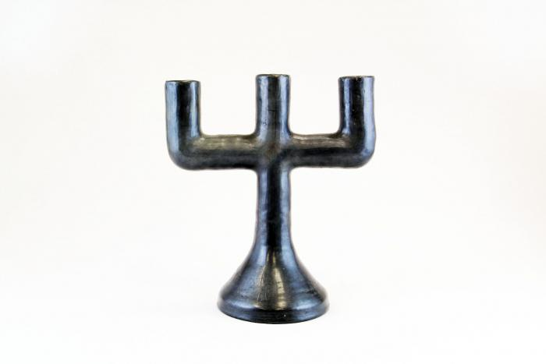
Barro Negro Candelabra (M1109)

Slide 20
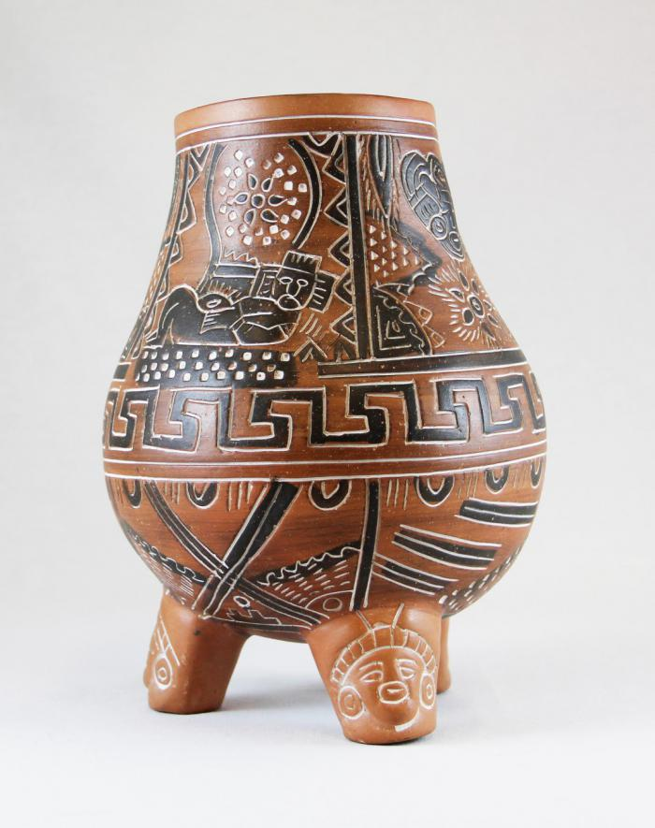
Vessel with Pre-Columbian Designs (M1111)

Slide 21
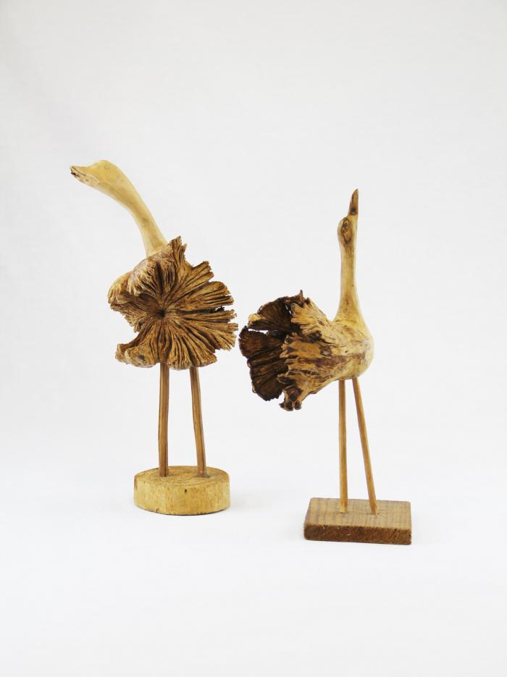
Two Wood Carved Birds (M1552)

Slide 22
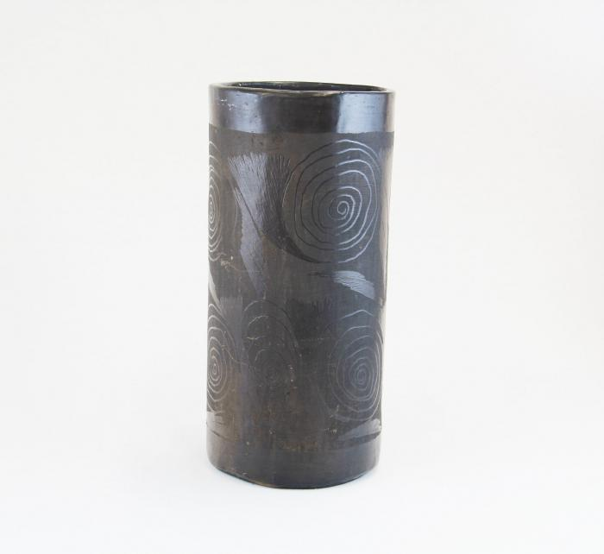
Barro Negro Vase (M1605)

Slide 23
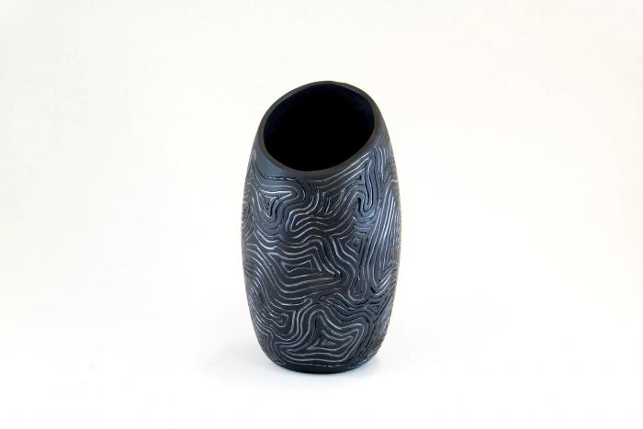
Barro Negro Incised Vase (M1607)

Slide 24
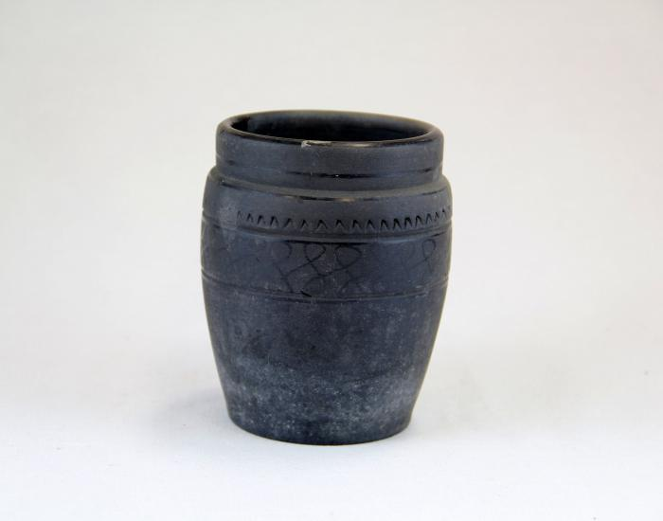
Barro Negro Pot (M1608)

Slide 25
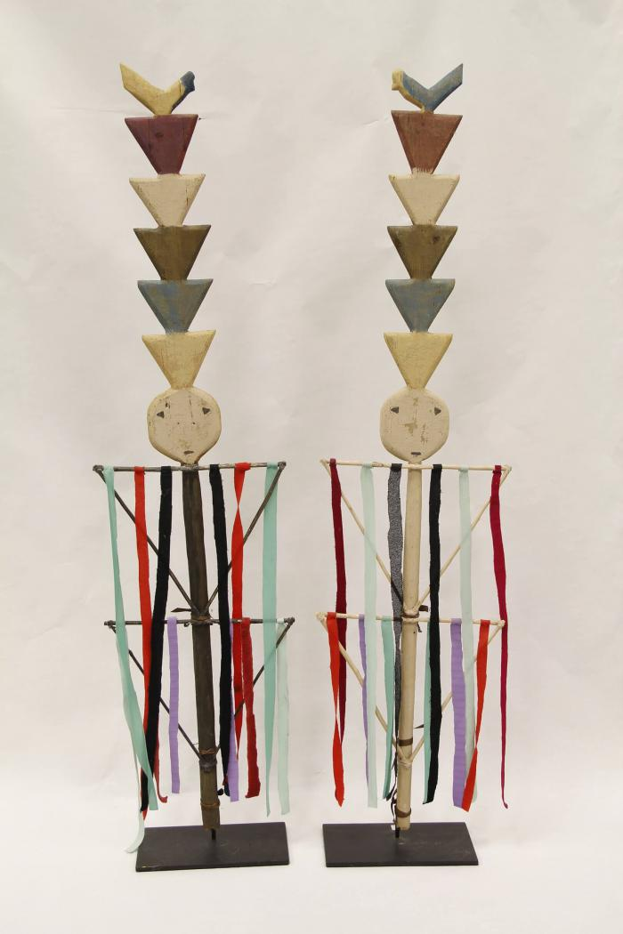
Two Navajo Dance Wands (MU3471)

Slide 26
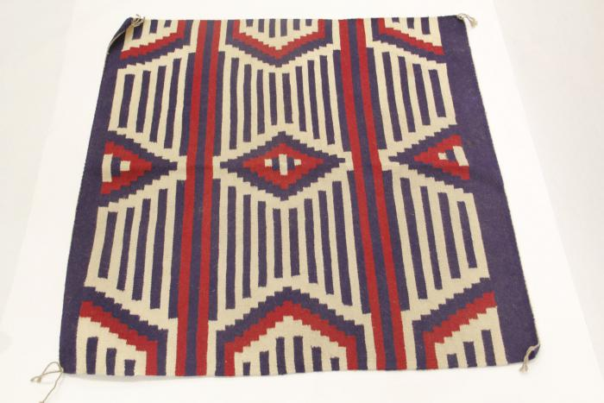
Navajo Chief's Blanket Third Phase (MU3473)

Slide 27
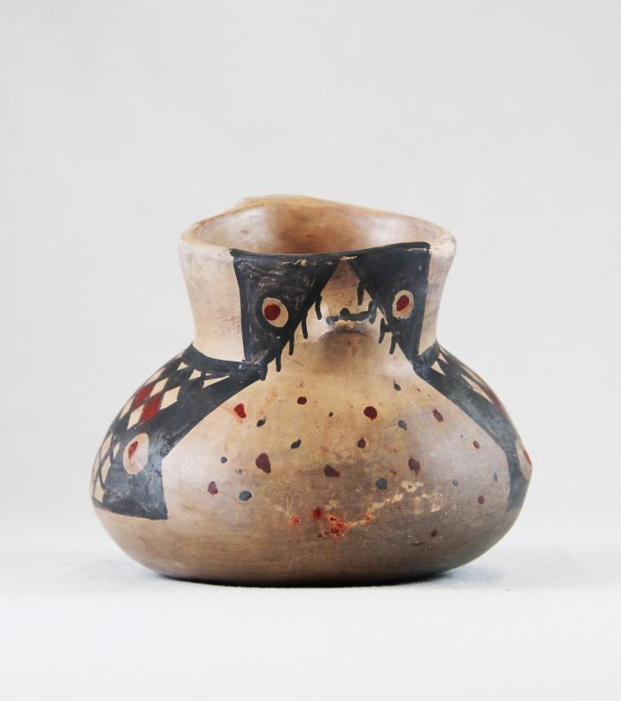
Diaguita Duck Pitcher (MU3477)

Slide 28
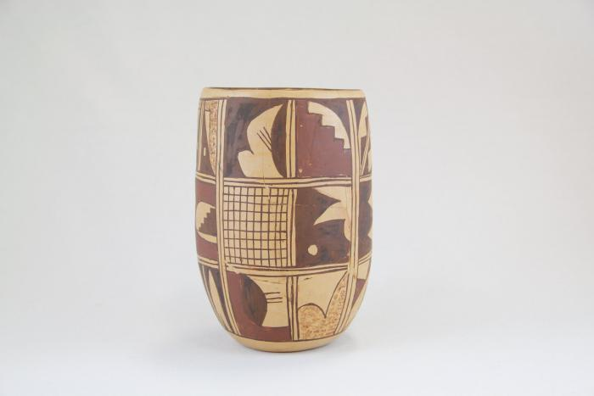
Zuni Burnished Pot (MU3479)

Slide 29
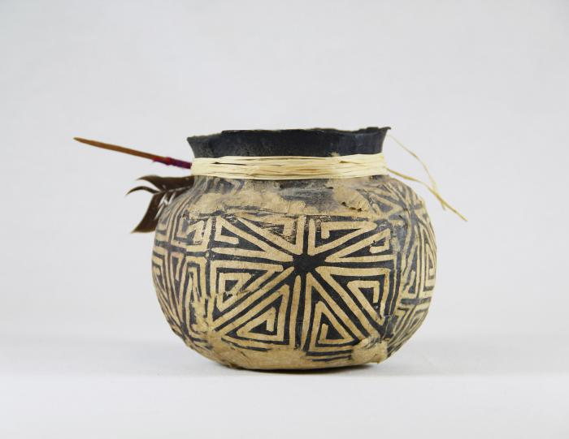
Cream & White Pot (MU3482)

Slide 30
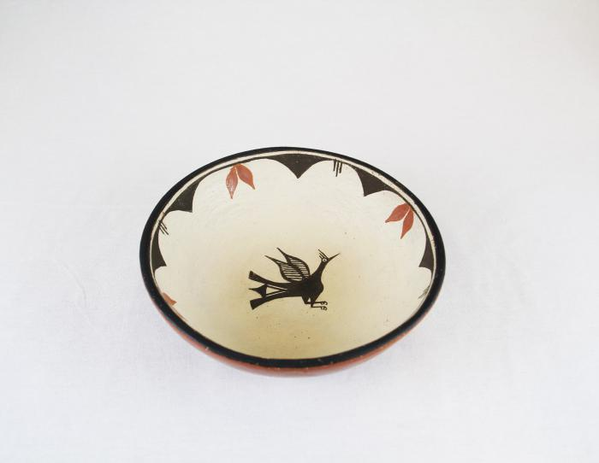
Terra Cotta Bowl with Bird in Center (MU3483)

Slide 31
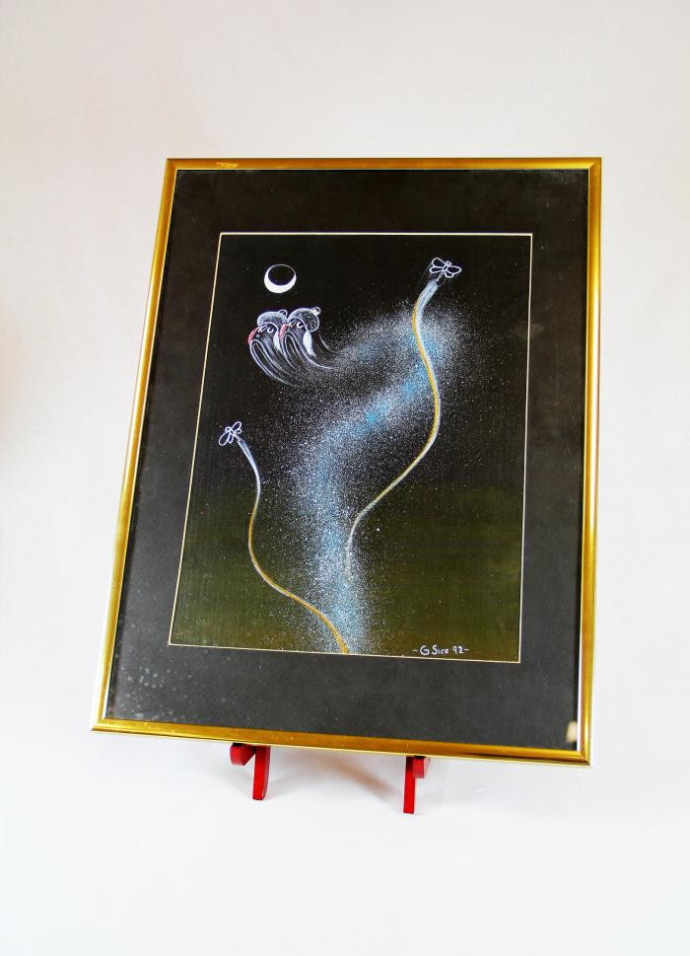
"4th World" Painting (MU3523)

Slide 32
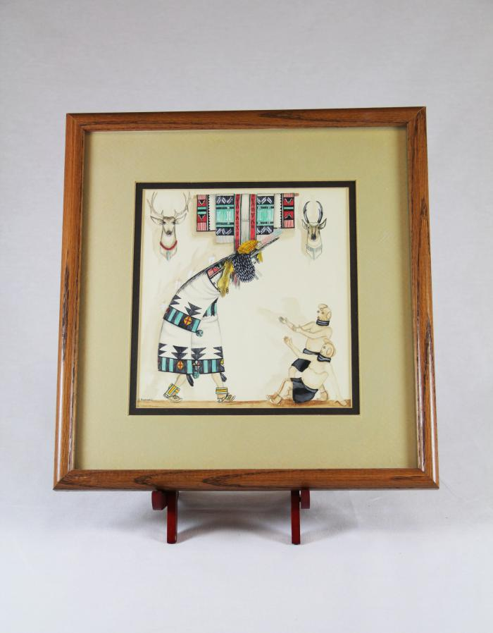
Zuni Shalako Kachina Painting (MU3525)

Slide 33
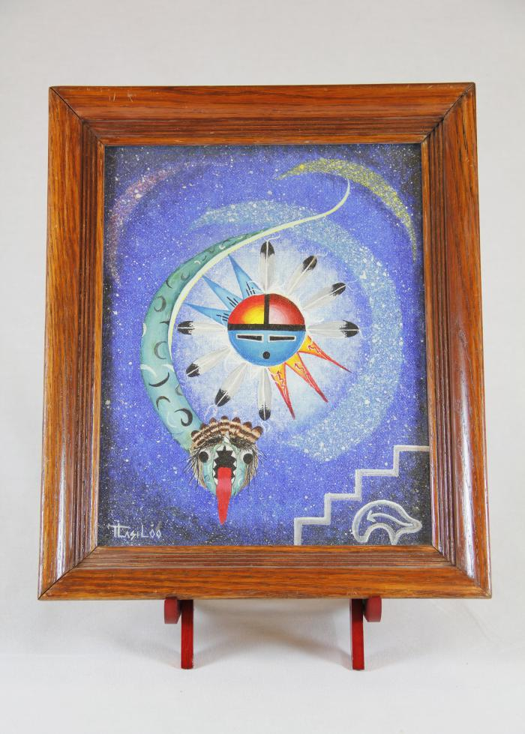
Sun Father and Snake Painting (MU3526)

Slide 34
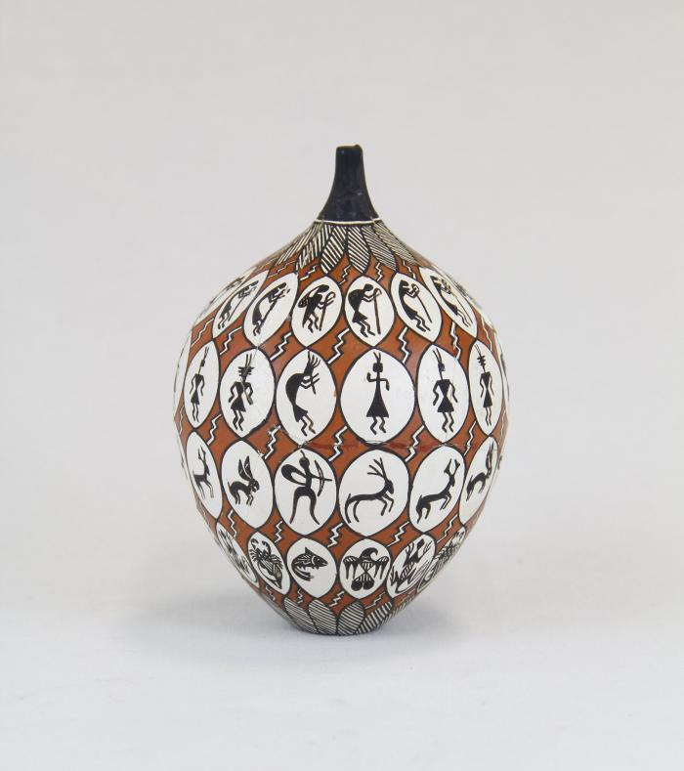
Storytelling Painted Pot (MU14)

Slide 35
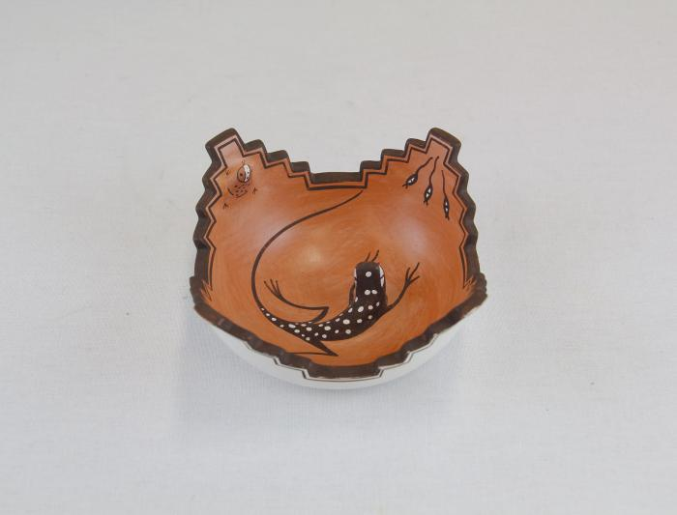
Zuni Pot with Lizard in Center (MU15)

Slide 36
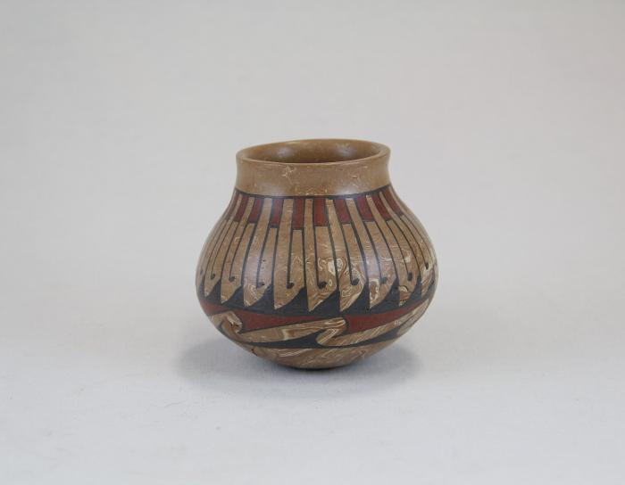
Repeated Wave Pot (MU16)

Slide 37
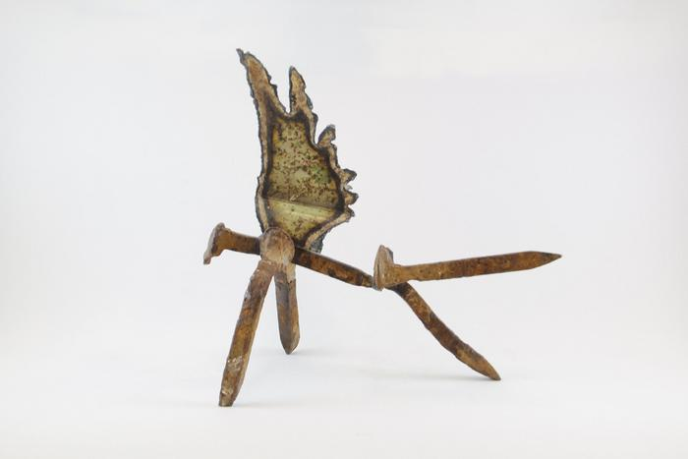
Angel (EH9)

Slide 38
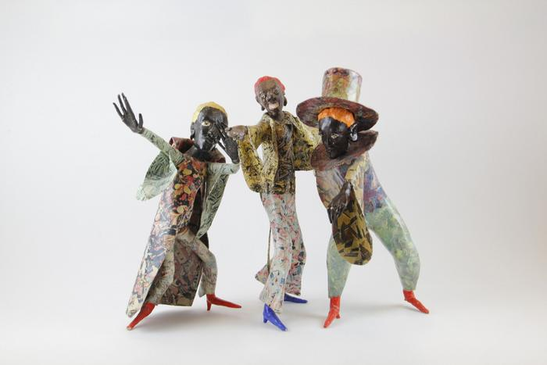
Three Minstrels (EH10)

Slide 39
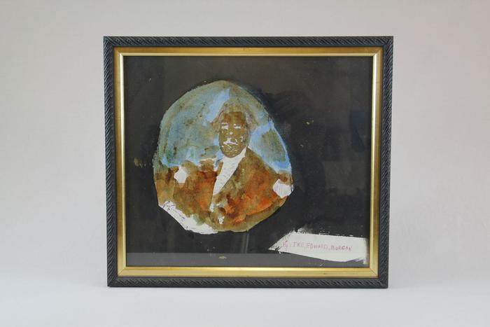
George Washington (EH21)

Slide 40
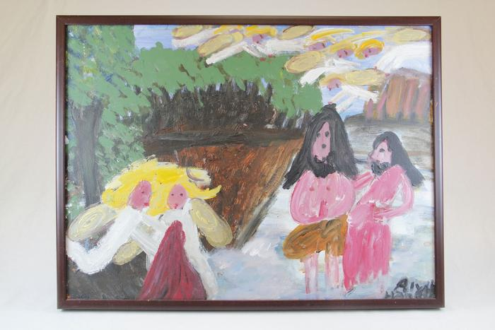
John the Baptist, with Yellow Haired Angels (EH22)

Slide 41
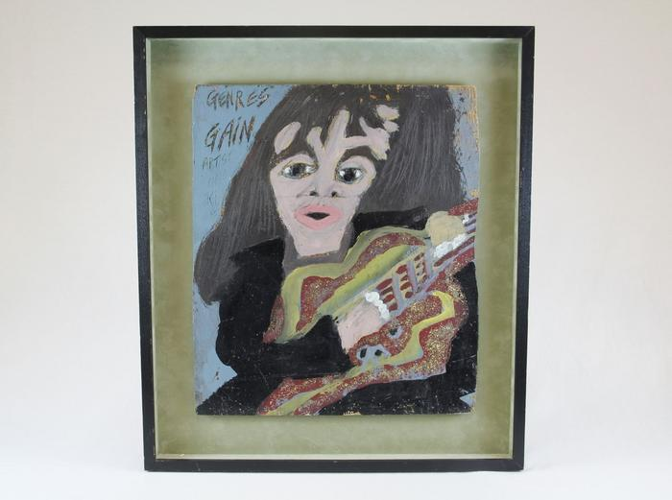
Woman Guitarist (EH23)

Slide 42
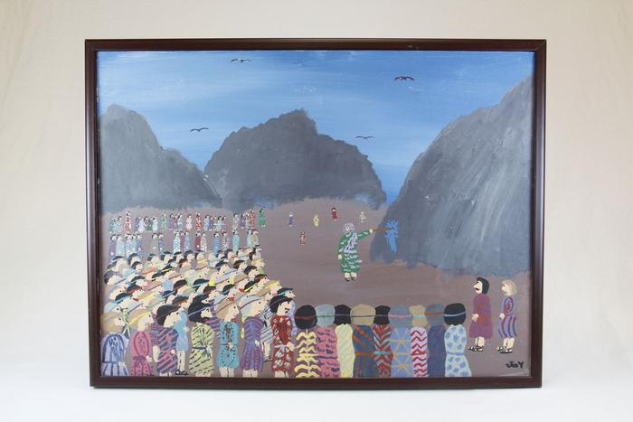
Moses Strikes the Rock at Kadesh (EH24)

Slide 43
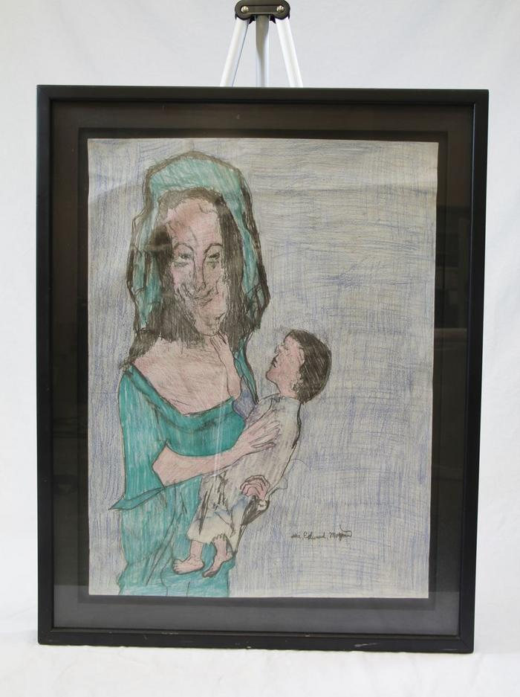
Woman and Child (EH32)

Slide 44
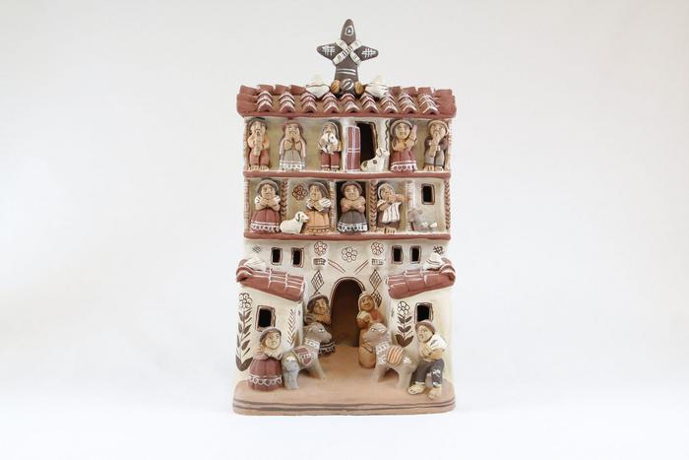
Peruvian Church with Market Scene (SE51)

Slide 45
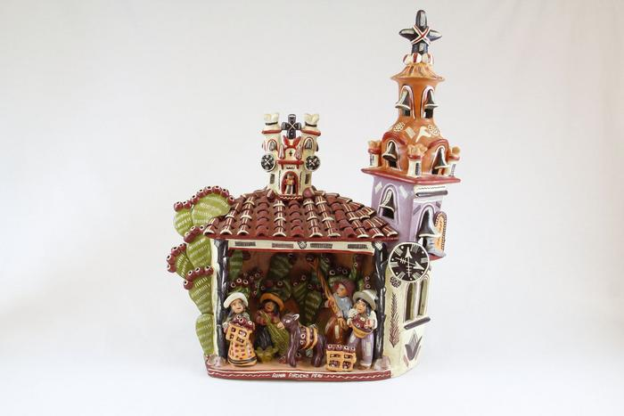
Peruvian Church with Multiple Small Figures (SE53)

Slide 46
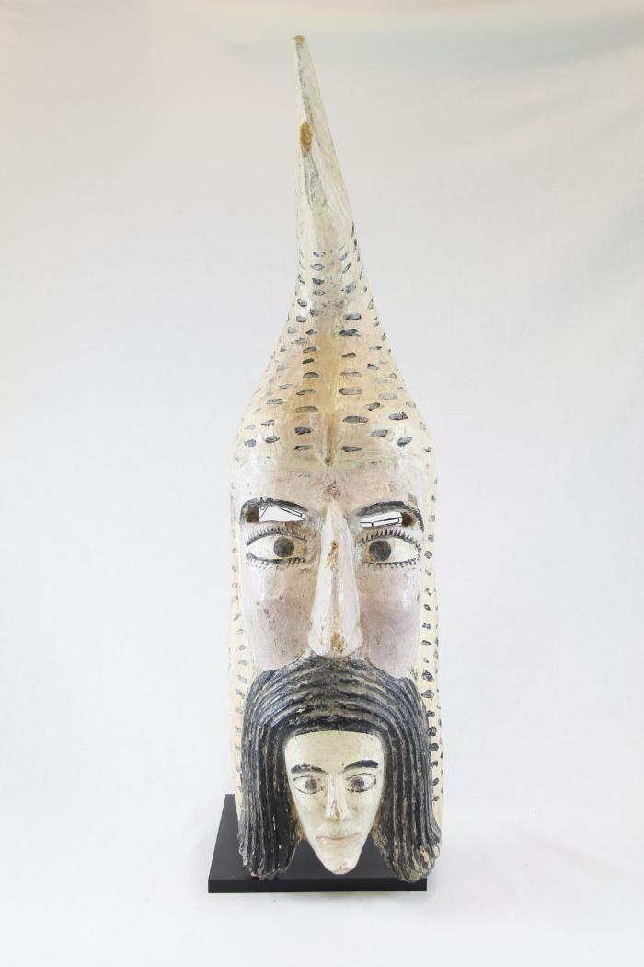
Mermaid Mask (PR4)

Slide 47
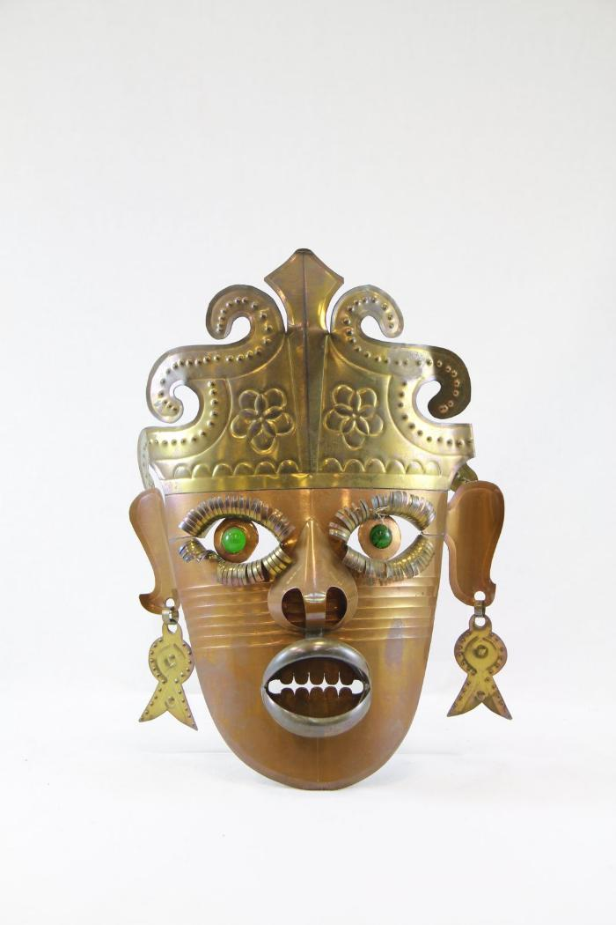
Tin Mask (PR11)

Slide 48
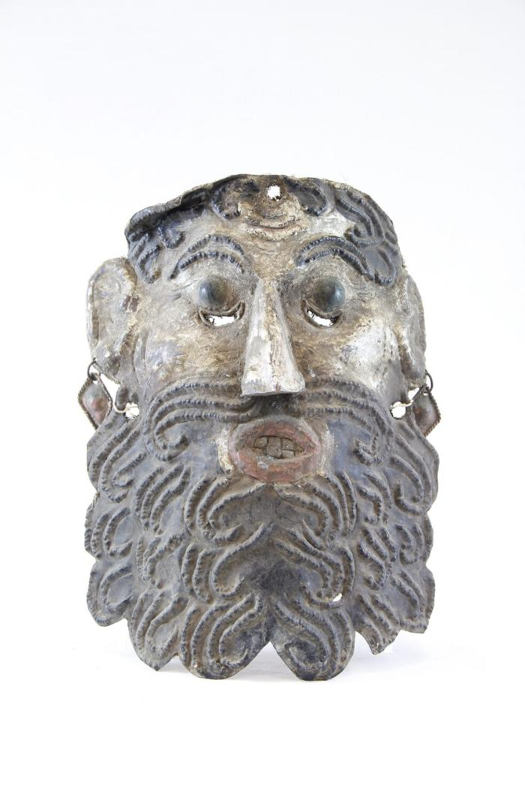
El Barbón Mask (PR12)

Slide 49
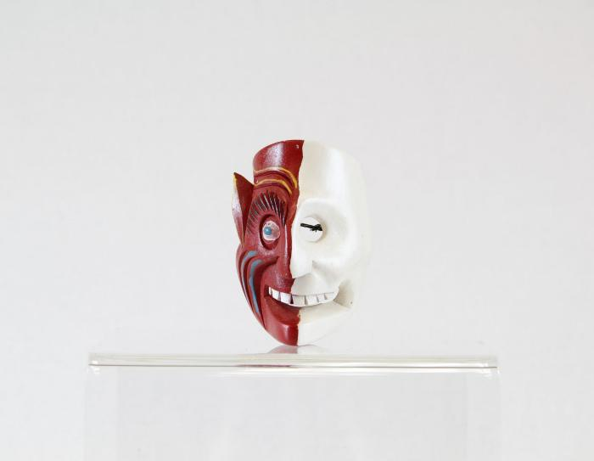
Diablo-Calavera (Devil-Skull) Mask (PR15)

Slide 50
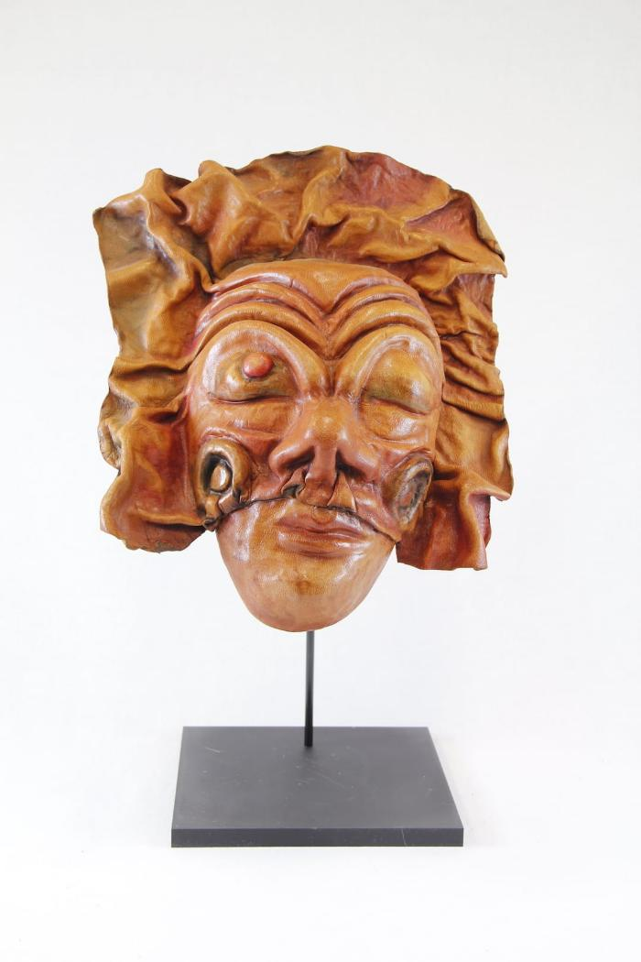
Leather Mask (PR16)

Slide 51
Blue Devil Mask (PR21)

Slide 52
Devil Mask (PR24)

Slide 53
Moon and Star Ceramic Mask (PR26)

Slide 54
Stars Ceramic Mask (PR27)

Slide 55
Venezuelan Tribal Mask (PR28)

Slide 56
Vejigantes Mask (PR31)

Slide 57
Ranga Mask (PR33)

Slide 58
Barong Mask (PR34)

Slide 59
Balinese Long Mask with Lizards (PR36)

Slide 60
Ganesha mask (PR37)

Slide 61
Thai Warrior Mask (PR39)

Slide 62
Foo Dog Wall Hanging (PR41)

Slide 63
Okina Mask (PR45)

Slide 64
Tengu mask (PR46)

Slide 65
Okame (Otafuku) Mask (PR47)

Slide 66
Nojang (monk) mask (PR48)

Slide 67
African Wood Carved Mask (PR50)

Slide 68
Carved Coconut Husk of Man's Head (PR51)

Slide 69
Gemstone Mask (PR53)

Slide 70
Rectangular Wood Mask (PR54)

Slide 71
Monkey Mask (MC12)

Slide 72
Guro Mask (MC13)

Slide 73
African Long Forehead Mask (MC15)

Slide 74
Makonde Shetani Sculpture (SH62)

Slide 75
Garuda (SH66)

Slide 76
Devil Masked Peasant Dancer (SH69)

Slide 77
Impressioned Silver Mask (SHA1)

Slide 78
"Land Carer" (PE1)

Slide 79
Bird House and Flowers (HA1)

Slide 80
Man smoking pipe with cat and flowers (HA2)

Slide 81
Two girls and chickens (HA3)

Slide 82
Cat sits on chair surrounded by flowers (HA4)

Slide 83
Tibetan Camels Print (FR32)

Slide 84
La Fiesta de la Virgen de la Candelaria by Juan Luis Cuyo (FR177)

Slide 85
Angel Etching (FRA1)

Slide 86
Mona Lisa (FRA2)

Slide 87
Blue Planet (FRA3)

Slide 88
Dancing in the Shadows (FRA4)

Slide 89
Huf der Kanter on the Edge (FRA5)

Slide 90
Madonna of the Canon George Vander Pale, Dan Allison (FRA6)

Slide 91
Checkered Woman and Man (FRA7)

