Slide 1
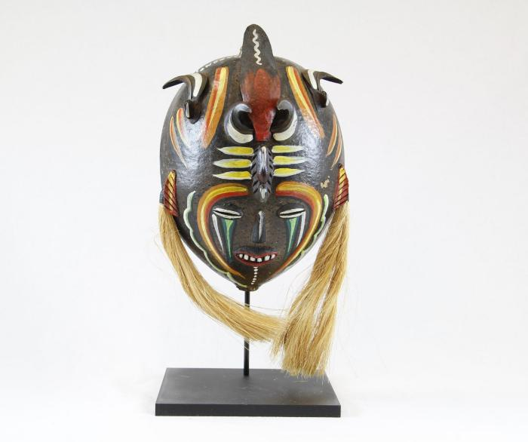
Venezuelan Tribal Mask (PR28)

Slide 2
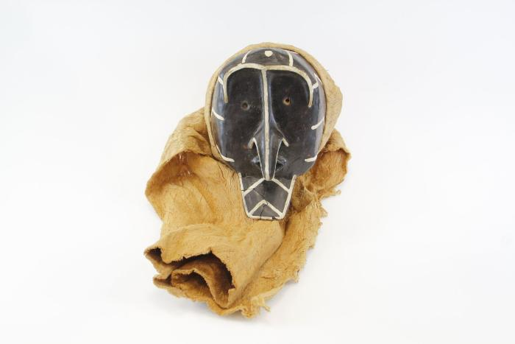
Piaroa Kohue Mask (PR29)

Slide 3
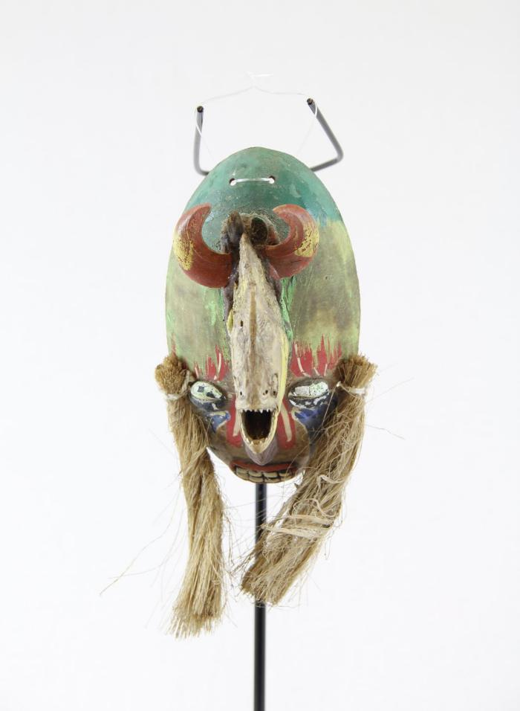
Venezuelan Piranha Mask (MC8)

