Slide 1
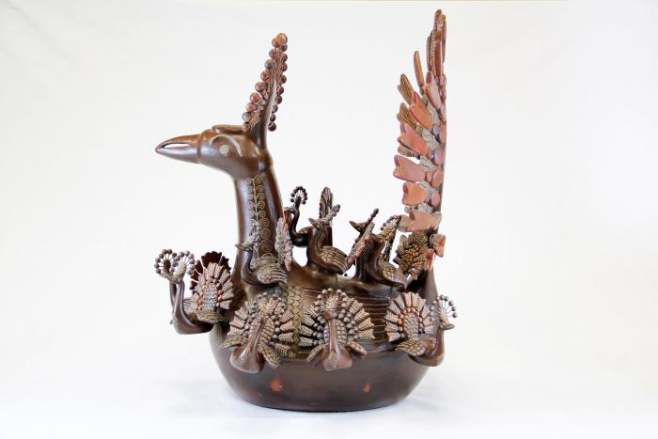
Peacock and Babies (CA20)

Slide 2
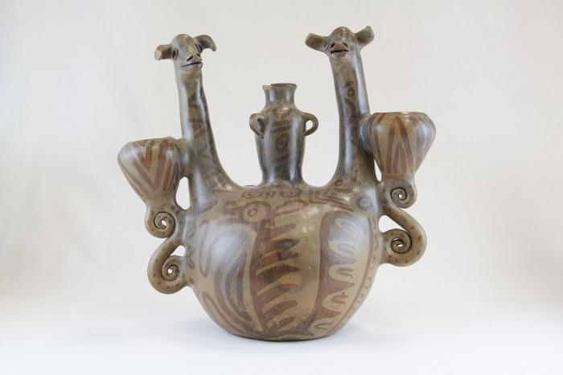
Double Headed Giraffe Candelabra (JO1)

Slide 3
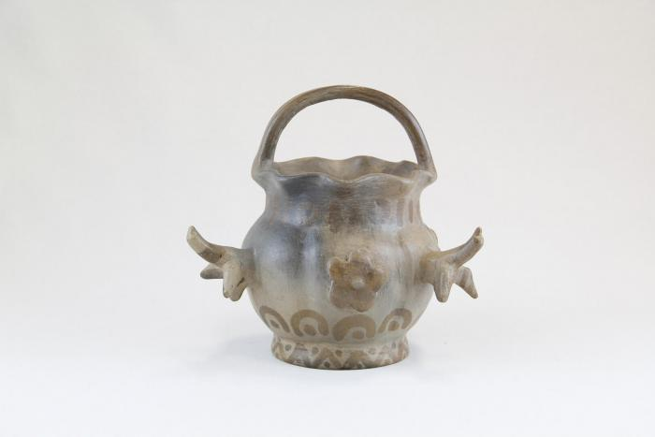
Small Pot with Birds (JO2)

Slide 4
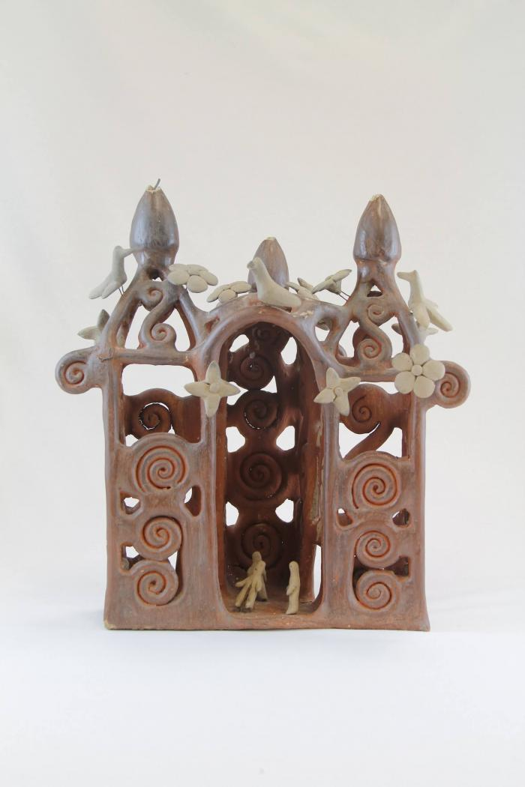
Large Ceramic Church (JO3)

Slide 5
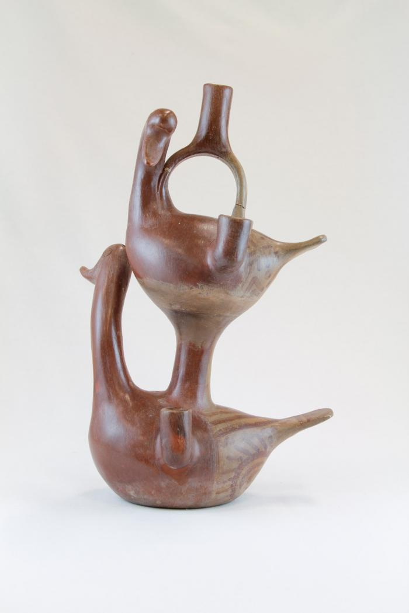
Two Duck Candelabra (JO4)

Slide 6
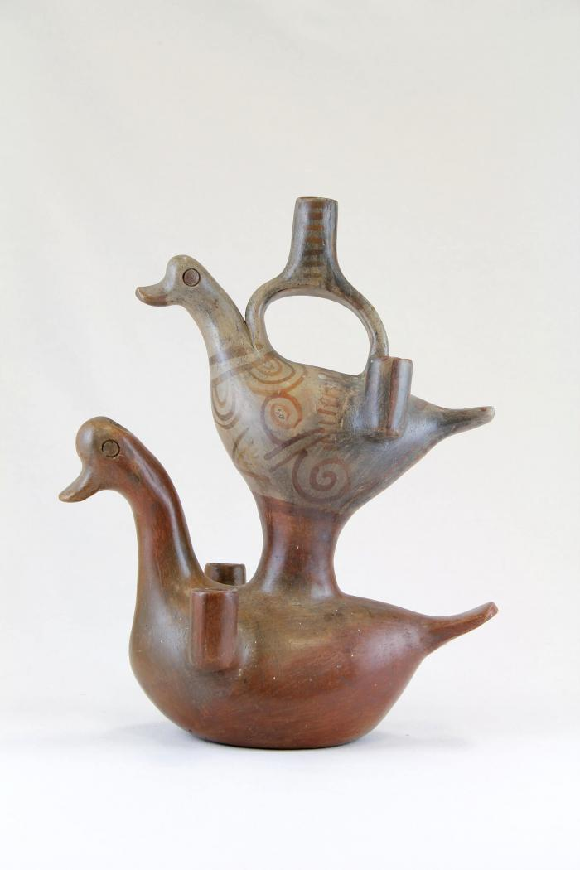
Two Duck Diamond Candelabra (JO5)

Slide 7
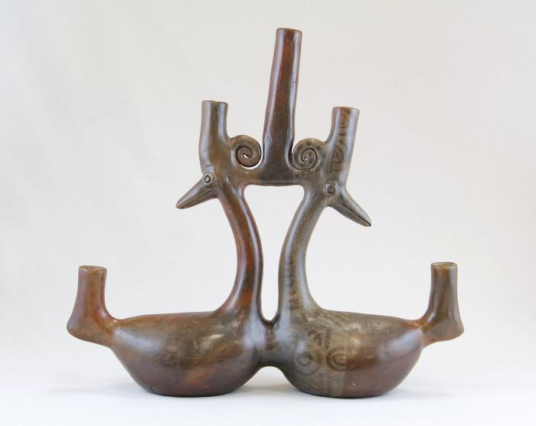
Parallel Ducks Candelabra (JO6)

Slide 8
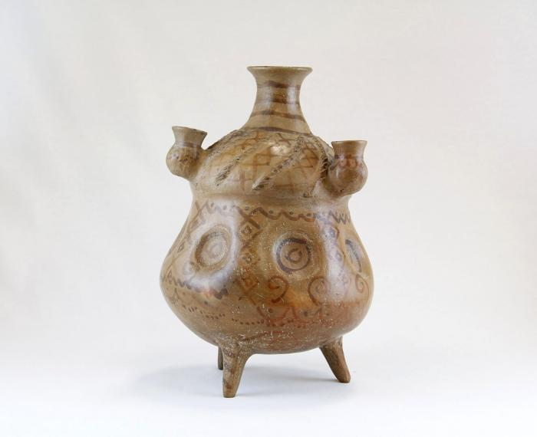
Large Criss Cross Candelabra Pot (JO7)

Slide 9
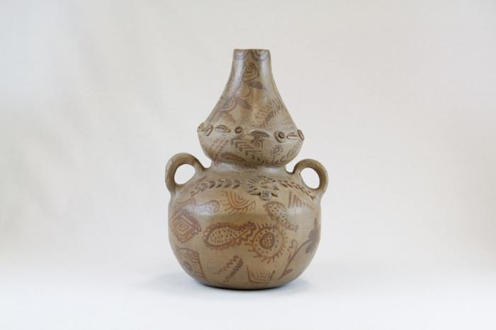
Two Handle Pot with Flowers (JO8)

Slide 10
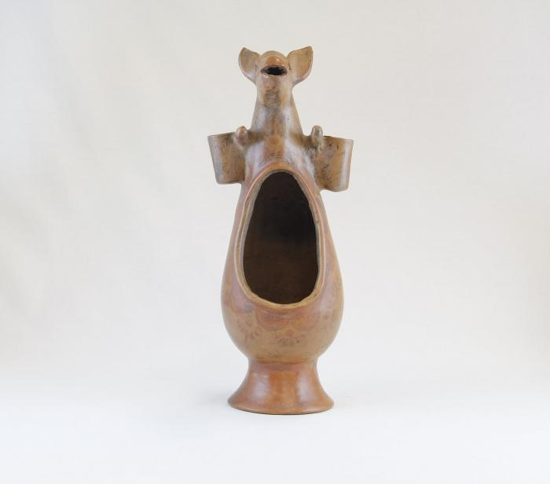
Kangaroo Luminaria (JO9)

Slide 11
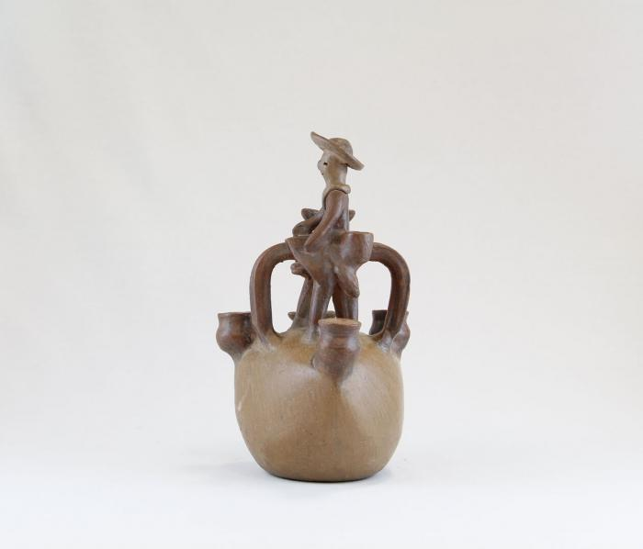
Man on Horse Candelabra (JO10)

Slide 12
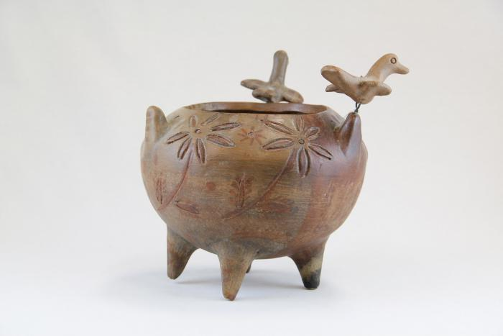
Incised Pot with Three Birds (JO11)

Slide 13
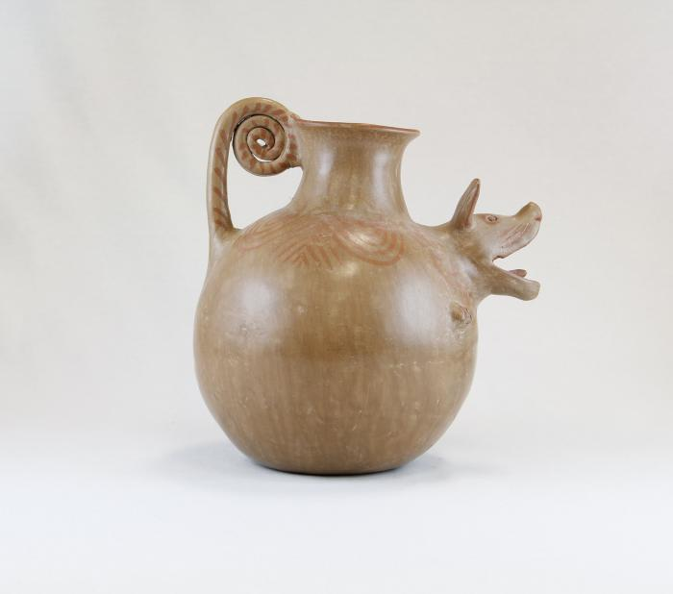
Barking Dog Pot (JO12)

Slide 14
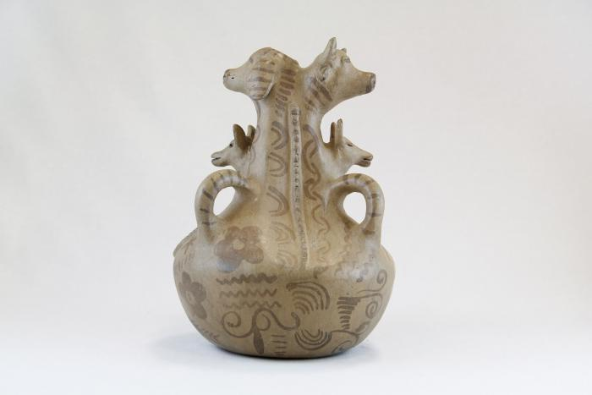
Three Dogs and a Cow Pot (JO13)

Slide 15
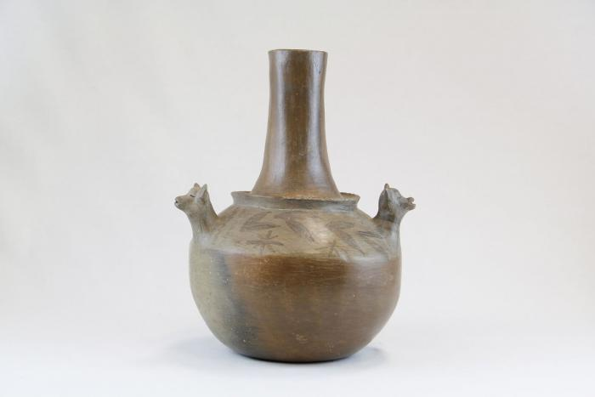
Three Dog Pot (JO14)

Slide 16
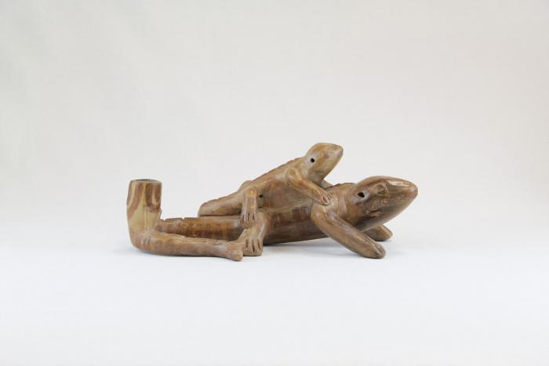
Lizard and Baby Lizard Candle Holder (JO15)

Slide 17
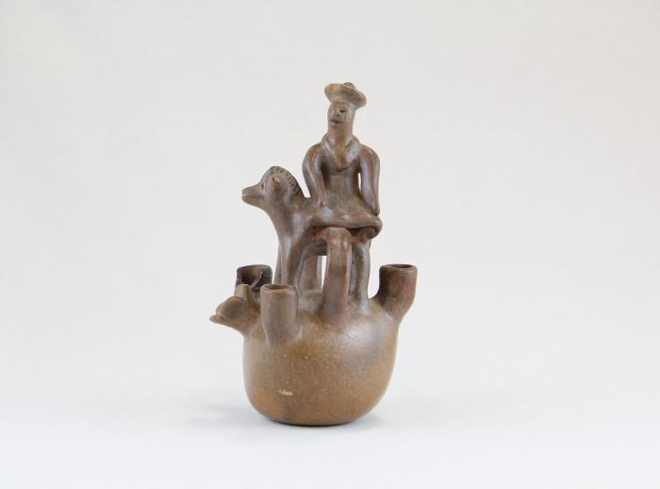
Little Man on Horse Candelabra (JO16)

Slide 18
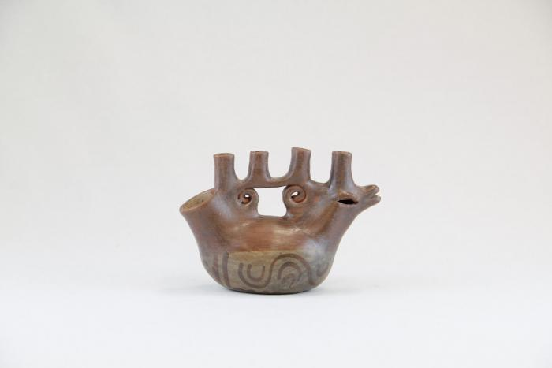
Sitting Bird Candelabra (JO17)

Slide 19
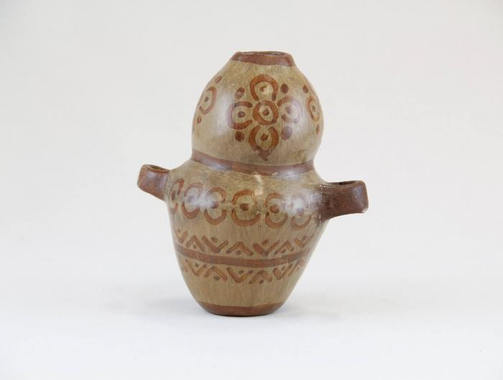
Small Two Handle Vase with Flowers (JO18)

Slide 20
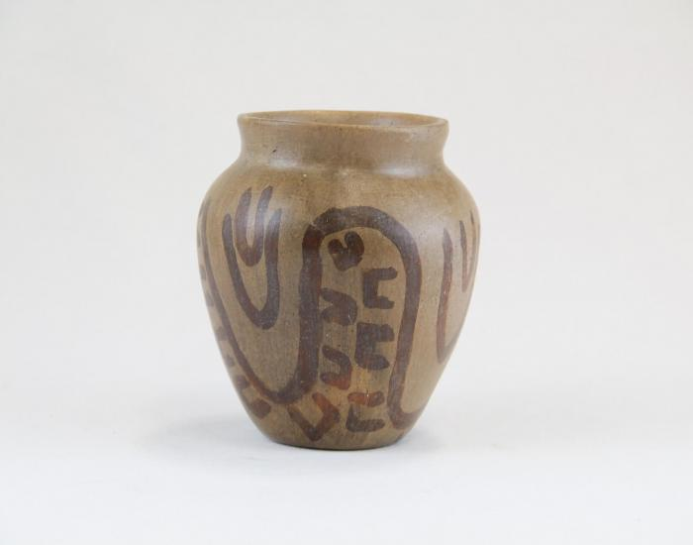
Small Pot with Painted Hand Shapes (JO19)

Slide 21
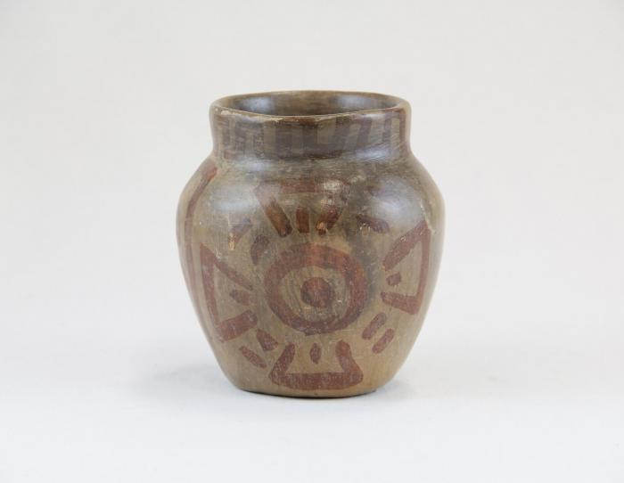
Small Pot with Medallions (JO20)

Slide 22
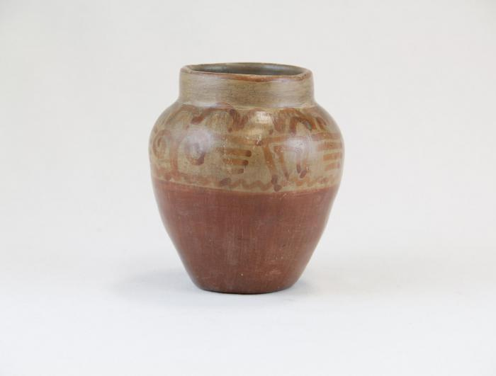
Small Pot with Greco Designs (JO21)

Slide 23
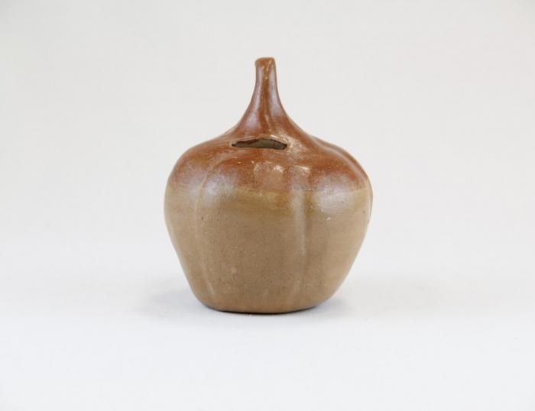
Small Pumpkin Bank (JO22)

Slide 24
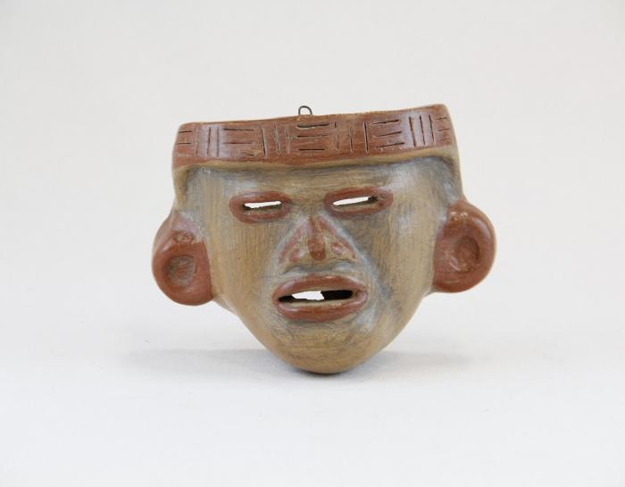
Small Pre-Columbian Face Mask (JO23)

Slide 25
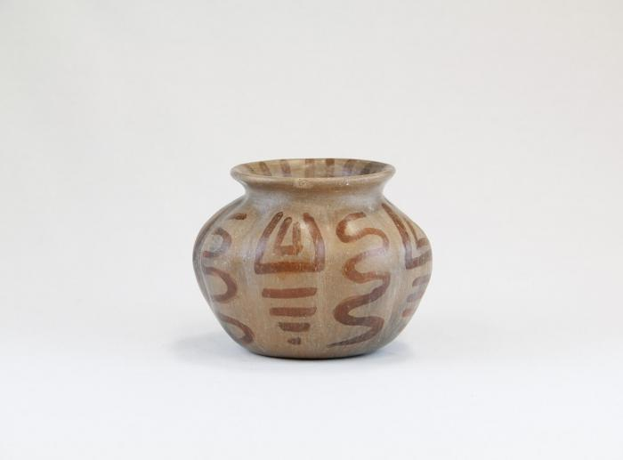
Small Pot with Squiggles (JO24)

Slide 26
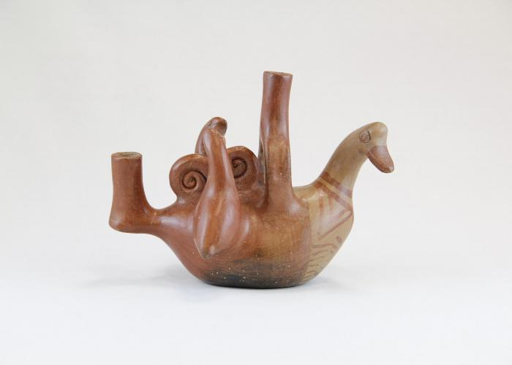
Bird and Two Baby Birds Candelabra (JO25)

Slide 27
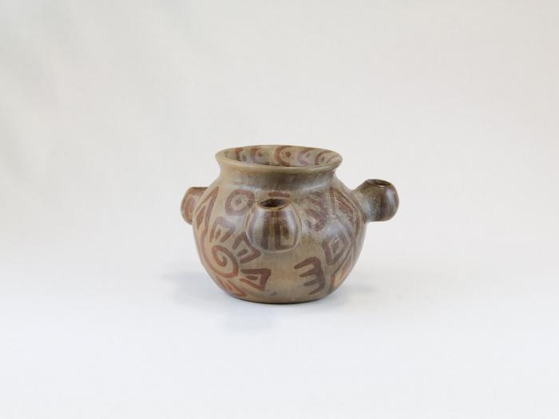
Small Three Candle Candelabra Pot (JO26)

Slide 28
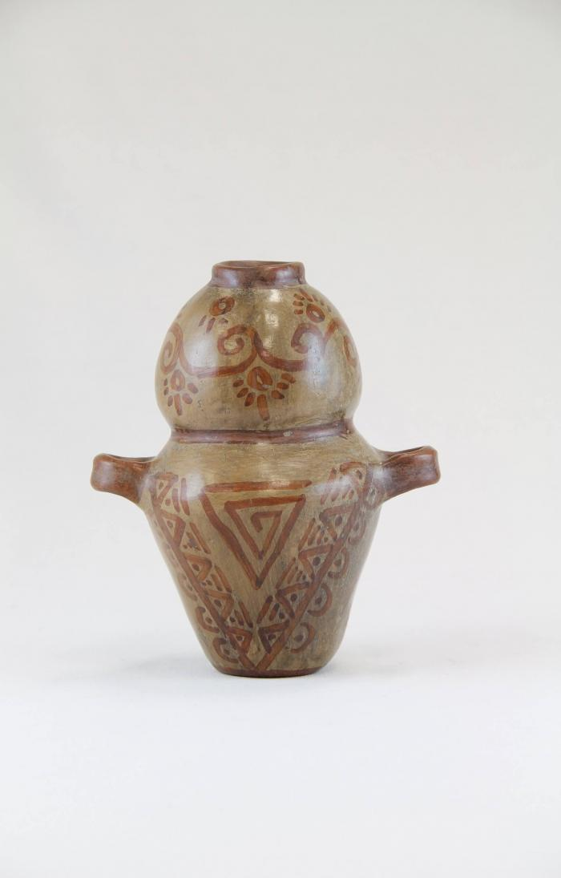
Two Handle Pot (JO27)

Slide 29
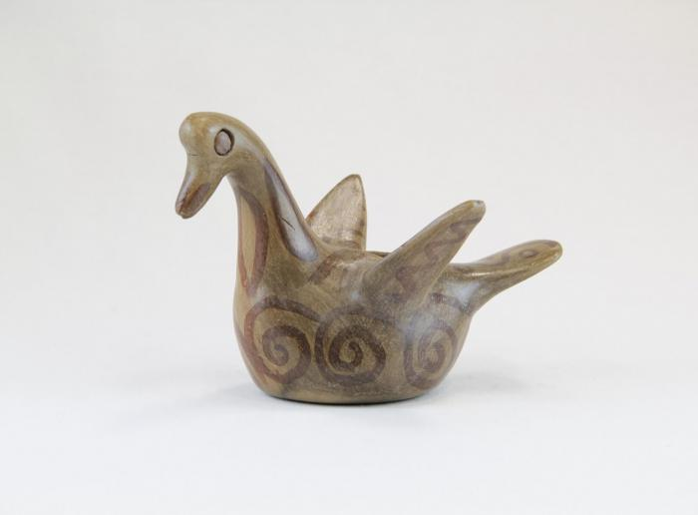
Small Bird with Curl-li-que Candle Holder (JO28)

Slide 30
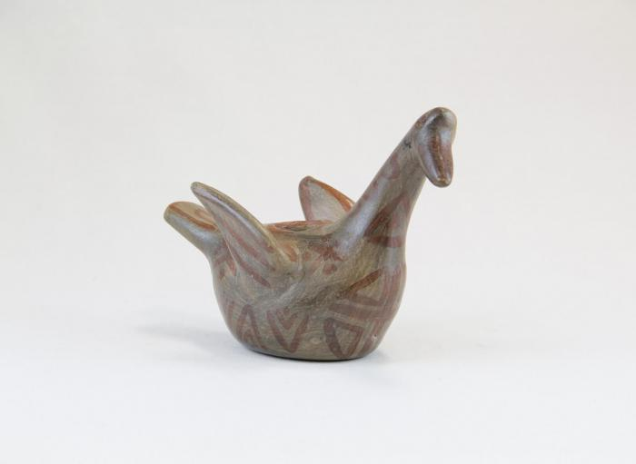
Small Bird with X on its Side Candle Holder (JO29)

Slide 31
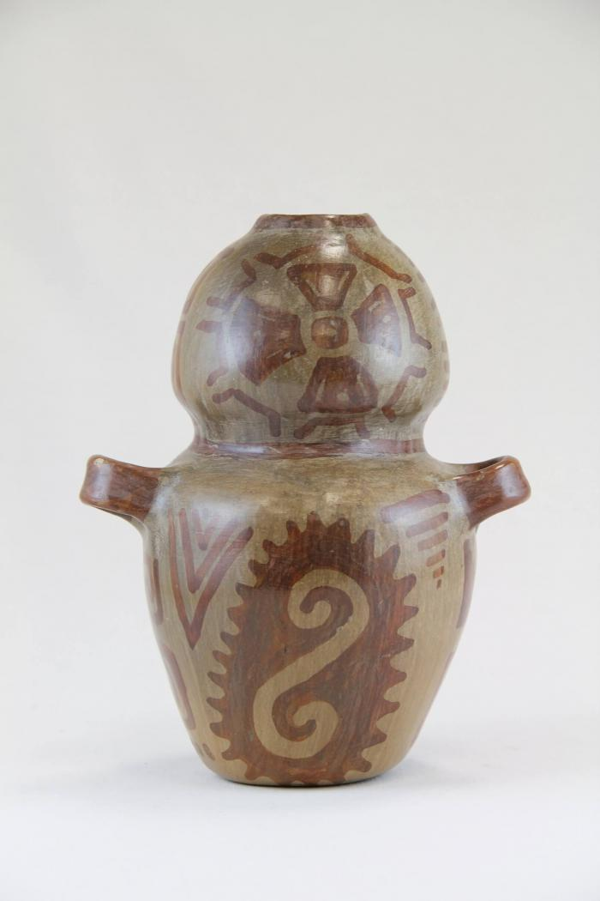
Large Two Handle Pot (JO30)

Slide 32
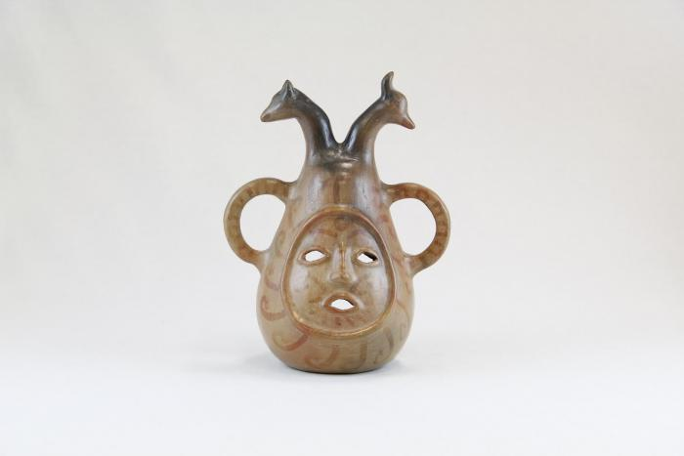
Face and Two Animal Head Candelabra (JO31)

Slide 33
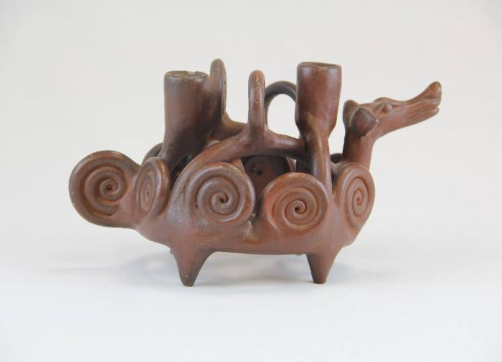
Dog Candelabra with Curled Designs (JO32)

Slide 34
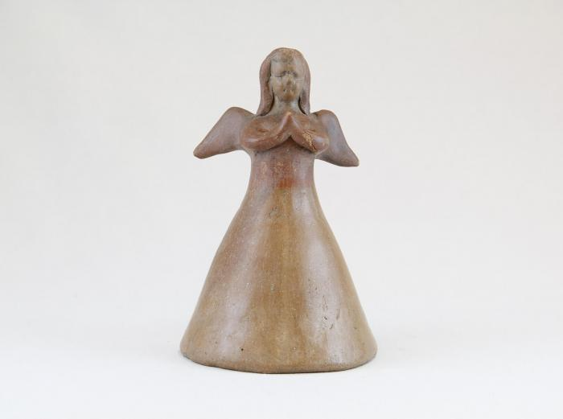
Angel Candle Holder (JO33)

Slide 35
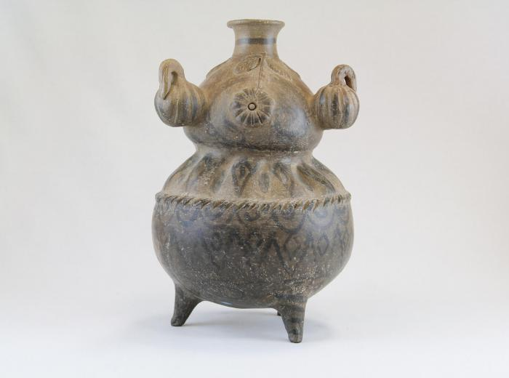
Three Squash Pot (JO34)

Slide 36
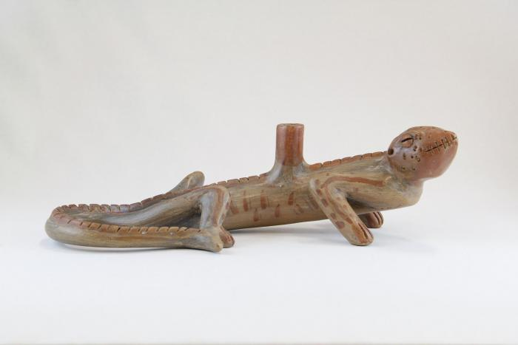
Lizard Candle Holder (JO35)

Slide 37
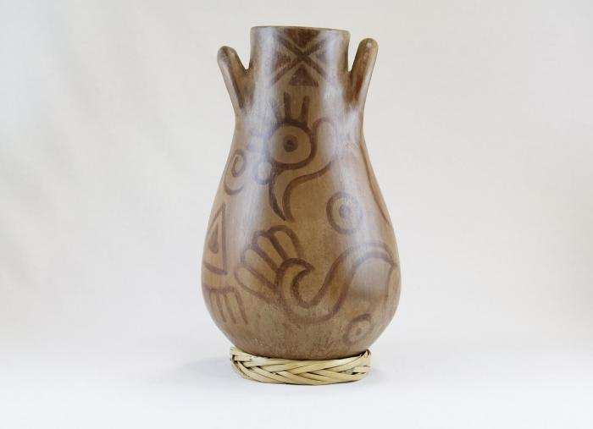
Large Pot on Ring Made of Straw (JO36)

Slide 38
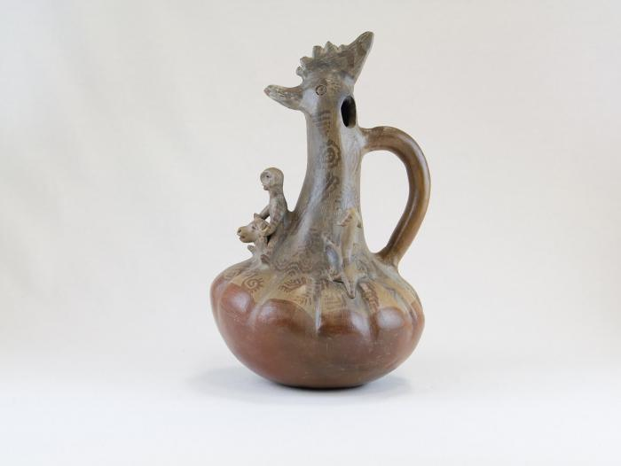
Chicken Pot with Man and Dog (JO37)

Slide 39
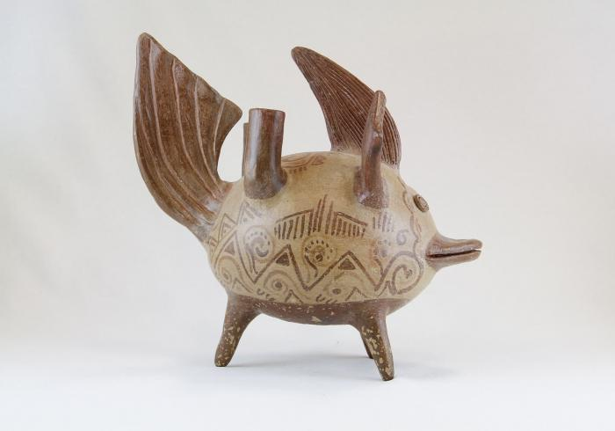
Fish with Happy Face Candelabra (JO38)

Slide 40
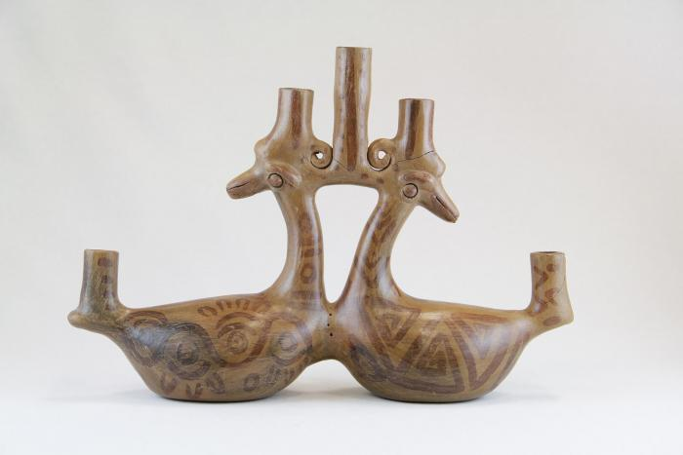
Two Decorated Sitting Ducks Candelabra (JO39)

Slide 41
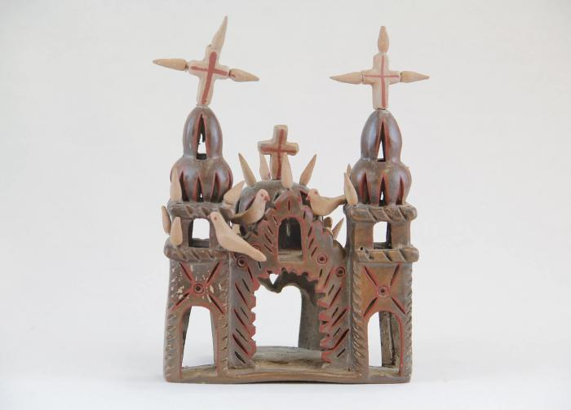
Small Ceramic Church with Birds (JO40)

Slide 42
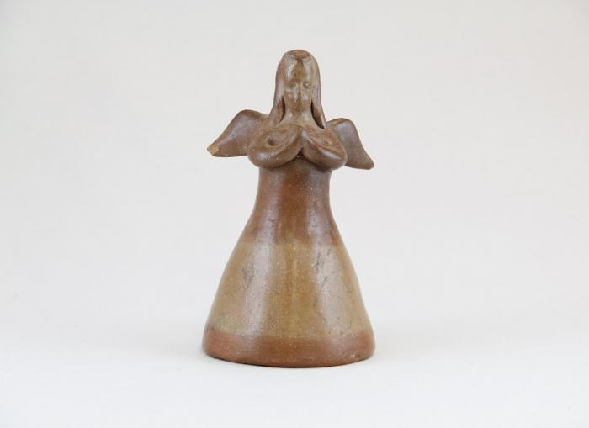
Small Angel Bell Candle Holder (1) (JO41)

Slide 43
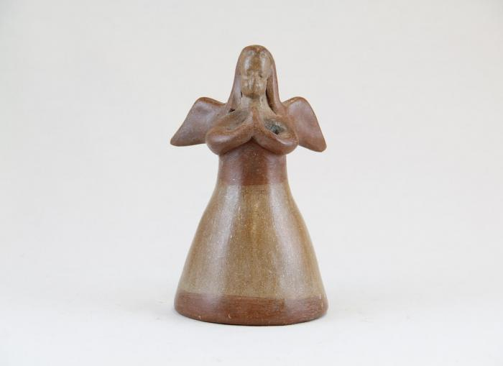
Small Angel Bell Candle Holder (2) (JO42)

Slide 44
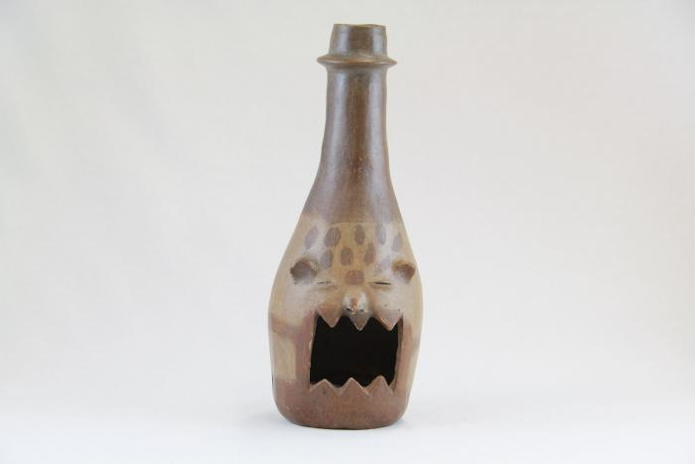
Animal Face Chimenario (JO43)

Slide 45
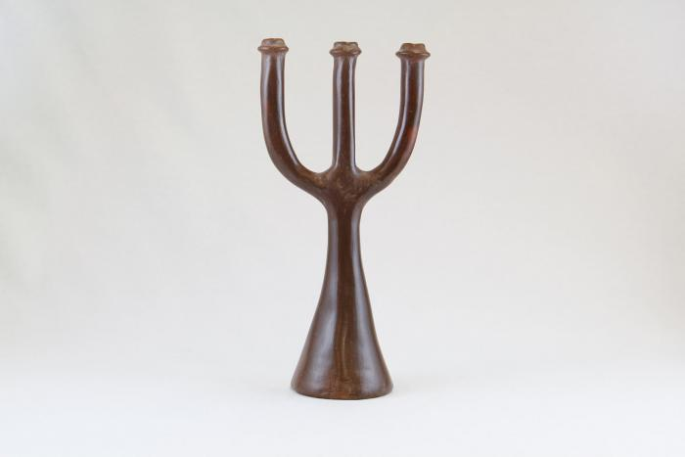
Small Three Prong Candelabra (JO44)

Slide 46
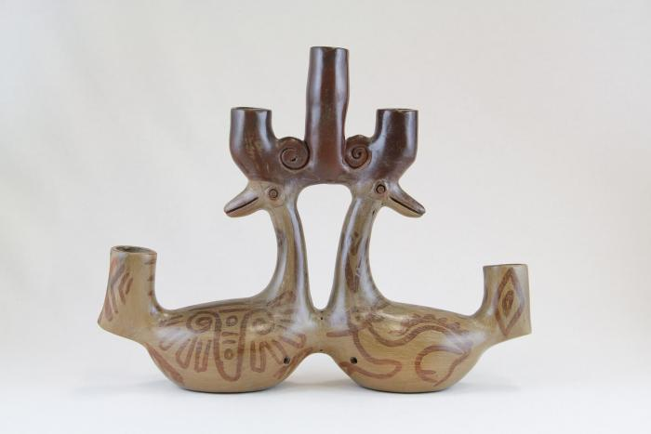
Two Ducks Five Candle Candelabra (JO45)

Slide 47
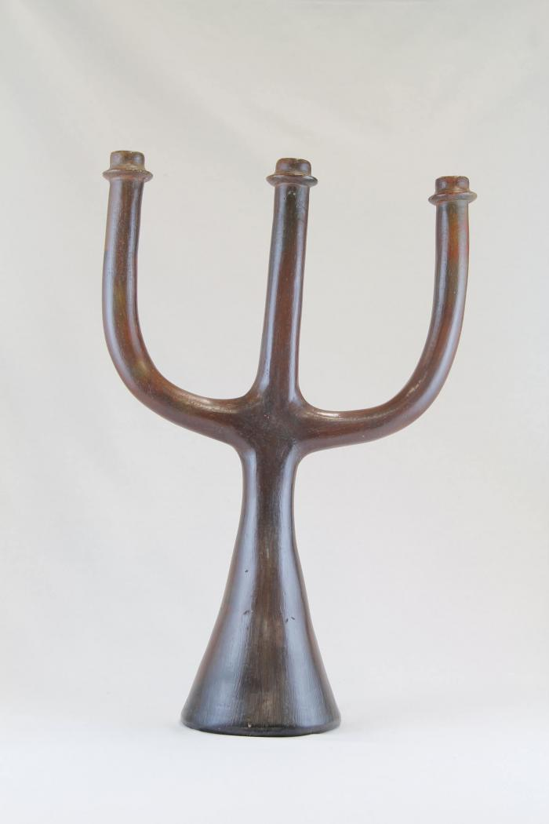
Large Three Prong Candelabra (JO46)

Slide 48
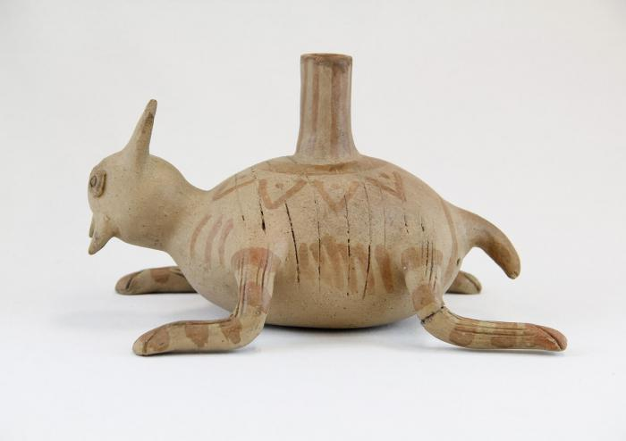
Insect Candle Holder (JO47)

Slide 49
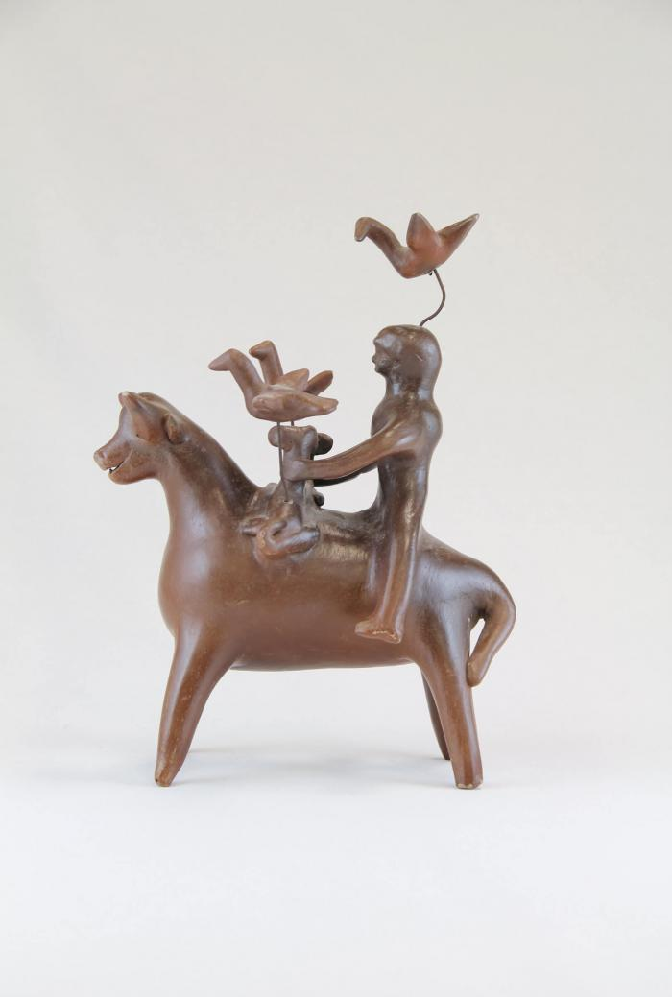
Man Sitting on Bull with Birds and Dogs (JO48)

Slide 50
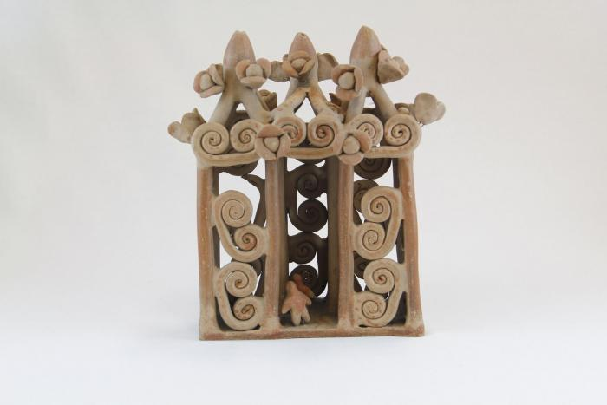
Ceramic Church with Curl-li-cues (Missing Crosses) (JO49)

Slide 51
Large Ceramic Lizard with Painted Lines and Dots (JO50)

Slide 52
Five Stacked Ceramic Animals (JO51)

Slide 53
Big Eared Dog Candle Holder (JO52)

Slide 54
Ceramic Coiled Rattlesnake (JO53)

Slide 55
Large Ceramic Lizard with Painted Triangles (JO54)

Slide 56
Sitting bird with Two Small Birds Candelabra (JO55)

Slide 57
Octopus Candle Holder (JO56)

Slide 58
Ceramic Cart with Wheels (JO57)

Slide 59
Ceramic Nacimiento (Nativity) (18 pieces) (JO58)

Slide 60
Circular Tree Candelabra (JO59)

Slide 61
Eight Ceramic Peacocks (JO60)

Slide 62
Face and Birds Candle holder (VM19)

Slide 63
Ducks Candelabra (VM20)

Slide 64
Bird, Fox and Face Candelabra (VM21)

Slide 65
Candelabra with Animals and Flowers (M1001)

Slide 66
Tree of Life on Donkey (M1002)

Slide 67
Angular Vessel (M1003)

Slide 68
Tree of Life Candle Holder (M1004)

Slide 69
12 Piece Nativity Scene (M1005 / 1006)

Slide 70
Circular Wall Sconces with 2 Birds ( 2 Pieces) (M1007)

Slide 71
Flight Into Egypt (M1008)

Slide 72
Cart with Team of Horses (M1009)

Slide 73
Bird Shaped Candelabra (M1010)

Slide 74
Mermaid (M1011)

Slide 75
Two Mice Candle Holder (M1012)

