Slide 1
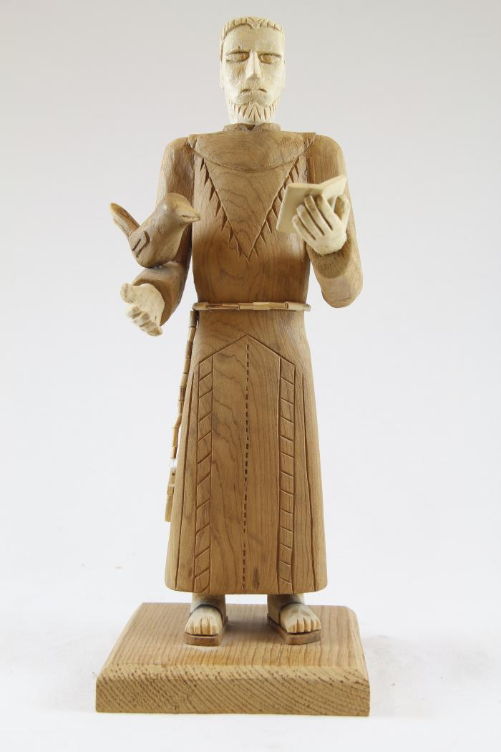
Saint Francis of Assisi (SH106)

