Slide 1
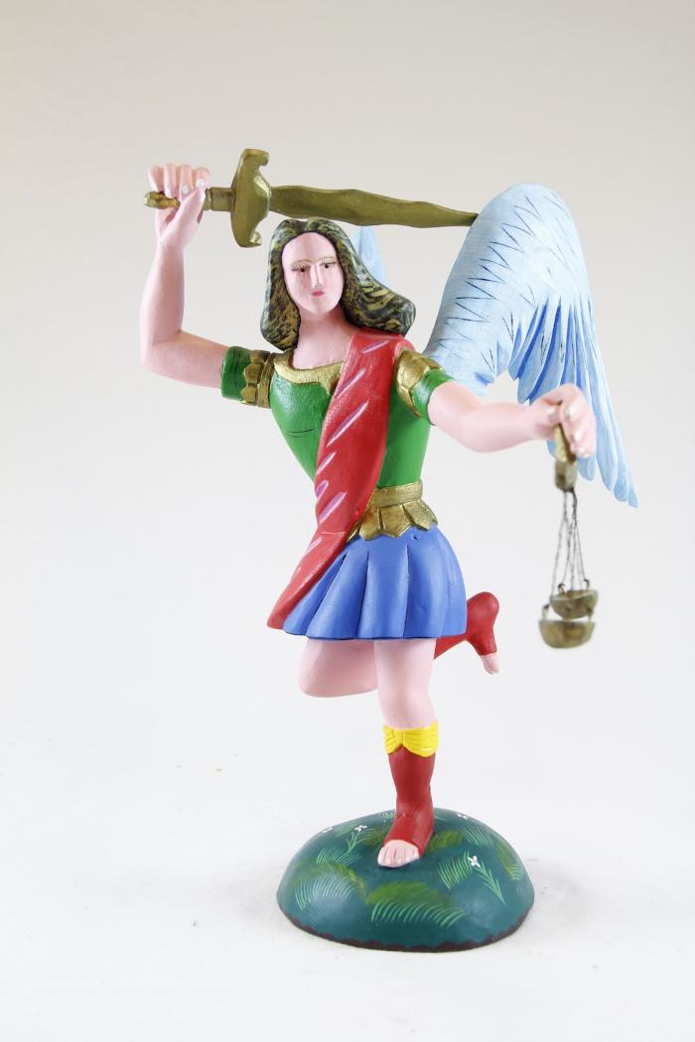
Saint Michael (SH107)

