Slide 1
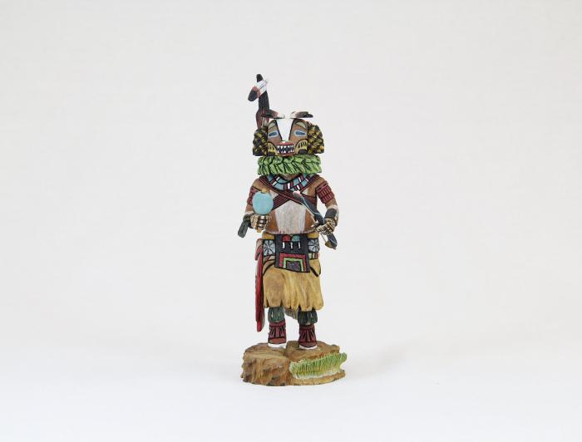
Kachina Doll (Badger) (MU3519)

