Slide 1
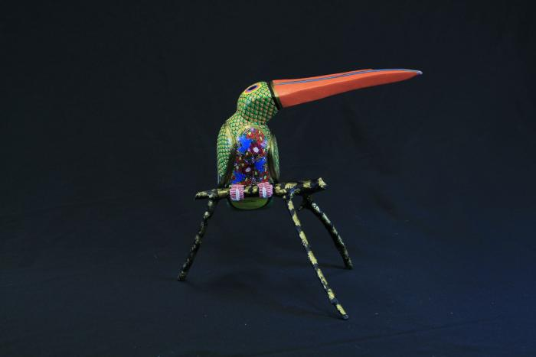
Toucan (SH113)

