Slide 1
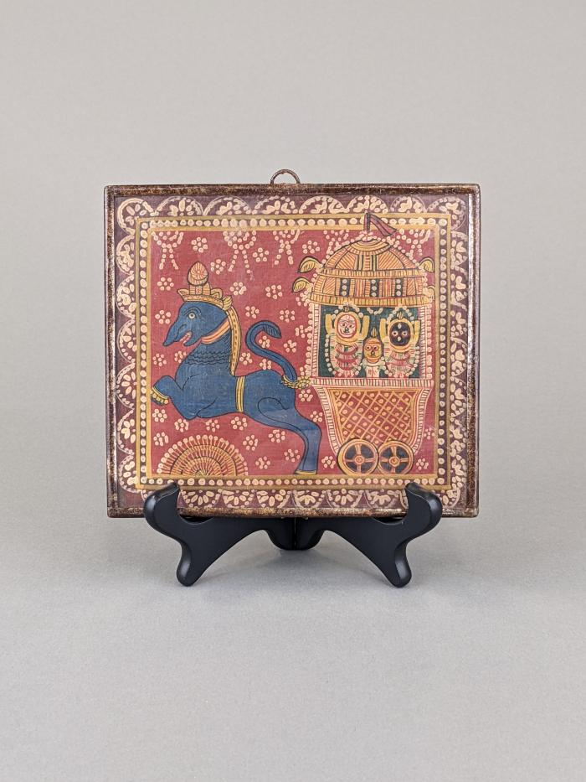
Indian Hindu Painting (FR53)

