Slide 1
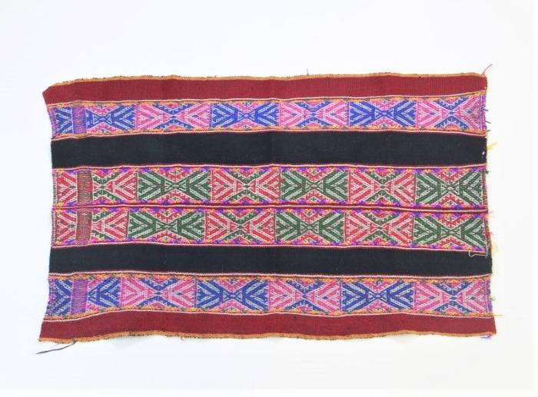
Andean Aguayo Blanket (WI1)

Slide 2
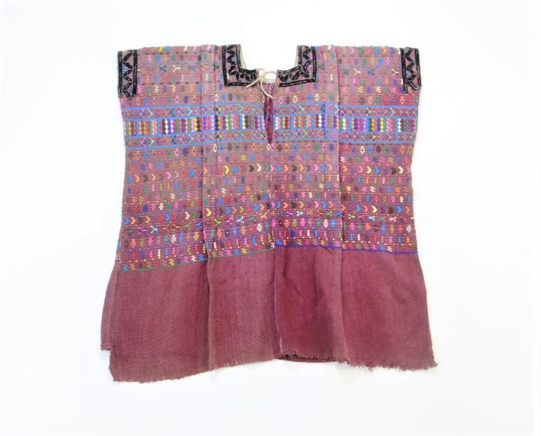
Guatemalan San Lucas Tolimán Huipil (WI2)

Slide 3
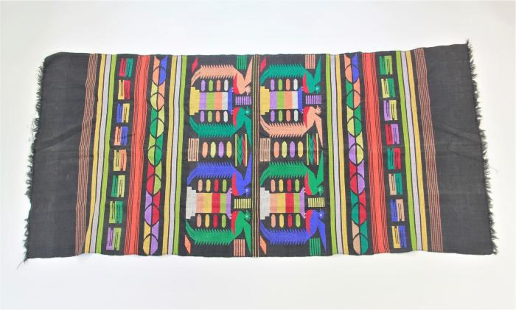
Guatemalan Tablecloth with Quetzales (WI3)

Slide 4
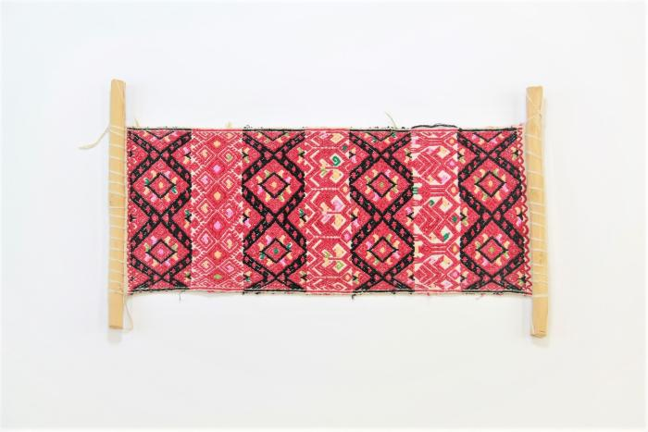
Wall Hanging from Chiapas (WI4)

Slide 5
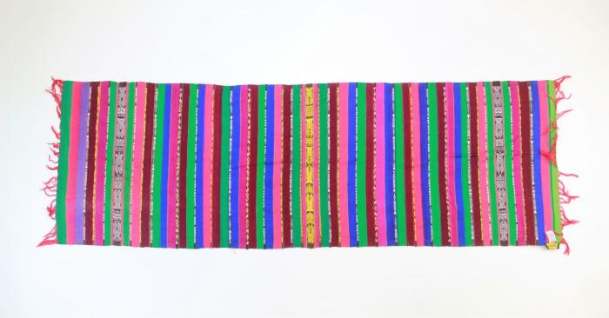
Rebozo from Totonicapan, Guatemala (WI5)

Slide 6
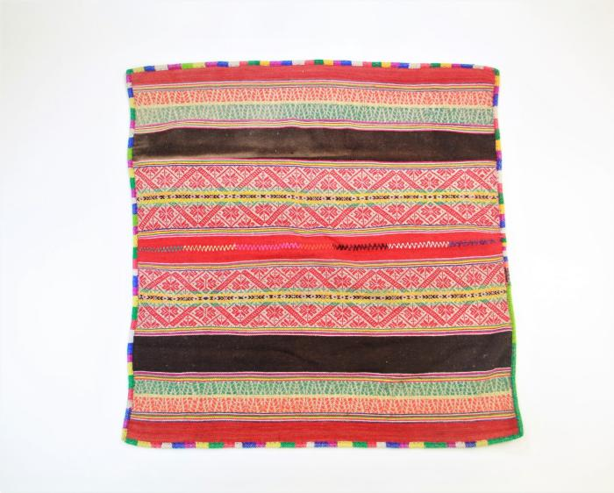
Peruvian Manta (WI6)

Slide 7
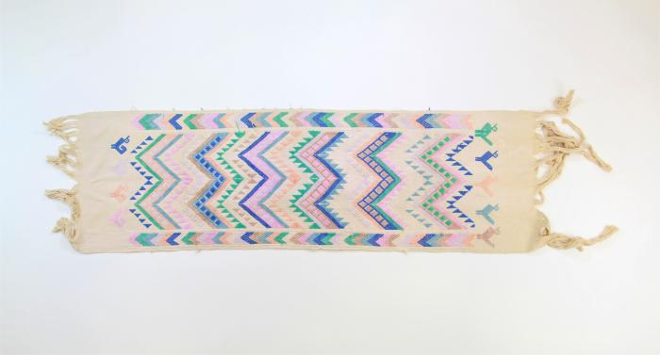
Vintage table runner from San Martin Jlitepeque, Guatemala (WI7)

Slide 8
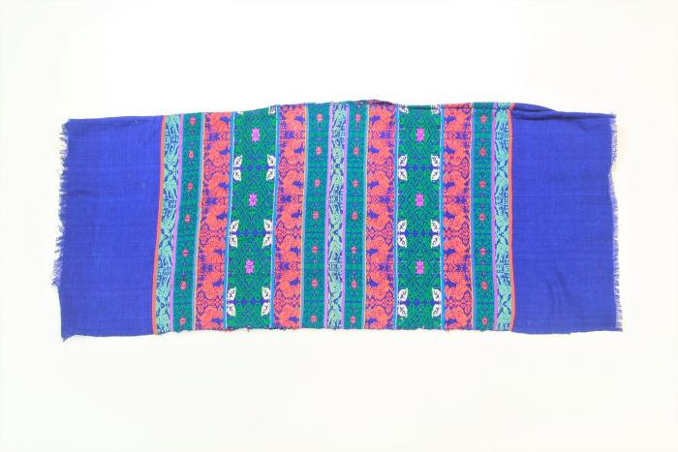
Guatemalan Huipil with Bird and Rooster Pattern (WI8)

Slide 9
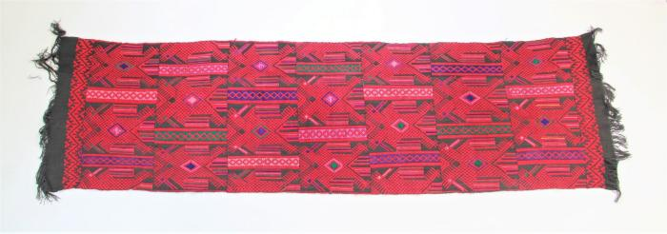
Guatemalan Rebozo (WI9)

Slide 10
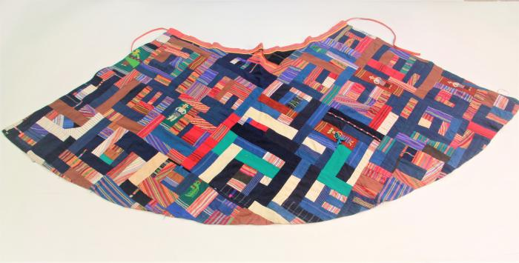
Guatemalan Patchwork Skirt (WI10)

Slide 11
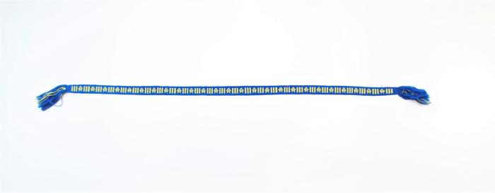
Blue and Yellow Guatemalan Belt (WI11)

Slide 12
Guatemalan Purple Belt with Diagonal Threaded Rectangles (WI12)

Slide 13
Guatemalan Striped Faja (WI13)

Slide 14
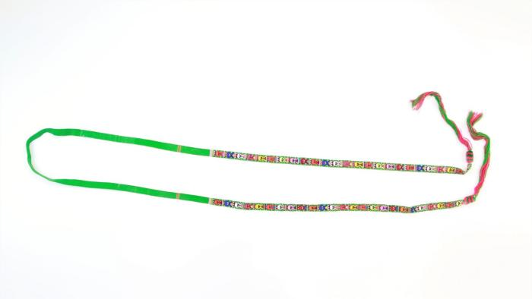
Thin Green Patterned Guatemalan Cinta (WI14)

Slide 15
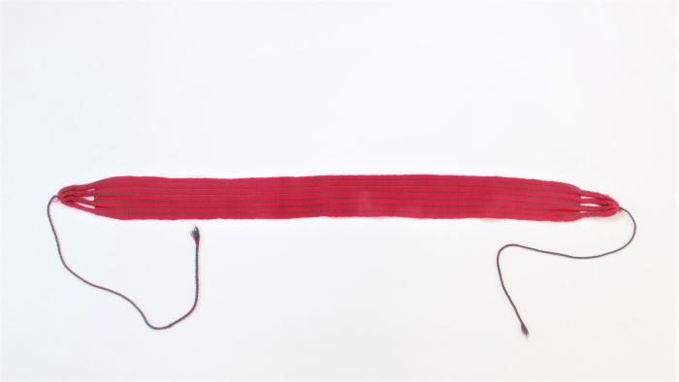
Guatemalan Short Red Striped Belt (WI15)

Slide 16
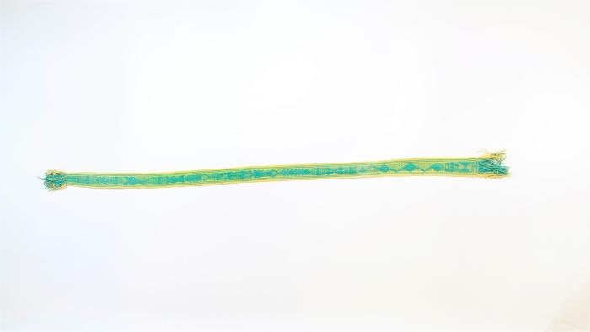
Turquoise and Yellow Faja (WI16)

Slide 17
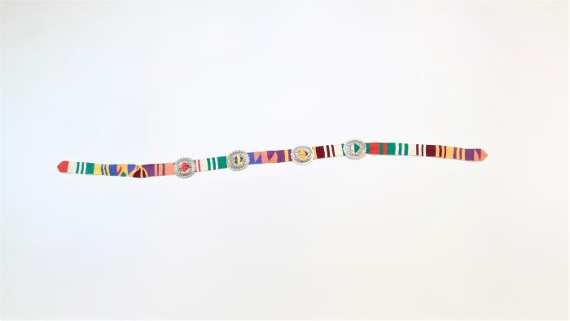
Guatemalan Belt with Silver Circle Conchos (WI17)

Slide 18
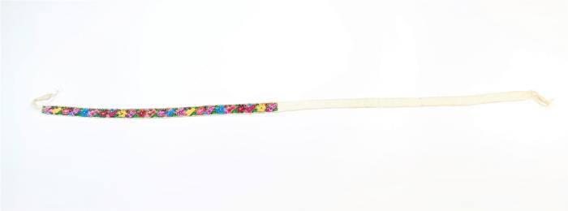
San Antonio Aguas Calientes Faja (WI18)

Slide 19
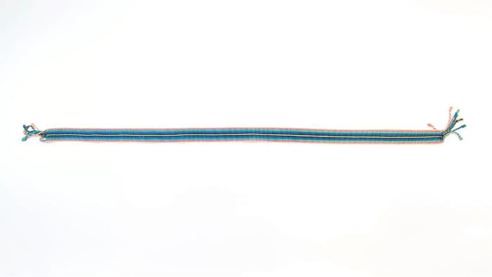
Guatemalan Multicolored Faja with Yellow Line (WI19)

Slide 20
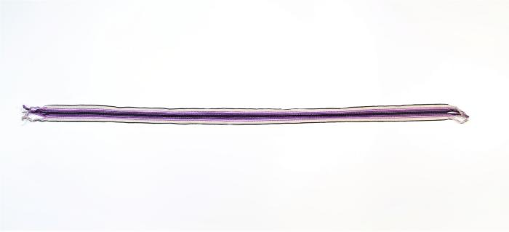
Purple and White Guatemalan Faja (WI20)

Slide 21
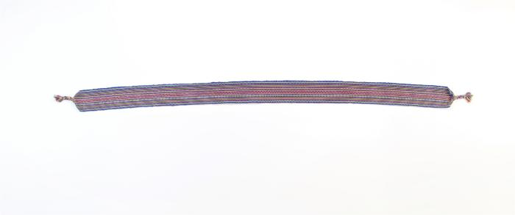
Stripe Belt (WI21)

Slide 22
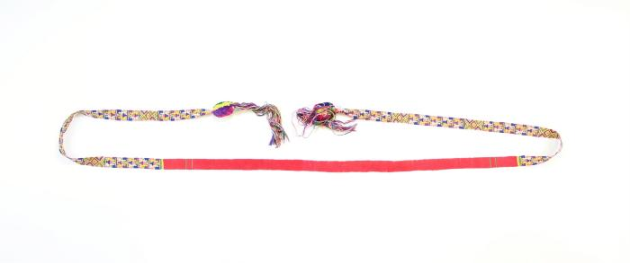
Zunil Cinta (WI22)

Slide 23
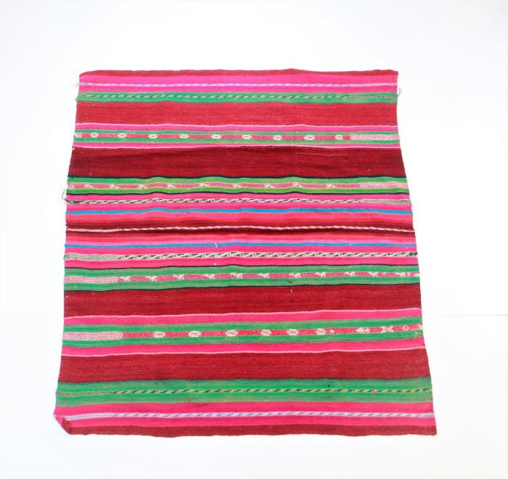
Bolivian Manta (WI24)

Slide 24
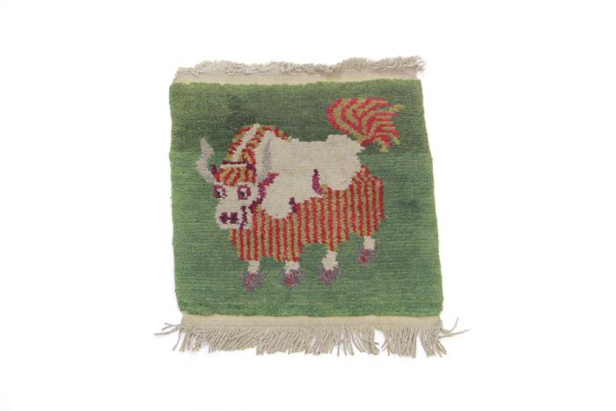
Tibetan Yak Mat (WI25)

Slide 25
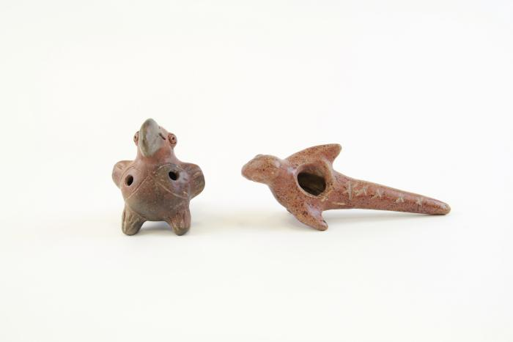
Toucan and Parrot Whistles (WI26)

Slide 26
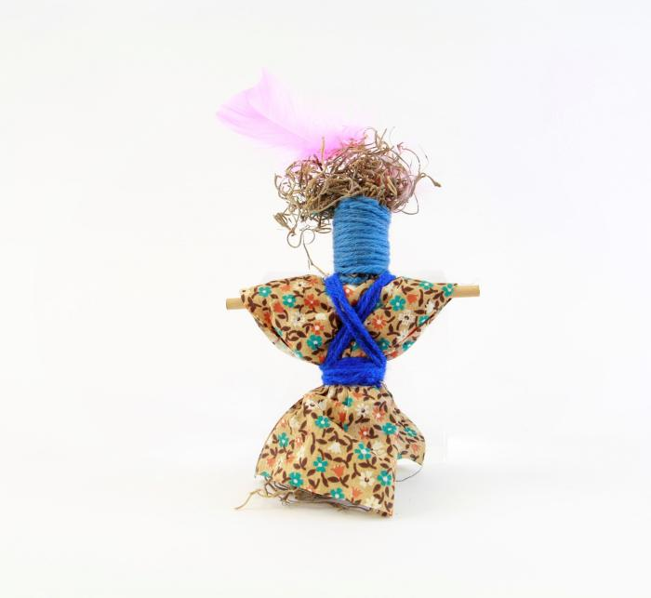
Voodoo Doll (WI27)

Slide 27
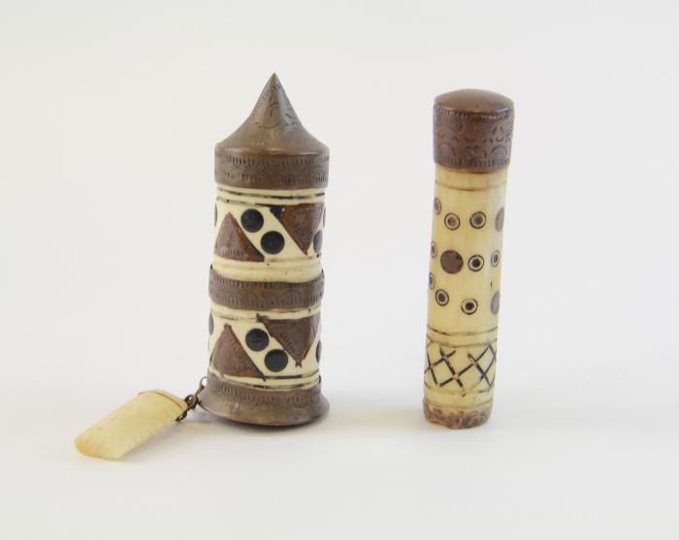
Ivory and Metal Sculptures (WI28)

Slide 28
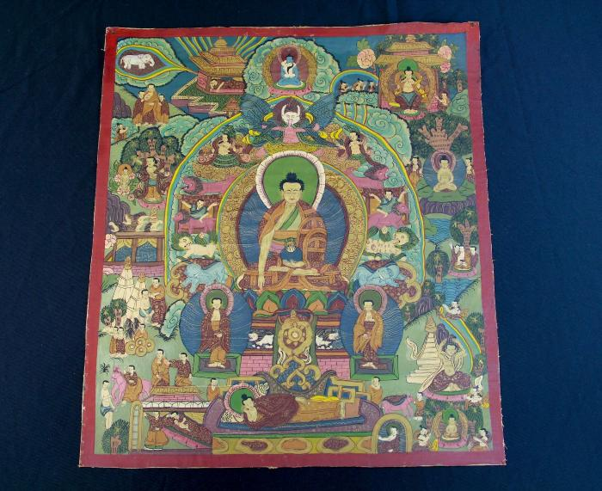
Tibetan Thangka (WI29)

Slide 29
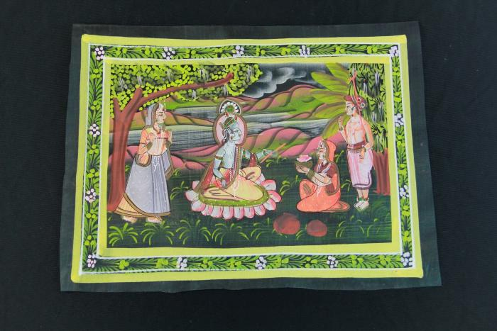
Krishna and Three Wives Fabric Painting (Pichhwai) (WI30)

Slide 30
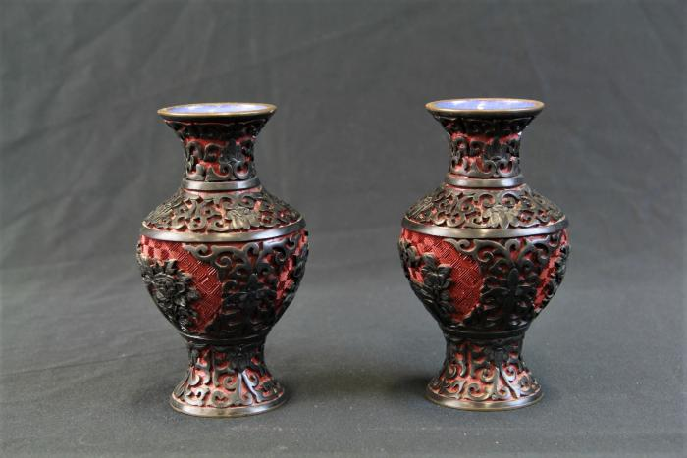
Chinese Carved Lacquer Vases (WI31)

Slide 31
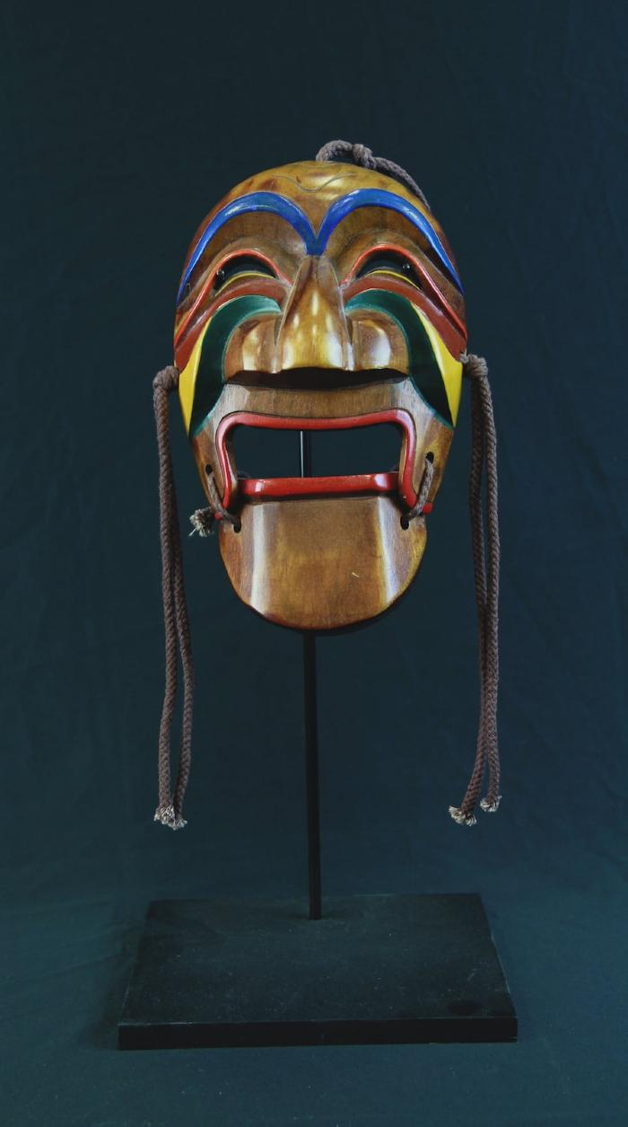
Yangban Mask (WI32)

Slide 32
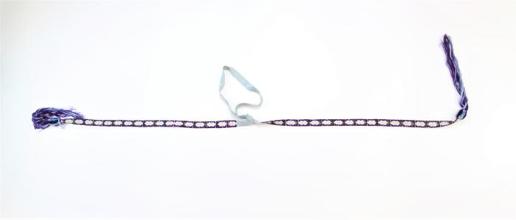
Repeating Flower Cinta (WI23)

