Slide 1
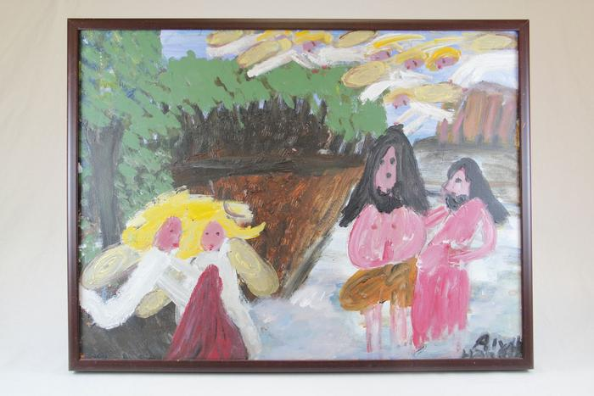
John the Baptist, with Yellow Haired Angels (EH22)

Slide 2
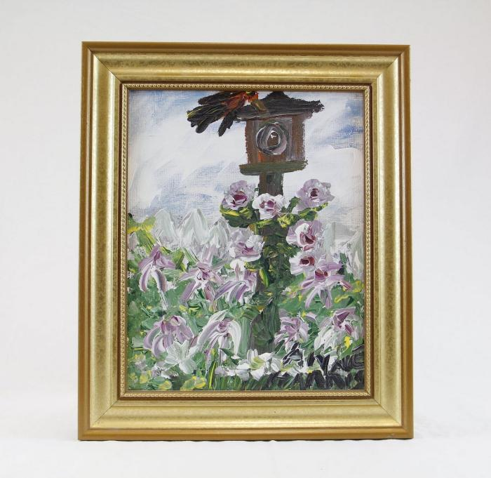
Bird House and Flowers (HA1)

Slide 3
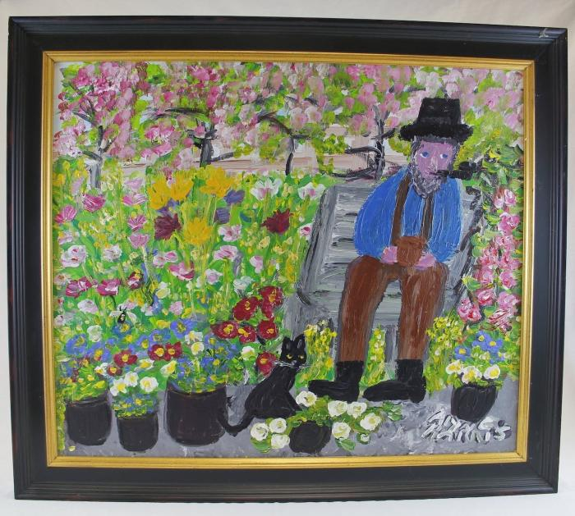
Man smoking pipe with cat and flowers (HA2)

Slide 4
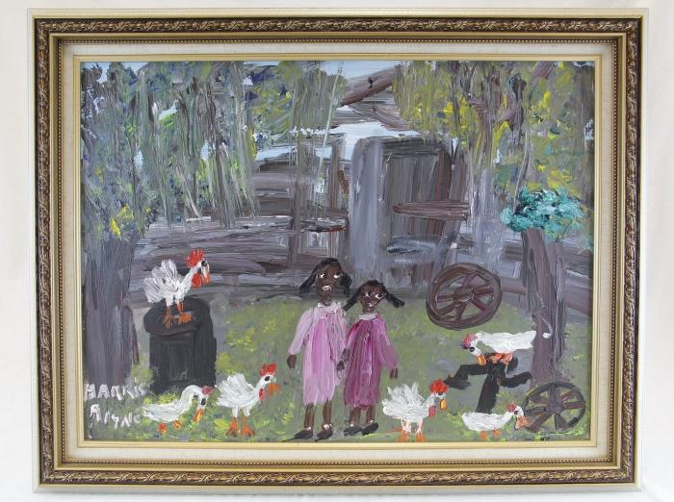
Two girls and chickens (HA3)

Slide 5
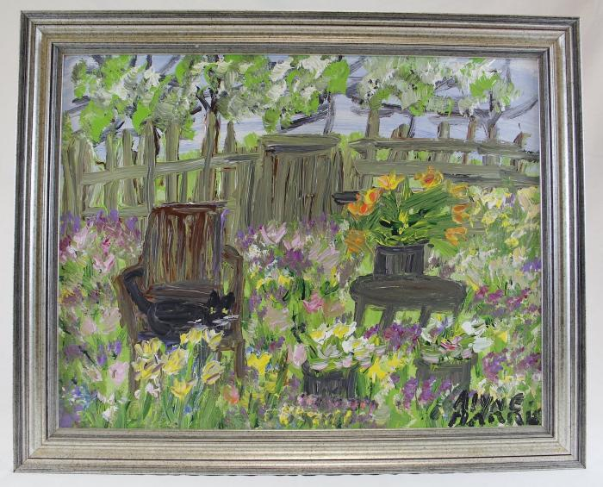
Cat sits on chair surrounded by flowers (HA4)

