Slide 1
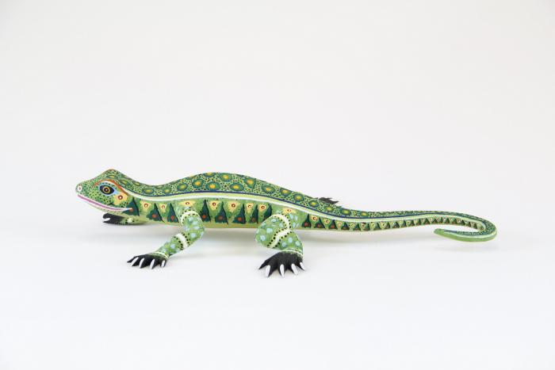
Lizard (CA10)

