Slide 1
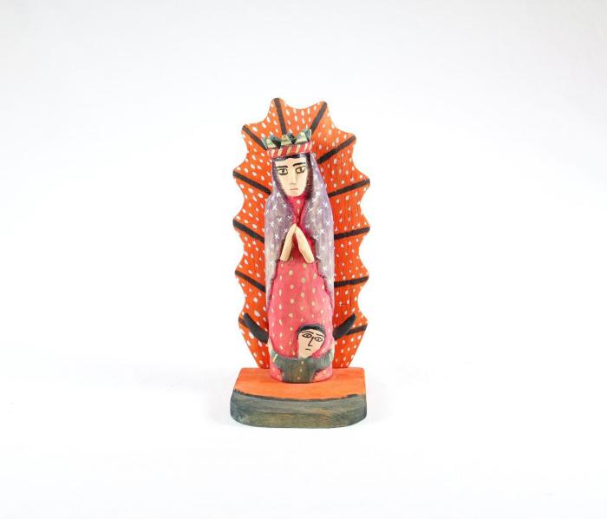
Virgin Mary (SH124)

