Slide 1
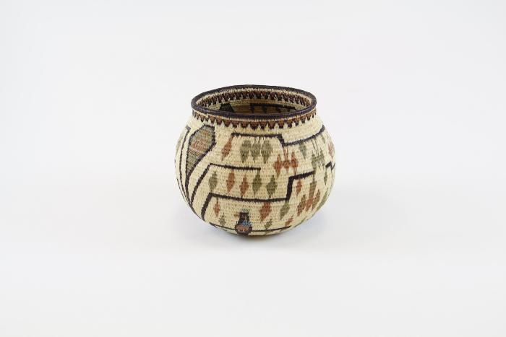
Vase (SH115)

