Slide 1
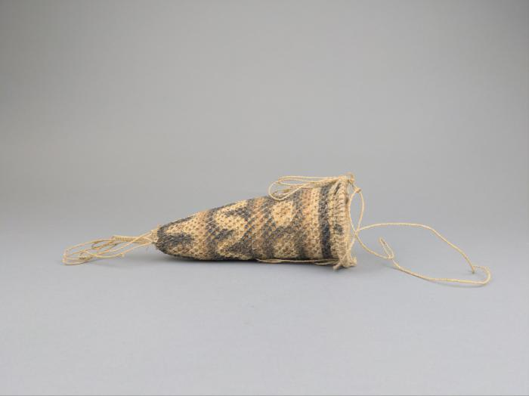
Papua New Guinea Koteka (FR112)

Slide 2
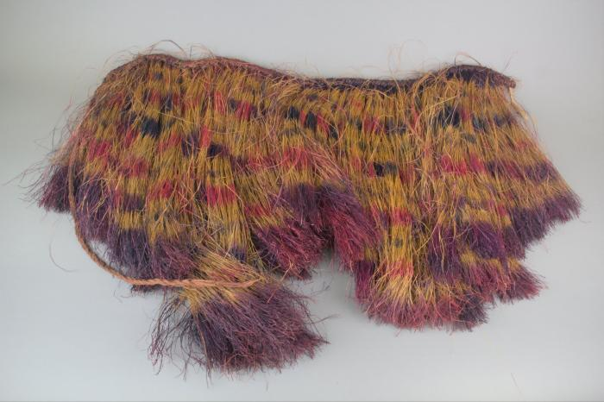
Papua New Guinea Raffia Skirt (FR113)

Slide 3
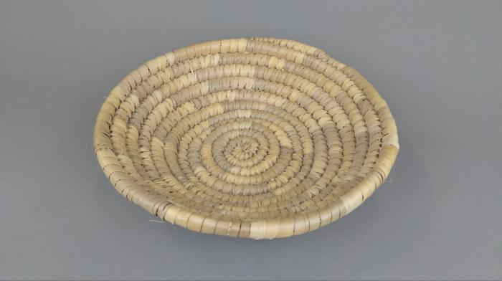
Pima Coil Basket (FR152)

Slide 4
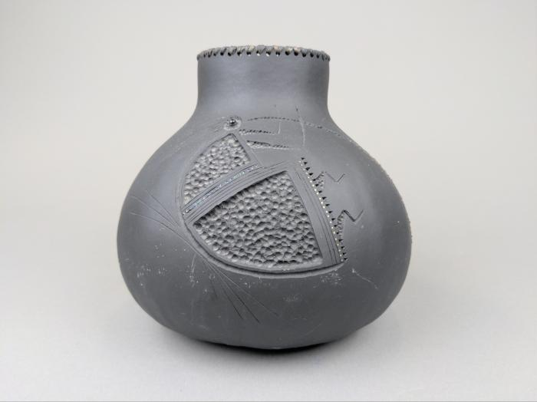
Robert Rivera Gourd with Flute Player (FR153)

Slide 5
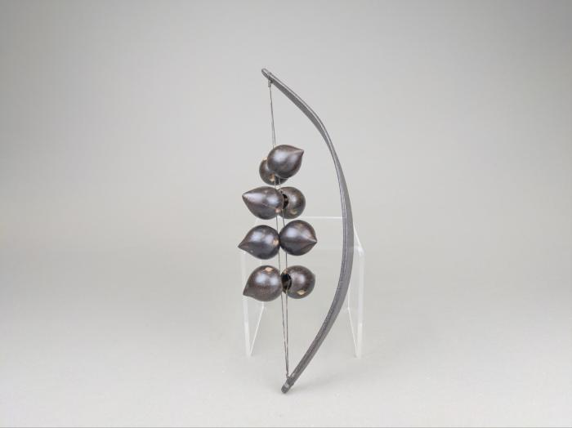
Nut Rattle (FR164)

Slide 6
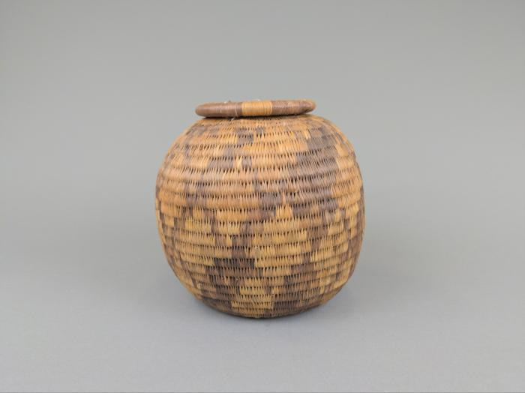
Botswana Woven Coil Basket with Lid (FR165)

