Slide 1
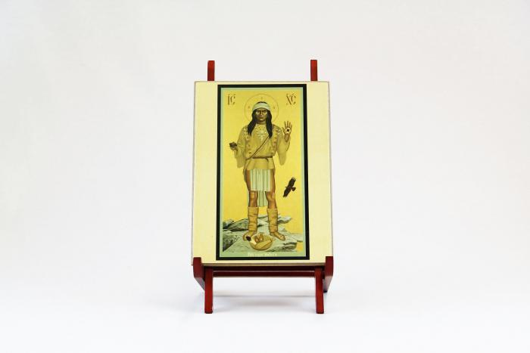
Apache Christ (MU3527)

