Slide 1
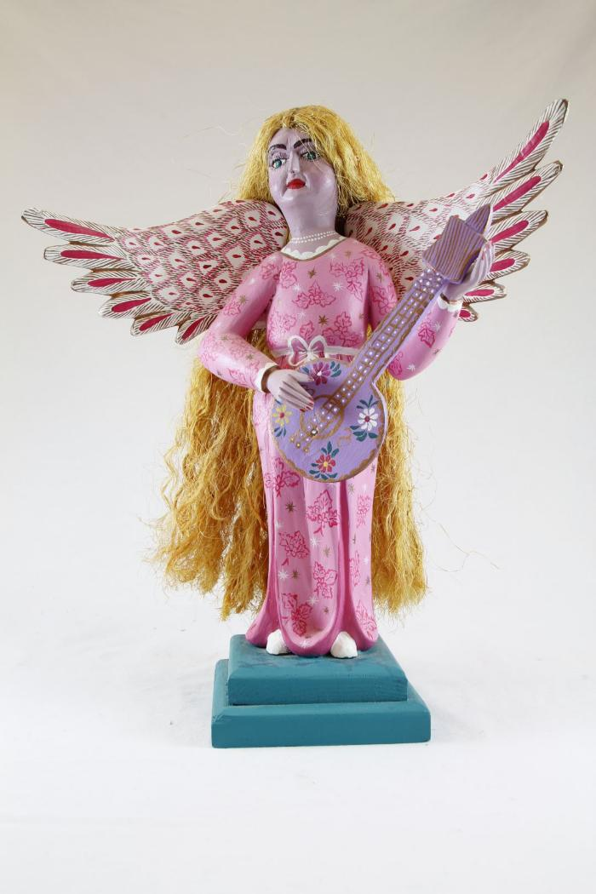
Angel playing Guitar (SH11)

Slide 2
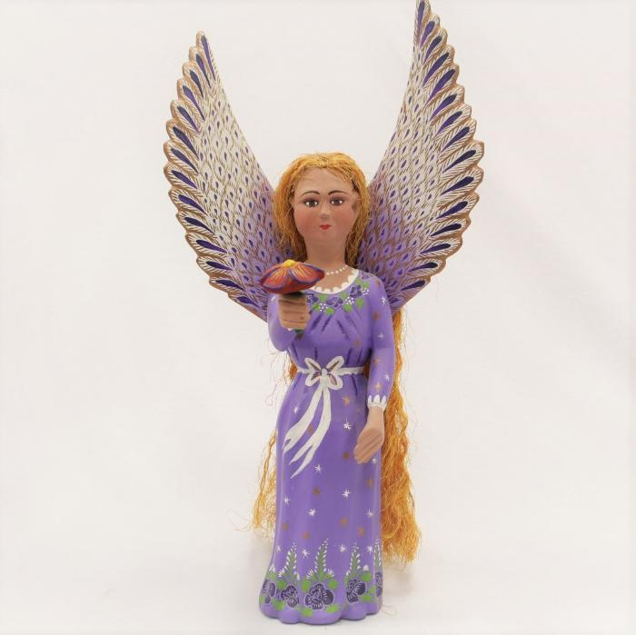
Purple Angel holding Flower (SH100)

Slide 3
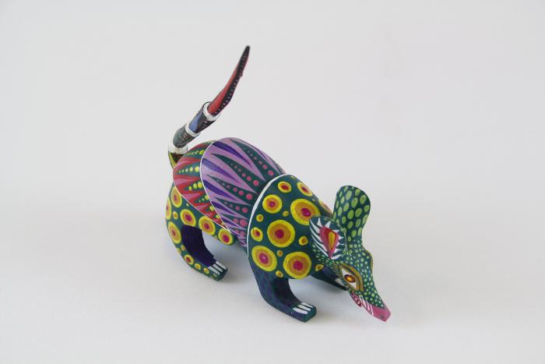
Rat Woodcarving (SH102)

