Slide 1
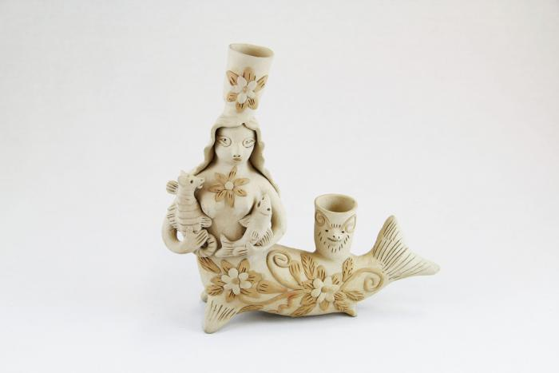
Mermaid Candelabra (M1033)

Slide 2
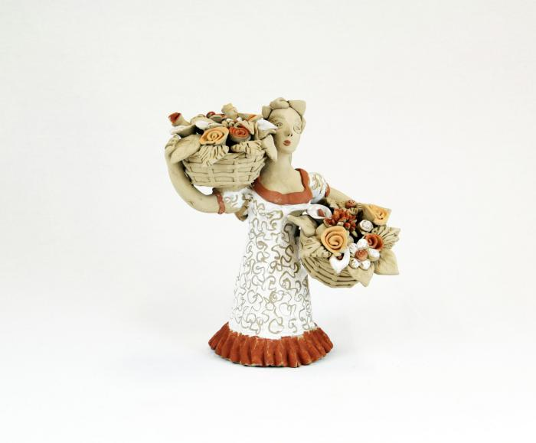
Dancer with Two Flower Baskets (M1035)

Slide 3
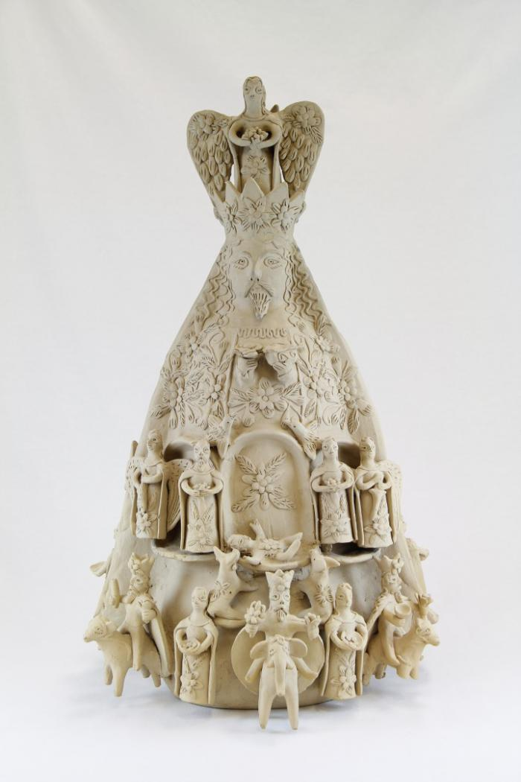
Two Sided Sculpture with Nativity Scenes (M1036)

Slide 4
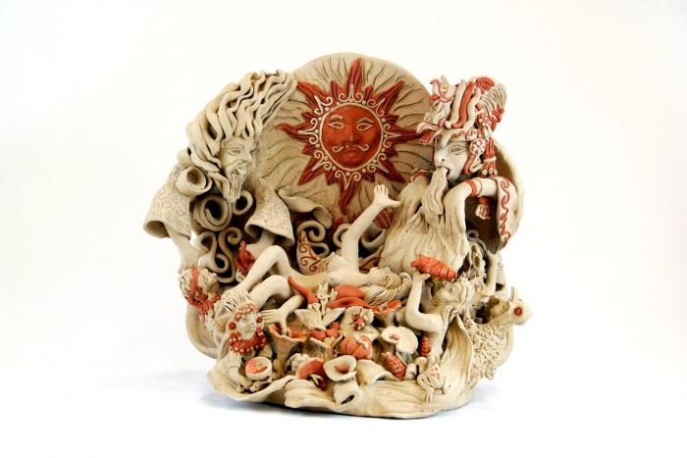
Wind, Water, Light (M1604)

