Slide 1
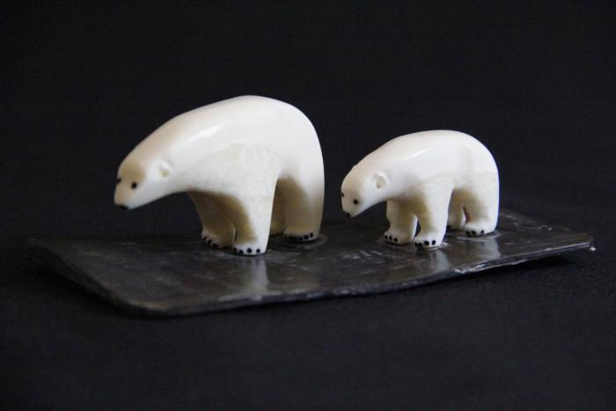
Polar bear with Cub (AC1)

Slide 2
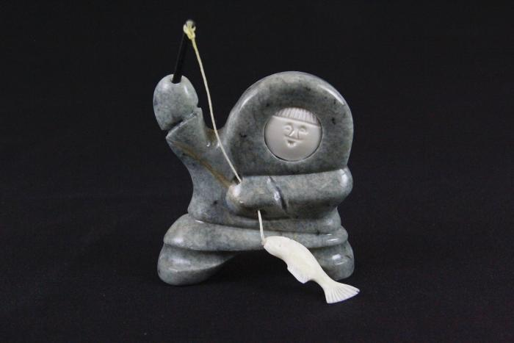
Boy Fishing (AC2)

Slide 3
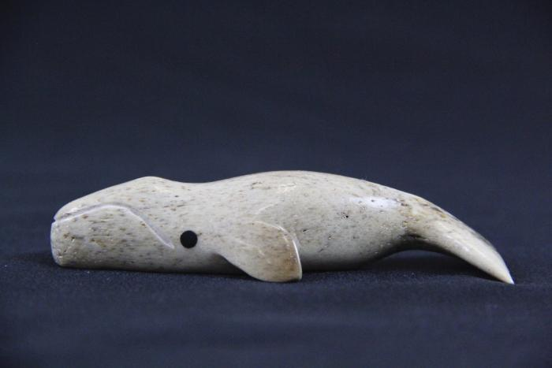
Humpback whale (AC3)

Slide 4
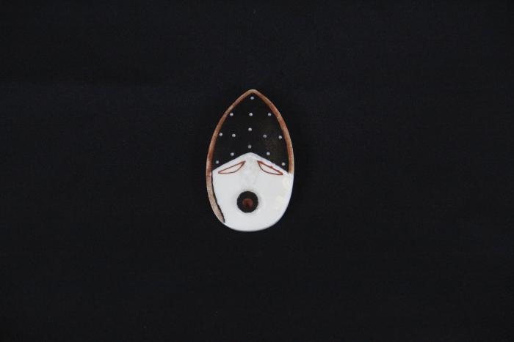
Spirit of the Mountain (AC4)

Slide 5
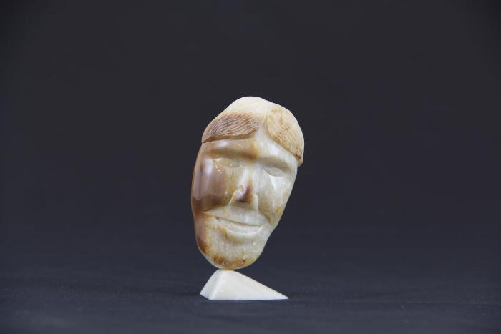
Two-Headed Statue (AC5)

Slide 6
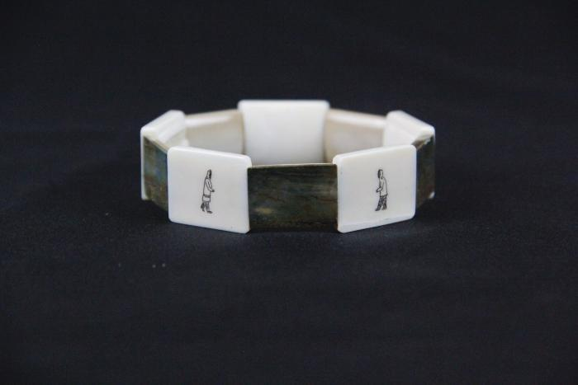
Stages of Marriage Bracelet (AC7)

Slide 7
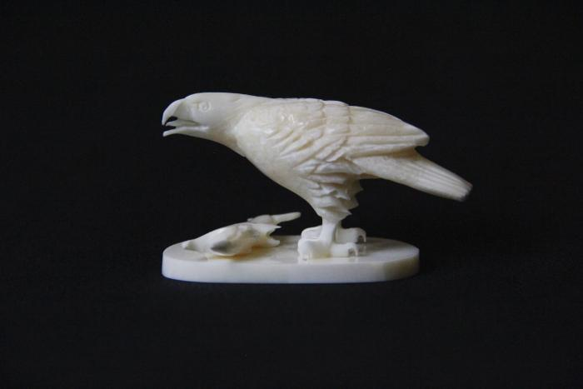
Eagle and Fish (AC8)

Slide 8
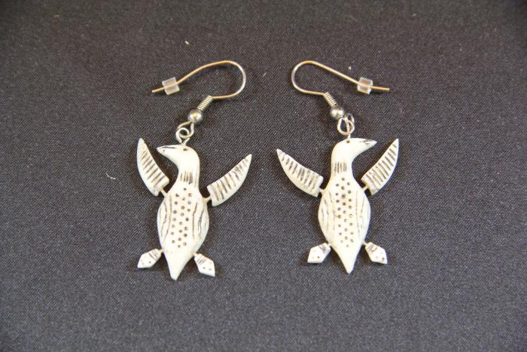
Loon Birds Earrings (AC10)

Slide 9
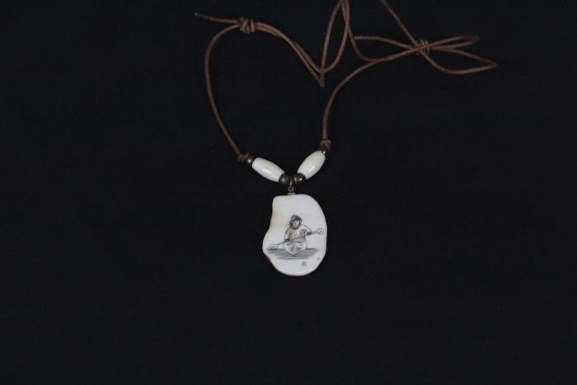
Kayak Necklace (AC11)

Slide 10
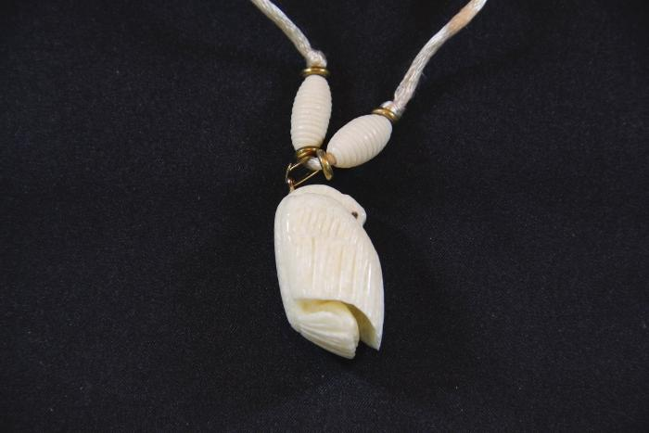
Ivory Swan Pendant (AC12)

Slide 11
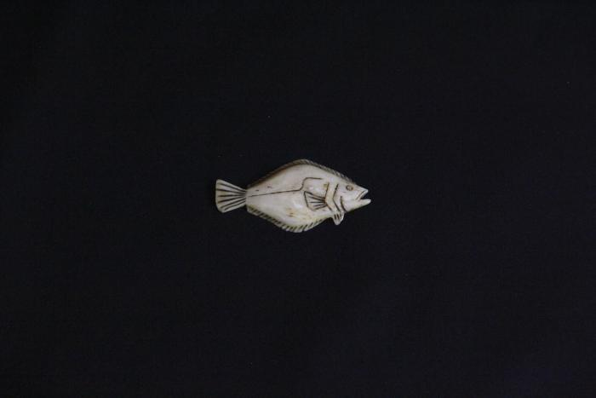
Lucky Halibut (AC13)

Slide 12
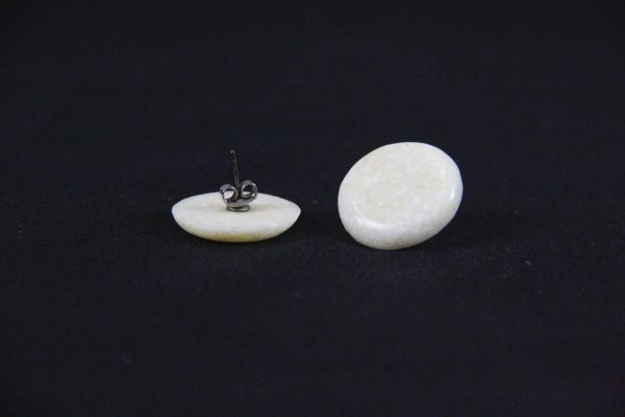
Round Earrings (AC14)

Slide 13
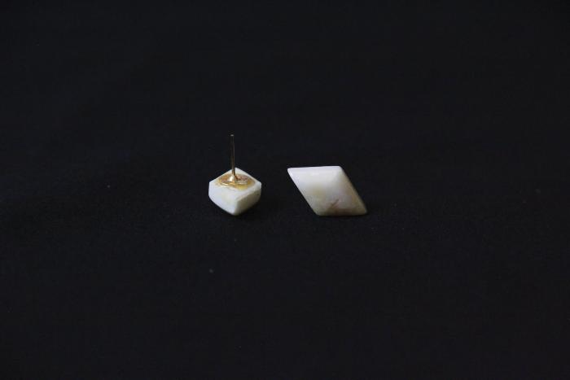
Rhombus Earrings (AC15)

Slide 14
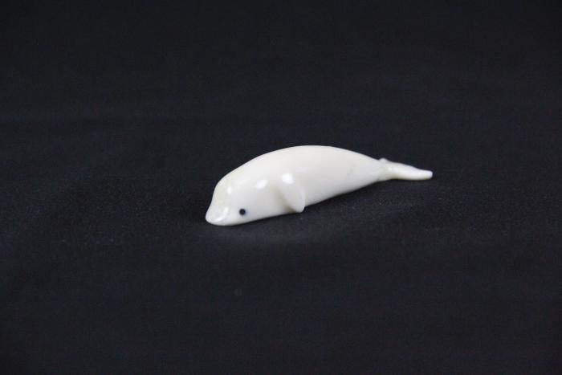
Beluga Whale (AC16)

Slide 15
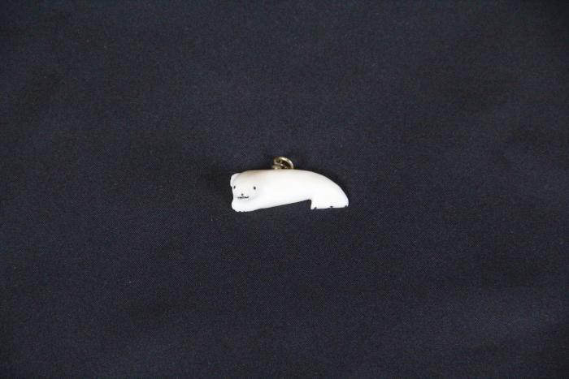
Baby Seal (AC17)

Slide 16
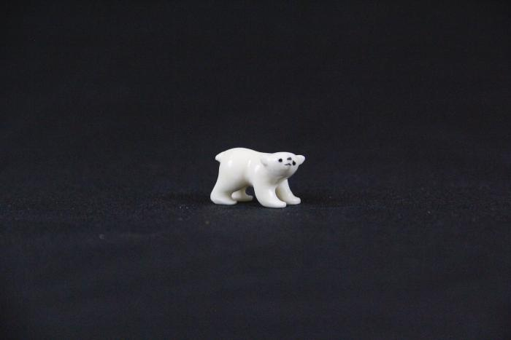
Baby Polar Bear (AC18)

Slide 17
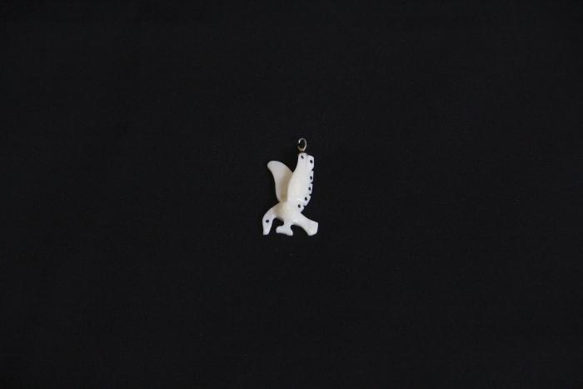
Bird Pendant (AC19)

