Slide 1
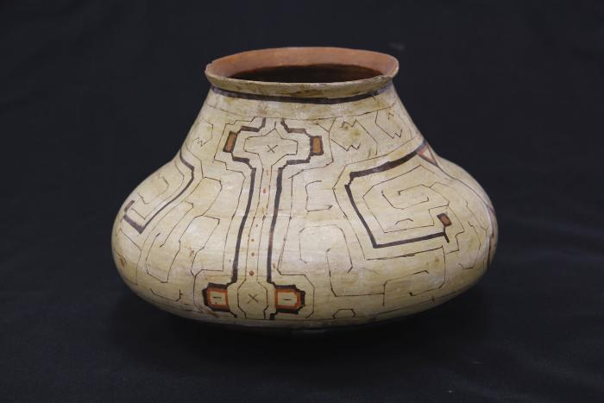
Shipibo Ceramic Olla (SHA2)

Slide 2
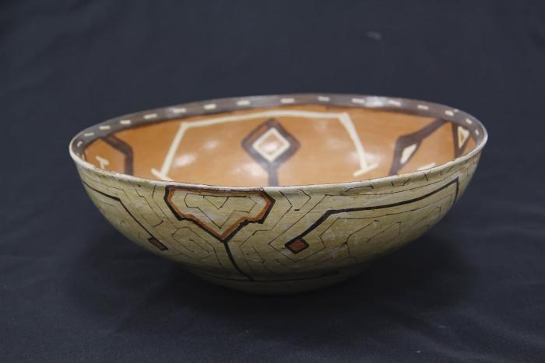
Shipibo Ceramic Bowl (SHA3)

Slide 3
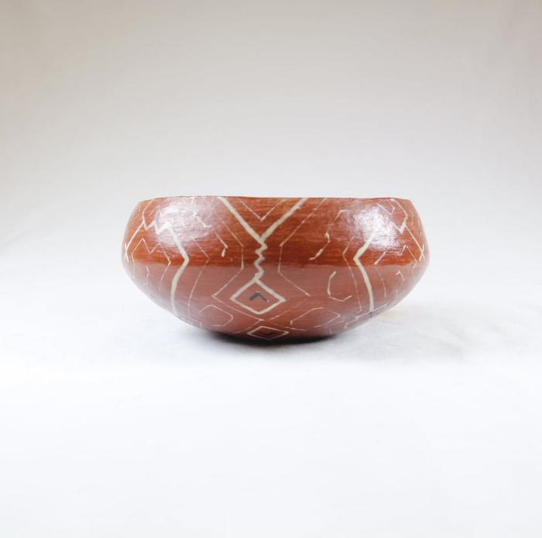
Shipibo Ceramic Bowl (SHA4)

Slide 4
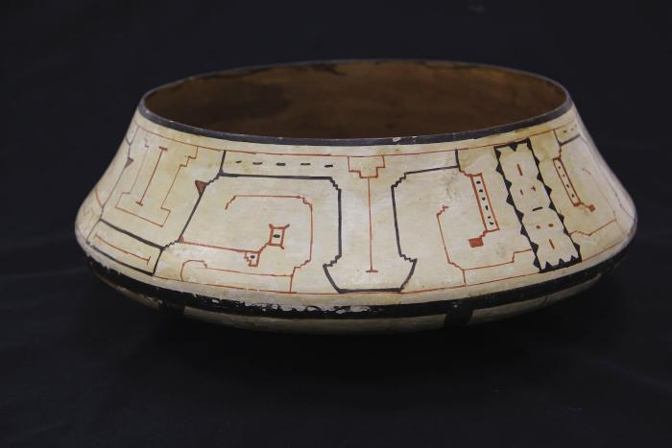
Shipibo Ceramic Bowl (SHA5)

Slide 5
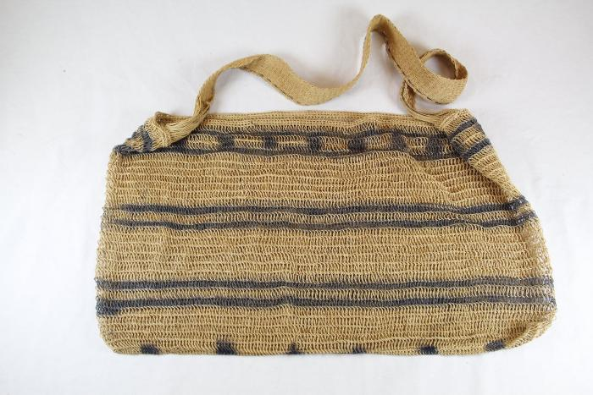
Shipibo Woven Bag (SHA10)

Slide 6
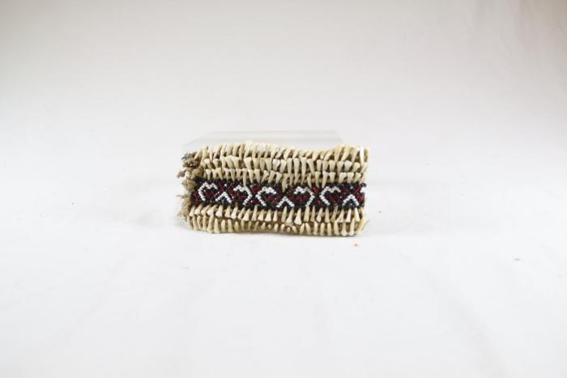
Shipibo Bracelet (SHA11)

Slide 7
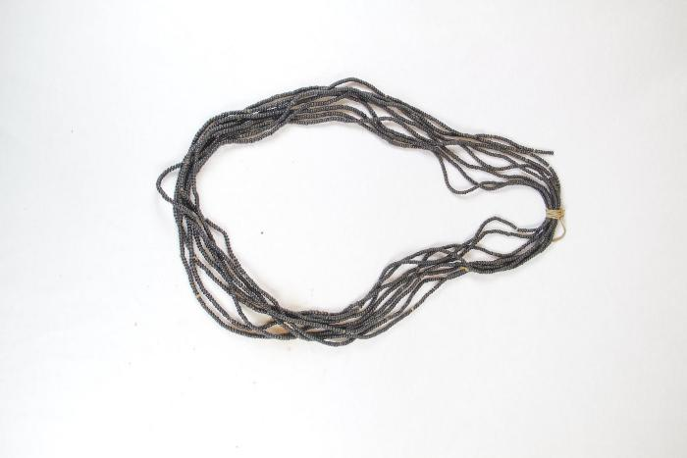
Shipibo Seed Necklace (SHA12)

Slide 8
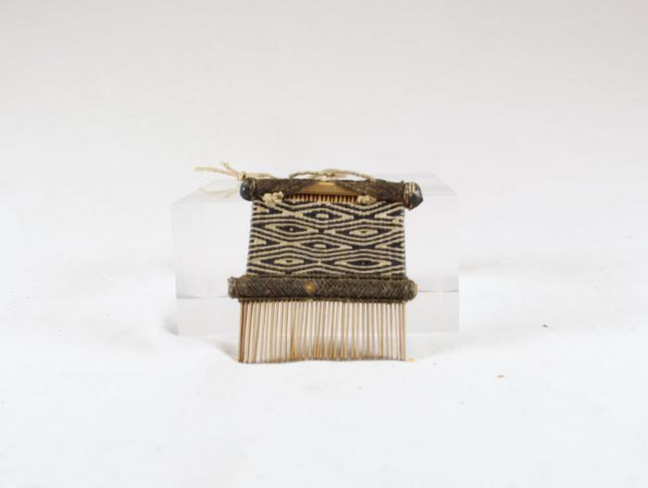
Shipibo Comb (SHA13)

Slide 9
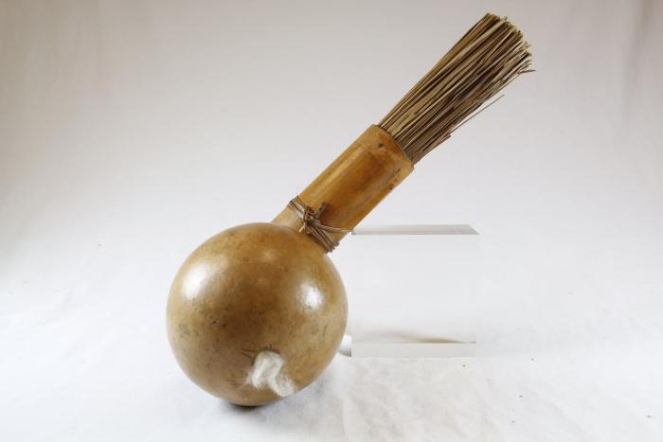
Shipibo Dart Quiver with Goard (SHA14)

Slide 10
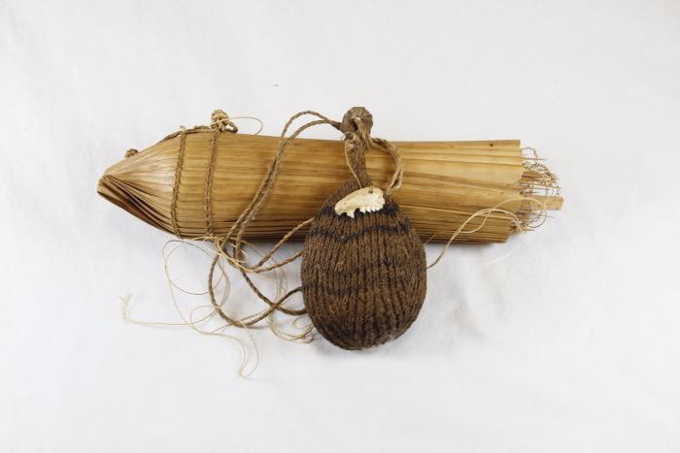
Shipibo Dart Quiver with Jaw Bone (SHA15)

Slide 11
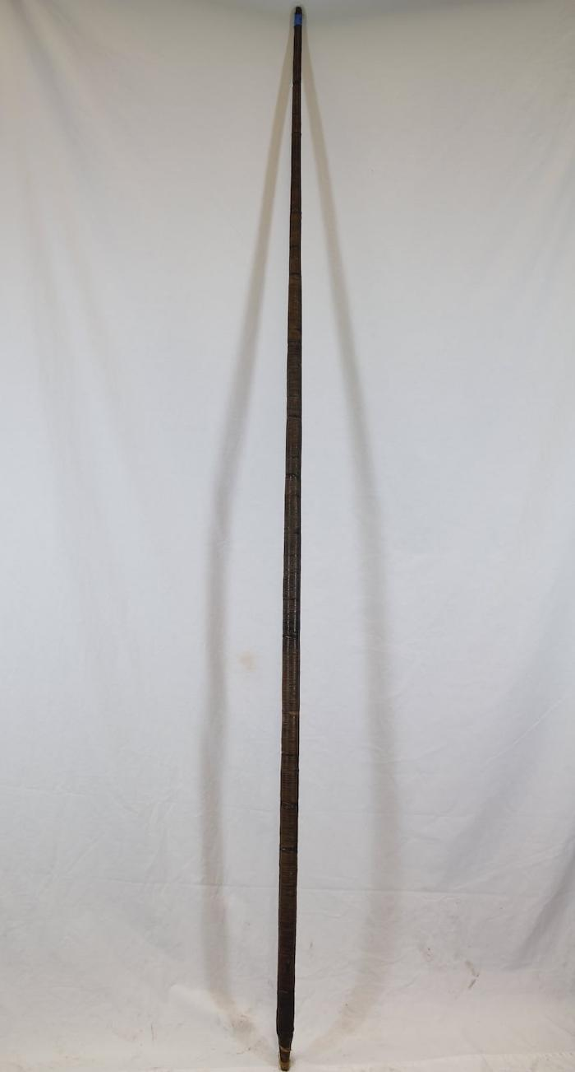
Shipibo Blowgun (SHA16)

Slide 12
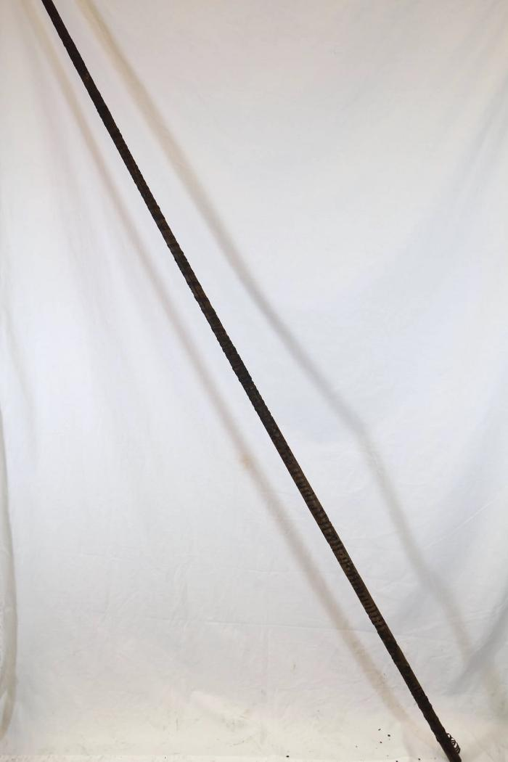
Shipibo Blowgun (damaged) (SHA17)

Slide 13
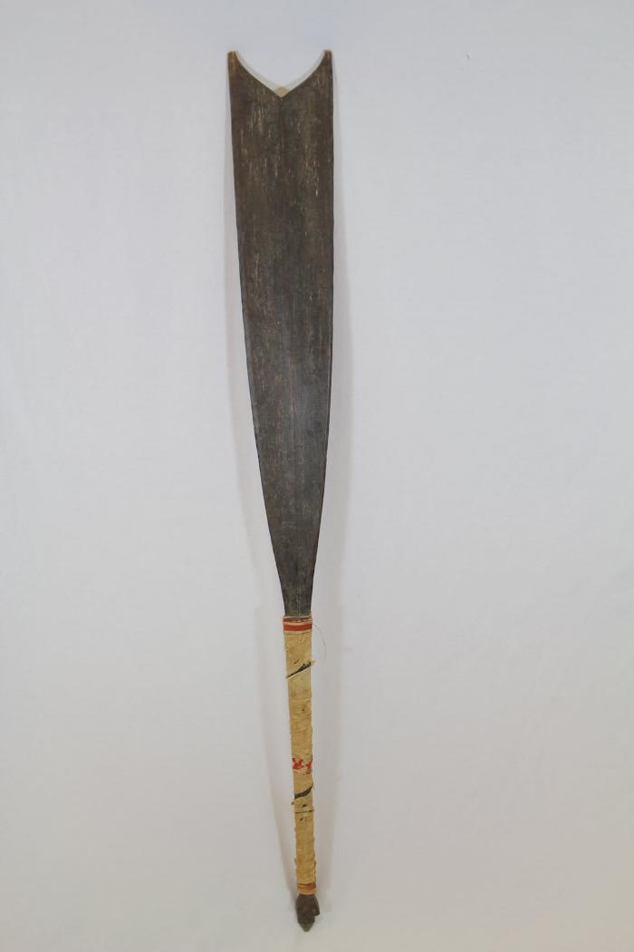
Shipibo Ceremonial Club (SHA18)

Slide 14
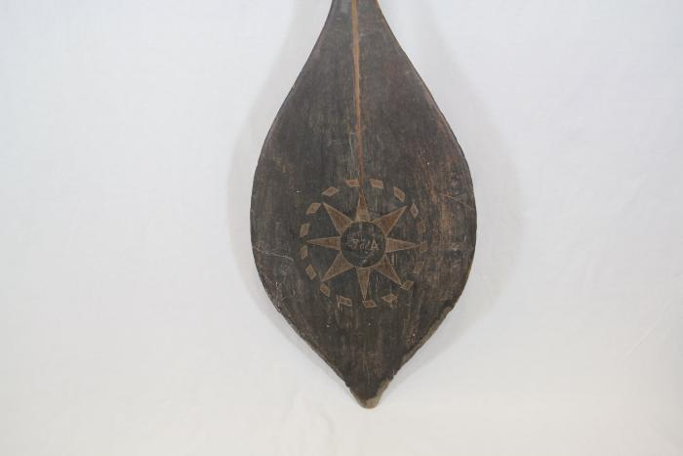
Shipibo Paddle (SHA19)

Slide 15
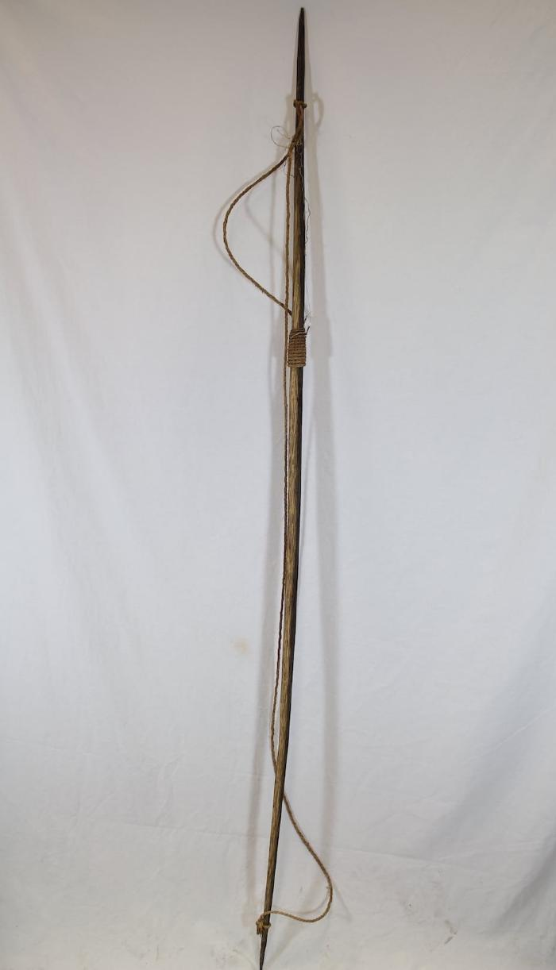
Shipibo Bow (SHA20)

Slide 16
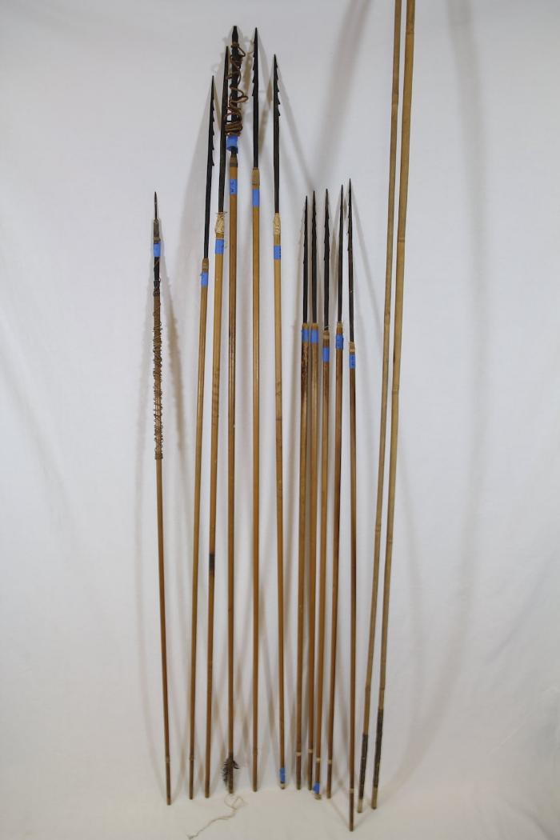
Shipibo Fishing Arrows (SHA21)

Slide 17
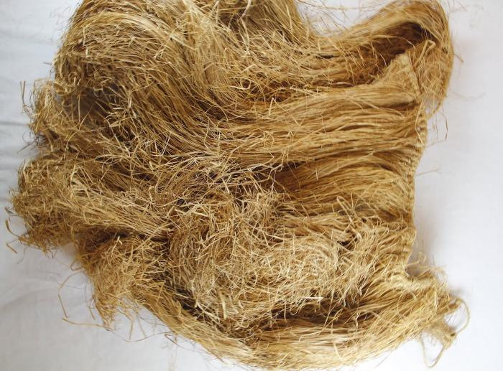
Shipibo Grass Clothing (SHA22)

