Slide 1
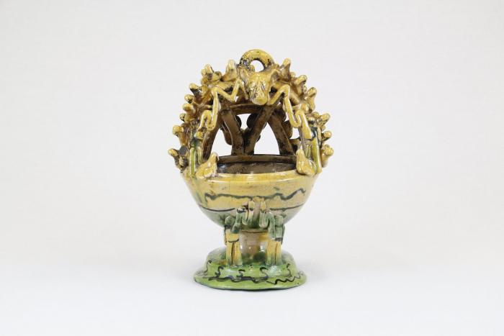
Mayolica Incense Burner (CA5)

Slide 2
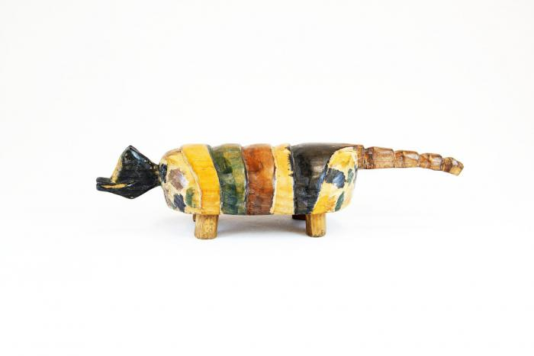
Painted Armadillo (M1088)

Slide 3
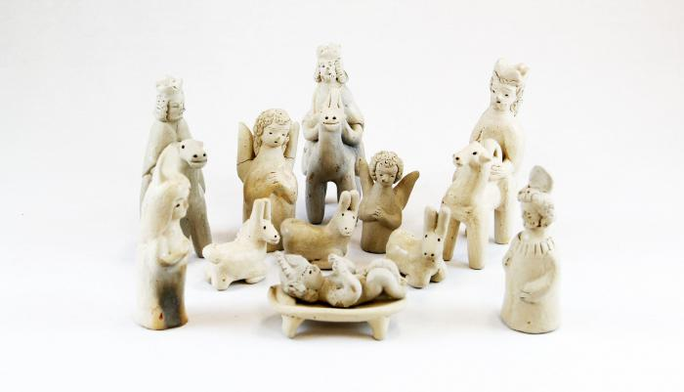
Clay Nativity (12 pieces) (M1528)

Slide 4
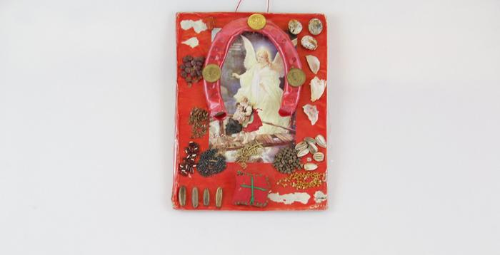
Guatemalan Horseshoe Wall Art (EH14)

Slide 5
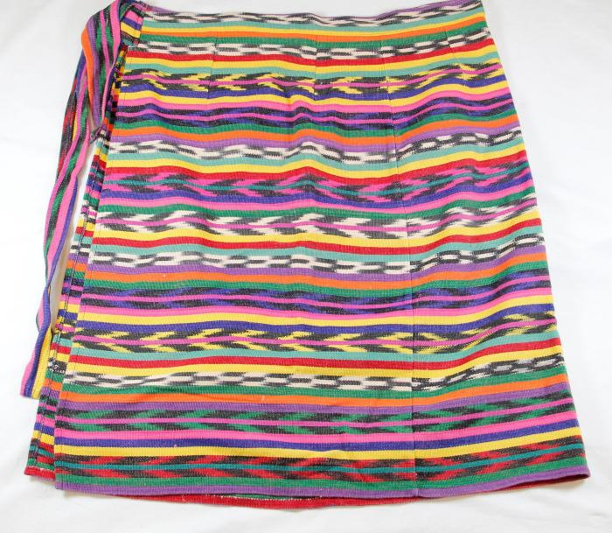
Big Jaguar Wrap Skirt (AFFA1)

Slide 6
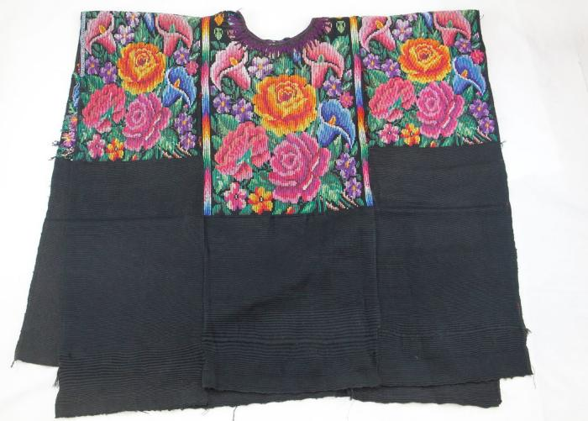
Chichicastenango Flowers Huipil (AFFA8)

Slide 7
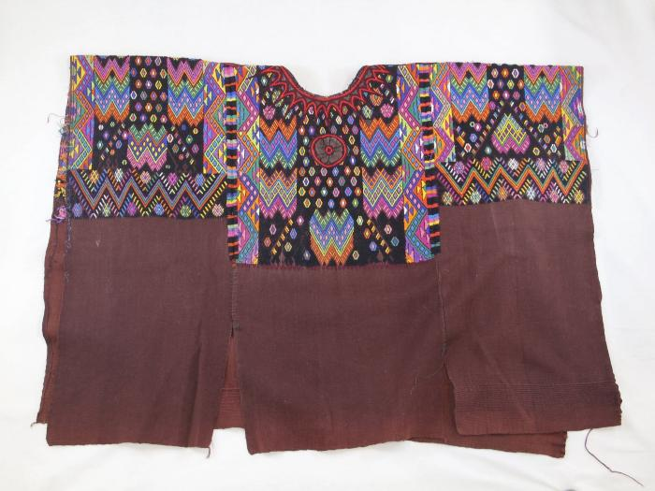
Chichicastenango Huipil (AFFA9)

Slide 8
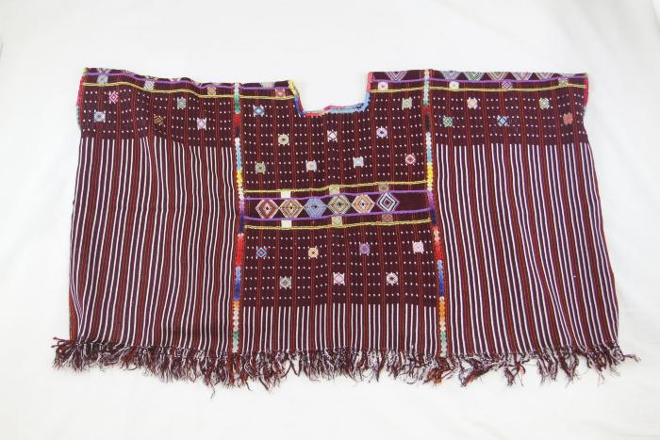
Colotenango Huipil (AFFA10)

Slide 9
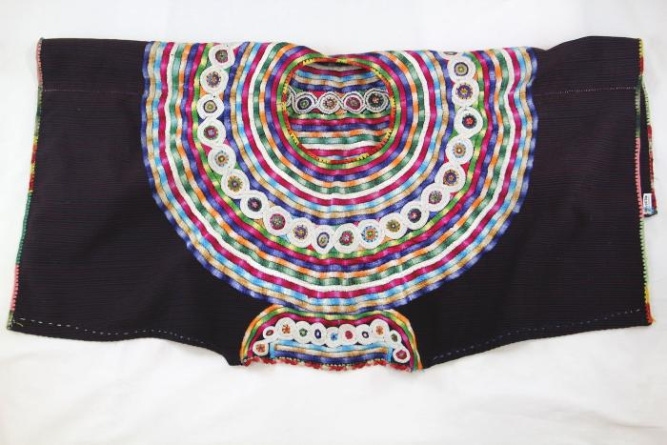
Joyabaj Huipil (AFFA12)

Slide 10
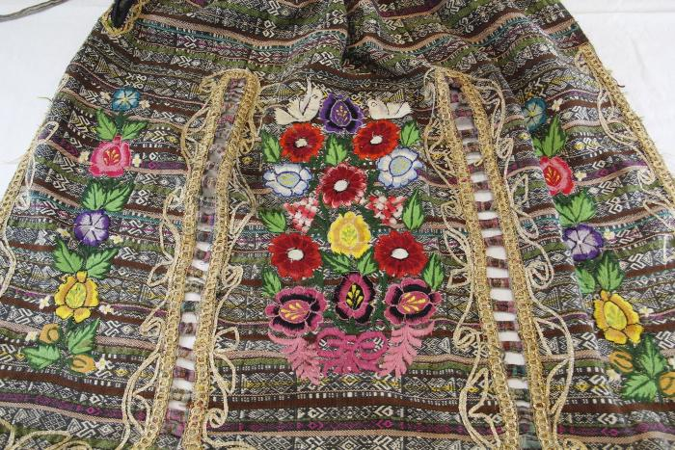
Market Apron (AFFA13)

Slide 11
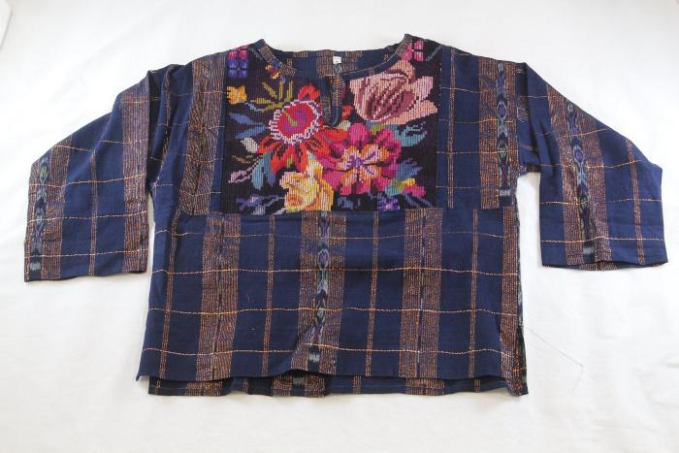
Chichicastenango Huipil with gold threading (AFFA17)

Slide 12
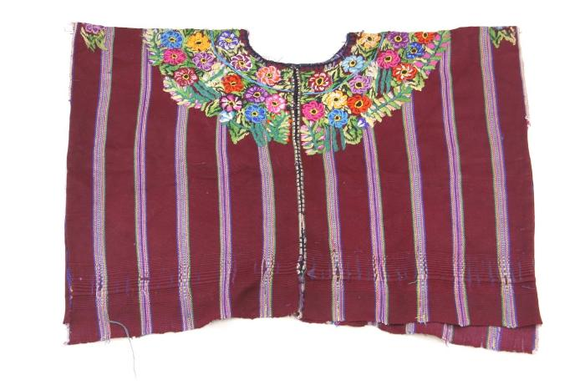
Patzún Huipil 1 (AFFA18)

Slide 13
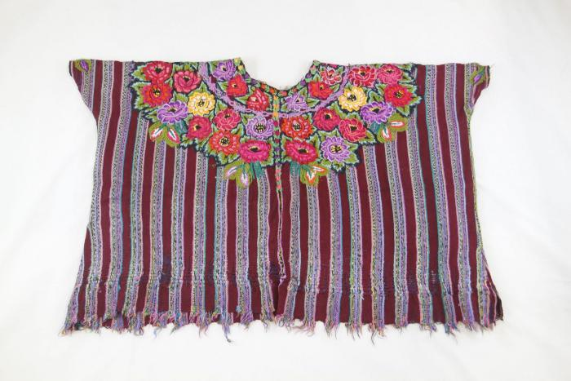
Patzún Huipil 2 (AFFA19)

Slide 14
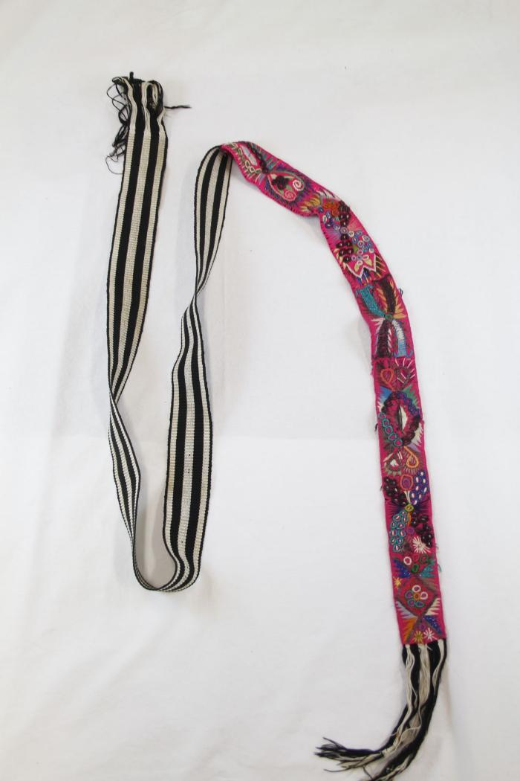
Pink Belt (AFFA20)

Slide 15
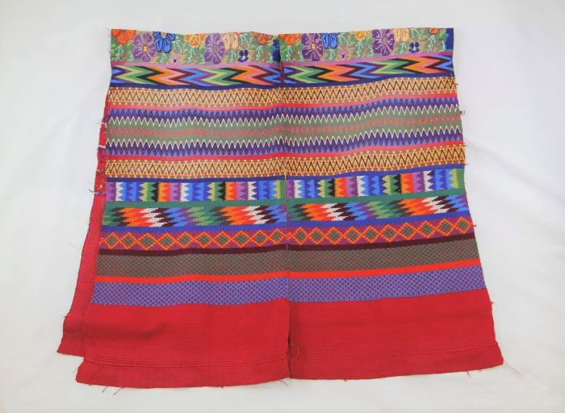
San Antonio Aguas Calientes Huipil (AFFA21)

Slide 16
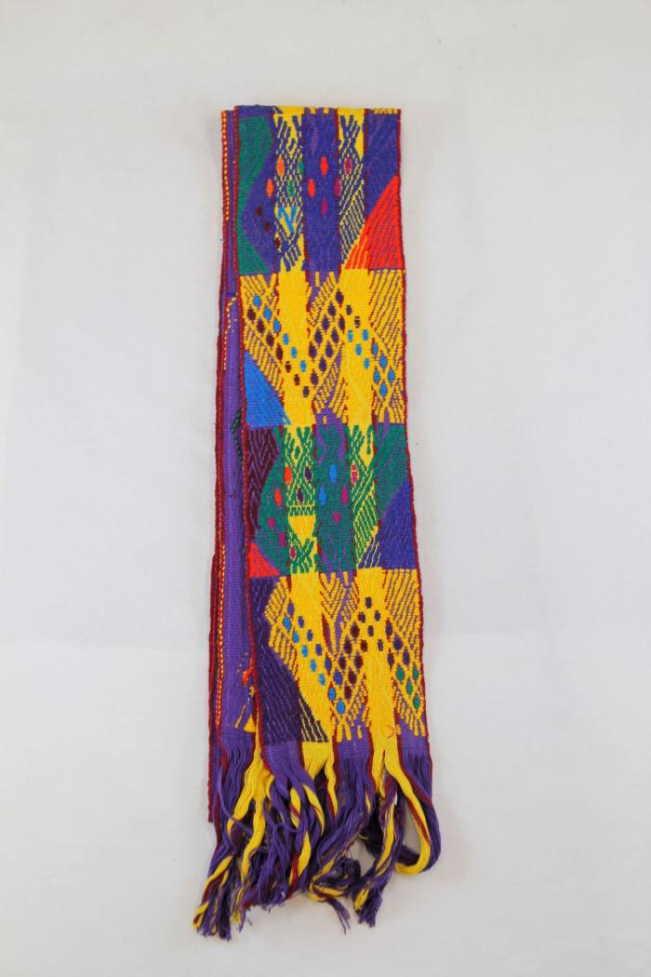
San Juan Sacatepequez Faja (AFFA22)

Slide 17
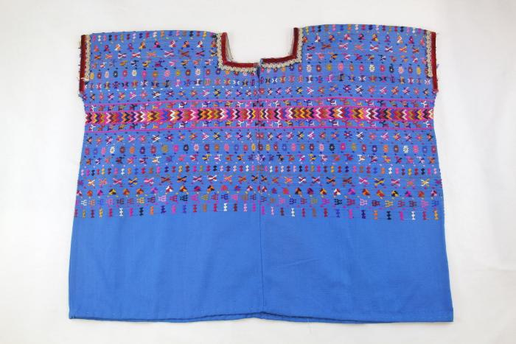
San Lucas Toliman Huipil (AFFA23)

Slide 18
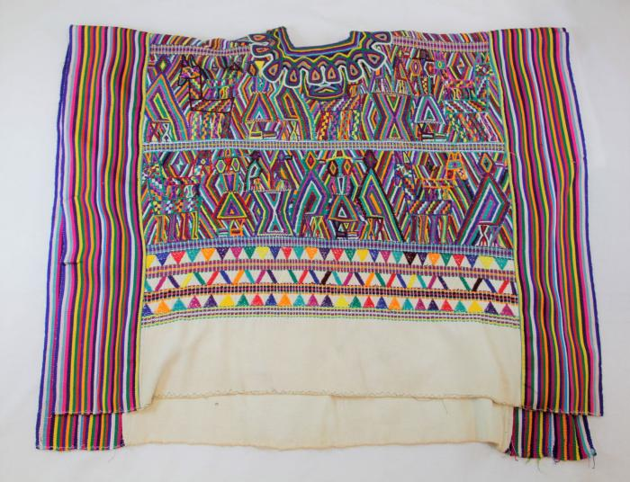
Santa Maria Nebaj Huipil (AFFA24)

Slide 19
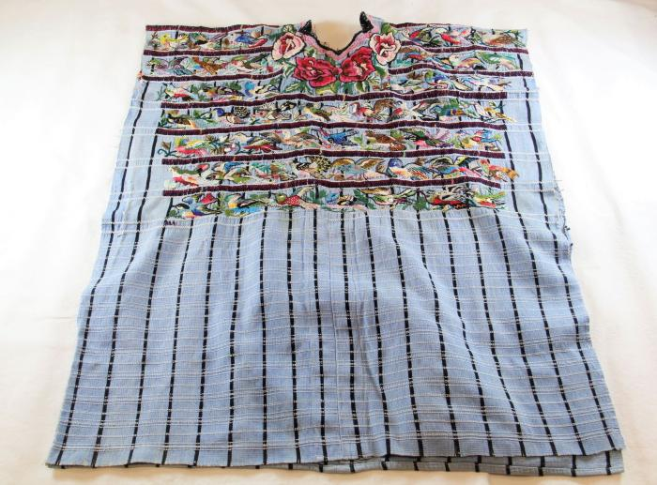
Santiago Atitlán Bird Huipil (AFFA25)

Slide 20
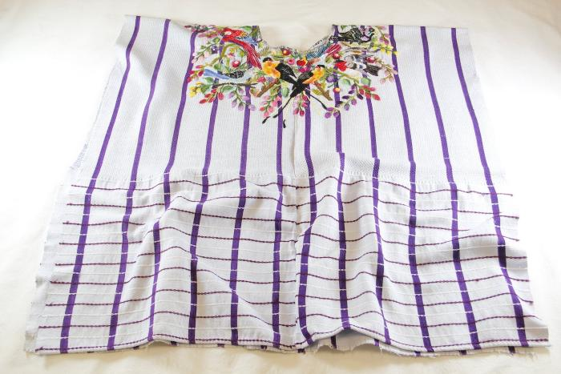
Santiago Atitlán Bird Huipil #2 (AFFA26)

Slide 21
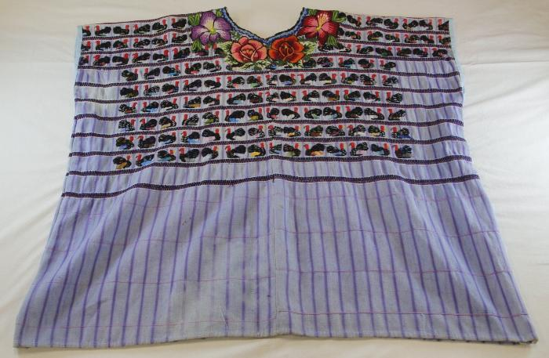
Santiago Atitlán Turkey Huipil (AFFA27)

Slide 22
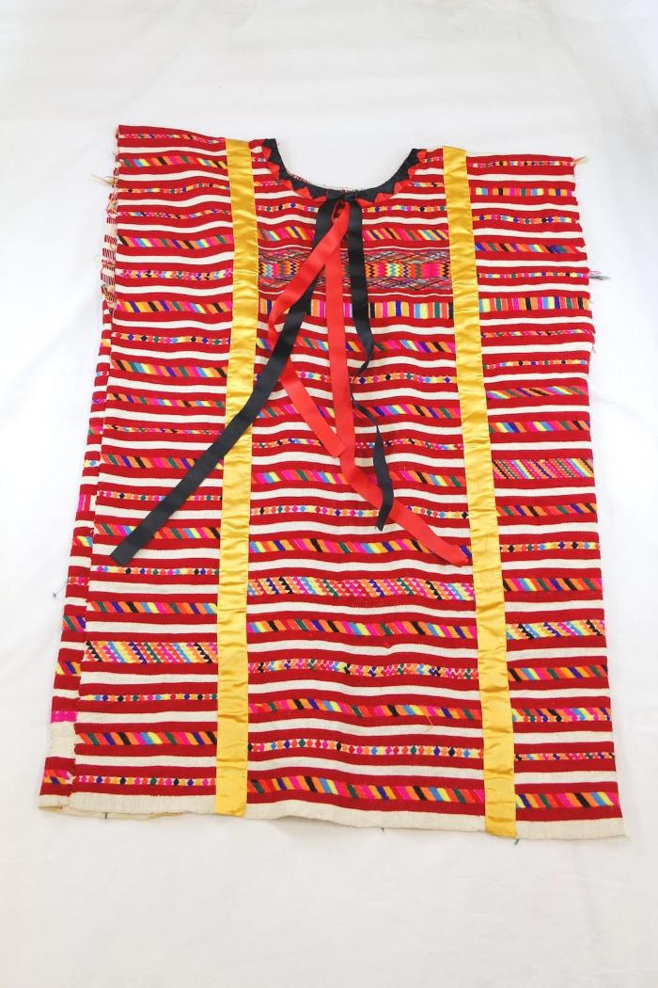
Trique Huipil (AFFA28)

Slide 23
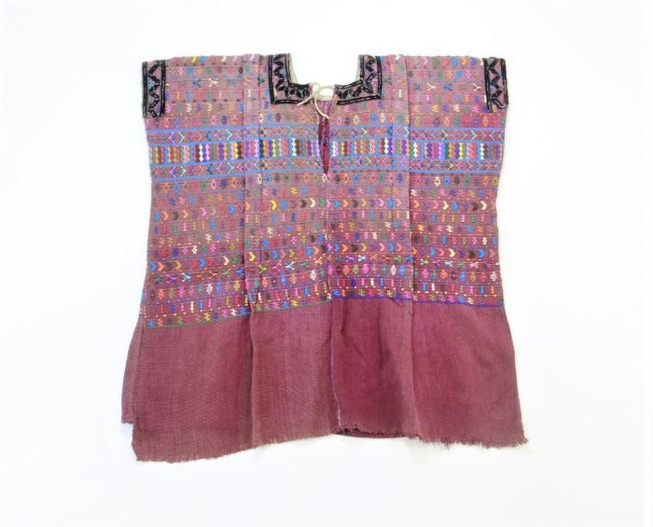
Guatemalan San Lucas Tolimán Huipil (WI2)

Slide 24
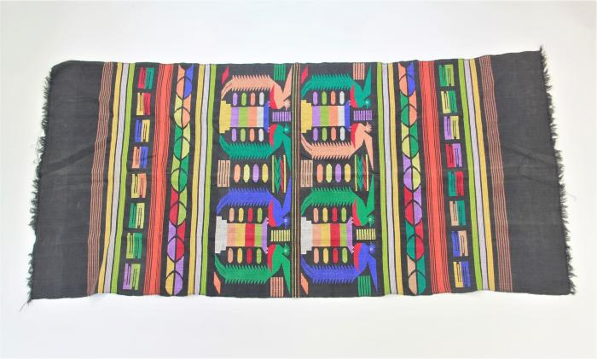
Guatemalan Tablecloth with Quetzales (WI3)

Slide 25
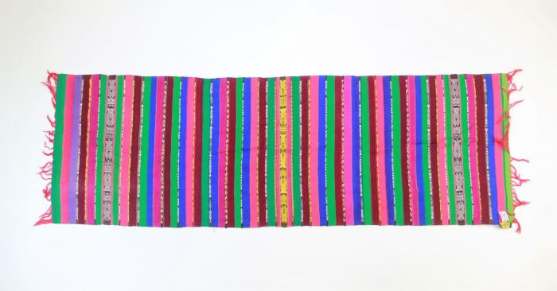
Rebozo from Totonicapan, Guatemala (WI5)

Slide 26
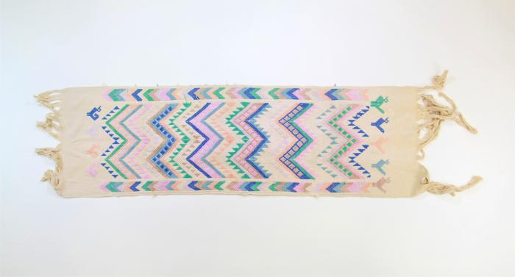
Vintage table runner from San Martin Jlitepeque, Guatemala (WI7)

Slide 27
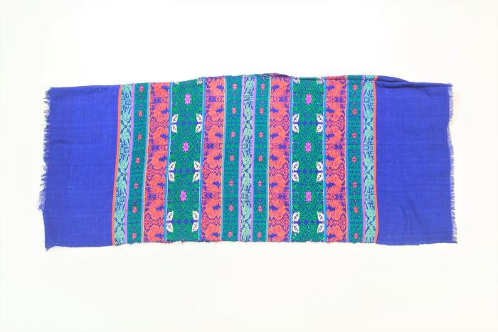
Guatemalan Huipil with Bird and Rooster Pattern (WI8)

Slide 28
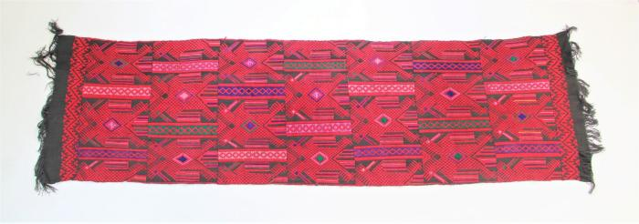
Guatemalan Rebozo (WI9)

Slide 29
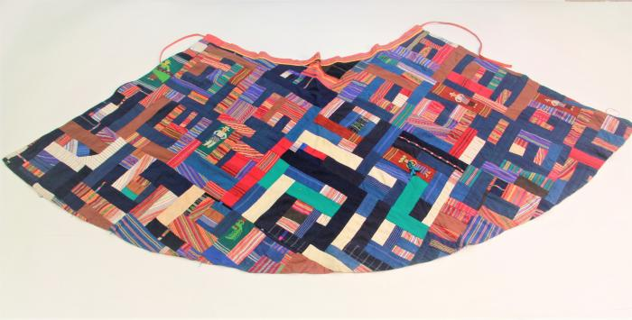
Guatemalan Patchwork Skirt (WI10)

Slide 30
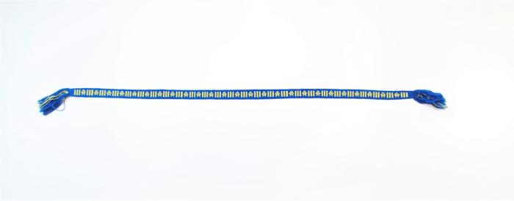
Blue and Yellow Guatemalan Belt (WI11)

Slide 31
Guatemalan Purple Belt with Diagonal Threaded Rectangles (WI12)

Slide 32
Guatemalan Striped Faja (WI13)

Slide 33
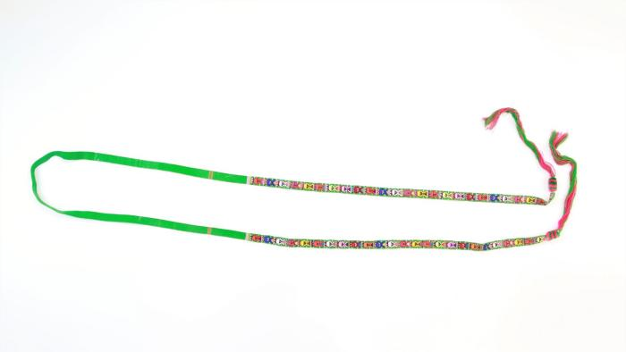
Thin Green Patterned Guatemalan Cinta (WI14)

Slide 34
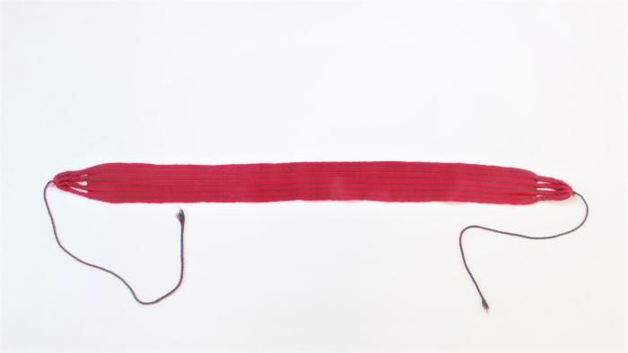
Guatemalan Short Red Striped Belt (WI15)

Slide 35
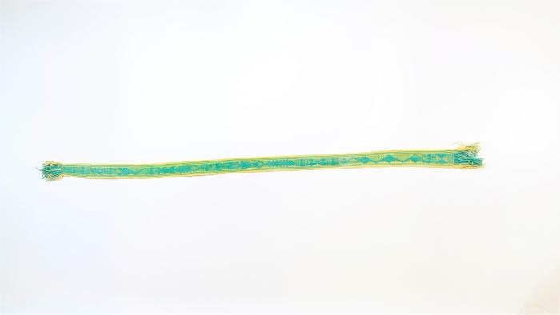
Turquoise and Yellow Faja (WI16)

Slide 36
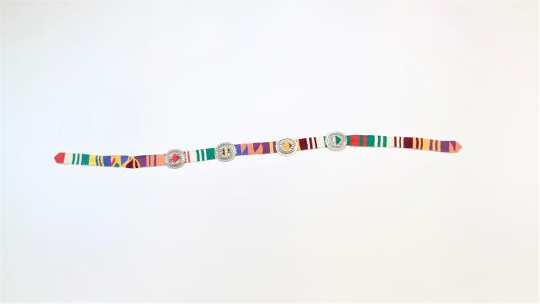
Guatemalan Belt with Silver Circle Conchos (WI17)

Slide 37
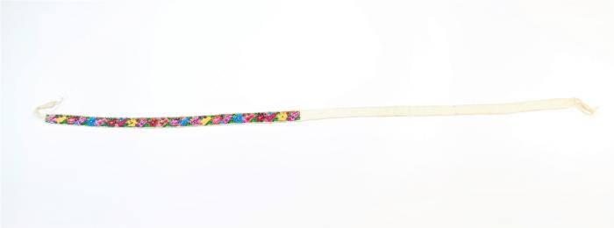
San Antonio Aguas Calientes Faja (WI18)

Slide 38
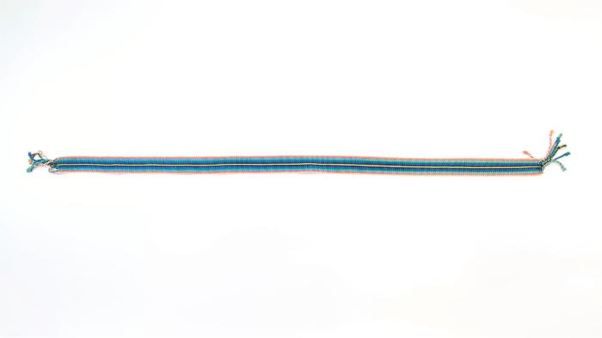
Guatemalan Multicolored Faja with Yellow Line (WI19)

Slide 39
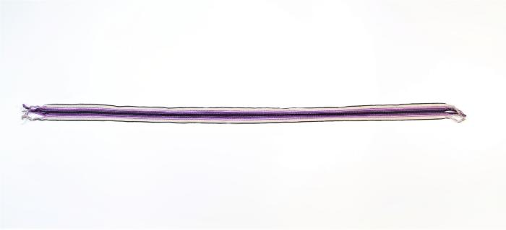
Purple and White Guatemalan Faja (WI20)

Slide 40
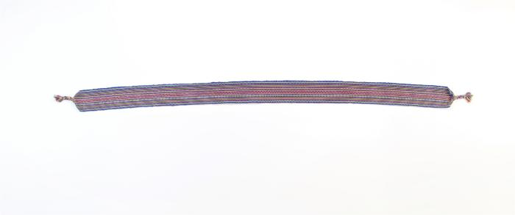
Stripe Belt (WI21)

Slide 41
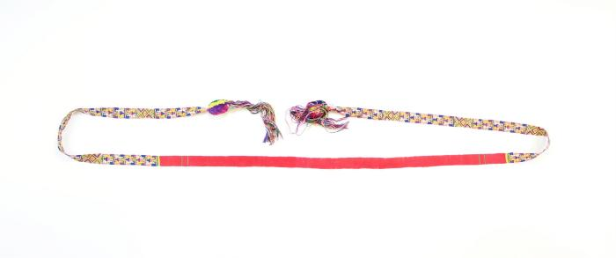
Zunil Cinta (WI22)

Slide 42
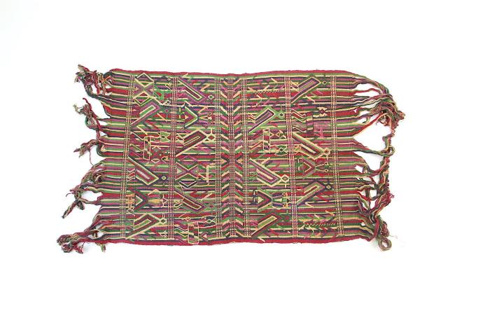
Santa Maria Nebaj Rebozo (HU4)

Slide 43
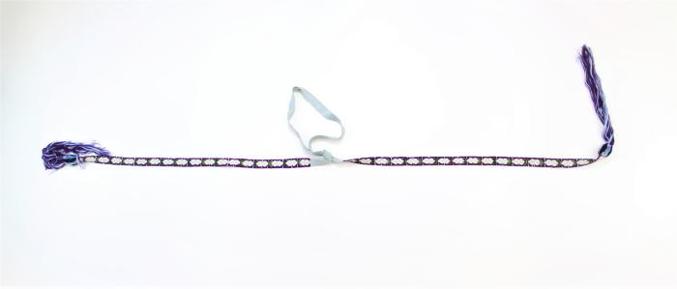
Repeating Flower Cinta (WI23)

Slide 44
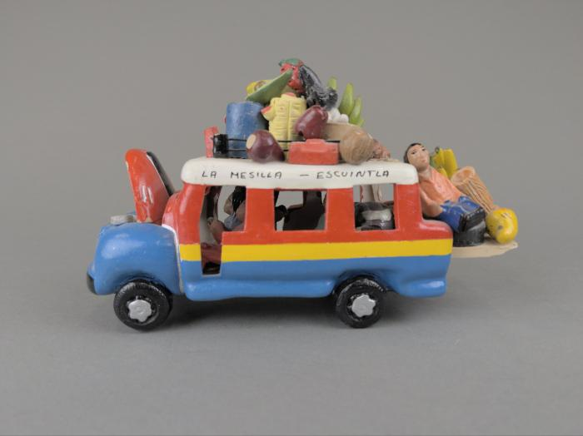
Guatemalan Chicken Van (FR42)

Slide 45
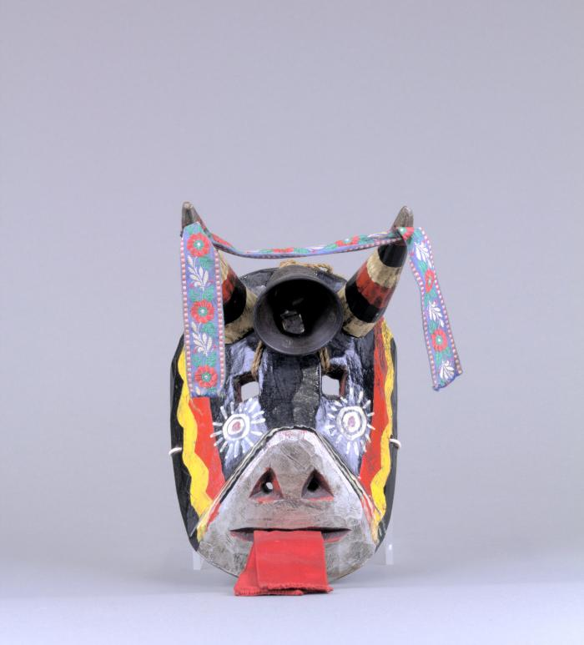
Guatemalan Wooden Bull Mask (FR43)

Slide 46
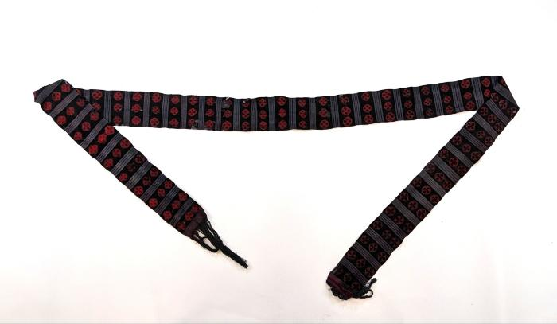
Red and Black Faja (FR44)

Slide 47
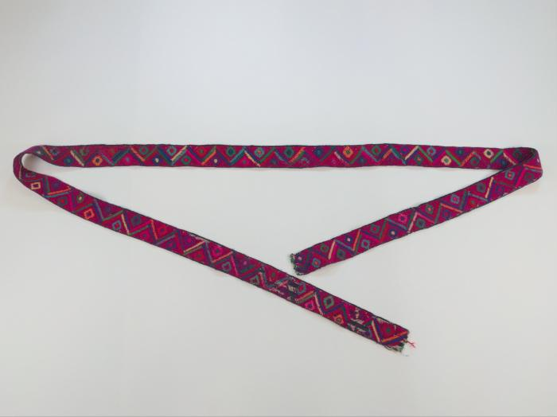
Chichicastenango Faja (FR45)

Slide 48
Faja (FR46)

Slide 49
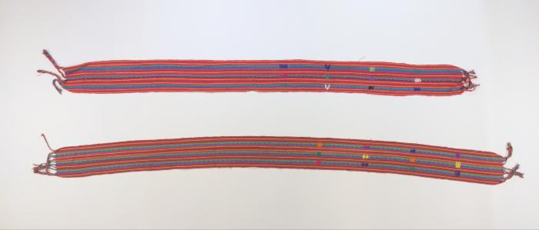
Guatemalan Sashes (Fajas) (FR47)

Slide 50
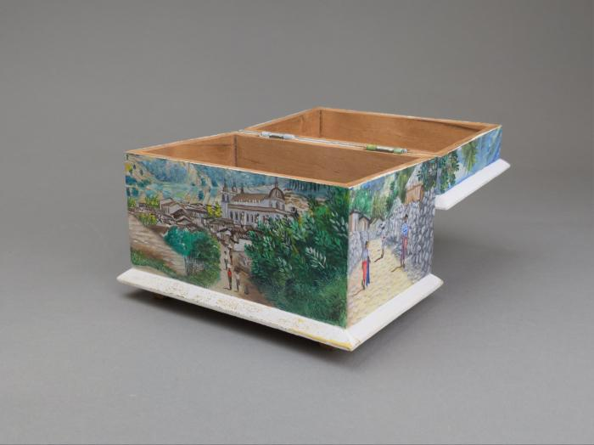
Painted Cofre Box by Otzoy (FR48)

Slide 51
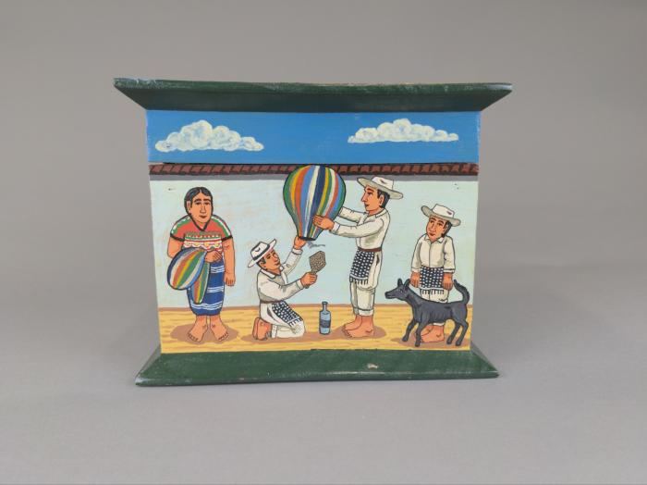
Painted Cofre by Filiberto Simon (FR49)

Slide 52
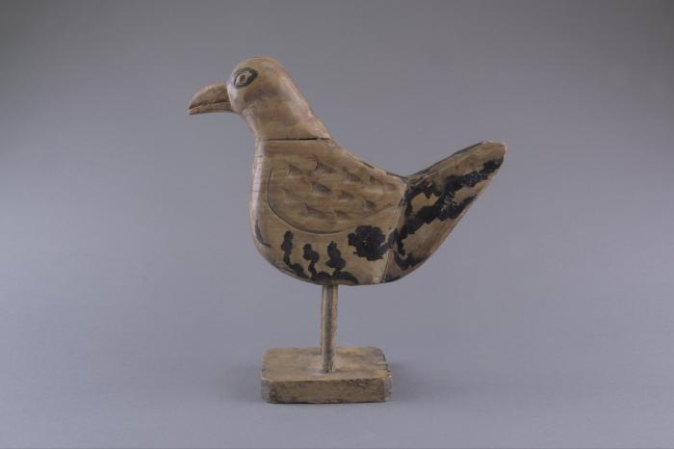
Guatemalan Chicken Candle Holder (FR50)

