Slide 1
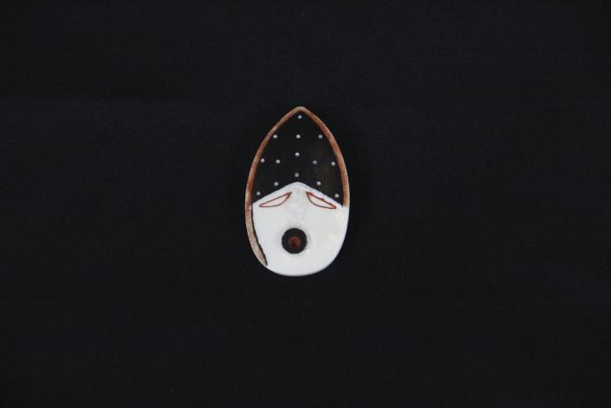
Spirit of the Mountain (AC4)

