Slide 1
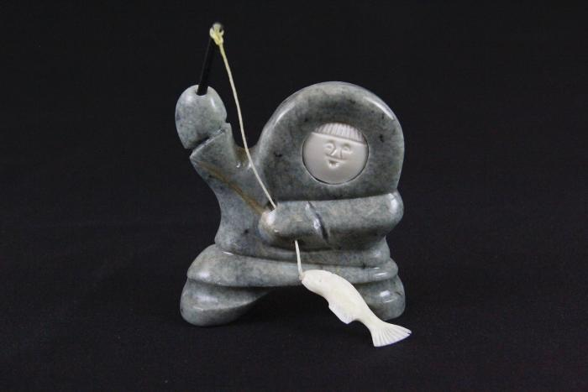
Boy Fishing (AC2)

