Slide 1
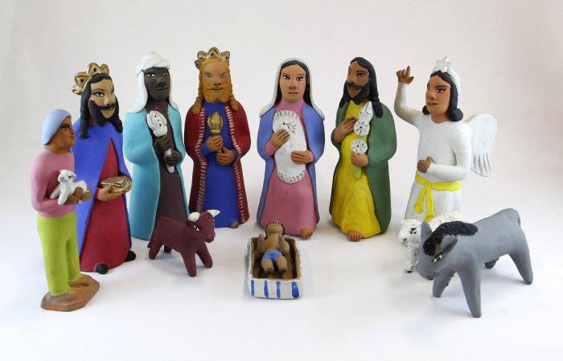
Oaxacan Aguilar Nativity #1 (12 pieces) (M1020a)

Slide 2
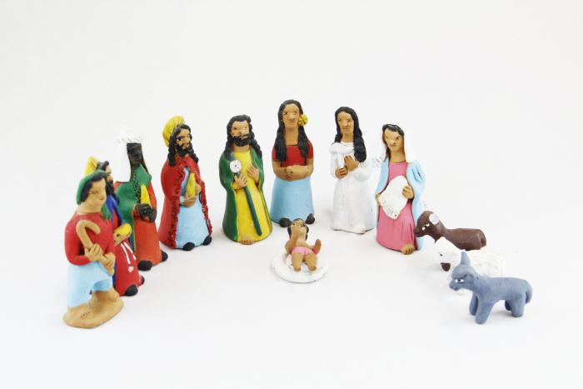
Oaxacan Aguilar Nativity #2 (13 pieces) (M1020b)

