Slide 1
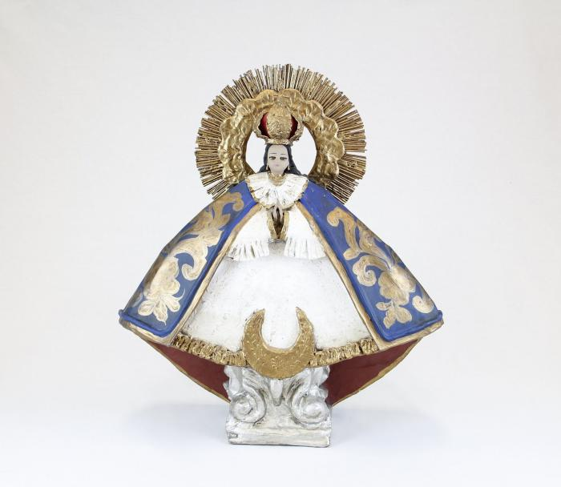
Nuestra Senora de la Salud (CA1)

Slide 2
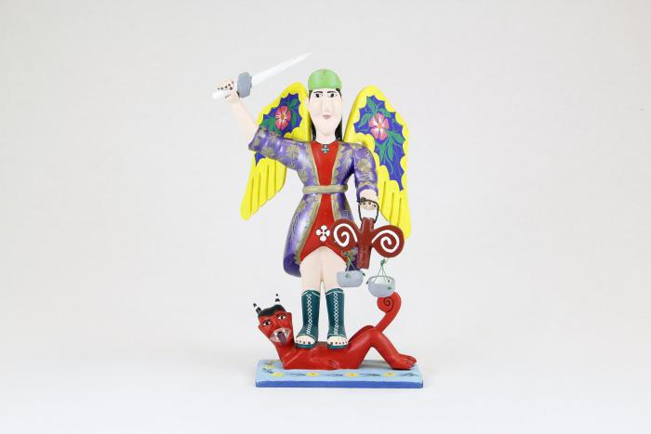
St. Michael with wings, sword and scales (CA2)

Slide 3
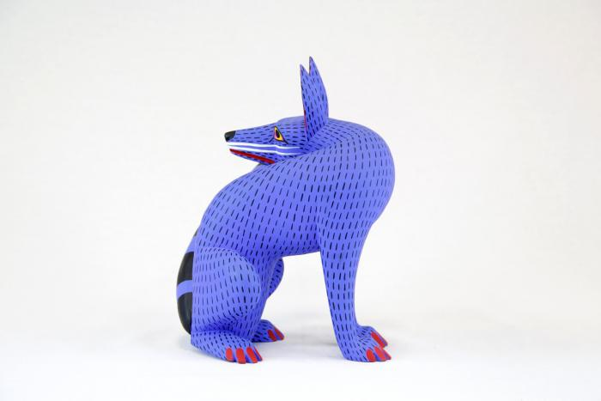
Coyote (CA3)

Slide 4
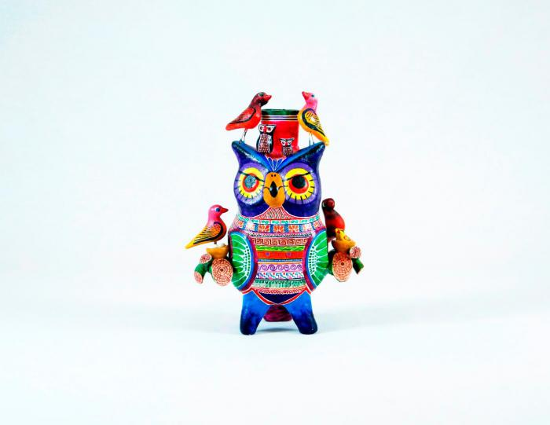
Owl Candleholder (CA4)

Slide 5
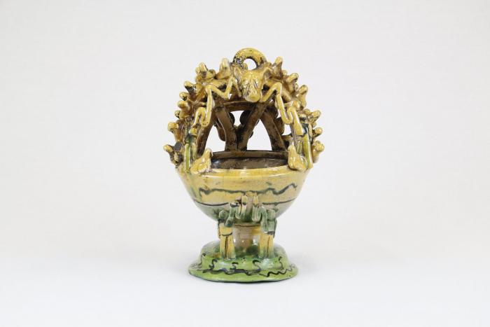
Mayolica Incense Burner (CA5)

Slide 6
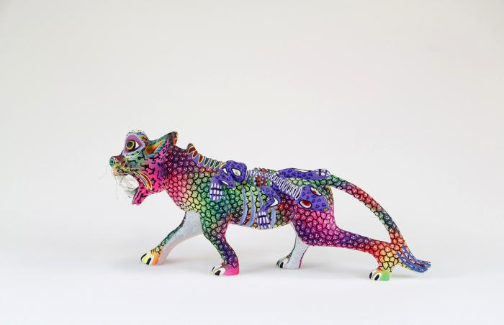
Whiskered jaguar with lizard (CA6)

Slide 7
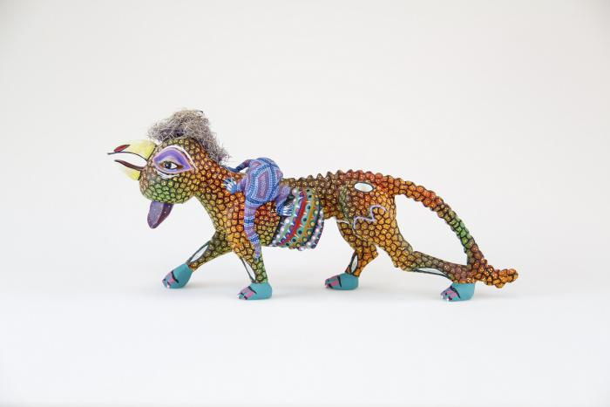
Rooster headed jaguar with lizard (CA7)

Slide 8
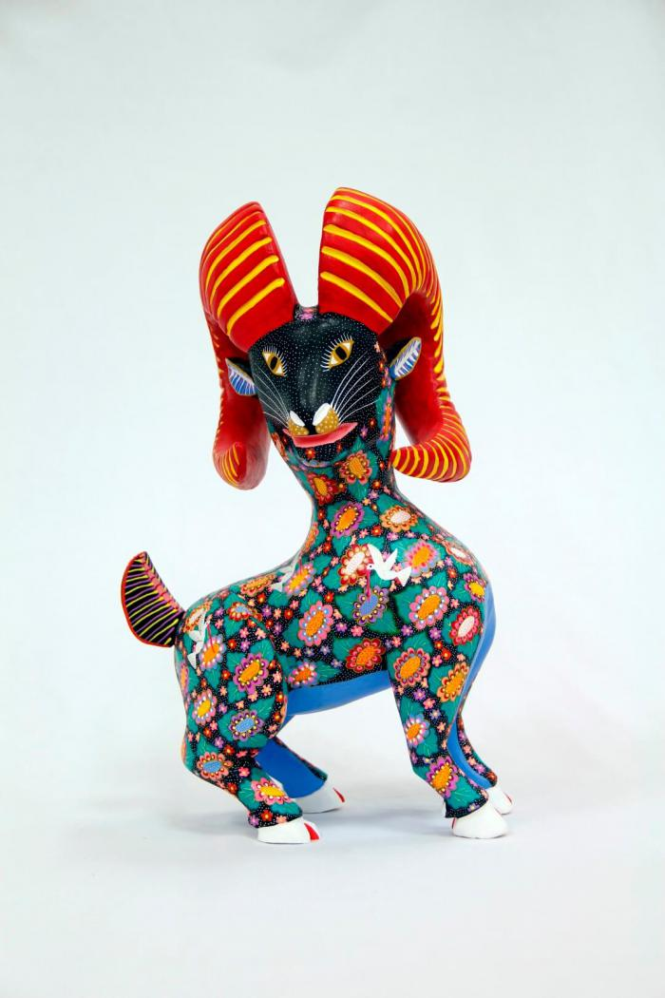
Horned goat (CA8)

Slide 9
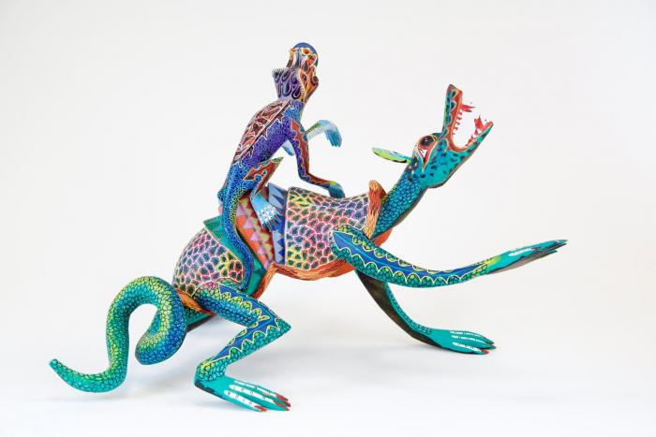
Two lizards (CA9)

Slide 10
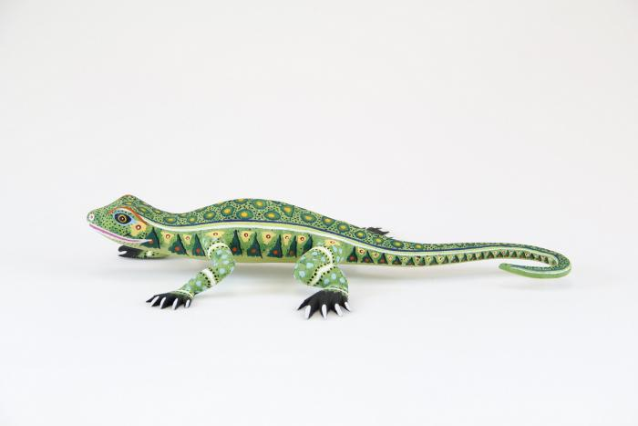
Lizard (CA10)

Slide 11
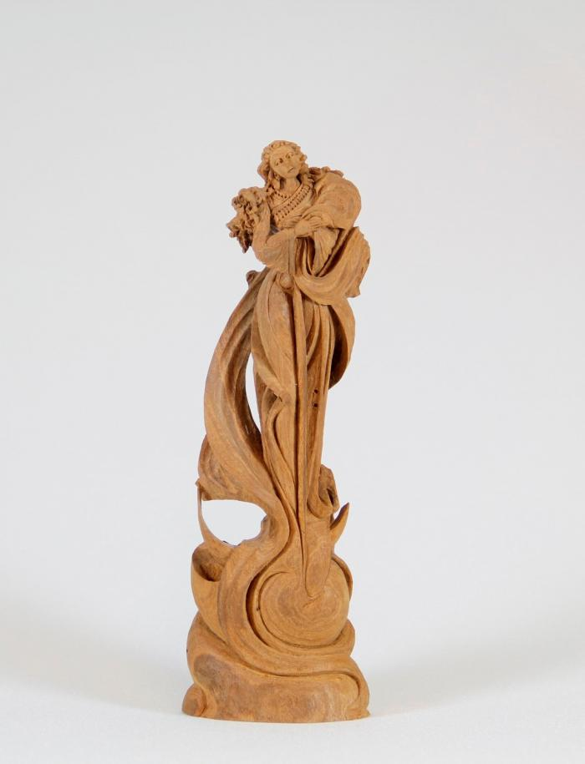
Angel (CA11)

Slide 12
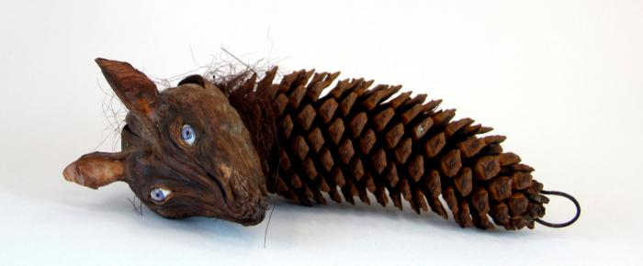
wolf head on pine cone (CA12)

Slide 13
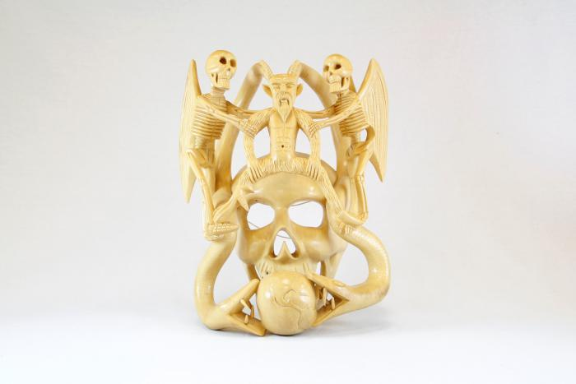
Skull mask (CA13)

Slide 14
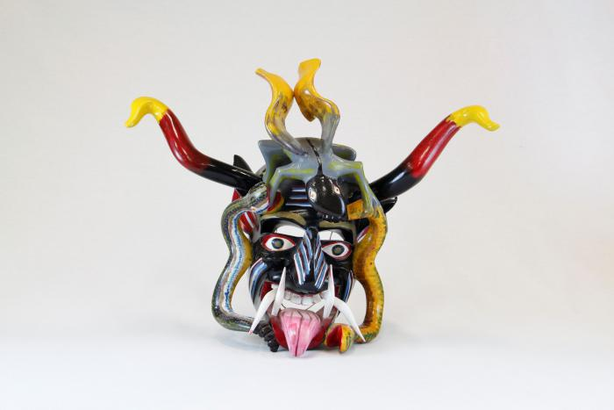
Devil mask with 2 snakes, horns (CA14)

Slide 15
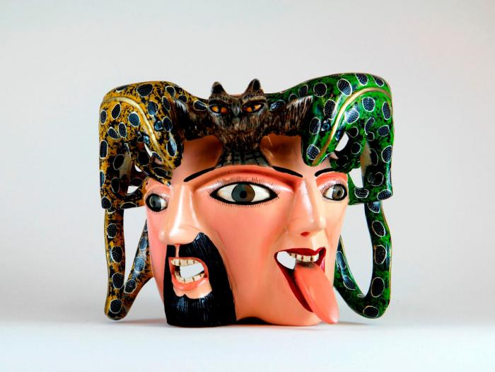
Male / female mask owl and lizards on top (CA15)

Slide 16
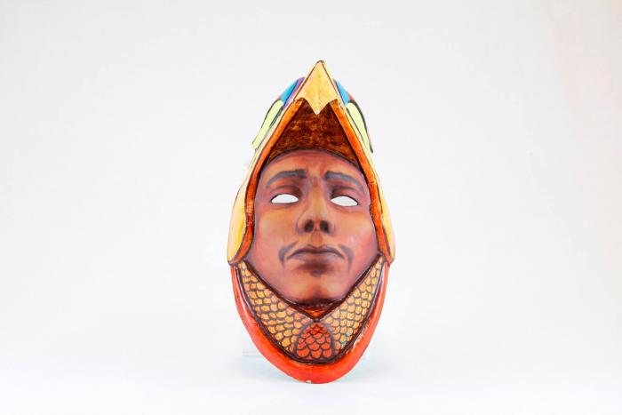
Eagle Warrior mask (CA16)

Slide 17
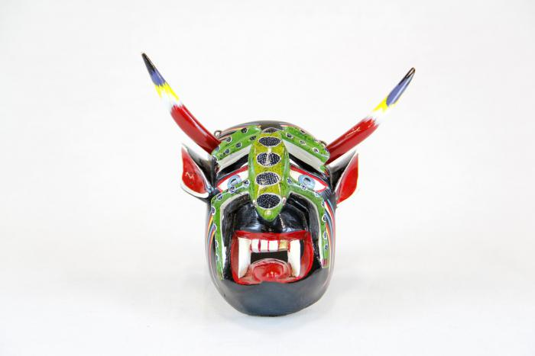
Small devil mask with green lizard (CA17)

Slide 18
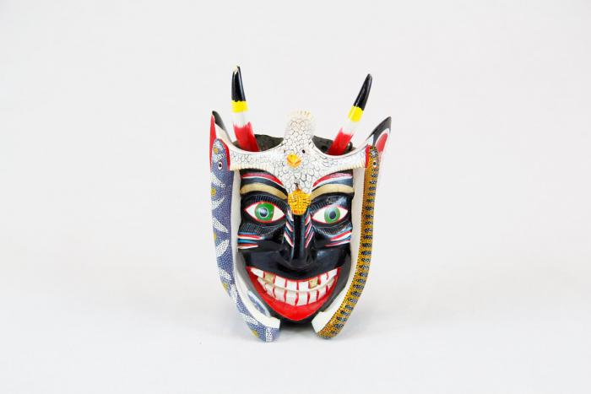
Small black devil mask with bird (CA18)

Slide 19
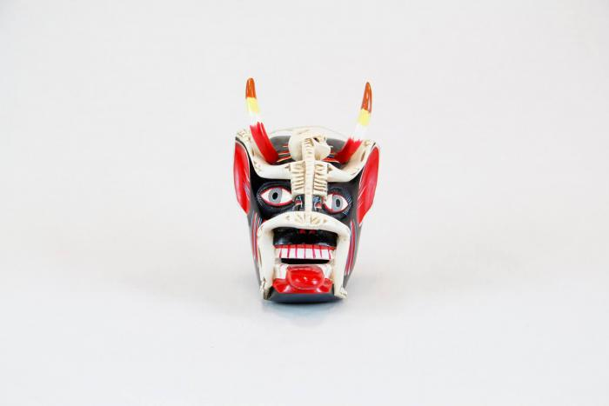
Small devil mask with skeleton (CA19)

Slide 20
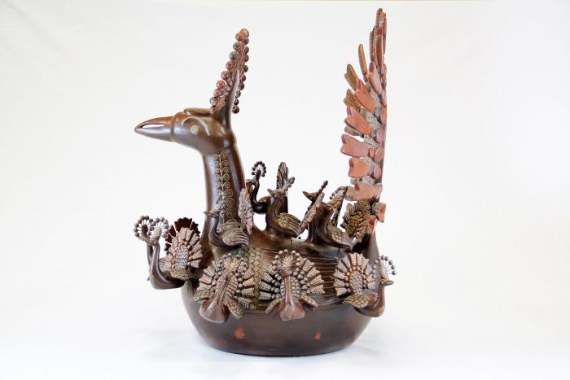
Peacock and Babies (CA20)

Slide 21
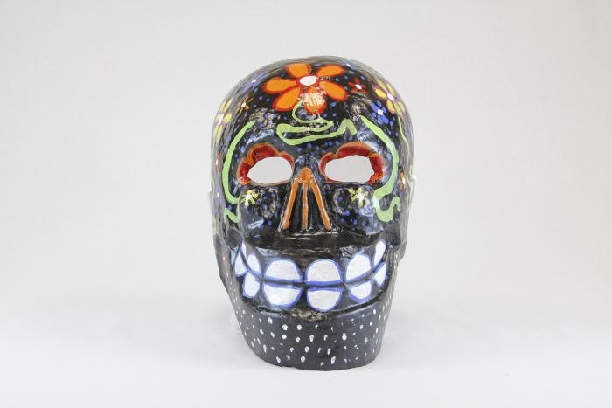
Large black skull mask with flowers (CA21)

Slide 22
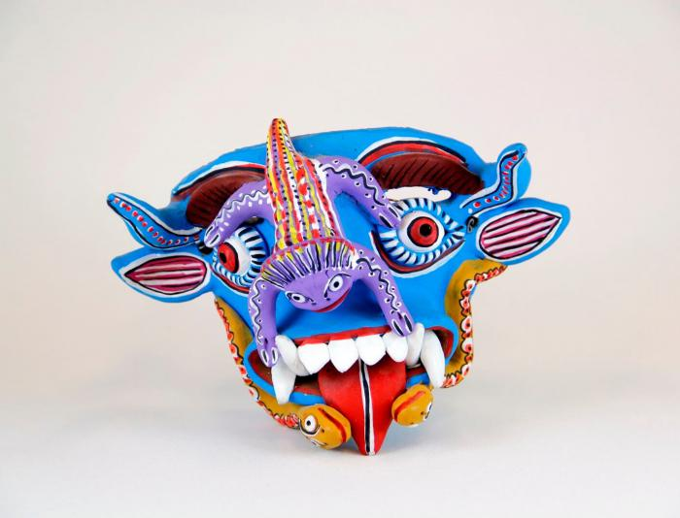
Blue Devil mask (CA22)

Slide 23
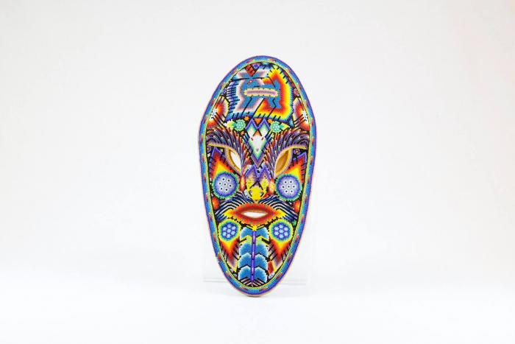
Huichol mask (CA23)

Slide 24
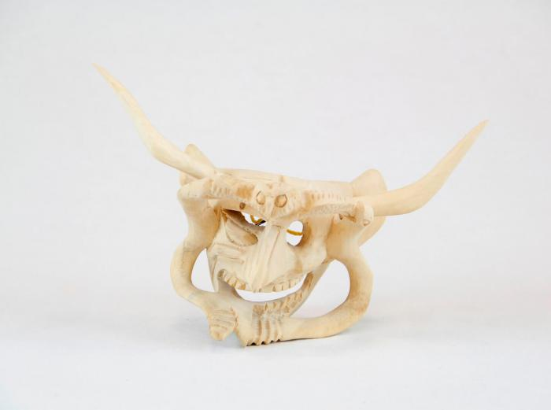
Devil Mask w/ two serpents and owl (CA24)

Slide 25
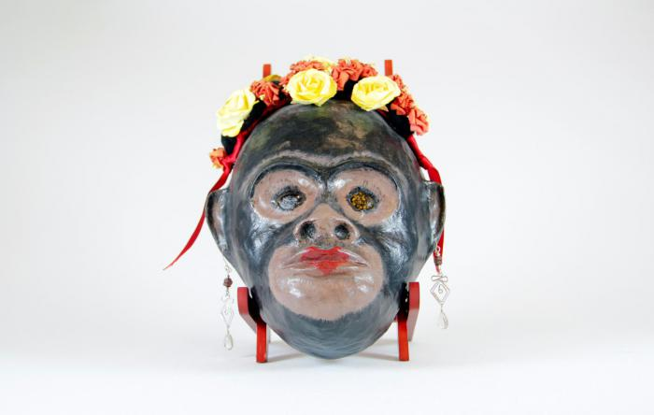
Monkey mask with flowers and earrings (CA25)

Slide 26
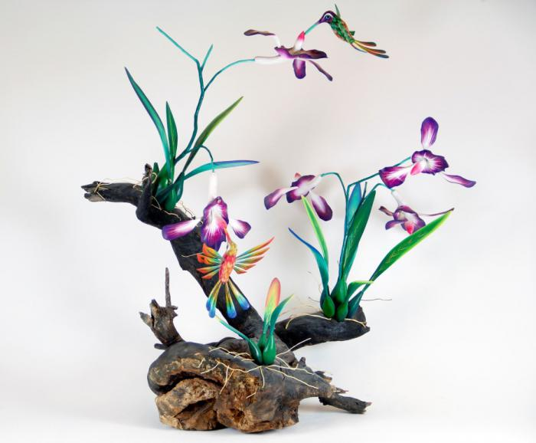
Orchid and Hummingbirds on driftwood base (CA26)

Slide 27
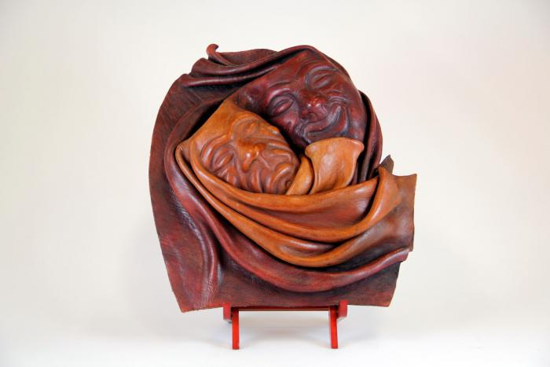
"Good Times / Bad Times" Mask (CA27)

Slide 28
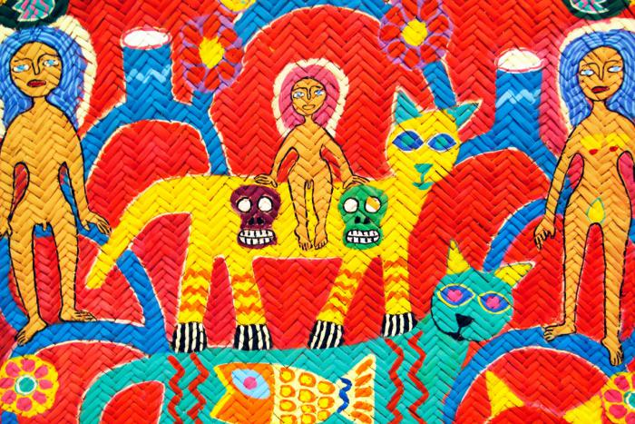
Woven Tree of Life Mat (CA28)

Slide 29
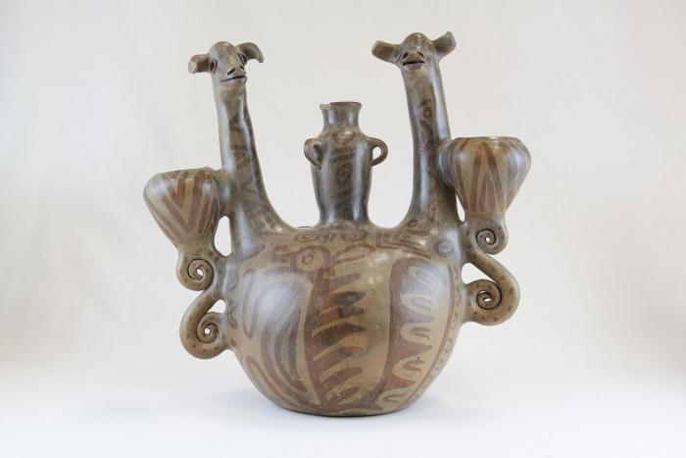
Double Headed Giraffe Candelabra (JO1)

Slide 30
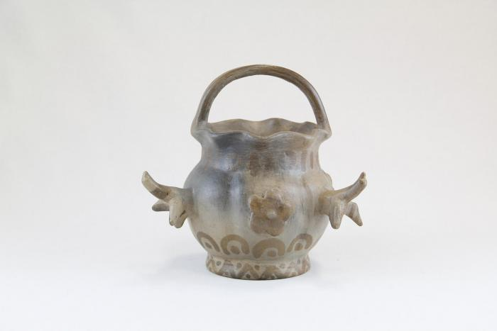
Small Pot with Birds (JO2)

Slide 31
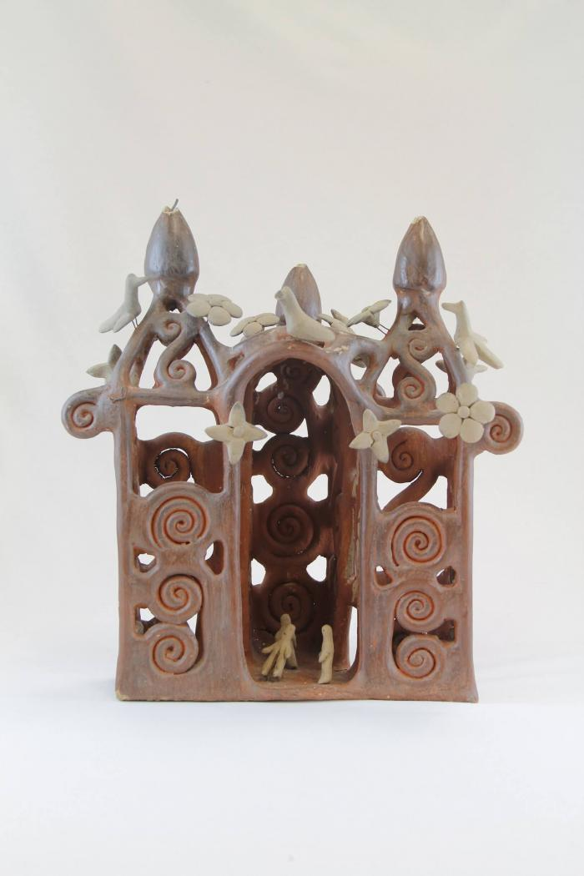
Large Ceramic Church (JO3)

Slide 32
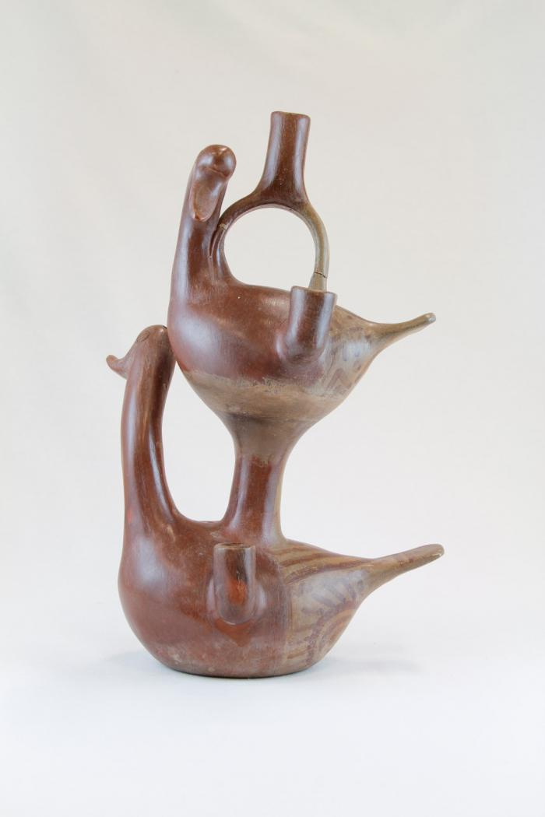
Two Duck Candelabra (JO4)

Slide 33
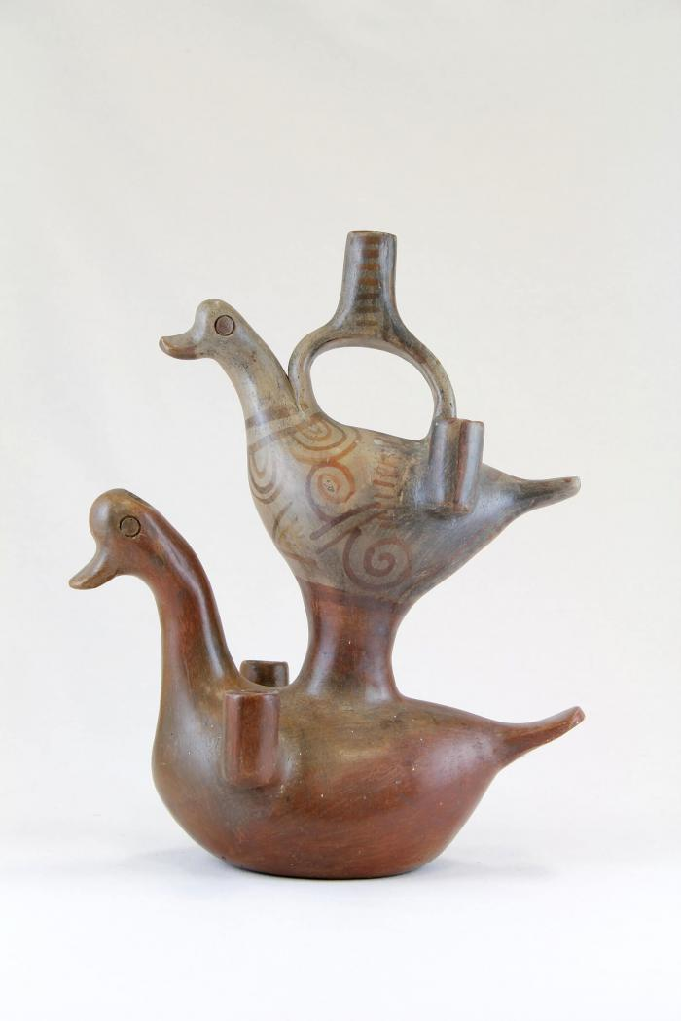
Two Duck Diamond Candelabra (JO5)

Slide 34
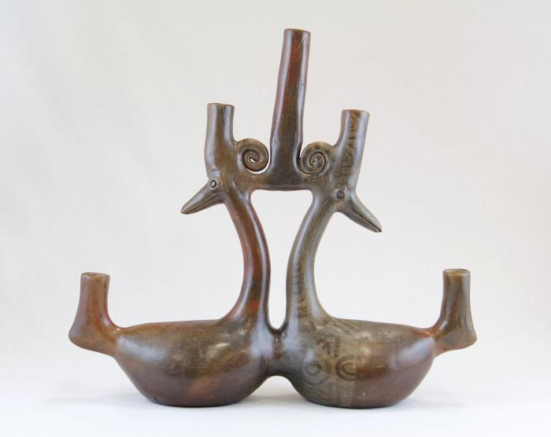
Parallel Ducks Candelabra (JO6)

Slide 35
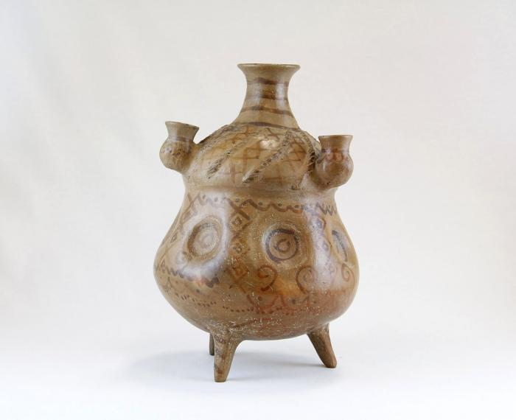
Large Criss Cross Candelabra Pot (JO7)

Slide 36
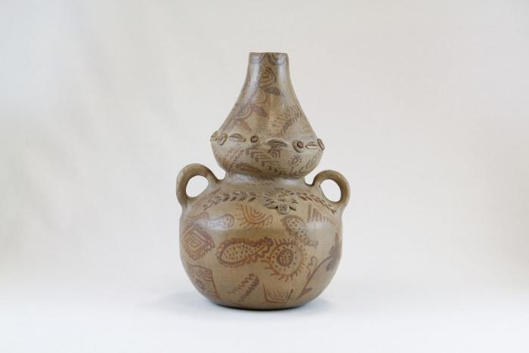
Two Handle Pot with Flowers (JO8)

Slide 37
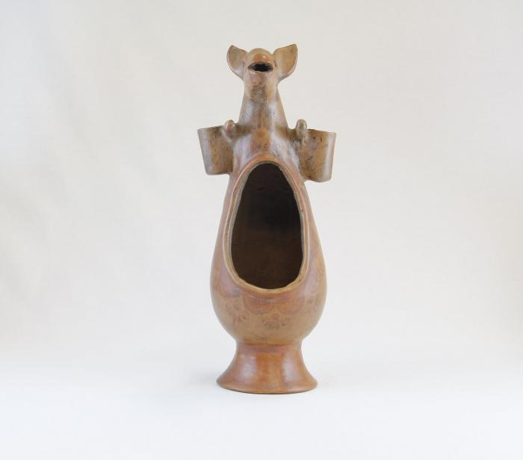
Kangaroo Luminaria (JO9)

Slide 38
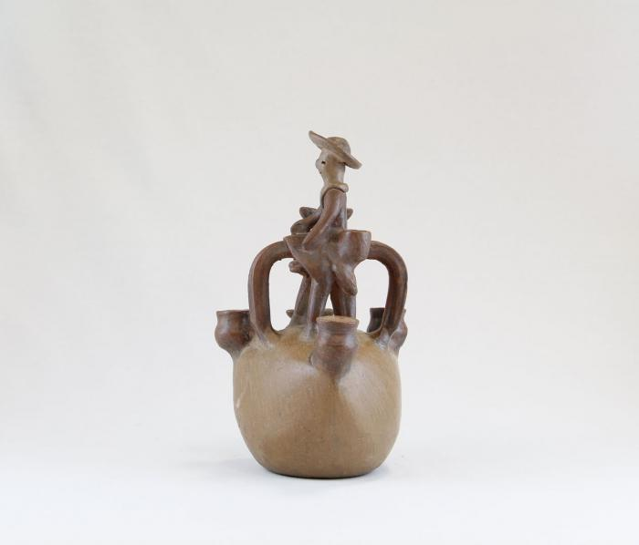
Man on Horse Candelabra (JO10)

Slide 39
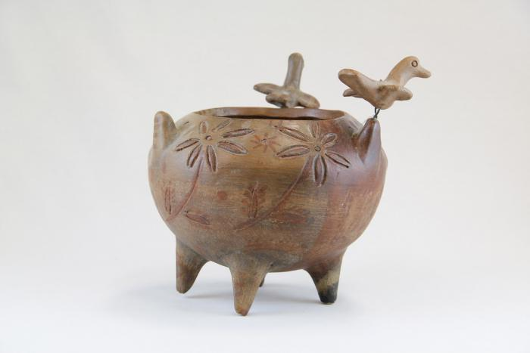
Incised Pot with Three Birds (JO11)

Slide 40
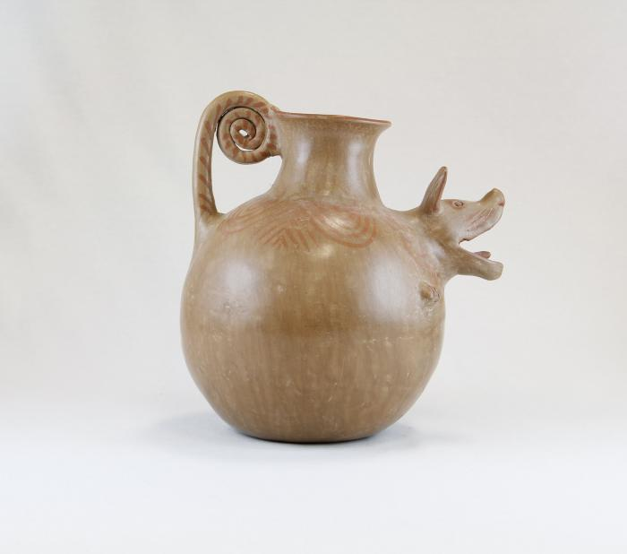
Barking Dog Pot (JO12)

Slide 41
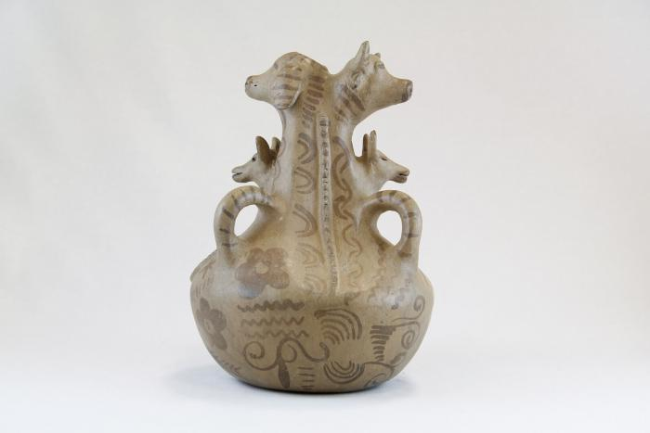
Three Dogs and a Cow Pot (JO13)

Slide 42
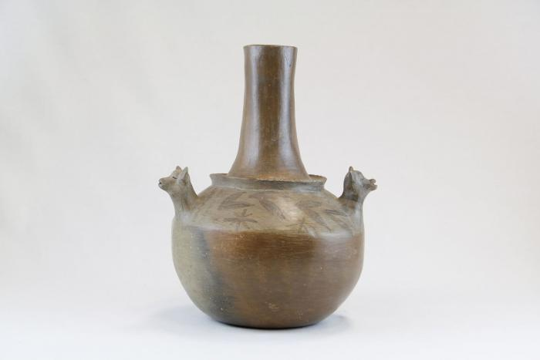
Three Dog Pot (JO14)

Slide 43
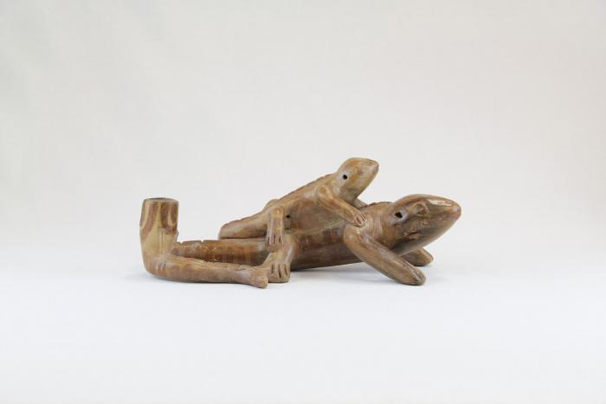
Lizard and Baby Lizard Candle Holder (JO15)

Slide 44
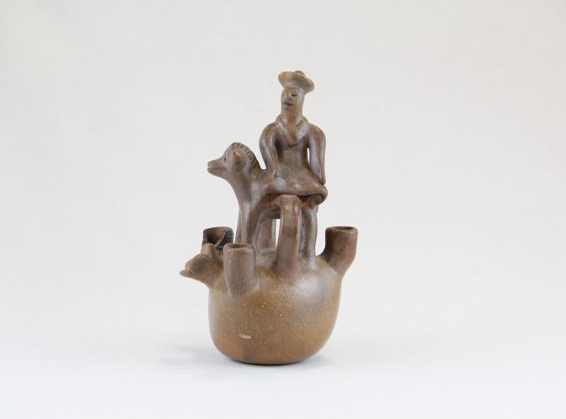
Little Man on Horse Candelabra (JO16)

Slide 45
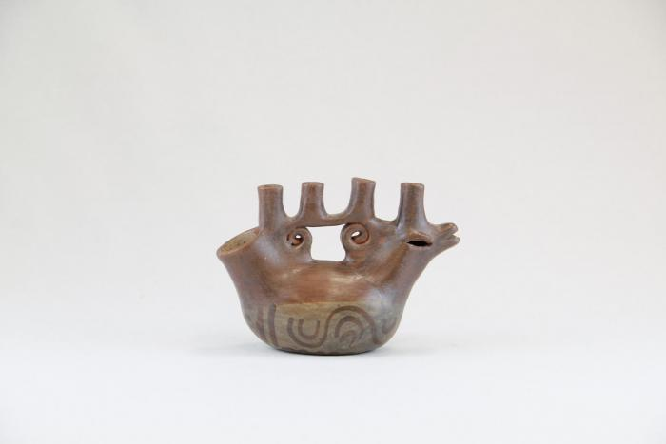
Sitting Bird Candelabra (JO17)

Slide 46
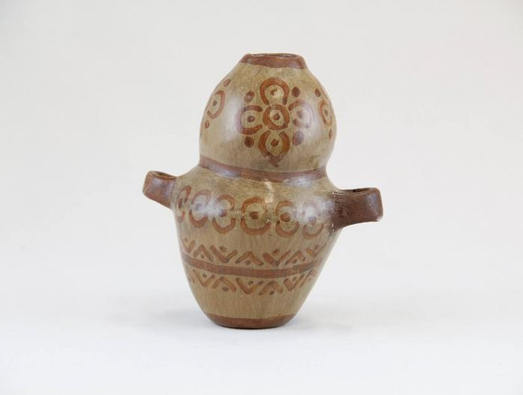
Small Two Handle Vase with Flowers (JO18)

Slide 47
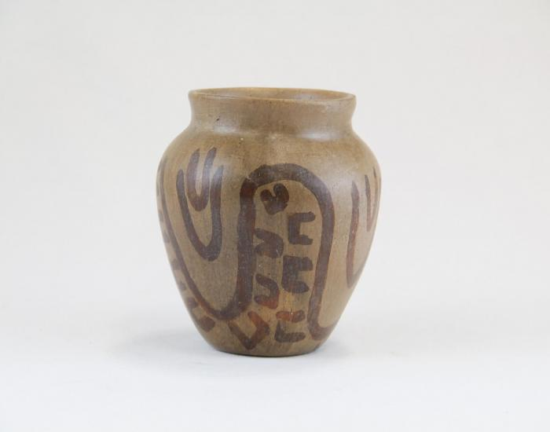
Small Pot with Painted Hand Shapes (JO19)

Slide 48
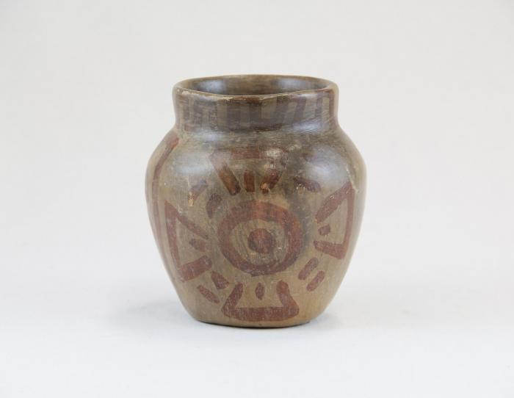
Small Pot with Medallions (JO20)

Slide 49
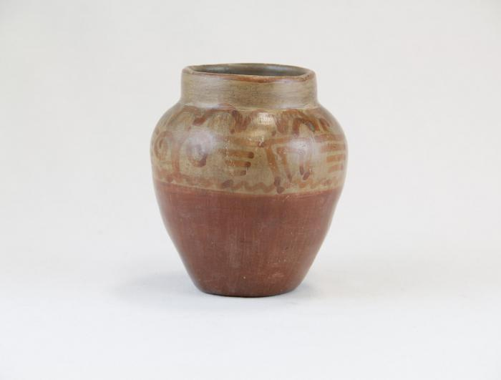
Small Pot with Greco Designs (JO21)

Slide 50
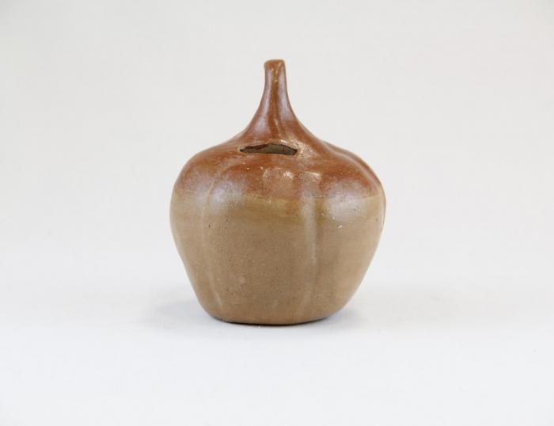
Small Pumpkin Bank (JO22)

Slide 51
Small Pre-Columbian Face Mask (JO23)

Slide 52
Small Pot with Squiggles (JO24)

Slide 53
Bird and Two Baby Birds Candelabra (JO25)

Slide 54
Small Three Candle Candelabra Pot (JO26)

Slide 55
Two Handle Pot (JO27)

Slide 56
Small Bird with Curl-li-que Candle Holder (JO28)

Slide 57
Small Bird with X on its Side Candle Holder (JO29)

Slide 58
Large Two Handle Pot (JO30)

Slide 59
Face and Two Animal Head Candelabra (JO31)

Slide 60
Dog Candelabra with Curled Designs (JO32)

Slide 61
Angel Candle Holder (JO33)

Slide 62
Three Squash Pot (JO34)

Slide 63
Lizard Candle Holder (JO35)

Slide 64
Large Pot on Ring Made of Straw (JO36)

Slide 65
Chicken Pot with Man and Dog (JO37)

Slide 66
Fish with Happy Face Candelabra (JO38)

Slide 67
Two Decorated Sitting Ducks Candelabra (JO39)

Slide 68
Small Ceramic Church with Birds (JO40)

Slide 69
Small Angel Bell Candle Holder (1) (JO41)

Slide 70
Small Angel Bell Candle Holder (2) (JO42)

Slide 71
Animal Face Chimenario (JO43)

Slide 72
Small Three Prong Candelabra (JO44)

Slide 73
Two Ducks Five Candle Candelabra (JO45)

Slide 74
Large Three Prong Candelabra (JO46)

Slide 75
Insect Candle Holder (JO47)

Slide 76
Man Sitting on Bull with Birds and Dogs (JO48)

Slide 77
Ceramic Church with Curl-li-cues (Missing Crosses) (JO49)

Slide 78
Large Ceramic Lizard with Painted Lines and Dots (JO50)

Slide 79
Five Stacked Ceramic Animals (JO51)

Slide 80
Big Eared Dog Candle Holder (JO52)

Slide 81
Ceramic Coiled Rattlesnake (JO53)

Slide 82
Large Ceramic Lizard with Painted Triangles (JO54)

Slide 83
Sitting bird with Two Small Birds Candelabra (JO55)

Slide 84
Octopus Candle Holder (JO56)

Slide 85
Ceramic Cart with Wheels (JO57)

Slide 86
Ceramic Nacimiento (Nativity) (18 pieces) (JO58)

Slide 87
Circular Tree Candelabra (JO59)

Slide 88
Eight Ceramic Peacocks (JO60)

Slide 89
Man carrying Turkey (VM1)

Slide 90
Muñeca holding Dog (VM2)

Slide 91
Kneeling Muñeca in White and Purple Dress with Carrots and Plate of Carrots (VM3)

Slide 92
Small Clay Table (VM4)

Slide 93
Three Yellow Baskets / Three Pineapples (VM5)

Slide 94
Kneeling Muñeca with Onions and Plate of Onions (VM6)

Slide 95
Kneeling Muñeca in Blue Dress with Carrots and Plate of Carrots (VM7)

Slide 96
Bowl of Fruit (VM8)

Slide 97
Kneeling Muñeca with Pinneapple (VM9)

Slide 98
Standing Muñeca with Onions and Plate of Onions (VM10)

Slide 99
Kneeling Muñeca with Basket (VM11)

Slide 100
Standing Muñeca with Pinneapple (VM12)

Slide 101
Muñeca with Fruit Bowl (VM13)

Slide 102
Muñeca Holding Basket and Lime (VM14)

Slide 103
Police Officer Holding White Object (VM15)

Slide 104
Police Officer (VM16)

Slide 105
Muñeca with Purse (VM17)

Slide 106
Muñeca with Fruit Basket and Onions (VM18)

Slide 107
Face and Birds Candle holder (VM19)

Slide 108
Ducks Candelabra (VM20)

Slide 109
Bird, Fox and Face Candelabra (VM21)

Slide 110
Candelabra with Animals and Flowers (M1001)

Slide 111
Tree of Life on Donkey (M1002)

Slide 112
Angular Vessel (M1003)

Slide 113
Tree of Life Candle Holder (M1004)

Slide 114
12 Piece Nativity Scene (M1005 / 1006)

Slide 115
Circular Wall Sconces with 2 Birds ( 2 Pieces) (M1007)

Slide 116
Flight Into Egypt (M1008)

Slide 117
Cart with Team of Horses (M1009)

Slide 118
Bird Shaped Candelabra (M1010)

Slide 119
Mermaid (M1011)

Slide 120
Two Mice Candle Holder (M1012)

Slide 121
Virgen de la Soledad (Virgin of Solitude) (M1013)

Slide 122
Virgen de los Desamparados (M1014)

Slide 123
Madonna with Child Virgen del Carmen (M1015)

Slide 124
Virgen Madonna with Gold Crown (M1016)

Slide 125
Aguilar Flight into Egypt (4 pieces) (M1017)

Slide 126
Clay Bird (M1018)

Slide 127
Virgen with Sword (M1019)

Slide 128
Oaxacan Aguilar Nativity #1 (12 pieces) (M1020a)

Slide 129
Oaxacan Aguilar Nativity #2 (13 pieces) (M1020b)

Slide 130
Virgen de Guadalupe (M1021)

Slide 131
Black Maiden with Basket (M1023)

Slide 132
Muñeca holding Bowl (M1024)

Slide 133
Black Clay Virgen de la Soledad (M1025)

Slide 134
Black Clay Pitchers (M1026)

Slide 135
Black Clay Flower (M1027)

Slide 136
White and Black Nativity (Nacimiento) (8 pieces) (M1028)

Slide 137
Rabbit Totem (M1029)

Slide 138
White Clay Virgin covered with Flowers (M1030)

Slide 139
Virgen de Guadalupe (M1031)

Slide 140
Tan Clay Pot with Lizards (M1032)

Slide 141
Mermaid Candelabra (M1033)

Slide 142
Clay Muñeca dressed in the style of Isthmus of Tehuantepec (M1034)

Slide 143
Dancer with Two Flower Baskets (M1035)

Slide 144
Two Sided Sculpture with Nativity Scenes (M1036)

Slide 145
Dyed Wood Nativity (12 pieces) (M1037)

Slide 146
Wisemen Standing (3 pieces) (M1038)

Slide 147
Three Wood Carved Wiseman riding on Animals (M1039)

Slide 148
Virgin (M1040)

Slide 149
Praying Angel, 1981 (M1041)

Slide 150
Nativity with Corn in Shelter (1 piece) (M1042)

Slide 151
Tonalá Burnished Nativity (11 Pieces) (M1043)

Slide 152
Mexican Nativity (Nacimiento) (10 pieces) (M1055)

Slide 153
Tree of Life Nativity (Nacimiento) Candle Holder (M1056)

Slide 154
Angel with Guitar Candle Holder (M1057)

Slide 155
Nativity (Nacimiento) with Stars Candle Holder (M1059)

Slide 156
Tree of Life Candelabra with Owls (M1061)

Slide 157
Tree of Life Candelabra with Person, Birds, Animals (M1062)

Slide 158
Wood Nativity (12 pieces) (M1063)

Slide 159
Circular Clay Nativity (1 piece) (M1065)

Slide 160
Nepal Nativity (11 pieces) (M1066)

Slide 161
Bolivia Church Scene Nativity (1 of 2) (M1067a)

Slide 162
Bolivia (Bell Scene) Nativity (2 of 2 ) (M1067b)

Slide 163
Native American Nativity (13 pieces) (M1068)

Slide 164
Wales Nativity (3 pieces) (M1070)

Slide 165
Uruguayan Nativity (13 pieces) (M1071)

Slide 166
3 Candle Candelabra Nativity (M1072)

Slide 167
African Nativity (11 pieces) (M1073)

Slide 168
Nativity Bas-Relief Carved from Tree (M1077)

Slide 169
Clay Madonna and Child in Oval Pot (M1084)

Slide 170
Spotted Feline (M1086)

Slide 171
Painted Armadillo (M1088)

Slide 172
Barro Negro Round Pot (M1092)

Slide 173
Unglazed Clay Pot with Blue Glaze Inside (M1093)

Slide 174
Eskimo Nativity (14 pieces) (M1096)

Slide 175
Peruvian Nativity Retablo (M1100)

Slide 176
Mexico Box Nativity set (Nicho) (9 pieces) (M1103)

Slide 177
Vessel with Face (M1105)

Slide 178
Barro Negro Candelabra (M1109)

Slide 179
Tree Single Candle Holder on clay base with a few people (M1110)

Slide 180
Vessel with Pre-Columbian Designs (M1111)

Slide 181
Pre-Columbian Reproduction Figure with Skulls on Forehead (M1500)

Slide 182
Clay figure with braided hair (M1502)

Slide 183
Pre-Columbian Figure Reprodiction (M1503)

Slide 184
Reproduction Pre-Columbian Kneeling Warrior (M1511)

Slide 185
Clay Figure holding a Cup (M1515)

Slide 186
Gray Mayan Hut with Figures and Dogs (broken into 9 pieces) (M1519)

Slide 187
Flight into Egypt - Mary on Donkey (M1524)

Slide 188
Clay Nativity (12 pieces) (M1528)

Slide 189
Two Brown Gourds that Open to Nativity (M1547)

Slide 190
Two Wood Carved Birds (M1552)

Slide 191
Mary, Joseph and Jesus Standing Together (M1554)

Slide 192
Santo Virgin of Guadalupe (M1555)

Slide 193
Small Nativity on Wood base (M1559)

Slide 194
Peruvian Nativity Plaque (M1570)

Slide 195
Peruvian Nativity (8 pieces) (M1578)

Slide 196
Painted Angel (M1595)

Slide 197
Three Kings (M1603)

Slide 198
Wind, Water, Light (M1604)

Slide 199
Barro Negro Vase (M1605)

Slide 200
Black Clay Candelabra (M1606)

Slide 201
Barro Negro Incised Vase (M1607)

Slide 202
Barro Negro Pot (M1608)

Slide 203
Two Navajo Dance Wands (MU3471)

Slide 204
3 Native American Fantasy Snakes (MU3472)

Slide 205
Navajo Chief's Blanket Third Phase (MU3473)

Slide 206
Diaguita Duck Pitcher (MU3477)

Slide 207
Burnished Pot from Mata Ortiz, Chihuahua (MU3478)

Slide 208
Zuni Burnished Pot (MU3479)

Slide 209
Zuni Terra Cotta Pot with Brown & Red Accents (MU3480)

Slide 210
Casas Grandes Vase (MU3481)

Slide 211
Cream & White Pot (MU3482)

Slide 212
Terra Cotta Bowl with Bird in Center (MU3483)

Slide 213
Painted Particle Board (MU3484)

Slide 214
Black & White Seed Pot with lizards (MU3485)

Slide 215
Black & White Zuni Pot with Tadpole Motif (MU3486)

Slide 216
Clay Black & White Acoma Pot (MU3487)

Slide 217
Small Clay White, Black & Tan Painted Pot (MU3488)

Slide 218
Small Painted Acoma Pot with Lizard Design (MU3489)

Slide 219
Small painted Acoma Pot with Lid & Kokopelli design (MU3490)

Slide 220
Small Painted Clay Turtle (MU3491)

Slide 221
Cochiti Pueblo Ceramic Frog (MU3492)

Slide 222
Small Clay Brown and Tan Painted Pot (MU3493)

Slide 223
Small Clay Painted Pot (MU3494)

Slide 224
Small Clay Brown & Tan Painted Incense Burner with Lizard Design (MU3495)

Slide 225
Small Clay Black & White Painted Bowl with Deer Design (MU3496)

Slide 226
Mexican Clay Pipe Held by Warrior & Crocodile (MU3497)

Slide 227
Small Painted Brown & Black Ceramic Pot (MU3498)

Slide 228
7 Porcupine Quills (MU3499)

Slide 229
Tohona-O’Odham Small Woven Cream & Brown Coil Pot (MU3500)

Slide 230
Tohona-O’Odham Yucca & Devil Claw Round Basket with Rim (MU3501)

Slide 231
Tohono-O’Odham Woven Yucca Round Basket (MU3502)

Slide 232
Tohono-O’Odham Woven Yucca Basket (MU3503)

Slide 233
Tohono-O’Odham Flat, Round Basket with Yucca Flower Pattern (MU3504)

Slide 234
Ojibwe Porcupine Quill and Birch Bark Box (MU3505)

Slide 235
Gourd Doll on Grass Ring Pedestal (MU3506)

Slide 236
Singer Stone Figure Sculpture with Bird Feathers (MU3507)

Slide 237
Kachina Doll (Shaloko) (MU3508)

Slide 238
Kachina Doll (Palhik Mana) (MU3509)

Slide 239
Kachina Doll (MU3510)

Slide 240
Kachina Doll (Chasing Star) (MU3511)

Slide 241
Kachina Doll (Zuni Fire God) (MU3512)

Slide 242
Kachina Doll (Corn Maiden) (MU3513)

Slide 243
Kachina Doll (Palhik Mana) (MU3515)

Slide 244
Kachina Doll (MU3516)

Slide 245
Kachina Doll (Shalako) (MU3517)

Slide 246
Kachina Doll (Ogre Woman) (MU3518)

Slide 247
Kachina Doll (Badger) (MU3519)

Slide 248
Kachina Doll (Hopi - Red Beard Long Hair) (MU3520)

Slide 249
"4th World" Painting (MU3523)

Slide 250
Zuni Shalako Kachina Painting (MU3525)

Slide 251
Sun Father and Snake Painting (MU3526)

Slide 252
Apache Christ (MU3527)

Slide 253
Paper scroll with rendering of mural on the interior walls of a painted kiva in the Southwest area (MU3528)

Slide 254
Initiation Doll (MU1)

Slide 255
Sangoma Doll (MU2)

Slide 256
Ceremonial Doll (MU3)

Slide 257
Isicwoyo Front Apron (MU4)

Slide 258
Small Doll (MU5)

Slide 259
Maiden Doll (MU6)

Slide 260
Inkehli / Headdress (MU7)

Slide 261
Quechua Rag Doll (MU8)

Slide 262
Dancing Women Blanket (MU9)

Slide 263
Dancing Figures Blanket (MU10)

Slide 264
4 Beaded Coasters (MU11)

Slide 265
Brown, Black and White Coaster (MU12)

Slide 266
Storytelling Woman, "Naya" (MU13)

Slide 267
Storytelling Painted Pot (MU14)

Slide 268
Zuni Pot with Lizard in Center (MU15)

Slide 269
Repeated Wave Pot (MU16)

Slide 270
Jar with belt pattern and base (MU17)

Slide 271
Hopi Hemis Kachina (MU18)

Slide 272
Two Wooden Spoons (MU19)

Slide 273
Kachina doll (Hilili) (MU3514)

Slide 274
Kachina Doll (Handprint Racer) (MU3521)

Slide 275
Oil Painting of Kachina Figure Framed in Wood (MU3524)

Slide 276
Abstract Tile #1 (SE1)

Slide 277
Abstract Tile #2 (SE2)

Slide 278
Abstract Tile #3 (SE3)

Slide 279
Abstract Tile #4 (SE4)

Slide 280
Abstract Tile #5 (SE5)

Slide 281
Abstract Tile #6 (SE6)

Slide 282
Abstract Tile #7 (SE7)

Slide 283
Abstract Tile #8 (SE8)

Slide 284
Abstract Tile #9 (SE9)

Slide 285
Abstract Tile #10 (SE10)

Slide 286
Abstract Tile #11 (SE11)

Slide 287
Abstract Tile #12 (SE12)

Slide 288
Abstract Tile #13 (SE13)

Slide 289
Abstract Tile #14 (SE14)

Slide 290
Abstract Tile #15 (SE15)

Slide 291
Abstract Tile #16 (SE16)

Slide 292
Abstract Tile #17 (SE17)

Slide 293
Abstract Tile #18 (SE18)

Slide 294
Abstract Tile #19 (SE19)

Slide 295
Abstract Tile #20 (SE20)

Slide 296
Abstract Tile #21 (SE21)

Slide 297
Abstract Tile #22 (SE22)

Slide 298
Abstract Tile #23 (SE23)

Slide 299
Abstract Tile #24 (SE24)

Slide 300
Abstract Tile #25 (SE25)

Slide 301
Man Holding Pot Cross Legged Tile #1 (SE26)

Slide 302
Man Holding Pot Cross Legged Tile #2 (SE27)

Slide 303
Man Holding Pot Cross Legged Tile #3 (SE28)

Slide 304
Man Holding Pot Cross Legged Tile #4 (SE29)

Slide 305
Man Holding Pot Cross Legged Tile #5 (SE30)

Slide 306
Man Holding Pot Cross Legged Tile #6 (SE31)

Slide 307
Man Holding Pot Cross Legged Tile #7 (SE32)

Slide 308
Man Holding Pot Cross Legged Tile #8 (SE33)

Slide 309
MesoAmerican Head Tile #1 (SE34)

Slide 310
MesoAmerican Head Tile #2 (SE35)

Slide 311
MesoAmerican Head Tile #3 (SE36)

Slide 312
MesoAmerican Head Tile #4 (SE37)

Slide 313
MesoAmerican Head Tile #5 (SE38)

Slide 314
MesoAmerican Head Tile #6 (SE39)

Slide 315
MesoAmerican Head Tile #7 (SE40)

Slide 316
MesoAmerican Head Tile #8 (SE41)

Slide 317
MesoAmerican Head Tile #9 (SE42)

Slide 318
MesoAmerican Head Tile #10 (SE43)

Slide 319
MesoAmerican Head Tile #11 (SE44)

Slide 320
MesoAmerican Head Tile #12 (SE45)

Slide 321
MesoAmerican Head Tile #13 (SE46)

Slide 322
MesoAmerican Head Tile #14 (SE47)

Slide 323
MesoAmerican Head Tile #15 (SE48)

Slide 324
Laying Man with Dog (SE49)

Slide 325
Laying Woman with Cats (SE50)

Slide 326
Skull Candlesticks (EH1)

Slide 327
Skeleton Couple (EH2)

Slide 328
Catrina (EH3)

Slide 329
Face Jug (EH4)

Slide 330
Ceramic Chiva Bus (EH5)

Slide 331
Skeleton Riding Bicycle (EH6)

Slide 332
Zimbabwean Quilt (EH7)

Slide 333
Peruvian Chancay Birthing Scene (EH8)

Slide 334
Angel (EH9)

Slide 335
Three Minstrels (EH10)

Slide 336
Metal Figures attached to Bone (EH11)

Slide 337
Two Skeleton Drummers (EH12)

Slide 338
"Visions" Bolo Tie (EH13)

Slide 339
Guatemalan Horseshoe Wall Art (EH14)

Slide 340
White Eagle (EH15)

Slide 341
Jumex Ceramic Heart with Nails (EH16)

Slide 342
Wolf Head on Metal Band (EH17)

Slide 343
Sterling Silver Sculpture of Man playing Violin, made in Israel (EH18)

Slide 344
"Sisters in Progress", Painted Rock Paperweight (EH19)

Slide 345
Woman Riding Elephant in Glass Case (EH20)

Slide 346
George Washington (EH21)

Slide 347
John the Baptist, with Yellow Haired Angels (EH22)

Slide 348
Woman Guitarist (EH23)

Slide 349
Moses Strikes the Rock at Kadesh (EH24)

Slide 350
Three Sitting Dogs Playing Cards on Green Plank (EH25)

Slide 351
Cowboy Alligator (EH26)

Slide 352
Large Skeleton with Rotating Arms and Legs (EH27)

Slide 353
Wood Skeleton Armoire (EH28)

Slide 354
Two Carved Wood Indoor Scenes (EH29)

Slide 355
Howard Finster Eagle and Poem on Board (EH30)

Slide 356
Tiger Table (EH31)

Slide 357
Woman and Child (EH32)

Slide 358
Don Pedrito Jaramillo with chipped nose on blue base (RE1)

Slide 359
Don Pedrito Jaramillo with criss cross base and chair (RE2)

Slide 360
Don Pedrito Jaramillo white and dark grey hair seated in orange chair (RE3)

Slide 361
Peruvian Church with Market Scene (SE51)

Slide 362
Peruvian Church Candle Holder and Luminary (SE52)

Slide 363
Peruvian Church with Multiple Small Figures (SE53)

Slide 364
Iatmul Wood Figure (SE54)

Slide 365
Tigre Mask (PR1)

Slide 366
Bat Mask (PR2)

Slide 367
Devil Mask with Two Snakes (PR3)

Slide 368
Mermaid Mask (PR4)

Slide 369
Hermit Mask (PR5)

Slide 370
Goat Mask (PR6)

Slide 371
Mermaid and Bird Mask (PR7)

Slide 372
Old Man Mask (Viejo) (PR8)

Slide 373
Viejito Mask (PR9)

Slide 374
Bat and Mermaid Mask (PR10)

Slide 375
Tin Mask (PR11)

Slide 376
El Barbón Mask (PR12)

Slide 377
Nagual Mask (PR13)

Slide 378
Wood Carved Leopard Mask (PR14)

Slide 379
Diablo-Calavera (Devil-Skull) Mask (PR15)

Slide 380
Leather Mask (PR16)

Slide 381
Carnival Jester Mask (PR17)

Slide 382
Moro Pasion Mask (PR18)

Slide 383
Round Ceramic Mask (PR19)

Slide 384
Unglazed Ocumicho Mask (PR20)

Slide 385
Blue Devil Mask (PR21)

Slide 386
Straw or Palm Mask (PR22)

Slide 387
Donkey Mask (PR23)

Slide 388
Devil Mask (PR24)

Slide 389
Chané Jaguar Mask (PR25)

Slide 390
Moon and Star Ceramic Mask (PR26)

Slide 391
Stars Ceramic Mask (PR27)

Slide 392
Venezuelan Tribal Mask (PR28)

Slide 393
Piaroa Kohue Mask (PR29)

Slide 394
Ecuadorian Monkey Mask (PR30)

Slide 395
Vejigantes Mask (PR31)

Slide 396
Puerto Rican Vejigantes Mask (PR32)

Slide 397
Ranga Mask (PR33)

Slide 398
Barong Mask (PR34)

Slide 399
Indonesian Barong Mask (PR35)

Slide 400
Balinese Long Mask with Lizards (PR36)

Slide 401
Ganesha mask (PR37)

Slide 402
Gold Jeweled Thai Mask (PR38)

Slide 403
Thai Warrior Mask (PR39)

Slide 404
Sepik River Mask (PR40)

Slide 405
Foo Dog Wall Hanging (PR41)

Slide 406
Jero Luh Mask (PR42)

Slide 407
Namahage Mask (PR43)

Slide 408
Meng Liang, white opera mask (PR44)

Slide 409
Okina Mask (PR45)

Slide 410
Tengu mask (PR46)

Slide 411
Okame (Otafuku) Mask (PR47)

Slide 412
Nojang (monk) mask (PR48)

Slide 413
Fang Mask from Ghana (PR49)

Slide 414
African Wood Carved Mask (PR50)

Slide 415
Carved Coconut Husk of Man's Head (PR51)

Slide 416
Dan Tribe Mask (PR52)

Slide 417
Gemstone Mask (PR53)

Slide 418
Rectangular Wood Mask (PR54)

Slide 419
Maasai mask (PR55)

Slide 420
Ashanti mask, from the Akan people group in Ghana (PR56)

Slide 421
Fanged Mask (PR57)

Slide 422
Brazilian Carranca Figurehead (PR58)

Slide 423
Kifwebe Ceremonial Mask (PR59)

Slide 424
Sombreria Market Scene (MC1)

Slide 425
Grocery Store Scene "Tienda Amelia" (MC2)

Slide 426
"Artesanias Ecuador" Market Scene (MC3)

Slide 427
Grocery Store Scene "Tienda Penelope" (MC4)

Slide 428
Christ on Cross with Angels Wood Wall Hanging (MC5)

Slide 429
Topsy Turvy Doll (MC6)

Slide 430
Chancay Doll, Mother and Child (MC7)

Slide 431
Venezuelan Piranha Mask (MC8)

Slide 432
Wooden Mask, Stained Pink (MC9)

Slide 433
Indonesian Wayang Shadow Puppet (MC10)

Slide 434
Yagua Mask (MC11)

Slide 435
Monkey Mask (MC12)

Slide 436
Guro Mask (MC13)

Slide 437
Ebony Carved Figures from Makonde Tribe (MC14)

Slide 438
African Long Forehead Mask (MC15)

Slide 439
Ebony Carved Woman with Fabric Dress, Metal Neck Wrap, Beaded Earrings (MC16)

Slide 440
Mapula (Mother of Rain) Flower and Lion Cloth (MC17)

Slide 441
Small Wood Carved Figure with Wire Earrings and Staff (MC18)

Slide 442
Ashanti Small Mask (MC19)

Slide 443
Beaded Metal Dragon (MC20)

Slide 444
Papua New Guinea Tribal Shield (SE55)

Slide 445
Kilim Rug (SE56)

Slide 446
Agave Plant with Virgin of Guadalupe (SH1)

Slide 447
Agave Plant with Virgin of Guadalupe (SH2)

Slide 448
Angel (SH3)

Slide 449
Angel (SH4)

Slide 450
Angel (SH5)

Slide 451
Angel (SH6)

Slide 452
Angel holding Book (SH7)

Slide 453
Angel holding Dove (SH8)

Slide 454
Angel holding Flowers (SH9)

Slide 455
Angel kneeling (SH10)

Slide 456
Angel playing Guitar (SH11)

Slide 457
Angel playing Harp (SH12)

Slide 458
Angel with Purple and Red Flower (SH13)

Slide 459
Angel with Red and Yellow Flower (SH14)

Slide 460
Angel with Small Angel (SH15)

Slide 461
Animal Band (SH16)

Slide 462
Animal Bell (SH17)

Slide 463
Animal playing an Electric Guitar (SH18)

Slide 464
Armadillo (SH19)

Slide 465
Armadillo (SH20)

Slide 466
Aztec / Mayan holding Woman (SH21)

Slide 467
Bird Cage with Tree (SH22)

Slide 468
Black and Red Vase (SH23)

Slide 469
Black Green and Red Vase (SH24)

Slide 470
Black Vase (SH25)

Slide 471
Black Vase (SH26)

Slide 472
Black Vase (SH27)

Slide 473
Black Vase (SH28)

Slide 474
Mata Ortiz Black Vase (SH29)

Slide 475
Black Vase (SH30)

Slide 476
Black Vase (SH31)

Slide 477
Blue Animal (SH32)

Slide 478
Blue Goat (SH33)

Slide 479
Blue Rattle Snake (SH34)

Slide 480
Willow Kumeyaay PaiPai Basket (SH35)

Slide 481
Tarahumara Indian Baskets (SH36)

Slide 482
Boy Angel playing Harp (SH37)

Slide 483
Cactus (SH38)

Slide 484
Cactus blooming Pink Flower (SH39)

Slide 485
Cactus with Three Virgins (SH40)

Slide 486
Cart with Cows (SH41)

Slide 487
Celebration Belt (SH42)

Slide 488
Centaur playing Violin (SH43)

Slide 489
Chicken with Chicks (SH44)

Slide 490
Cows with Cart (SH45)

Slide 491
Crocodile (SH46)

Slide 492
Crucification (SH47)

Slide 493
Danza de la Pluma (SH48)

Slide 494
Danza de la Pluma (SH49)

Slide 495
Dancing Man with Bird (SH50)

Slide 496
Torito Dancer with Fireworks (SH51)

Slide 497
Dancing Man with Cow Fireworks (SH52)

Slide 498
Decorated Cows with Cart (SH53)

Slide 499
Desert Scene (SH54)

Slide 500
Dog playing Guitar (SH55)

Slide 501
Dragon (SH56)

Slide 502
Dragon (SH57)

Slide 503
Dragon (SH58)

Slide 504
East African Ngoma (SH59)

Slide 505
Elephant (SH60)

Slide 506
Farmers on Parade (SH61)

Slide 507
Makonde Shetani Sculpture (SH62)

Slide 508
Firework Castle (SH63)

Slide 509
Firework Dancing man (SH64)

Slide 510
Frog Pitcher Set (SH65)

Slide 511
Garuda (SH66)

Slide 512
Giant Vase (SH67)

Slide 513
Goat with Guitar (SH68)

Slide 514
Devil Masked Peasant Dancer (SH69)

Slide 515
Hookah (SH70)

Slide 516
Deer Alebrije (SH71)

Slide 517
Humming Bird (SH72)

Slide 518
Kneeling Angel (SH73)

Slide 519
La Serina playing Horn (SH74)

Slide 520
La Virgen de San Juan de los Lagos (SH75)

Slide 521
La Virgen del Apocalipsis (SH76)

Slide 522
Women selling Goods (SH77)

Slide 523
Woman with White Flowers (SH78)

Slide 524
Tigrada Parade Cornhusk Doll (SH79)

Slide 525
Tigrada Parade Cornhusk Doll (SH80)

Slide 526
Lion (SH81)

Slide 527
Lizard (SH82)

Slide 528
Lizard (SH83)

Slide 529
Lizard (SH84)

Slide 530
Longhaired Maiden (SH85)

Slide 531
Man displaying Virgin (SH86)

Slide 532
Man riding with Animals (SH87)

Slide 533
Man with Maracas (SH88)

Slide 534
Man with Whip (SH89)

Slide 535
Many Faces of Mata Ortiz (SH90)

Slide 536
Mermaid with Frog (SH91)

Slide 537
Mermaids on Beach (SH92)

Slide 538
Monk with Bird (SH93)

Slide 539
Mother Skunk (SH94)

Slide 540
Multi Color Bikini Cat Band (SH95)

Slide 541
Oaxacan Plume Dancer (SH96)

Slide 542
Ethiopian Canoe Gambella Basket (SH97)

Slide 543
Palm Tree with Feeding Bird (SH98)

Slide 544
Pink Flower (SH99)

Slide 545
Purple Angel holding Flower (SH100)

Slide 546
Rabbit (SH101)

Slide 547
Rat Woodcarving (SH102)

Slide 548
Red Green and Silver Vase (SH103)

Slide 549
Red Vase (SH104)

Slide 550
Rooster (SH105)

Slide 551
Saint Francis of Assisi (SH106)

Slide 552
Saint Michael (SH107)

Slide 553
Serpent Pottery Vessel (SH108)

Slide 554
Skeleton Band (SH109)

Slide 555
Small Red Vase (SH110)

Slide 556
Small Red Vase (SH111)

Slide 557
Tea Pot (SH112)

Slide 558
Toucan (SH113)

Slide 559
Wood Carved Turtles (SH114)

Slide 560
Vase (SH115)

Slide 561
Virgen de la Soledad (SH116)

Slide 562
Virgin de Guadalupe (SH117)

Slide 563
Virgin de Guadalupe (SH118)

Slide 564
Virgin de Guadalupe (SH119)

Slide 565
Virgin de Guadalupe (SH120)

Slide 566
Virgin de Guadalupe (SH121)

Slide 567
Virgin de la Soledad (SH122)

Slide 568
Virgin De Rosary (SH123)

Slide 569
Virgin Mary (SH124)

Slide 570
Virgin Mary (SH125)

Slide 571
Virgin Mary with Man kneeling (SH126)

Slide 572
Virgin of Guadalupe (SH127)

Slide 573
Virgin of Guadalupe Cactus (SH128)

Slide 574
Chalupa Boat (SH129)

Slide 575
Woman making a Rug (SH130)

Slide 576
Polar bear with Cub (AC1)

Slide 577
Boy Fishing (AC2)

Slide 578
Humpback whale (AC3)

Slide 579
Spirit of the Mountain (AC4)

Slide 580
Two-Headed Statue (AC5)

Slide 581
Caribou Skin Mask with Black Ink Tattoos (AC6)

Slide 582
Stages of Marriage Bracelet (AC7)

Slide 583
Eagle and Fish (AC8)

Slide 584
Miniature Mountain Spirit Mask (AC9)

Slide 585
Loon Birds Earrings (AC10)

Slide 586
Kayak Necklace (AC11)

Slide 587
Ivory Swan Pendant (AC12)

Slide 588
Lucky Halibut (AC13)

Slide 589
Round Earrings (AC14)

Slide 590
Rhombus Earrings (AC15)

Slide 591
Beluga Whale (AC16)

Slide 592
Baby Seal (AC17)

Slide 593
Baby Polar Bear (AC18)

Slide 594
Bird Pendant (AC19)

Slide 595
Button Face Native Doll (AC20)

Slide 596
Yupik Bone Doll (AC21)

Slide 597
Yupik Bone Doll (AC22)

Slide 598
Chevak Cup'ik Doll holding Berries (AC23)

Slide 599
Chevak Cup'ik Doll (AC24)

Slide 600
Impressioned Silver Mask (SHA1)

Slide 601
Shipibo Ceramic Olla (SHA2)

Slide 602
Shipibo Ceramic Bowl (SHA3)

Slide 603
Shipibo Ceramic Bowl (SHA4)

Slide 604
Shipibo Ceramic Bowl (SHA5)

Slide 605
Pucara Ceramic Bull (SHA6)

Slide 606
Carved Wooden Bowl (SHA7)

Slide 607
Pisco Figural Bottle (SHA8)

Slide 608
Pisco Figural Bottle (SHA9)

Slide 609
Shipibo Woven Bag (SHA10)

Slide 610
Shipibo Bracelet (SHA11)

Slide 611
Shipibo Seed Necklace (SHA12)

Slide 612
Shipibo Comb (SHA13)

Slide 613
Shipibo Dart Quiver with Goard (SHA14)

Slide 614
Shipibo Dart Quiver with Jaw Bone (SHA15)

Slide 615
Shipibo Blowgun (SHA16)

Slide 616
Shipibo Blowgun (damaged) (SHA17)

Slide 617
Shipibo Ceremonial Club (SHA18)

Slide 618
Shipibo Paddle (SHA19)

Slide 619
Shipibo Bow (SHA20)

Slide 620
Shipibo Fishing Arrows (SHA21)

Slide 621
Shipibo Grass Clothing (SHA22)

Slide 622
"Land Carer" (PE1)

Slide 623
"Mother Earth" (PE2)

Slide 624
Bird House and Flowers (HA1)

Slide 625
Man smoking pipe with cat and flowers (HA2)

Slide 626
Two girls and chickens (HA3)

Slide 627
Cat sits on chair surrounded by flowers (HA4)

Slide 628
Big Jaguar Wrap Skirt (AFFA1)

Slide 629
Blue Hearts Huipil (AFFA2)

Slide 630
Chiapas Magdalena Huipil (AFFA3)

Slide 631
Chiapas Tenejapa Huipil (AFFA4)

Slide 632
Chiapas Tenejapa Shawl (AFFA5)

Slide 633
Chiapas Zinacantan Huipil (AFFA6)

Slide 634
Chiapas Zinacantan Serape (AFFA7)

Slide 635
Chichicastenango Flowers Huipil (AFFA8)

Slide 636
Chichicastenango Huipil (AFFA9)

Slide 637
Colotenango Huipil (AFFA10)

Slide 638
Jalapa de Diaz Oaxaca Multicolored Bird and Flower Huipil (AFFA11)

Slide 639
Joyabaj Huipil (AFFA12)

Slide 640
Market Apron (AFFA13)

Slide 641
Bolivian Men's Poncho (AFFA14)

Slide 642
Oaxacan Amuzgo Huipil (AFFA15)

Slide 643
Oaxacan Huautla Huipil and Falda (AFFA16)

Slide 644
Chichicastenango Huipil with gold threading (AFFA17)

Slide 645
Patzún Huipil 1 (AFFA18)

Slide 646
Patzún Huipil 2 (AFFA19)

Slide 647
Pink Belt (AFFA20)

Slide 648
San Antonio Aguas Calientes Huipil (AFFA21)

Slide 649
San Juan Sacatepequez Faja (AFFA22)

Slide 650
San Lucas Toliman Huipil (AFFA23)

Slide 651
Santa Maria Nebaj Huipil (AFFA24)

Slide 652
Santiago Atitlán Bird Huipil (AFFA25)

Slide 653
Santiago Atitlán Bird Huipil #2 (AFFA26)

Slide 654
Santiago Atitlán Turkey Huipil (AFFA27)

Slide 655
Trique Huipil (AFFA28)

Slide 656
Two Peacocks Black and White Dress (AFFA29)

Slide 657
White Campesina Blouse (AFFA30)

Slide 658
White Skirt with Woman and Horse Scene on Edge (AFFA31)

Slide 659
Ecuadorian Women's Outfit (AFFA32)

Slide 660
Catrina (ME1)

Slide 661
Group of Día de los Muertos Skeletons (GR1)

Slide 662
"Elephant" Carved Dried Gourd with Lid (YO1)

Slide 663
"Zulu" Carved Dried Gourd (YO2)

Slide 664
Beaded Bracelets (YO3)

Slide 665
Beaded Wood Ndebele Brush (YO4)

Slide 666
Beaded Wood Ndebele Knife (YO5)

Slide 667
Carved Wood Ladle (YO6)

Slide 668
Pasiking (Rattan Backpack) (YO7)

Slide 669
Beaded Fly Whisk (YO8)

Slide 670
Tzintzuntzan Boat Women (YO9)

Slide 671
Turkish Talisman with Evil Eye (HU1)

Slide 672
Turkmen Child Tunic (HU2)

Slide 673
Turkish Karagöz Shadow Puppets (HU5)

Slide 674
Papua New Guinea Shell Necklace (SE57)

Slide 675
Andean Aguayo Blanket (WI1)

Slide 676
Guatemalan San Lucas Tolimán Huipil (WI2)

Slide 677
Guatemalan Tablecloth with Quetzales (WI3)

Slide 678
Wall Hanging from Chiapas (WI4)

Slide 679
Rebozo from Totonicapan, Guatemala (WI5)

Slide 680
Peruvian Manta (WI6)

Slide 681
Vintage table runner from San Martin Jlitepeque, Guatemala (WI7)

Slide 682
Guatemalan Huipil with Bird and Rooster Pattern (WI8)

Slide 683
Guatemalan Rebozo (WI9)

Slide 684
Guatemalan Patchwork Skirt (WI10)

Slide 685
Blue and Yellow Guatemalan Belt (WI11)

Slide 686
Guatemalan Purple Belt with Diagonal Threaded Rectangles (WI12)

Slide 687
Guatemalan Striped Faja (WI13)

Slide 688
Thin Green Patterned Guatemalan Cinta (WI14)

Slide 689
Guatemalan Short Red Striped Belt (WI15)

Slide 690
Turquoise and Yellow Faja (WI16)

Slide 691
Guatemalan Belt with Silver Circle Conchos (WI17)

Slide 692
San Antonio Aguas Calientes Faja (WI18)

Slide 693
Guatemalan Multicolored Faja with Yellow Line (WI19)

Slide 694
Purple and White Guatemalan Faja (WI20)

Slide 695
Stripe Belt (WI21)

Slide 696
Zunil Cinta (WI22)

Slide 697
Bolivian Manta (WI24)

Slide 698
Tibetan Yak Mat (WI25)

Slide 699
Toucan and Parrot Whistles (WI26)

Slide 700
Voodoo Doll (WI27)

Slide 701
Ivory and Metal Sculptures (WI28)

Slide 702
Tibetan Thangka (WI29)

Slide 703
Krishna and Three Wives Fabric Painting (Pichhwai) (WI30)

Slide 704
Chinese Carved Lacquer Vases (WI31)

Slide 705
Yangban Mask (WI32)

Slide 706
Turkmen Child Tunic (HU3)

Slide 707
Santa Maria Nebaj Rebozo (HU4)

Slide 708
Repeating Flower Cinta (WI23)

Slide 709
Egyptian Rug (AC25)

Slide 710
Ethiopian Meqenet (AC26)

Slide 711
Ethiopian Gabi (AC27)

Slide 712
Senegalese Wedding Fabric Strip (AC28)

Slide 713
Mud Cloth from Benin (AC29)

Slide 714
Los Diablitos Toman la Presidencia (The Little Devils Take the Presidency) (LI1)

Slide 715
Vollis Simpson Whirligig (HN1)

Slide 716
Three Figures (DA1)

Slide 717
Akua'ba (DE1)

Slide 718
Ekeko Good Luck Charm (FR1)

Slide 719
Bolivian Cholita Doll (FR2)

Slide 720
Bolivian Aymara Blanket (FR3)

Slide 721
Woven Bamboo Conical Hat (FR4)

Slide 722
Bhutanese Kira (FR5)

Slide 723
Bhutan Belt (Kera) (FR6)

Slide 724
Bhutanese Embroidered Kira (FR7)

Slide 725
Cameroon Double Bell (FR8)

Slide 726
Inuit Stone Carved Bear (FR9)

Slide 727
Chinese Lotus Shoes (FR10)

Slide 728
Chinese Embroidered Headband (FR11)

Slide 729
Chinese Children's Tiger Hat (FR12)

Slide 730
Chinese Tiger Hat (FR13)

Slide 731
Jade Horse Incense Burner (FR14)

Slide 732
Lion Incense Holder (FR15)

Slide 733
Chinese Pose Doll (FR16)

Slide 734
Chinese Horse Bells (FR17)

Slide 735
Chinese Traditional Straw Sandals (FR18)

Slide 736
Chinese Wood Carved Panel (FR19)

Slide 737
Tibetan Miniature Village (FR20)

Slide 738
Tibetan Monk's Hat (FR21)

Slide 739
Tibetan Apron (FR22)

Slide 740
Tibetan Embroidered Silk Hat (FR23)

Slide 741
Tibetan Buddhist Amulet (FR24)

Slide 742
Tibetan Oil Lamp (FR25)

Slide 743
Tibetan Metal Fastener (FR26)

Slide 744
Tibetan Copper Pitcher (FR27)

Slide 745
Tibetan Prayer Wheels (FR28)

Slide 746
Tibetan Gau (FR29)

Slide 747
Tibetan Turquoise Pendant (FR30)

Slide 748
Tibetan Bowl (FR31)

Slide 749
Tibetan Camels Print (FR32)

Slide 750
Tibetan Wood Printing Block (FR33)

Slide 751
Tibetan Six Panel Printing Block (FR34)

Slide 752
Lega Hat (FR35)

Slide 753
Kuba Cloth (FR36)

Slide 754
Congo Kuba Table Cloth (FR37)

Slide 755
Kuba Raffia Cloth (FR38)

Slide 756
Kuba Cloth Checker Pattern (FR39)

Slide 757
Ecuadorian Straw Dolls (FR40)

Slide 758
Ghana Kente Cloth (FR41)

Slide 759
Guatemalan Chicken Van (FR42)

Slide 760
Guatemalan Wooden Bull Mask (FR43)

Slide 761
Red and Black Faja (FR44)

Slide 762
Chichicastenango Faja (FR45)

Slide 763
Faja (FR46)

Slide 764
Guatemalan Sashes (Fajas) (FR47)

Slide 765
Painted Cofre Box by Otzoy (FR48)

Slide 766
Painted Cofre by Filiberto Simon (FR49)

Slide 767
Guatemalan Chicken Candle Holder (FR50)

Slide 768
Guatemalan Rooster (FR51)

Slide 769
Calabash Gourd Shakers (FR52)

Slide 770
Indian Hindu Painting (FR53)

Slide 771
Lacquer Box from Kashmir (FR54)

Slide 772
Mortar and Pestle (FR55)

Slide 773
Indian Stamp with Elephant (FR56)

Slide 774
Indian Parcel-Gilt Silver Comb (FR57)

Slide 775
Indian Horseshoes (FR58)

Slide 776
Brass Jewelry Mold (FR59)

Slide 777
Rabari Carrying Ring (Indhoni) (FR60)

Slide 778
Rabari Cap (FR61)

Slide 779
Rabari Shisha Embroidered Cloth (FR62)

Slide 780
Rabari Hat with Mirrors (FR63)

Slide 781
Stone Carved Horse Sculpture (FR64)

Slide 782
Banjara Textile (FR65)

Slide 783
Gujarat Textile (FR66)

Slide 784
Banjara Wall Hanging (Toran) (FR67)

Slide 785
Banjara Marriage Bag (FR68)

Slide 786
Balaram Suvadra Idols (FR69)

Slide 787
Wood Carved Box (FR70)

Slide 788
Indian Woman Figure (FR71)

Slide 789
Hindu Wood Painting (FR72)

Slide 790
Rajasthan Kavad Box (FR73)

Slide 791
Sandalwood Carved Cigarette Box (FR74)

Slide 792
Wayang Kulit Shadow Puppet (FR75)

Slide 793
Two Maasai Dolls (FR76)

Slide 794
Turkana Doll (FR77)

Slide 795
Maasai Milk Jug (FR78)

Slide 796
Beaded Kenyan Jugs (FR79)

Slide 797
Nyatiti Instrument (FR80)

Slide 798
Virgin Figure Surrounded by Angels (FR81)

Slide 799
Small Nativity Tree of Life (FR82)

Slide 800
Adam and Eve Tree of Life (FR83)

Slide 801
Ceramic Church (FR84)

Slide 802
Ceramic Church (FR85)

Slide 803
Ceramic Donkey (FR86)

Slide 804
Ceramic Candle Holder with Flowers, Birds and Butterflies (FR87)

Slide 805
Three Tarahumara Wood Carved Figures (FR88)

Slide 806
Five Tarahumara Wood Carved Figures (FR89)

Slide 807
Tarahumara Corn Grinding Woman (FR90)

Slide 808
Tarahumara Drum and Mallet (FR91)

Slide 809
Popotillo Boxes (FR92)

Slide 810
Mexican Cartoneria Doll (FR93)

Slide 811
Mexican Marionette (FR94)

Slide 812
Mexican Paper Puppets (FR95)

Slide 813
Mexican "Mary" Cartoneria Doll (FR96)

Slide 814
Straw Church (FR97)

Slide 815
Lelé Doll (FR98)

Slide 816
Mexican Dance of the Feathers Yarn Dolls (FR99)

Slide 817
Otomi Doll (FR100)

Slide 818
Wood Carved Boat and Fisherman (FR101)

Slide 819
Mexican Wooden Fish Child's Toy (FR102)

Slide 820
Wood Carved Armadillos (FR103)

Slide 821
Wooden Virgin (FR104)

Slide 822
Deer Mask (FR105)

Slide 823
Mexican Clacker Toy (FR106)

Slide 824
Moroccan Peasant Doll Riding a Donkey (FR107)

Slide 825
Brass Incense Burner (FR108)

Slide 826
Sherpa Family Dolls in Box (FR109)

Slide 827
Tumbuan Long Nose Mask (FR110)

Slide 828
Bilum Bags (FR111)

Slide 829
Papua New Guinea Koteka (FR112)

Slide 830
Papua New Guinea Raffia Skirt (FR113)

Slide 831
Papua New Guinea Crocodile Boat (FR114)

Slide 832
Yerba Mate Cup and Mixer from Paraguay (FR115)

Slide 833
Pucara Bulls (FR116)

Slide 834
Chulucanas Peru Vessel (FR117)

Slide 835
Peruvian Wood and Stone Ear Gauges (FR118)

Slide 836
Peruvian Wood and Stone Box and Cup (FR119)

Slide 837
Yagua Doll (FR120)

Slide 838
Yagua Doll with Bowl (FR121)

Slide 839
Yagua Doll with Child (FR122)

Slide 840
Yagua Doll with Straw Dress and Beads (FR123)

Slide 841
Bamboo Mini Retablo (FR124)

Slide 842
Peruvian Carved Gourds (FR125)

Slide 843
Peruvian Fabric Doll with Baby (FR126)

Slide 844
Quechua Women's Hat (Montera) (FR127)

Slide 845
Quechua Women's Hat (Montera) #2 (FR128)

Slide 846
Peruvian Chullo Wool Hat (FR129)

Slide 847
Black and White Horse Pattern Bag (FR130)

Slide 848
Quechua Chumpi (FR131)

Slide 849
Shipibo Textile (FR132)

Slide 850
Small Andean Wool Blanket (FR133)

Slide 851
Andean Blanket with Animals (FR134)

Slide 852
Peruvian Wool Blanket (FR135)

Slide 853
Yarn Llama and Family (FR136)

Slide 854
Peruvian Painted Box (FR137)

Slide 855
Dymkovo Toy Figures (FR138)

Slide 856
Brass Russian Icon of St. Nicholas (FR139)

Slide 857
Russian Fabric Dolls (FR140)

Slide 858
Russian Cloth Doll (FR141)

Slide 859
Yaroslavna Russian Fabric Doll (FR142)

Slide 860
Straw Wreath (Swedish?) (FR143)

Slide 861
Tanzanian Tin Safari Jeep (FR144)

Slide 862
Zaramo "Mwana Hiti" Doll Figure (FR145)

Slide 863
Thai Spirit House (FR146)

Slide 864
Kilim Box with Fabric Lid and Wood Base (FR147)

Slide 865
Painted Gourd Doll (FR148)

Slide 866
Anatolian Talisman Wall Hanging (FR149)

Slide 867
Turkish Doll (FR150)

Slide 868
Don Pedrito Jaramillo with pattern base (RE4)

Slide 869
unknown (RE5)

Slide 870
Don Pedrito Jaramillo with blue and black base and red tie (RE6)

Slide 871
Don Pedrito Jaramillo on a light blue and dark red base (RE7)

Slide 872
Large Don Pedrito Jaramillo wearing hat and white scarf (RE8)

Slide 873
Large Don Pedrito Jaramillo wearing hat with checkered base (RE9)

Slide 874
Don Pedrito Jaramillo wearing hat with black suit and tie (RE10)

Slide 875
Don Pedrito Jaramillo wearing hat with red tie (RE11)

Slide 876
Grey monochromatic Don Pedrito Jaramillo wearing hat (RE12)

Slide 877
Two small identical Don Pedrito Jaramillo figures (RE13)

Slide 878
Small Don Pedrito Jaramillo wearing hat (RE14)

Slide 879
Don Pedrito Jaramillo in glass enclosure with flowers (RE15)

Slide 880
"Dios Bendiga Nustro Hogar" small altar to Don Pedrito Jaramillo (RE16)

Slide 881
A small gold altar to Don Pedrito Jaramillo with two angels (RE17)

Slide 882
"Bless Our Home" small altar to Don Pedrito Jaramillo (RE18)

Slide 883
A small altar to Don Pedrito Jaramillo in gold shell (RE19)

Slide 884
Turkish Runner Rug (FR151)

Slide 885
Pima Coil Basket (FR152)

Slide 886
Robert Rivera Gourd with Flute Player (FR153)

Slide 887
Amish Dolls (FR154)

Slide 888
Inuit Inukshuk Figurine (FR155)

Slide 889
Comb with Kohl Applicator (FR156)

Slide 890
Flower Hmong Dolls (FR157)

Slide 891
Dao Child's Hat (FR158)

Slide 892
Ludayi (Carved Calabash Gourd Ladles) (FR159)

Slide 893
Coca Cola Can Motorcycle (FR160)

Slide 894
Antique Bisque Doll (FR161)

Slide 895
Bone Carved Figure with Parrot (FR162)

Slide 896
Large Doll with Wood Body and Face (FR163)

Slide 897
Nut Rattle (FR164)

Slide 898
Botswana Woven Coil Basket with Lid (FR165)

Slide 899
Black and White Wool Bag (FR166)

Slide 900
Bhutan Lucky Symbols Banner (FR167)

Slide 901
Christ and Mahomet Embroidery (FR168)

Slide 902
Silk Embroidered Blouse with Birds, Horses and People (FR169)

Slide 903
Animal Skin Tunic with Cross Pattern (FR170)

Slide 904
Kilim Rug Blue Red and White (FR171)

Slide 905
Wooden Toy Truck (FR172)

Slide 906
Wood Stirrup (FR173)

Slide 907
Basket (FR174)

Slide 908
Lobi Stool (FR175)

Slide 909
Chinese Tea pot (FR176)

Slide 910
La Fiesta de la Virgen de la Candelaria by Juan Luis Cuyo (FR177)

Slide 911
Angel Doll (PE3)

Slide 912
Angel Etching (FRA1)

Slide 913
Mona Lisa (FRA2)

Slide 914
Blue Planet (FRA3)

Slide 915
Dancing in the Shadows (FRA4)

Slide 916
Huf der Kanter on the Edge (FRA5)

Slide 917
Madonna of the Canon George Vander Pale, Dan Allison (FRA6)

Slide 918
Checkered Woman and Man (FRA7)

