Slide 1
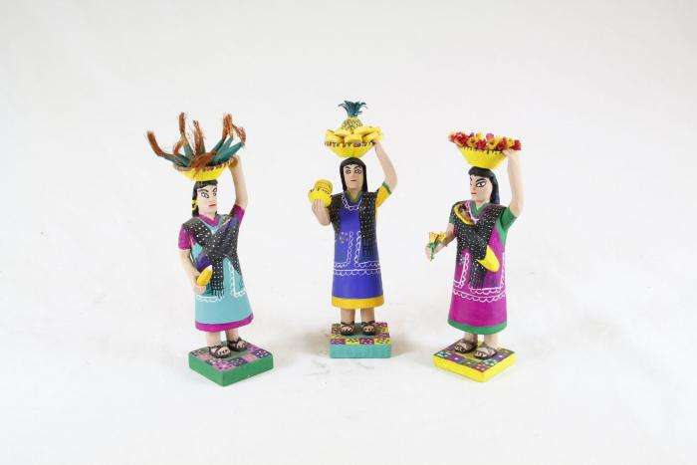
Women selling Goods (SH77)

