Slide 1
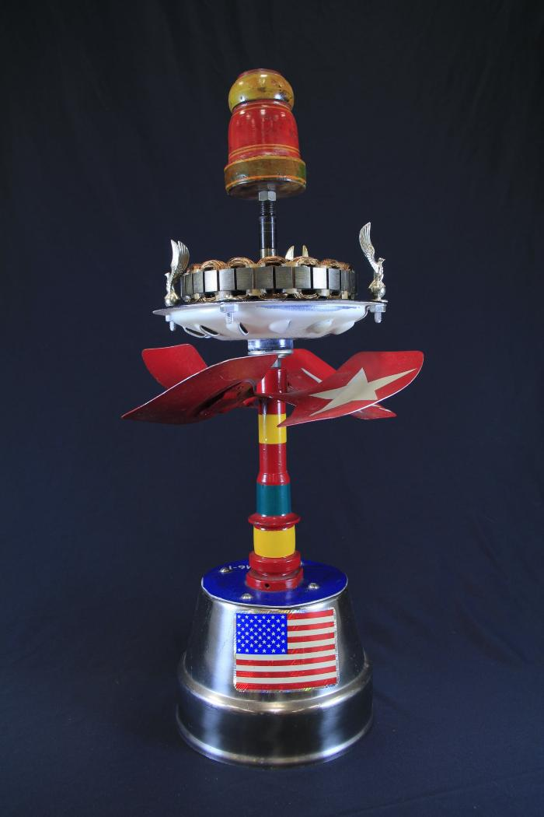
Vollis Simpson Whirligig (HN1)

