Slide 1
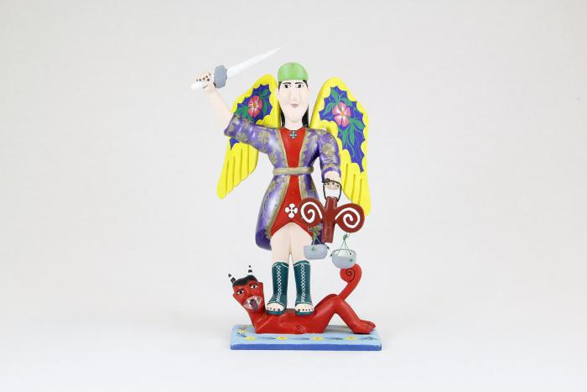
St. Michael with wings, sword and scales (CA2)

Slide 2
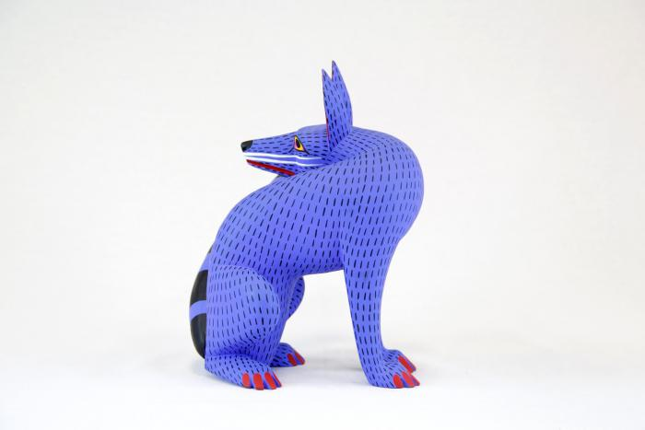
Coyote (CA3)

Slide 3
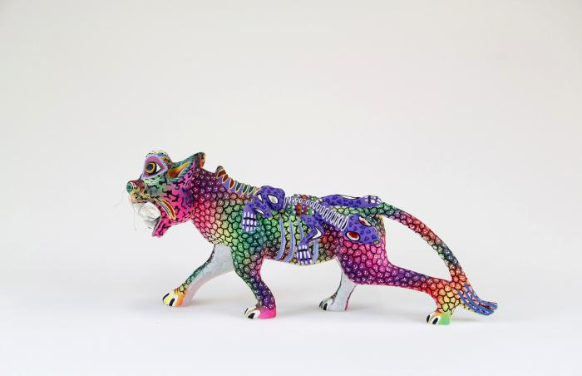
Whiskered jaguar with lizard (CA6)

Slide 4
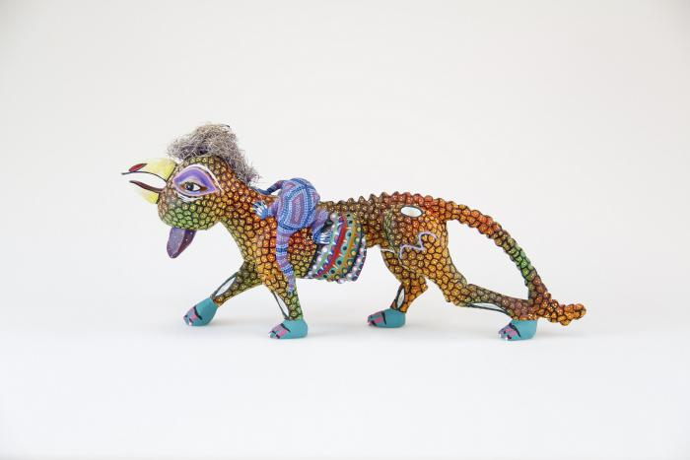
Rooster headed jaguar with lizard (CA7)

Slide 5
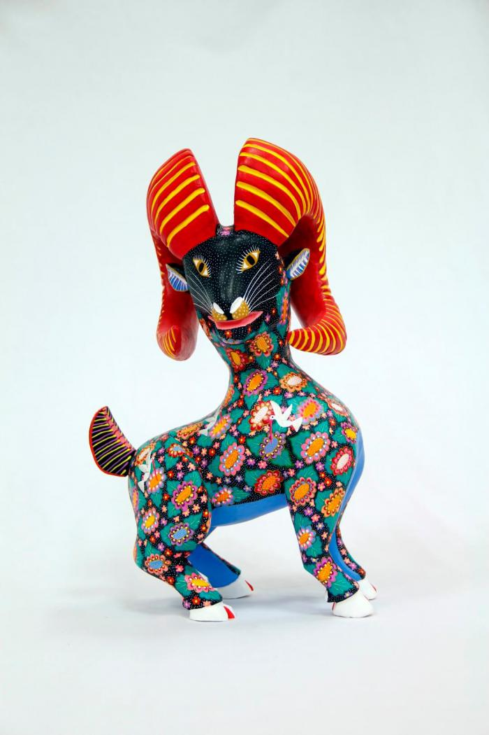
Horned goat (CA8)

Slide 6
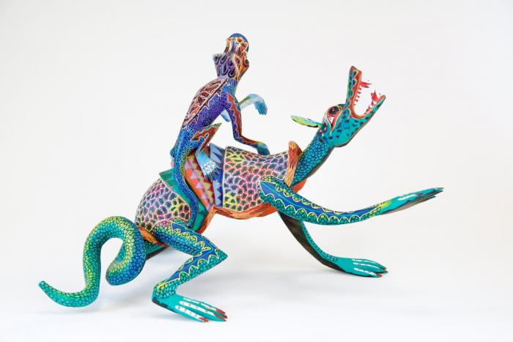
Two lizards (CA9)

Slide 7
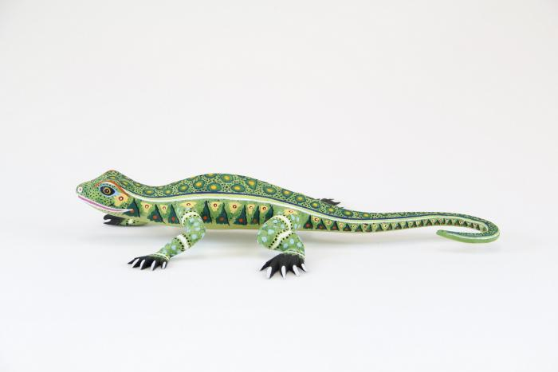
Lizard (CA10)

Slide 8
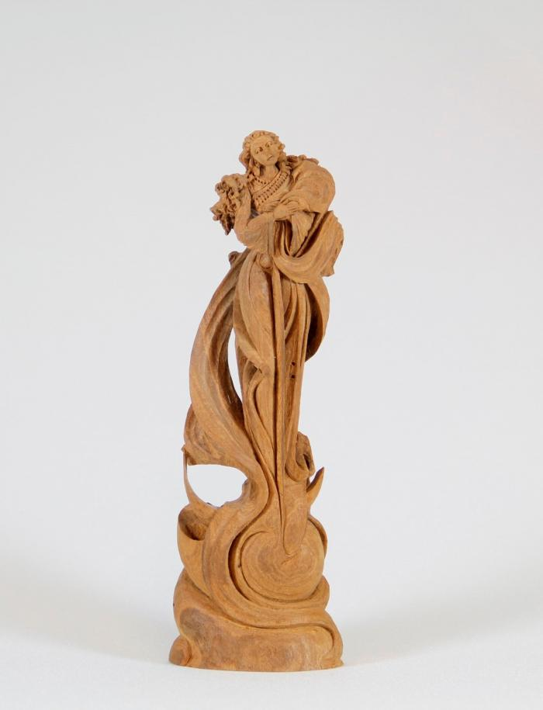
Angel (CA11)

Slide 9
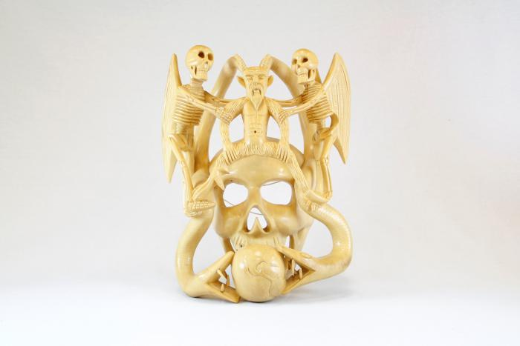
Skull mask (CA13)

Slide 10
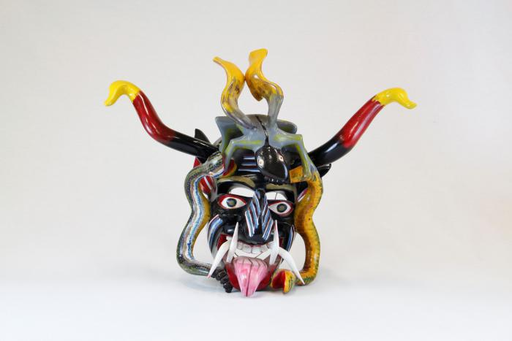
Devil mask with 2 snakes, horns (CA14)

Slide 11
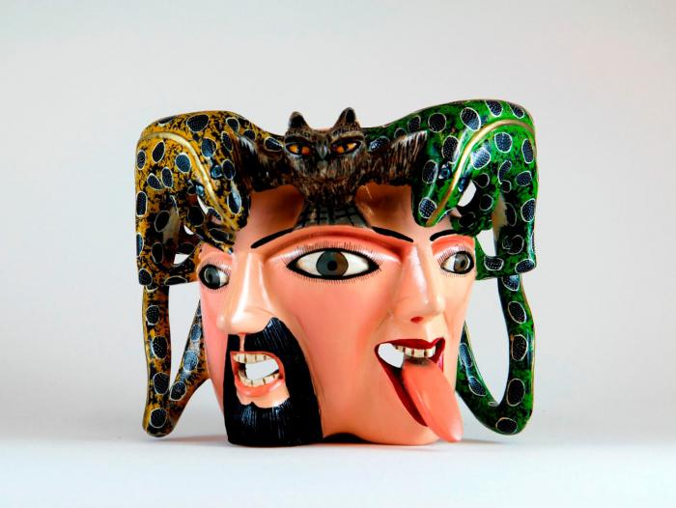
Male / female mask owl and lizards on top (CA15)

Slide 12
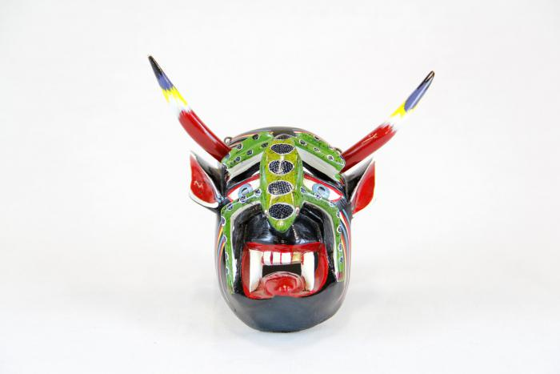
Small devil mask with green lizard (CA17)

Slide 13
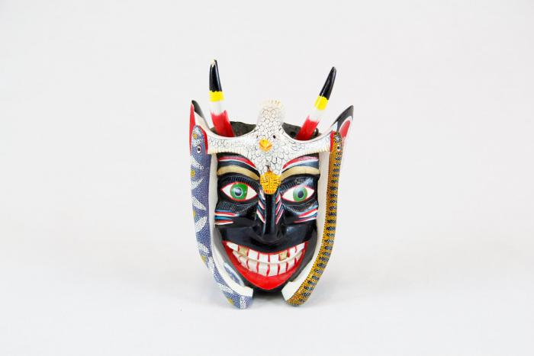
Small black devil mask with bird (CA18)

Slide 14
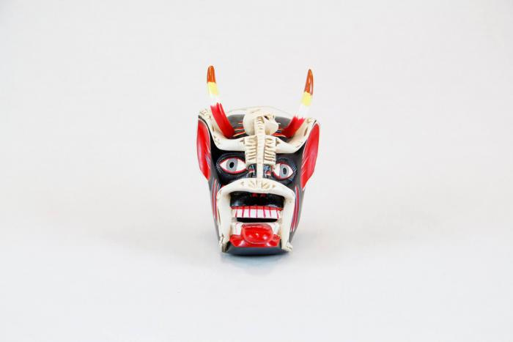
Small devil mask with skeleton (CA19)

Slide 15
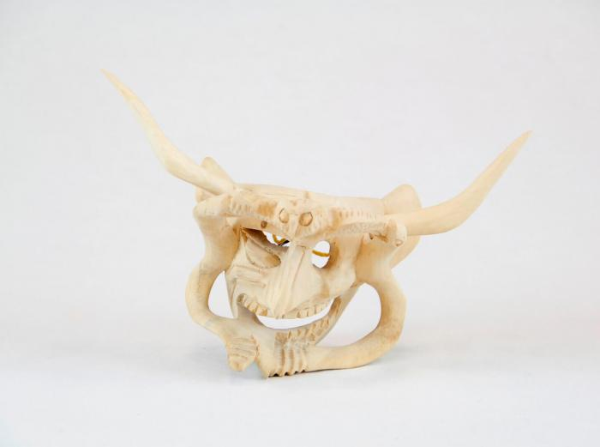
Devil Mask w/ two serpents and owl (CA24)

Slide 16
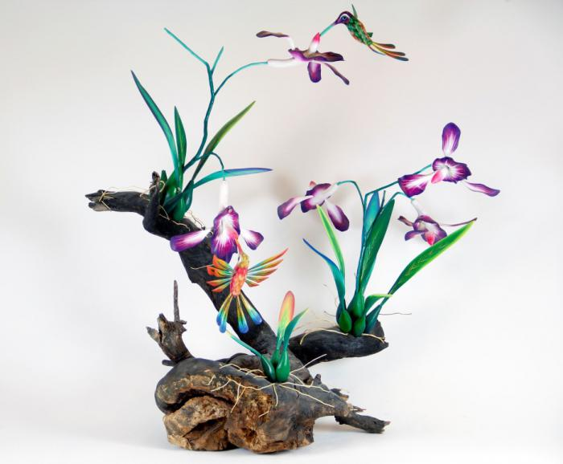
Orchid and Hummingbirds on driftwood base (CA26)

Slide 17
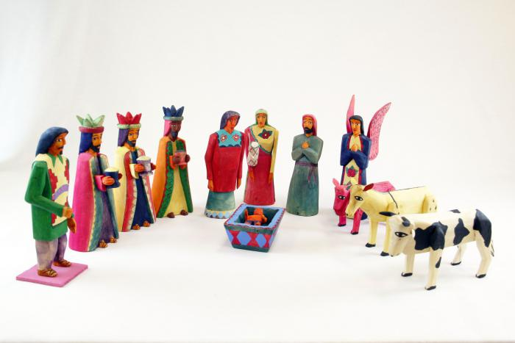
Dyed Wood Nativity (12 pieces) (M1037)

Slide 18
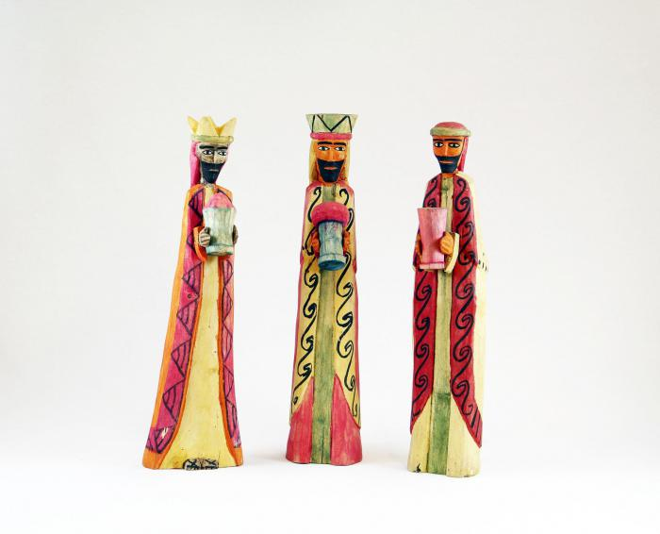
Wisemen Standing (3 pieces) (M1038)

Slide 19
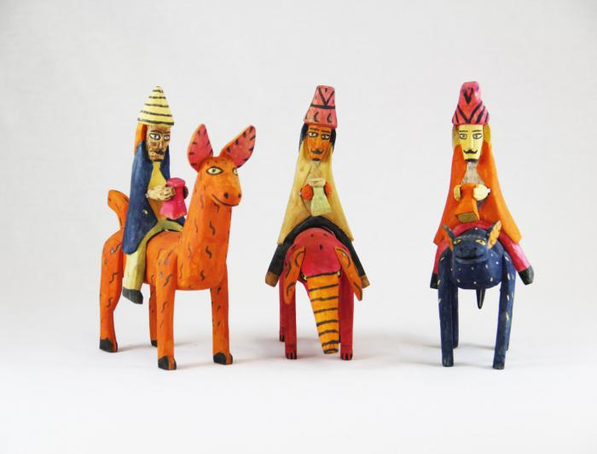
Three Wood Carved Wiseman riding on Animals (M1039)

Slide 20
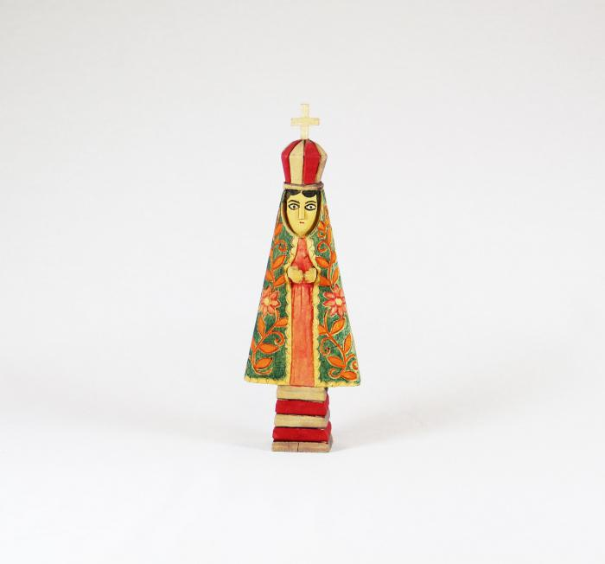
Virgin (M1040)

Slide 21
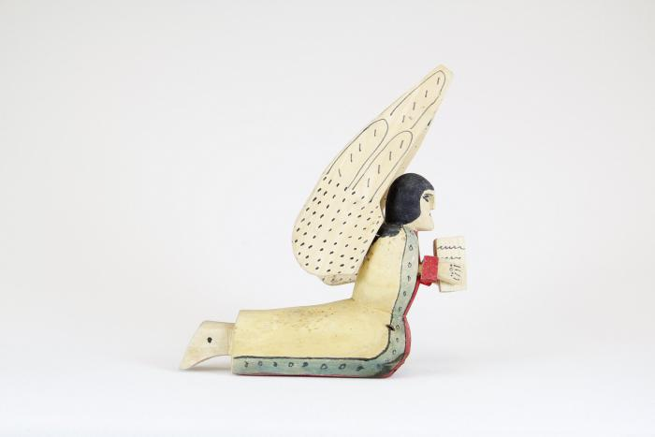
Praying Angel, 1981 (M1041)

Slide 22
Wood Nativity (12 pieces) (M1063)

Slide 23
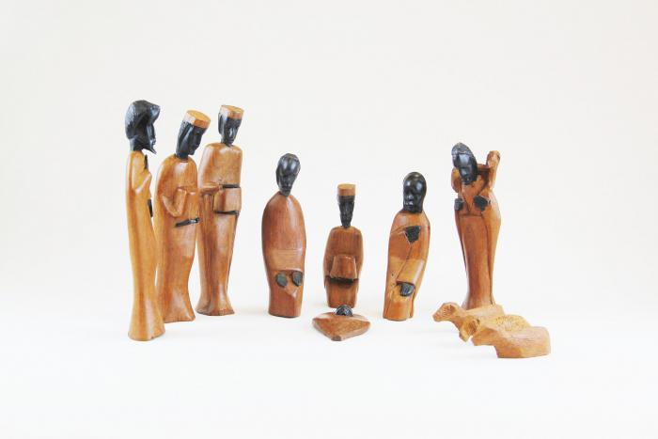
African Nativity (11 pieces) (M1073)

Slide 24
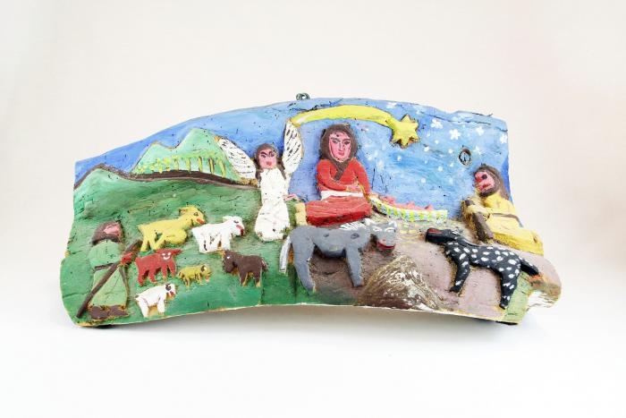
Nativity Bas-Relief Carved from Tree (M1077)

Slide 25
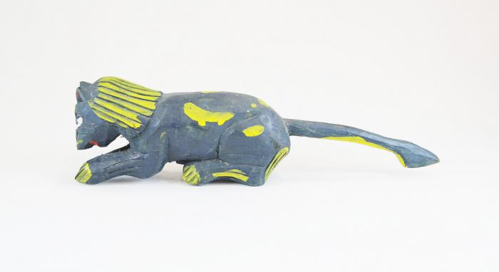
Spotted Feline (M1086)

Slide 26
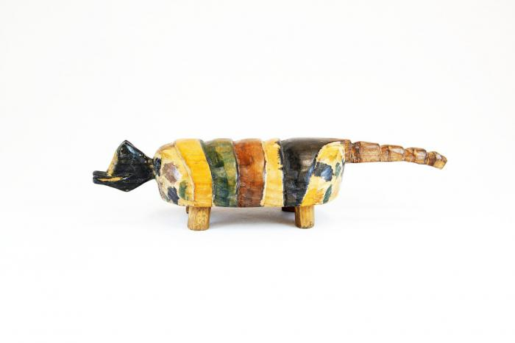
Painted Armadillo (M1088)

Slide 27
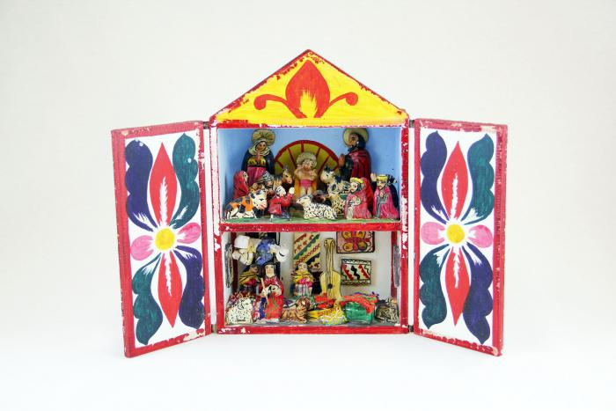
Peruvian Nativity Retablo (M1100)

Slide 28
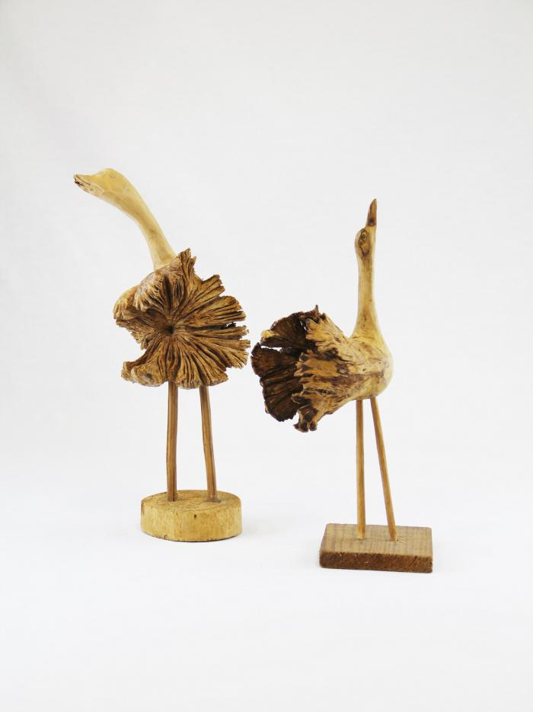
Two birds carved from Wood Burls (M1552)

Slide 29
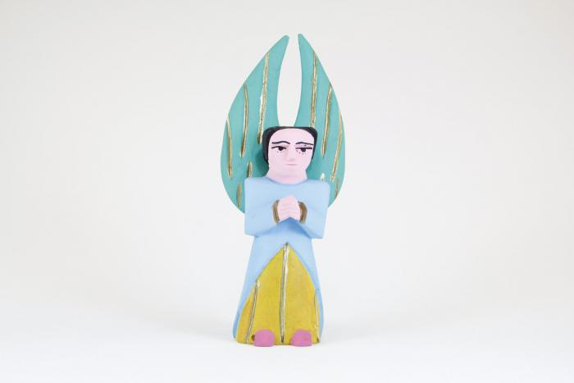
Painted Angel (M1595)

Slide 30
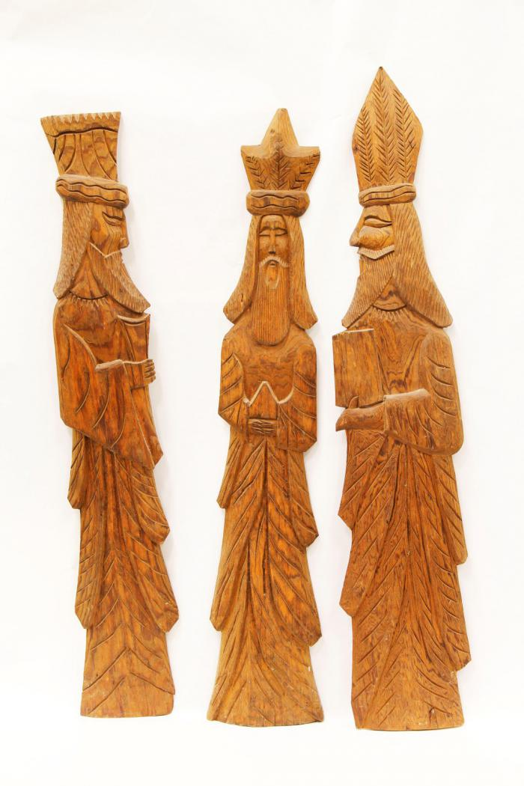
Three Kings (M1603)

Slide 31
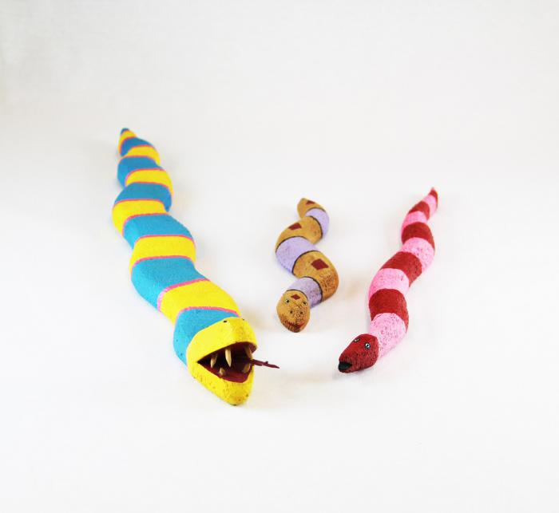
3 Native American Fantasy Snakes (MU3472)

Slide 32
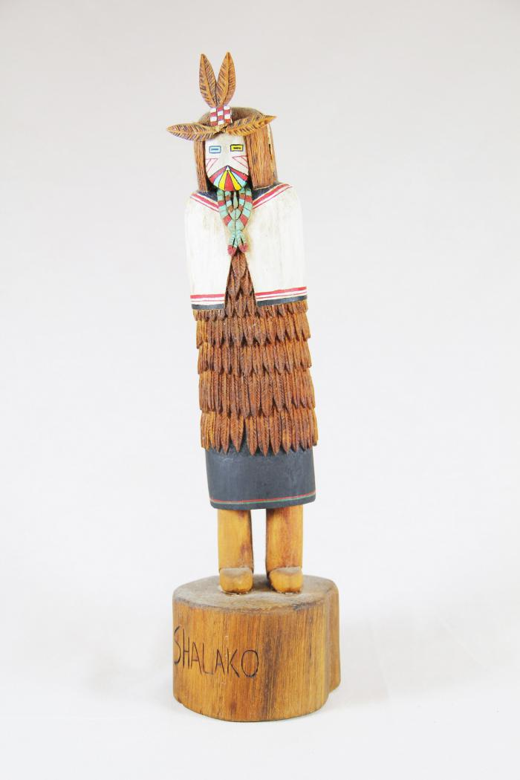
Kachina Doll (Shaloko) (MU3508)

Slide 33
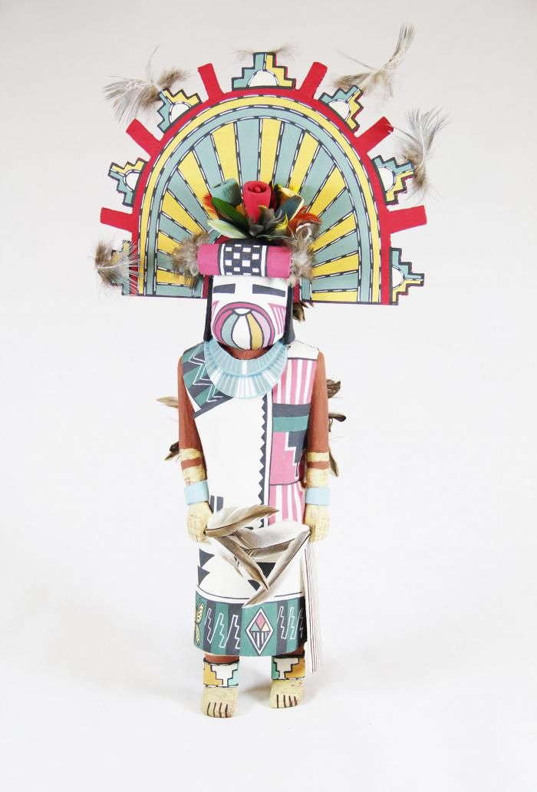
Kachina Doll (Palhik Mana) (MU3509)

Slide 34
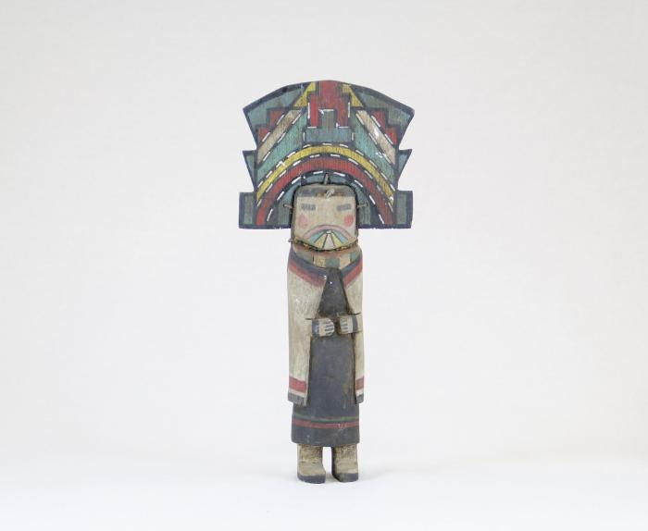
Kachina Doll (MU3510)

Slide 35
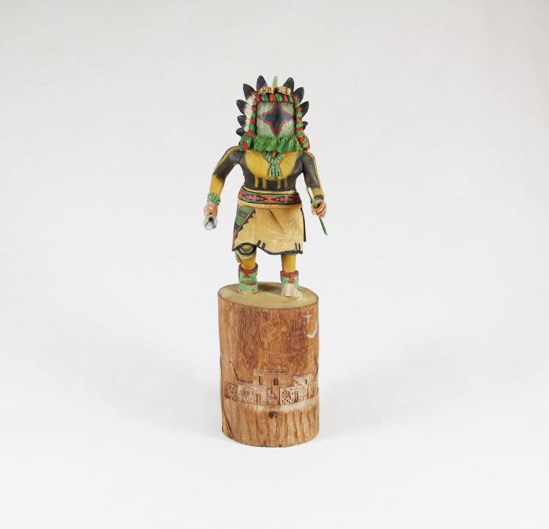
Kachina Doll (Chasing Star) (MU3511)

Slide 36
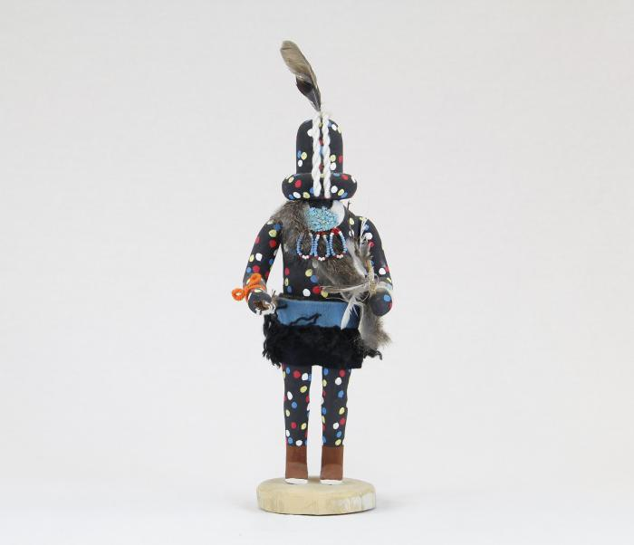
Kachina Doll (Zuni Fire God) (MU3512)

Slide 37
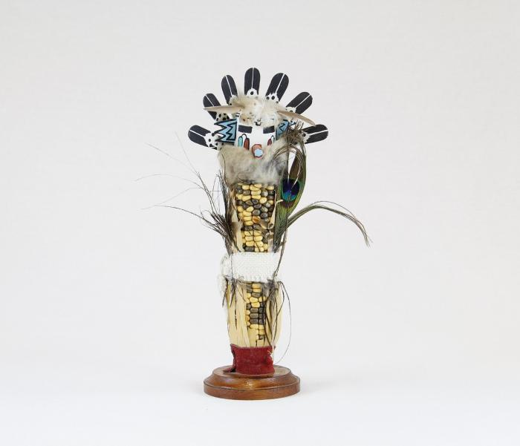
Kachina Doll (Corn Maiden) (MU3513)

Slide 38
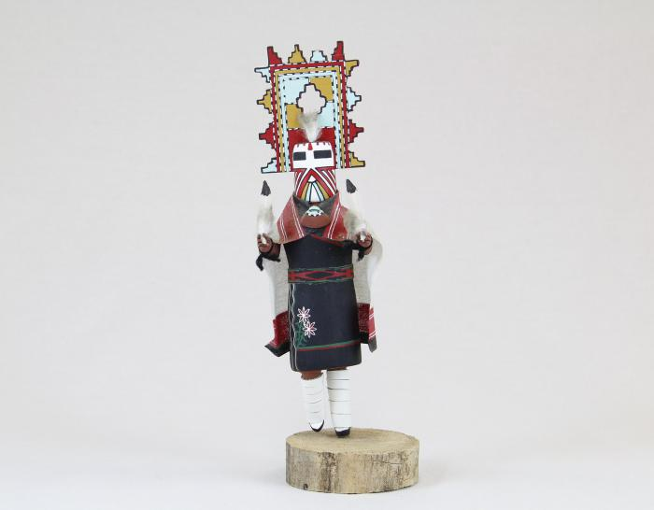
Kachina Doll (Palhik Mana) (MU3515)

Slide 39
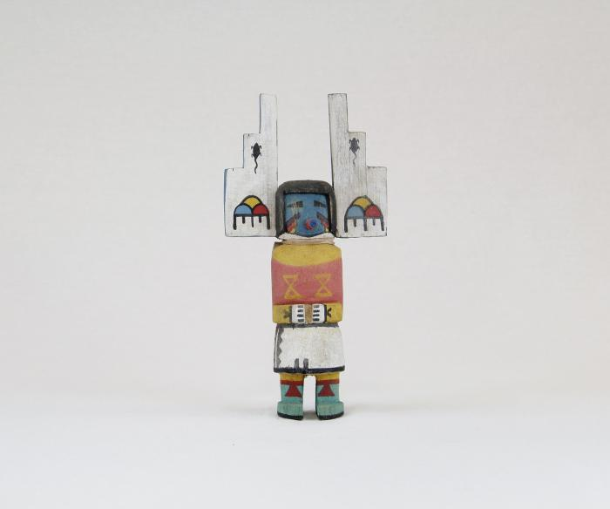
Kachina Doll (MU3516)

Slide 40
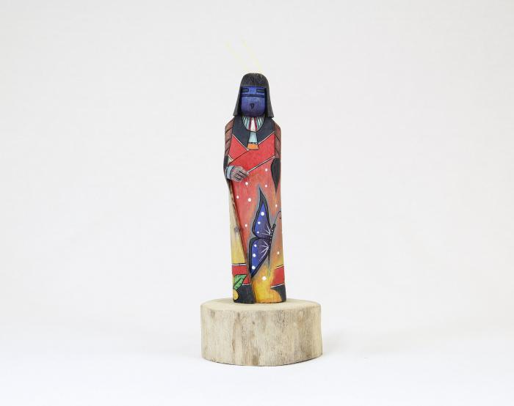
Kachina Doll (Shalako) (MU3517)

Slide 41
Kachina Doll (Ogre Woman) (MU3518)

Slide 42
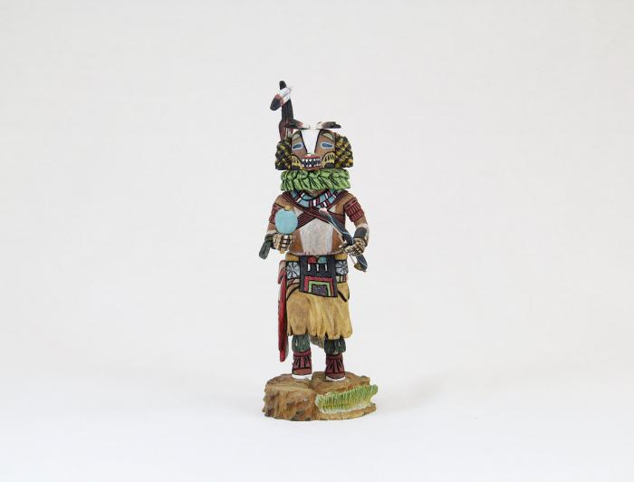
Kachina Doll (Badger) (MU3519)

Slide 43
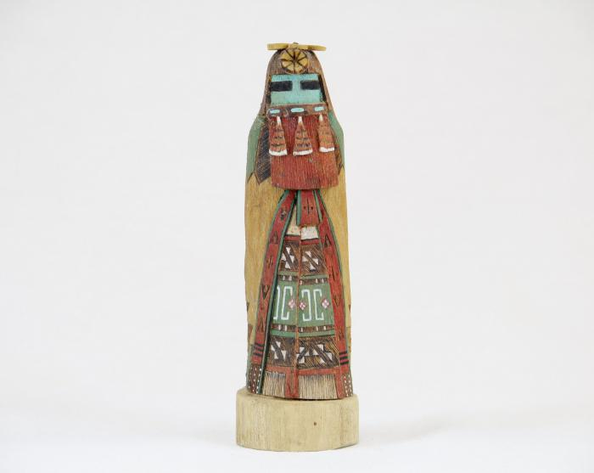
Kachina Doll (Hopi - Red Beard Long Hair) (MU3520)

Slide 44
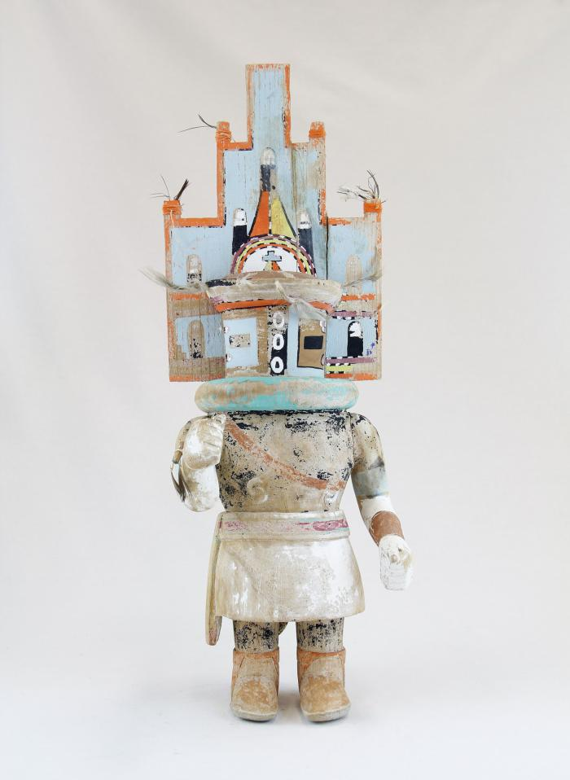
Hopi Hemis Kachina (MU18)

Slide 45
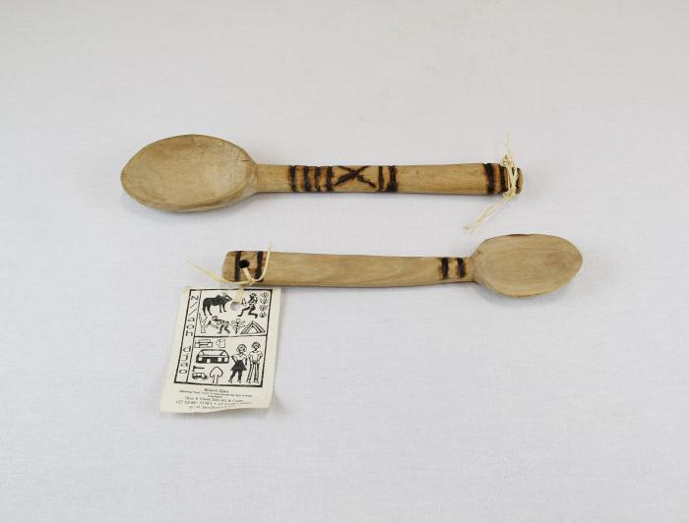
Two Wooden Spoons (MU19)

Slide 46
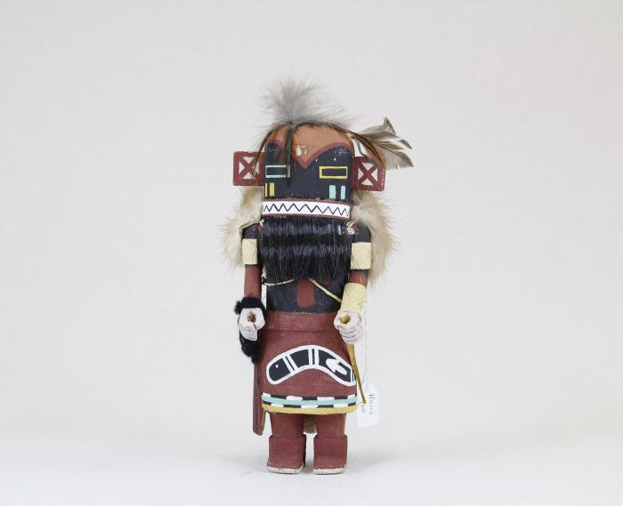
Kachina doll (Hilili) (MU3514)

Slide 47
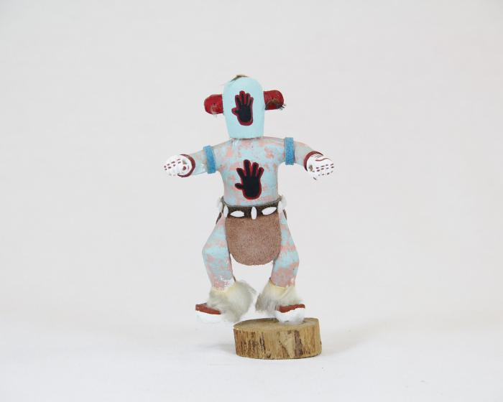
Kachina Doll (Handprint Racer) (MU3521)

Slide 48
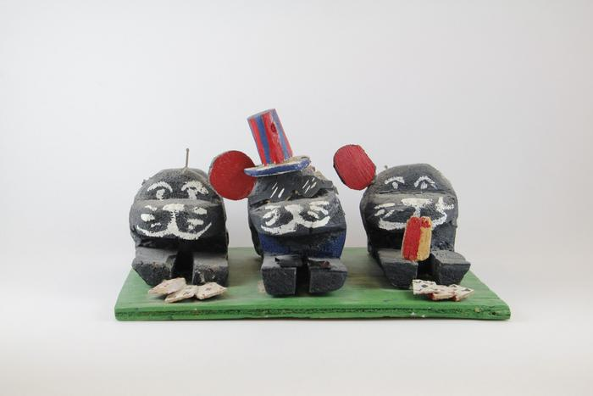
Three Sitting Dogs Playing Cards on Green Plank (EH25)

Slide 49
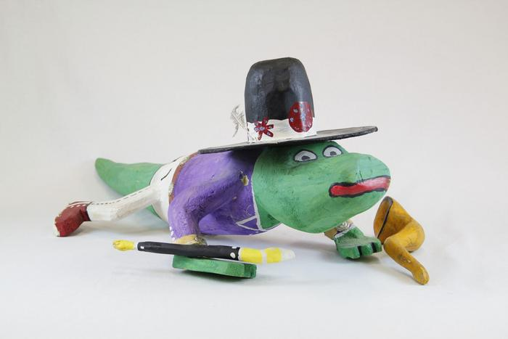
Cowboy Alligator (EH26)

Slide 50
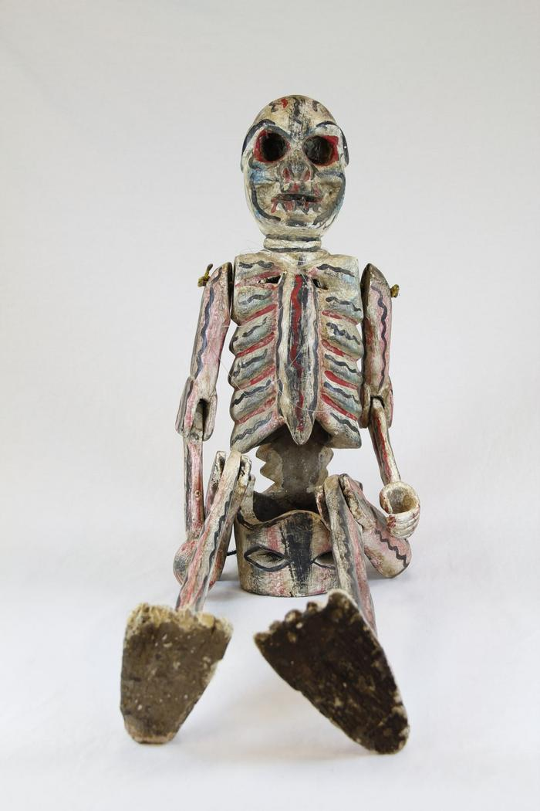
Large Skeleton with Rotating Arms and Legs (EH27)

Slide 51
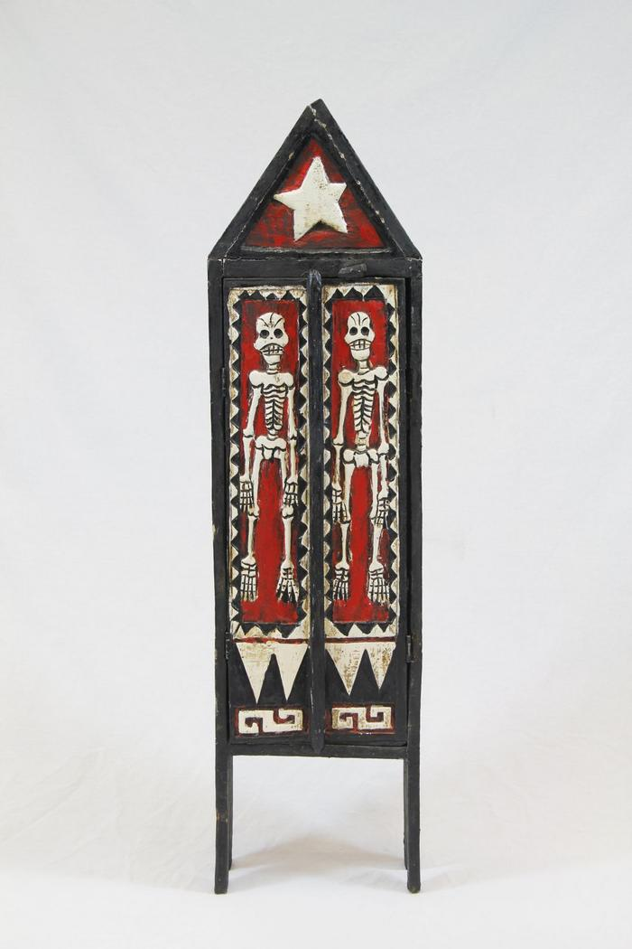
Wood Skeleton Armoire (EH28)

Slide 52
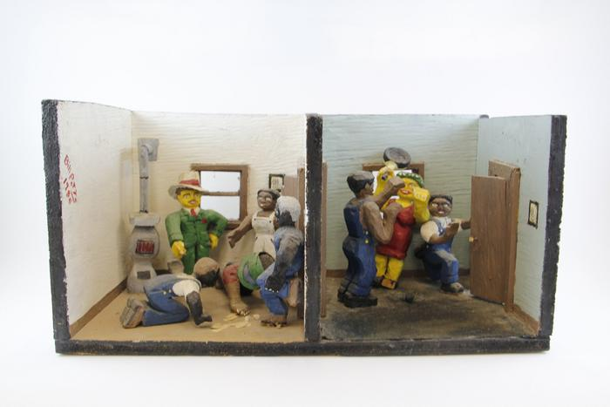
Two Carved Wood Indoor Scenes (EH29)

Slide 53
Howard Finster Eagle and Poem on Board (EH30)

Slide 54
Tiger Table (EH31)

Slide 55
Bat Mask (PR2)

Slide 56
Devil Mask with Two Snakes (PR3)

Slide 57
Mermaid Mask (PR4)

Slide 58
Hermit Mask (PR5)

Slide 59
Goat Mask (PR6)

Slide 60
Mermaid and Bird Mask (PR7)

Slide 61
Old Man Mask (Viejo) (PR8)

Slide 62
Viejito Mask (PR9)

Slide 63
Bat and Mermaid Mask (PR10)

Slide 64
El Barbón Mask (PR12)

Slide 65
Nagual Mask (PR13)

Slide 66
Wood Carved Leopard Mask (PR14)

Slide 67
Diablo-Calavera (Devil-Skull) Mask (PR15)

Slide 68
Moro Pasion Mask (PR18)

Slide 69
Blue Devil Mask (PR21)

Slide 70
Donkey Mask (PR23)

Slide 71
Chané Jaguar Mask (PR25)

Slide 72
Ecuadorian Monkey Mask (PR30)

Slide 73
Indonesian Barong Mask (PR34)

Slide 74
Indonesian Barong Mask (PR35)

Slide 75
Balinese Long Mask with Lizards (PR36)

Slide 76
Hill Tribe Thai Mask #1 (PR38)

Slide 77
Hill Tribe Thai Mask #2 (PR39)

Slide 78
Jero Luh Mask (PR42)

Slide 79
Meng Liang, white opera mask (PR44)

Slide 80
Okina Mask (PR45)

Slide 81
Okame (Otafuku) Mask (PR47)

Slide 82
Fang Mask from Ghana (PR49)

Slide 83
Carved Wood Mask, Possibly African (PR50)

Slide 84
Dan Tribe Mask (PR52)

Slide 85
Rectangular Wood Mask (PR54)

Slide 86
Maasai mask (PR55)

Slide 87
Brazilian Carranca Figurehead (PR58)

Slide 88
Christ on Cross with Angels Wood Wall Hanging (MC5)

Slide 89
Wooden Mask, Stained Pink (MC9)

Slide 90
Indonesian Wayang Shadow Puppet (MC10)

Slide 91
Guro Mask (MC13)

Slide 92
Ebony Carved Figures from Makonde Tribe (MC14)

Slide 93
Long Forehead Face Mask (MC15)

Slide 94
Agave Plant with Virgin of Guadalupe (SH1)

Slide 95
Agave Plant with Virgin of Guadalupe (SH2)

Slide 96
Angel (SH4)

Slide 97
Angel (SH5)

Slide 98
Angel (SH6)

Slide 99
Angel holding Book (SH7)

Slide 100
Angel holding Dove (SH8)

Slide 101
Angel kneeling (SH10)

Slide 102
Angel playing Guitar (SH11)

Slide 103
Angel playing Harp (SH12)

Slide 104
Angel with Small Angel (SH15)

Slide 105
Animal Band (SH16)

Slide 106
Animal playing an Electric Guitar (SH18)

Slide 107
Armadillo (SH19)

Slide 108
Armadillo (SH20)

Slide 109
Bird Cage with Tree (SH22)

Slide 110
Blue Animal (SH32)

Slide 111
Blue Goat (SH33)

Slide 112
Blue Rattle Snake (SH34)

Slide 113
Cactus (SH38)

Slide 114
Cactus blooming Pink Flower (SH39)

Slide 115
Cactus with Three Virgins (SH40)

Slide 116
Cart with Cows (SH41)

Slide 117
Centaur playing Violin (SH43)

Slide 118
Chicken with Chicks (SH44)

Slide 119
Cows with Cart (SH45)

Slide 120
Crocodile (SH46)

Slide 121
Danza de la Pluma (SH48)

Slide 122
Danza de la Pluma (SH49)

Slide 123
Dancing Man with Bird (SH50)

Slide 124
Decorated Cows with Cart (SH53)

Slide 125
Desert Scene (SH54)

Slide 126
Dog playing Guitar (SH55)

Slide 127
Dragon (SH56)

Slide 128
Dragon (SH57)

Slide 129
Dragon (SH58)

Slide 130
Drum (SH59)

Slide 131
Elephant (SH60)

Slide 132
Makonde Shetani Sculpture (SH62)

Slide 133
Firework Castle (SH63)

Slide 134
Firework Dancing man (SH64)

Slide 135
Garuda (SH66)

Slide 136
Deer Alebrije (SH71)

Slide 137
Humming Bird (SH72)

Slide 138
Kneeling Angel (SH73)

Slide 139
Women selling Goods (SH77)

Slide 140
Lion (SH81)

Slide 141
Lizard (SH82)

Slide 142
Lizard (SH83)

Slide 143
Lizard (SH84)

Slide 144
Longhaired Maiden (SH85)

Slide 145
Man with Whip (SH89)

Slide 146
Mermaids on Beach (SH92)

Slide 147
Monk with Bird (SH93)

Slide 148
Mother Skunk (SH94)

Slide 149
Multi Color Bikini Cat Band (SH95)

Slide 150
Oaxacan Plume Dancer (SH96)

Slide 151
Palm Tree with Feeding Bird (SH98)

Slide 152
Pink Flower (SH99)

Slide 153
Purple Angel holding Flower (SH100)

Slide 154
Rabbit (SH101)

Slide 155
Rat Woodcarving (SH102)

Slide 156
Rooster (SH105)

Slide 157
Saint Francis of Assisi (SH106)

Slide 158
Saint Michael (SH107)

Slide 159
Skeleton Band (SH109)

Slide 160
Toucan (SH113)

Slide 161
Wood Carved Turtles (SH114)

Slide 162
Virgin de Guadalupe (SH118)

Slide 163
Virgin de la Soledad (SH122)

Slide 164
Virgin Mary (SH124)

Slide 165
Virgin Mary with Man kneeling (SH126)

Slide 166
Virgin of Guadalupe (SH127)

Slide 167
Virgin of Guadalupe Cactus (SH128)

Slide 168
Woman making a Rug (SH130)

Slide 169
Carved Wooden Bowl (SHA7)

Slide 170
Shipibo Blowgun (SHA16)

Slide 171
Shipibo Blowgun (damaged) (SHA17)

Slide 172
Shipibo Ceremonial Club (SHA18)

Slide 173
Shipibo Paddle (SHA19)

Slide 174
Shipibo Bow (SHA20)

Slide 175
Shipibo Fishing Arrows (SHA21)

Slide 176
Carved Wood Ladle (YO6)

Slide 177
Yangban Mask (WI32)

Slide 178
Akua'ba (DE1)

Slide 179
Chinese Wood Carved Panel (FR19)

Slide 180
Tibetan Miniature Village (FR20)

Slide 181
Tibetan Wood Printing Block (FR33)

Slide 182
Tibetan Six Panel Printing Block (FR34)

Slide 183
Painted Cofre Box by Otzoy (FR48)

Slide 184
Painted Cofre by Filiberto Simon (FR49)

Slide 185
Guatemalan Chicken Candle Holder (FR50)

Slide 186
Guatemalan Rooster (FR51)

Slide 187
Balaram Suvadra Idols (FR69)

Slide 188
Wood Carved Box (FR70)

Slide 189
Indian Woman Figure (FR71)

Slide 190
Hindu Wood Painting (FR72)

Slide 191
Rajasthan Kavad Box (FR73)

Slide 192
Sandalwood Carved Cigarette Box (FR74)

Slide 193
Wood Carved Boat and Fisherman (FR101)

Slide 194
Mexican Wooden Fish Child's Toy (FR102)

Slide 195
Wood Carved Armadillos (FR103)

Slide 196
Wooden Virgin (FR104)

Slide 197
Deer Mask (FR105)

Slide 198
Mexican Clacker Toy (FR106)

Slide 199
Papua New Guinea Crocodile Boat (FR114)

Slide 200
Peruvian Painted Box (FR137)

Slide 201
Zaramo "Mwana Hiti" Doll Figure (FR145)

Slide 202
Thai Spirit House (FR146)

Slide 203
Inuit Inukshuk Figurine (FR155)

Slide 204
Wooden Toy Truck (FR172)

Slide 205
Wood Stirrup (FR173)

Slide 206
Basket (FR174)

Slide 207
Lobi Stool (FR175)

