Slide 1
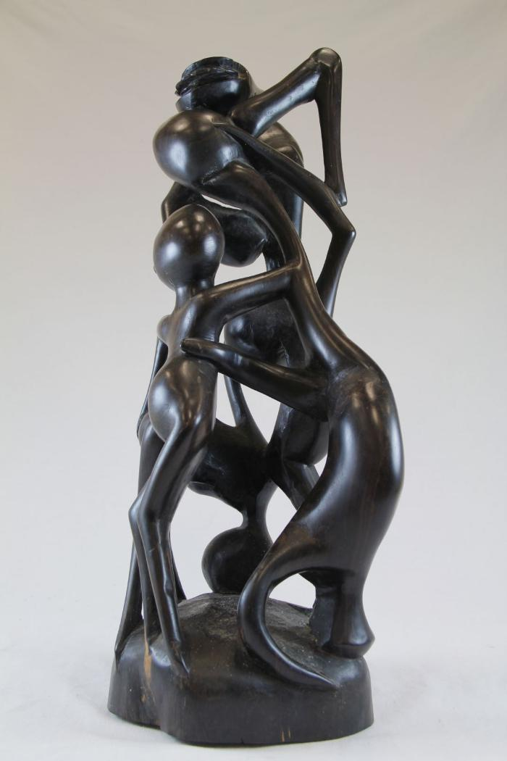
Makonde Shetani Sculpture (SH62)

Slide 2
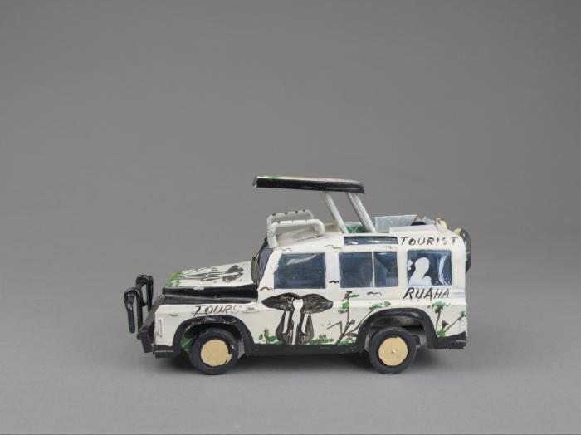
Tanzanian Tin Safari Jeep (FR144)

Slide 3
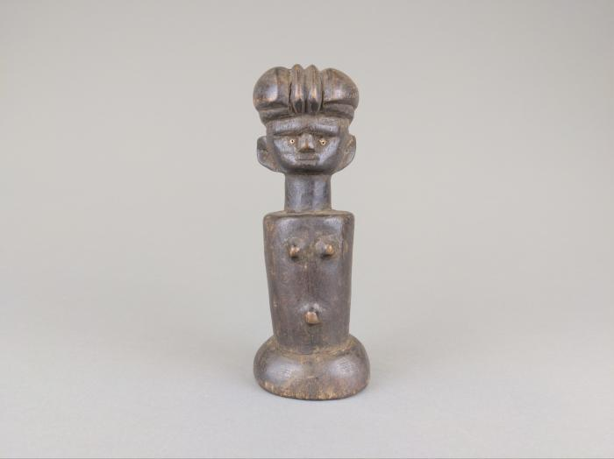
Zaramo "Mwana Hiti" Doll Figure (FR145)

